Slide 1
EU policy and actions to support Culture and Cultural Heritage
Protecting and promoting regional Cultural Heritage Seminar
European Alliance Group, CoR, 7 November 2022
Marta Jiménez Pumares
Policy officer - Culture, Regions, Statistics
Cultural Policy Unit, DG EAC
marta.jimenez-pumares@ec.europa.eu

Slide 2
What competencies for the European Commission?
MS are responsible for their own policies for the cultural sector
EU supports, coordinates and supplements the actions of MS towards conservation and safeguarding of European Cultural Heritage (article 167, TFUE).
EU supports and promotes policy cooperation between MS and cultural stakeholders, CCS authorities and institutions, and key players from CH.
EC Elaborates cultural policies and programmes to help address common challenges, such as the impact of digital technologies, changing models of cultural governance and the need to support the cultural and creative sectors in innovating.

Slide 3
Framework of priorities: Culture and CH as drivers
Council’s Work Plan for Culture 2019-2022, priorities:
1. Sustainability in Cultural Heritage
2. Cohesion and well-being
3. An ecosystem supporting artists, CCS and European content
4. Gender equality
5. International cultural relations
& Horizontal priorities: Digitalisation and cultural statistics
New European Agenda for Culture, three objectives: foster cultural activities and active participation; encourage mobility; protect and promote Europe’s CH.
Urban Agenda for the EU: Partnership on Culture and Cultural Heritage (end 2022: recommendations) and Partnership on Sustainable Tourism (from 2023).

Slide 4
European Year of Cultural Heritage 2018 - Legacy
Huge success: 12.8 million participants, 23.000 events, 37 countries
To scale-up EYCH: European Framework of Action on Cultural Heritage (EFACH)
From 2019 to 2022, over 60 actions in five key thematic sectors : inclusion, sustainability, resilience, innovation, international cooperation (ex. EHLabel, EHAwards, or CHiA).
European Commission Cultural Heritage Experts Group (CHEG)
Members : Culture and CH European Organisations, individual experts, Member States authorities in charge of CH policy, relevant internationals organisations.
Meets twice a year for exchanging information, good practices and ensure the follow-up of EFACH (last meeting on 13-14 October 2022 in Brussels).
Themes : COVID crisis impact and safe reopening of the sector ; protection and resilience related to climate change, looting, or illicit trafficking; European Heritage Label; European Year of Youth 2022; European Year of Skills (2023).

Slide 5
Cultural Heritage in Action (EFACH action) 1/2
3 years (2020-2023) – 5 partners – 32 good practices – 10 online peer-learning
EU-financed (Creative Europe) Peer-learning scheme on cultural heritage.
Implemented by Eurocities, in partnership with KEA, ERRIN, Europa Nostra and the Architects Council of Europe.
Six interlinked topical areas tackled:
Participatory governance of cultural heritage.
Adaptive re-use of heritage buildings.
Quality of interventions on cultural heritage.
Recovery and resilience through cultural heritage in a post pandemic world.
Cultural heritage for local sustainable development.
Governance and financing: new roles for local and regional authorities.

Slide 6
Cultural Heritage in Action (EFACH action) 2/2
Objectives:
Empower cities and regions to strengthen their cultural heritage policies and initiatives as well as develop innovative solutions to preserve cultural heritage assets.
To support exchanges between large numbers of cities, regions and stakeholders, thus building a broad learning community.
Outputs and achievements:
Catalogue of 60 good practices (44 already available).
15 Peer-learning visits: support the exchange of experience through direct contact between rural, local, regional and national administrations, as well as experts (civil society, NGOs, local organisations, urban planners, architects, etc.) during thematic peer-learning visits.
223 selected cultural practitioners and policy makers sharing knowledge.
39 thematic videos; 15 analytical reports; 10 online workshops; policy recommendations.
https://culturalheritageinaction.eu

Slide 7
EU sources of finance for Cultural Heritage
Creative Europe: EUR 2.442 billion in 2021-2027 (63% increase from previous program).
Horizon Europe: EUR 2.28 billion for research and innovation under Cluster 2 of pillar 2 “Culture, Creativity and Inclusive Society”. NEB is a key theme in 2022.
Cohesion Funds: EUR 39.3 billion for Culture and CH planned in 2014-2020, including for protecting, developing and promoting cultural heritage assets and services.
Erasmus+: for mobility, cooperation, partnerships… (i.e. HeritagePRO project on sharing good practices in cultural heritage preservation).
Recovery and Resilience Facility (RRF): the measures directly supporting culture and the CCSIs amount to more than EUR 10 billion, representing approximately 2% of the total expenditure of the 26 NRRPs endorsed by October 2022. CCSIs will also benefit from a larger pool of measures that have a wider policy focus, such as green construction or digitalisation.
More info: Funding opportunities for cultural heritage | Culture and Creativity (europa.eu)
Notes:
The Creative Europe programme is the main source of EU funding for the culture and creative sectors.
The Erasmus+ programme focuses on mobility projects and virtual exchanges, on organisational cooperation and partnerships as well as support to policy cooperation at European Union level.
HeritagePRO is an Erasmus+ project on sharing good practices in cultural heritage preservation.
Horizon Europe is the continuation of Horizon 2020 as the EU’s main research and innovation programme with a budget of €95.5 billion.
Research and Innovation activities in Cluster 2, among other objectives, aim to “improve protection, enhancement, conservation and more efficient restoration of European cultural heritage”.
Cohesion Fund, European Regional Development Fund – and within this Interreg Europe – are the main funding sources for EU regional development.
Within a €226 billion budget for the European Regional Development Fund, included €9 billion for the Interreg programme, around €4.7 billion are allocated to create local jobs at heritage sites and attract visitors to the specific cities and locations.
Interreg Europe are a series of programmes that aim at stimulating cooperation between regions in and outside of the EU. Cultural heritage is among the most popular topics within Interreg Europe.
What is the scope and volume of Cohesion funds support to culture and heritage? In the period 2014-2020 support to culture and heritage is mainly through actions funding the protection, development and promotion of public cultural actions. Around EUR 4.7 billion is planned under the ERDF primarily with a view to creating local jobs in the running of such heritage sites and attracting visitors to the specific cities or localities. Other relevant actions include development of heritage and cultural services, e-culture applications and private initiatives in the area of the cultural and creative industries all with the main objective of contributing to regional and economic development. When successful such activities can make cultural and heritage sites more accessible and secure their preservation for the future.

Slide 8

New European Bauhaus – Open urban call
Budget: EUR 50 million (ERDF). Call open from 10 October 2022 to 19 January 2023.
European Urban Initiative Innovative Actions (EUI-IA) first call for proposals in support to the New European Bauhaus (NEB) demonstrators (HE, May 2022, 25m).
Targeting innovative projects focusing on the NEB that deliver tangible, real-life examples of NEB interventions that fully integrate the three NEB core values of sustainability, inclusiveness, and aesthetics and demonstrate a clear contribution to the 6 specific objectives of the EU Cohesion policy (2021-2027).
Cities (> 50k hab.) are invited to consider the four following themes:
Construction and renovation in a spirit of circularity and carbon neutrality
Preserving and transforming cultural heritage
Adapting and transforming buildings for affordable housing solutions
Regenerating urban spaces
3 online Q&A sessions, plus Applicant seminars in several EU cities, from October to December.

Slide 9
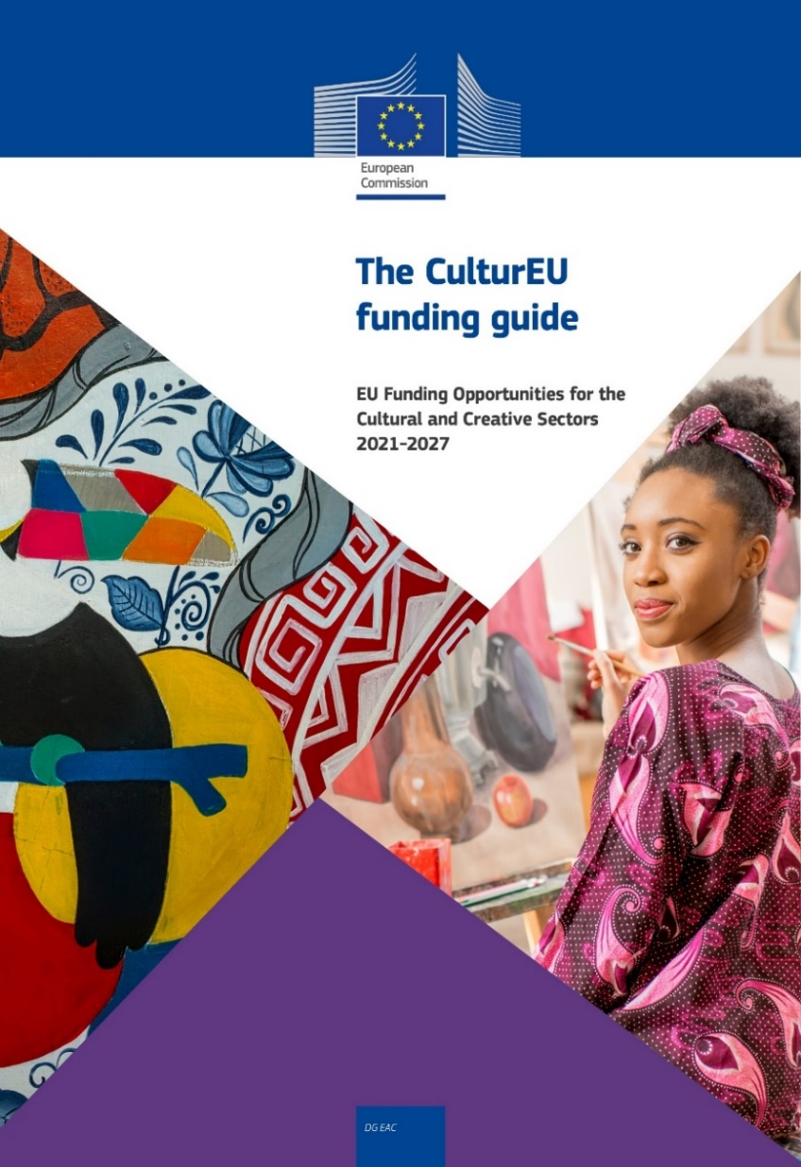
New! CulturEU funding guide
A funding Guide to help stakeholders of all sizes navigate all funding opportunities available for the CCS in EU programs for the 2021-2027 period.
2 elements: an interactive tool and a PDF manual
In 3 clicks to filter needs, sector and type of organisation:
21 different programmes,
75 financing possibilities, and
15 inspiring examples
Now available in ALL official languages of the UE
Regularly updated
https://culture.ec.europa.eu/fr/funding/cultureu-funding-guide

Slide 10
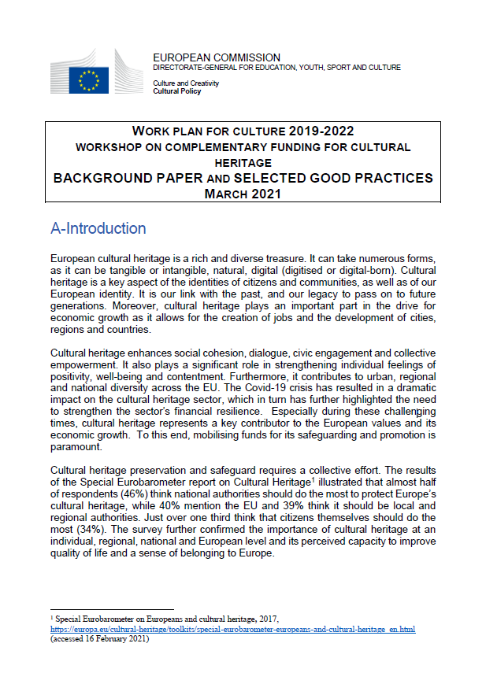
Alternative sources of finance for Cultural Heritage
Public-private partnerships
Impact financing / circular economy investments
Revolving funds
Building preservation trusts
Heritage for Commercial Use
Lottery funding
Crowdfunding
Other complementary funding schemes
Discover the Good practices examples

Slide 11
OMC group on Strengthening Cultural Heritage Resilience for Climate Change
50 experts from 25 EU Member States plus Switzerland, Norway and Iceland.
Studied the impact of climate change on cultural heritage and collected best practice examples to protect and safeguard Europe's cultural heritage.
Produced a report with a set of key recommendations for policy makers, with over 80 best practices, published online on 7 September:
“Strengthening cultural heritage resilience for climate change.
Where the European Green Deal meets cultural heritage”
(in EN + executive summary in all languages)

Slide 12
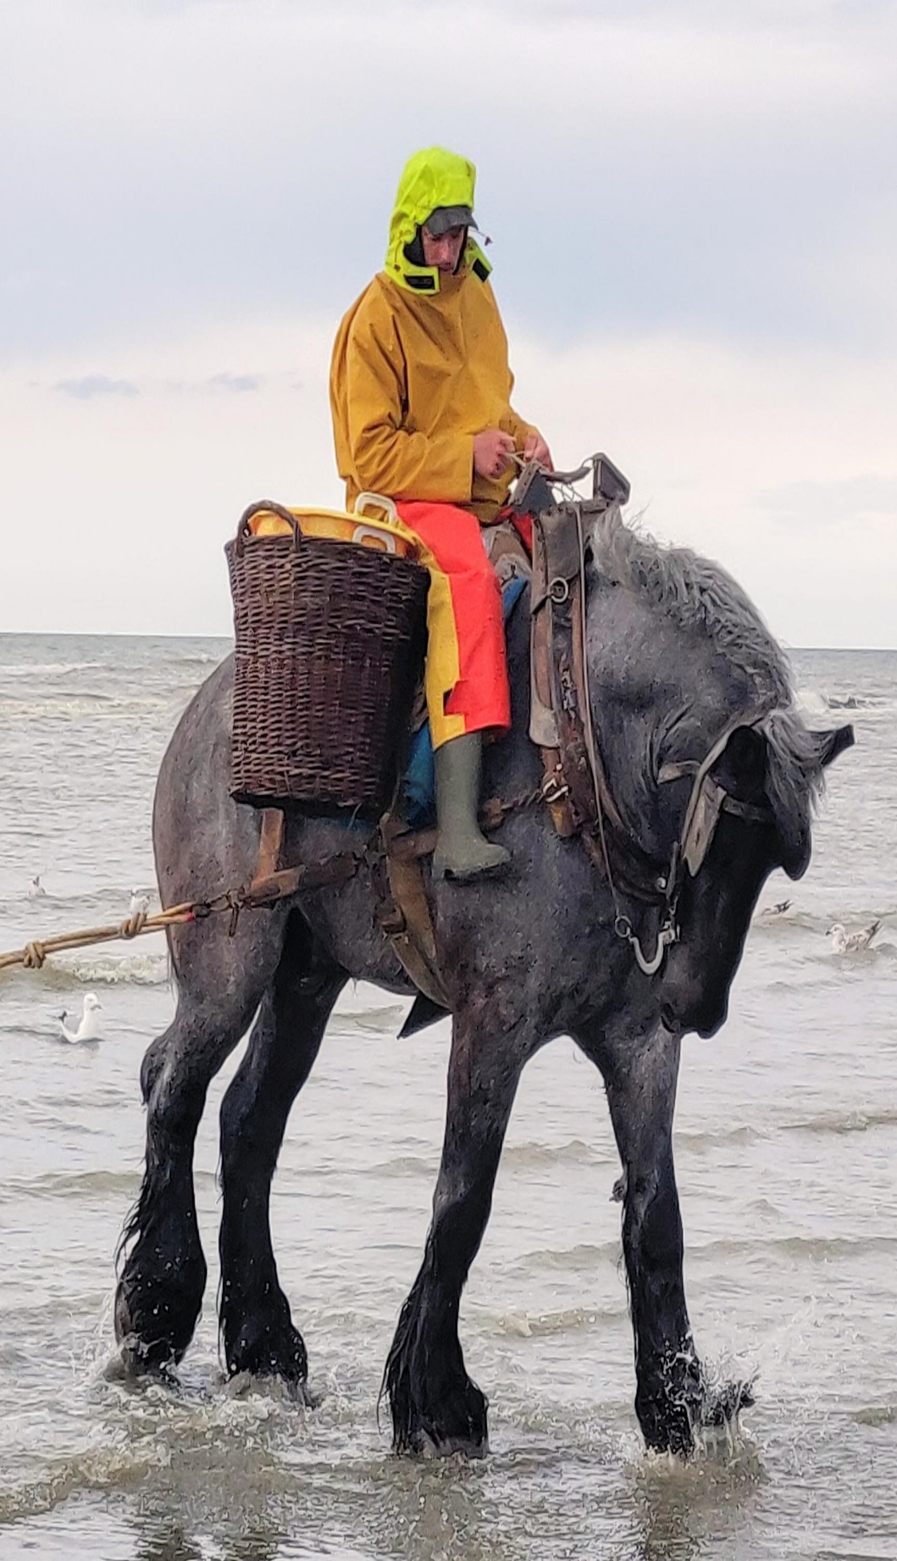
Additional information
https://ec.europa.eu/culture/cultural-heritage
New European Bauhaus
KIC call-for-proposals-scaling-the-new-european-bauhaus-ventures DDL 17 December 2021
OMC High-quality architecture and built environment for everyone
ICOMOS updated Quality Principles for EU-funded interventions with potential impact on cultural heritage and Abridged version
Sustainable cultural tourism (SCT) OMC member states working group report
European Cultural Heritage Green Paper, Europa Nostra in cooperation with ICOMOS & Climate Heritage Network, with input of members of European
DG GROW new funding guide for tourism here

Slide 13

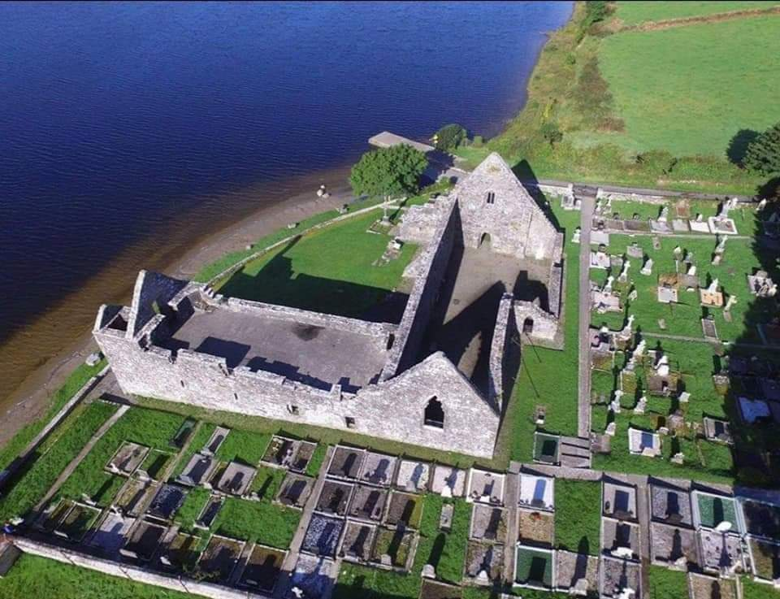


Thank you
#EuropeForCulture
The legacy continues Beyond

