Slide 1
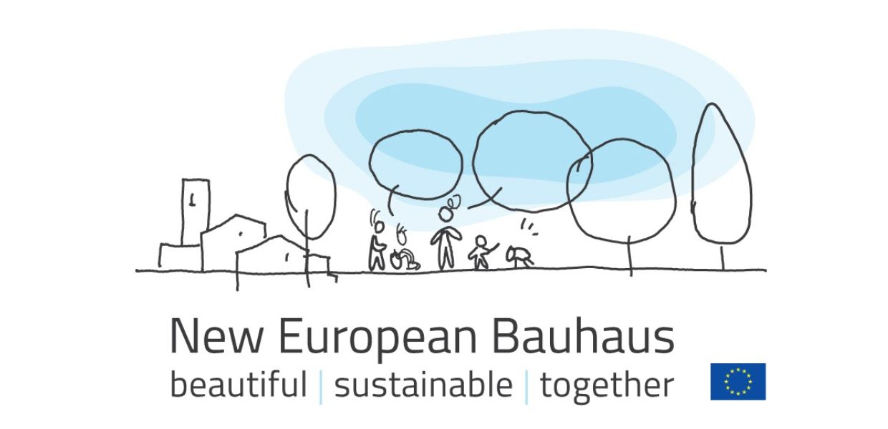
New European Bauhaus Beautiful, Sustainable, Together
Dr Kieran McCarthy, Cork City Council

Slide 2
What is it ?
a cross environmental, economic and cultural movement to help deliver the European Green Deal and support the recovery and transformation and of Europe following the COVID-19 pandemic.
envisages the participation of a wide range of actors, including students and academics, in a vast effort of cooperation between science, technology, the arts and culture. Its core values are sustainability, aesthetics and inclusiveness.

Slide 3
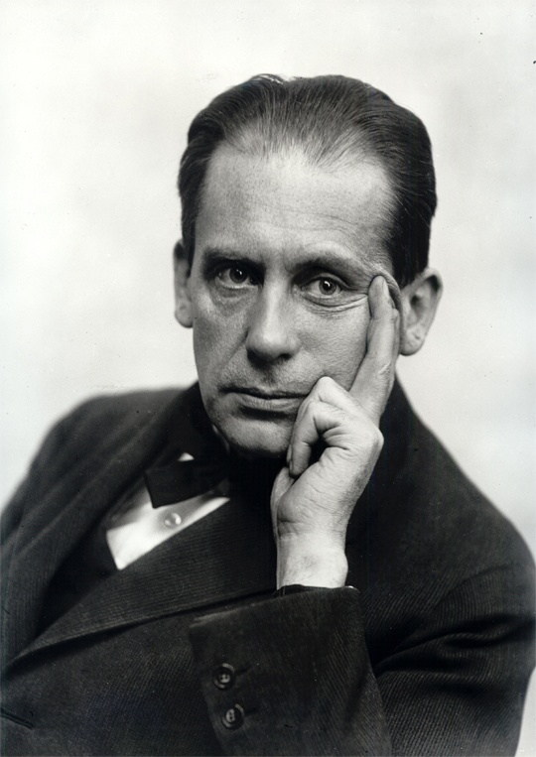
Historical Bauhaus
The Staatliches Bauhaus – commonly known as the Bauhaus, literally meaning “house construction” – began as a German school of the arts in the early 20th century.
Established by Walter Gropius in 1919, the school became famous for its approach to design, which strived to unify the principles of mass production with individual artistic vision and endeavoured to combine aesthetics with everyday function.
The Historical Bauhaus was created in a time of profound transformation as cities and regions were being reconstructed physically and economically after the First World War.

Slide 4
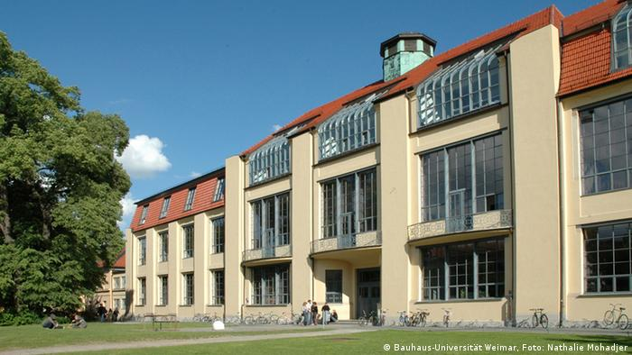
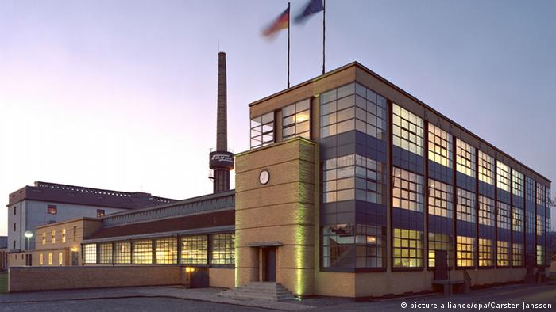
Bauhaus & UNESCO
Bauhaus arguably became the most visionary and influential art and design movement in history. It had a deep diffusion across the Europe of the day and further afield in the United States.
UNESCO has acknowledged the value of its ideas of sober design, functionalism and social reform as embodied in the original buildings. Some of the movement's achievements are on the World Heritage List.

Slide 5
New European Bauhaus is Highly Ambitious
Promotes a new lifestyle where sustainability matches style
Accelerating the green transition in various sectors of our economy such as construction, furniture, fashion and in our societies as well as other areas of our daily life.
A project of hope and positivity and in particular encourages working together in a participatory way.
New actions and funding possibilities
A cultural and creative dimension to the European Green Deal
Circular economy
Link to nature-related and nature-based solutions
Tangible experiences at the local level

Slide 6
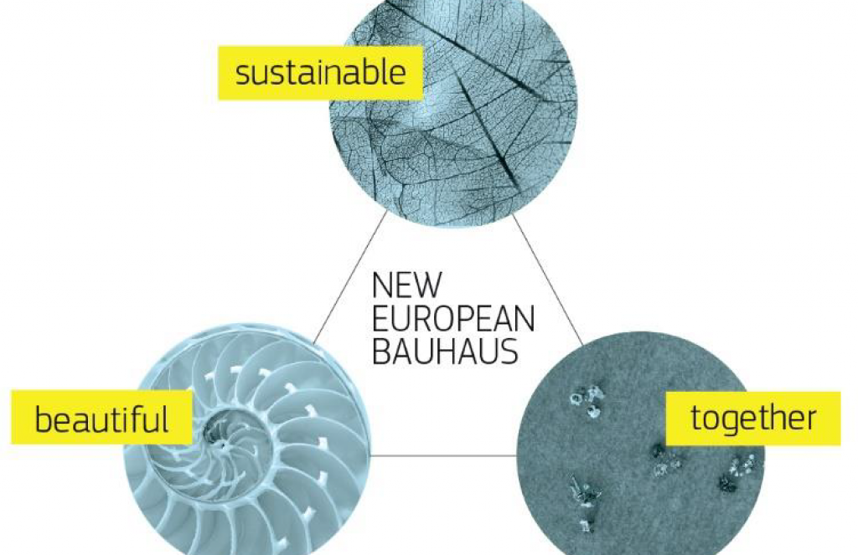
The Bauhaus Triangle
A triangle of three core inseparable values guides the New European Bauhaus:
Sustainability, from climate goals, to circularity, zero pollution and biodiversity
Aesthetics, quality of experience and style, beyond functionality
Inclusion, valorising diversity, equality for all, accessibility and affordability.

Slide 7
Foundational Principles (1)
Transdisciplinary - cross-fertilisation of ideas, knowledge, skills and methods
Innovative materials remain key
Explore more nature-based materials that are produced sustainably and to develop low-carbon production solutions
Multilevel approach to transformation – from global to local
Involves civil society and people of all ages and in all their diversity
Affordable and accessible for all
Place-based approach.

Slide 8
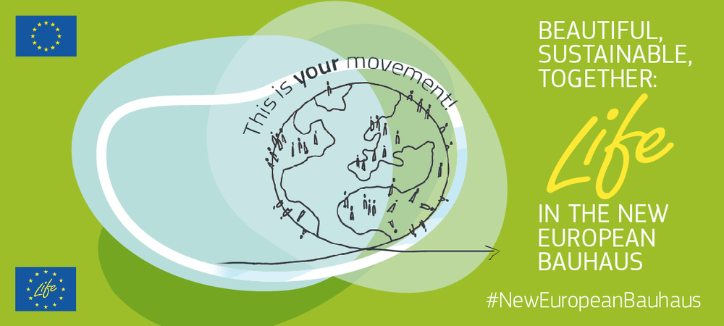
Foundational Principles (2)
Small-scale initiatives by individuals, neighbourhoods and local communities.
Life-centred perspective
Intergenerational solidarity
Tackle unsustainable use of resources and waste
Connections between rural and urban areas
Digital transition
Beyond European borders

Slide 9
Delivering the New European Bauhaus:
Three leverage points where specific actions should be implemented:
(a) making change happen in specific places on the ground
(b) the need for doing things differently in making innovation happen, including by improving our skills and methods
(c) the need for adapting the intentions and the way of thinking that is behind our actions.

Slide 10
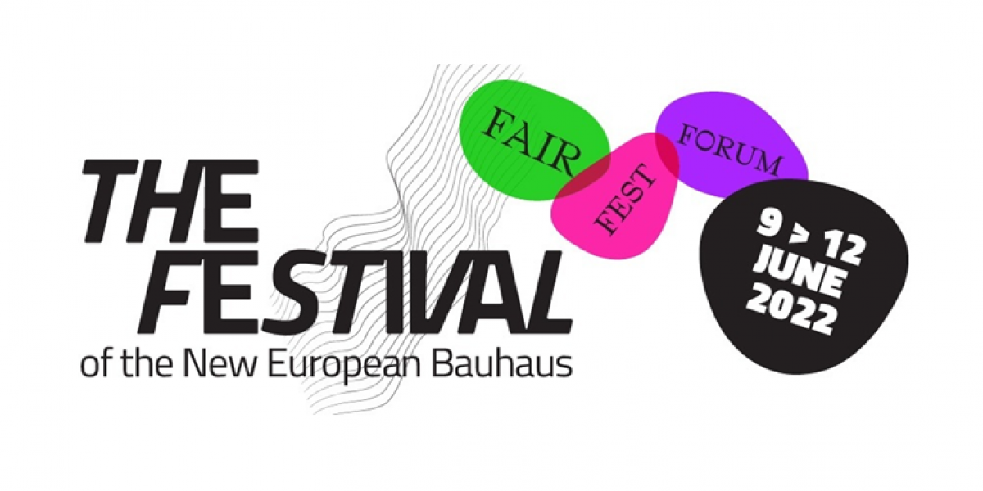
Projects/Programmes/ Schemes (1)
NEB Lab
New European Bauhaus Festival
Selecting innovative pilot projects
Providing technical assistance to support interested stakeholders, such as regional and local administrations
Introducing a dedicated urban development financial instrument leveraging EU and private investment
New European Bauhaus Seal of Excellence
Transition pathways
Cohesion Policy 2021-2027

Slide 11
Projects/Programmes/ Schemes (2)
Self-assessment tool
Horizon Europe programme
Mobilising the European Institute of Innovation and Technology (EIT) & European Innovation Council
LIFE Programme
Single Market Programme and its COSME pillar
Creative Europe Programme
Mobilising Digital Innovation Hubs
Digital Europe Work Programmes
Green procurement

Slide 12
Education and Training:
Erasmus +
New European Bauhaus prize
peer learning action to help local authorities
eTwinning 2022 annual theme on topics related to the New European Bauhaus.
European Innovative Teaching Award 2022
2022 DiscoverEU action
European Solidarity Corps 2022 annual call

Slide 13
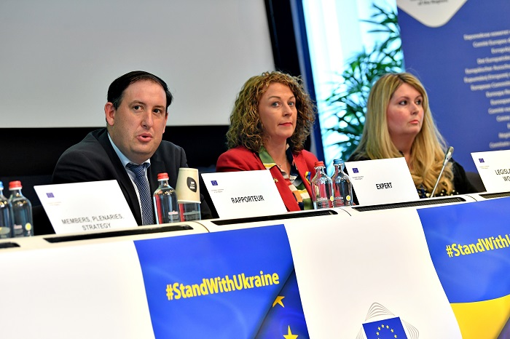
KMC Opinion
Role of cities and regions
Key performance indicators
Lab
Knowledge already in place
Cohesion funding
NEB 4 EU proposal

Slide 14
Thank You!
Contact: kieran_mccarthy@corkcity.ie

