Slide 1
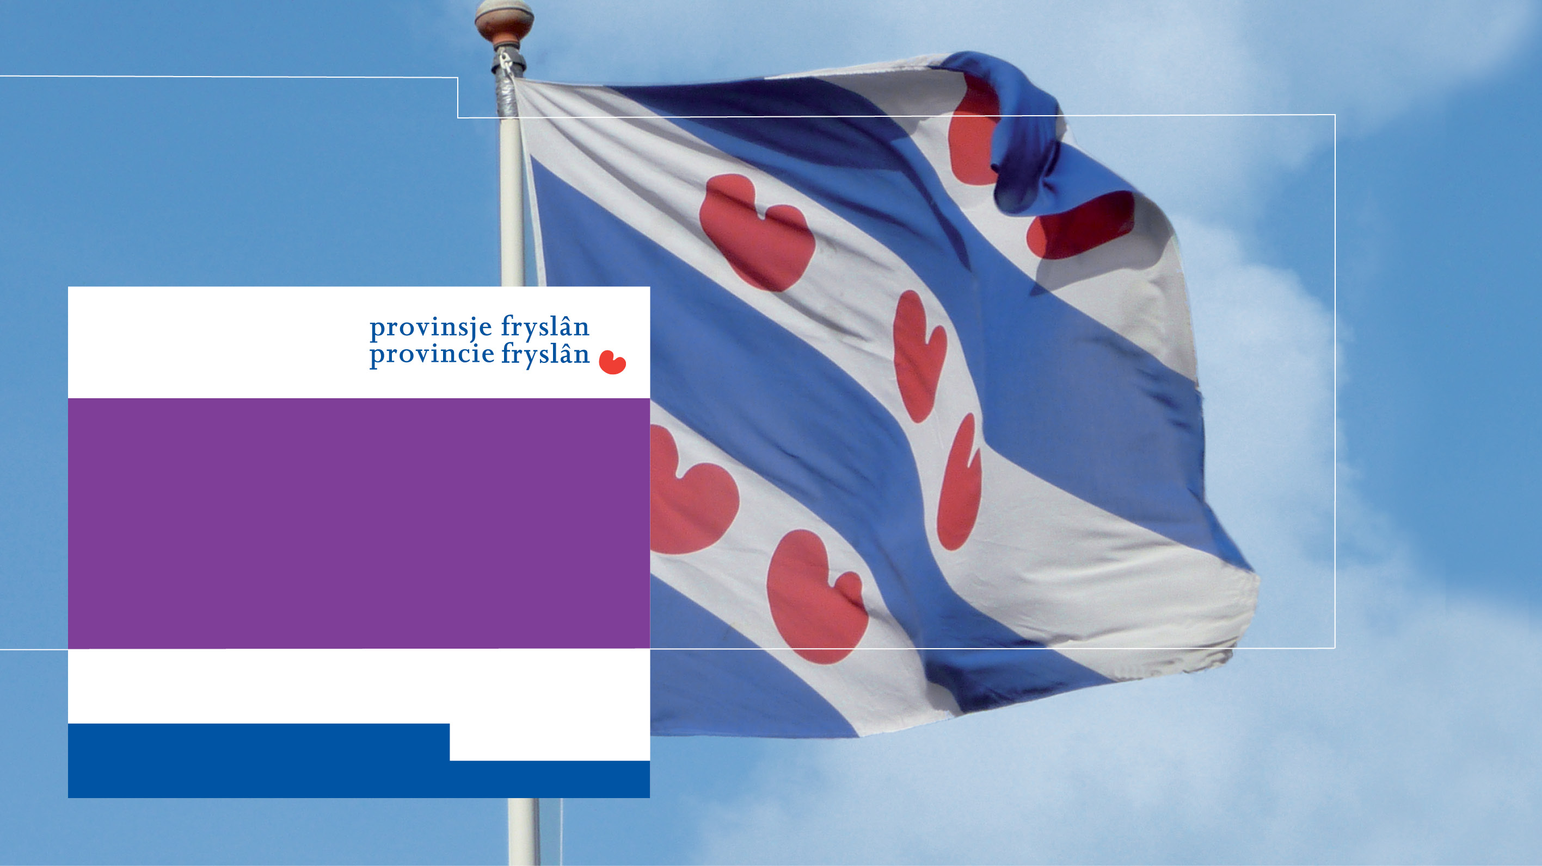
The importance of immovable cultural heritage and regional cooperation in the province of Fryslân
Brussels, November 7th, 2022

Slide 2
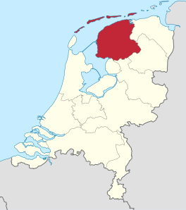
Introduction and Province of Fryslân
Klaas Fokkinga
  Regional Minister of the Province of Fryslân
Province of Fryslân:
  Just over 650.000 inhabitants;
  Leeuwarden as capital
  Frisian is the second official language in the Netherlands
  Wadden Islands
  So called ‘Frisian Paradox’

Slide 3
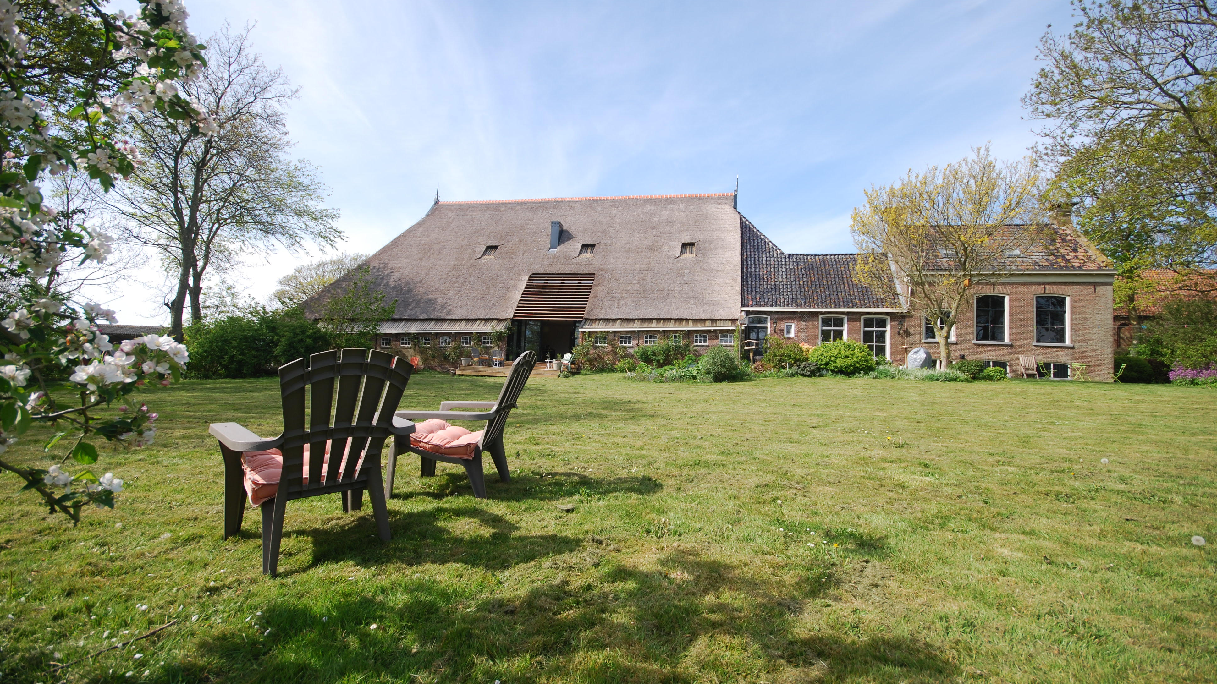
Heritage as part of the ‘Frisian Story’
Important part of our provincial liveability policy
‘Ferhaal fan Fryslân’ or the ‘The Story of Fryslân’ / ‘Frisian Story’
Example: Historical agricultural heritage in Fryslân
How?

Slide 5

This is DOM
“DOM is a collaborative method empowering villages and municipality to create ‘joie de vivre’ on an equal, structural and effective basis.
DOM enables optimal cooperation, co-creation and a fully integrated village development.”

Slide 6



The DOM method - principles
To collaborate
Together
Meet in the middle
Linking parties

Slide 7


The DOM method - principles
Project based
Concrete result
The government steers and lets go

Slide 8
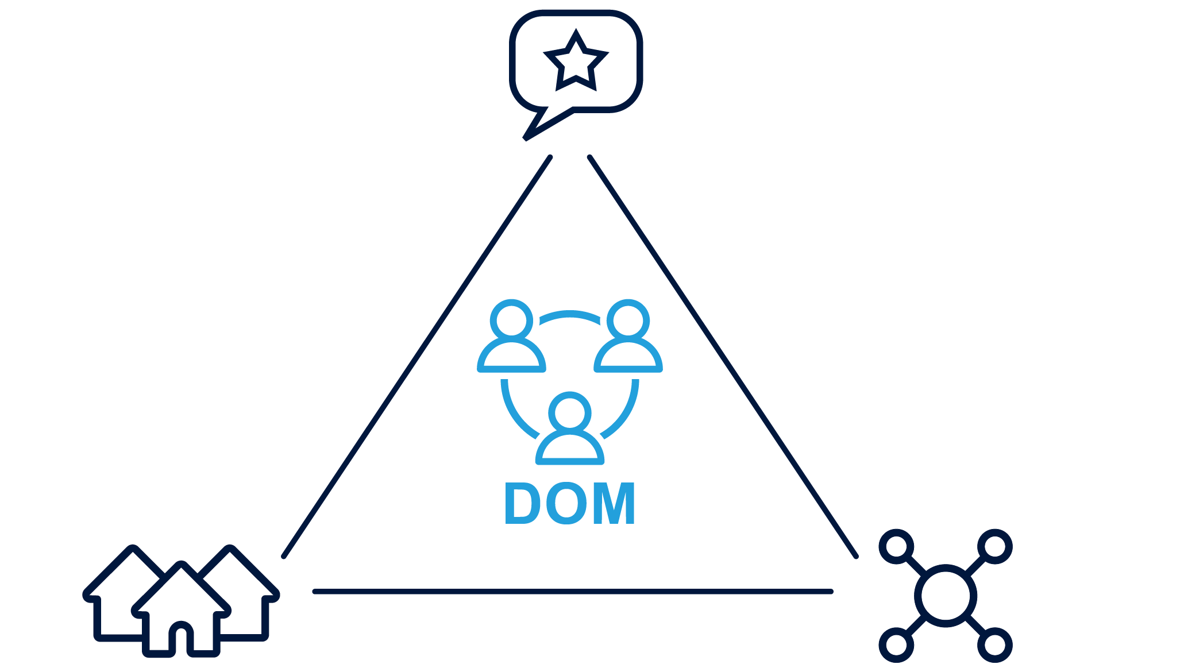
Villages
Municipality
Connector (independent)
The independent connector is the key to success!

Slide 9
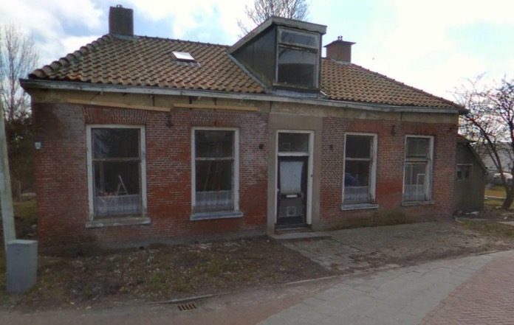
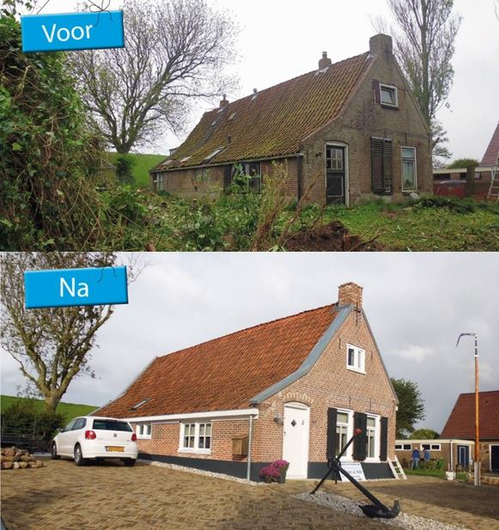
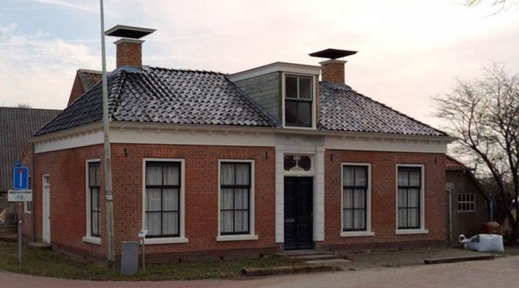
DOM: Paesens-Moddergat
Before
Before
After
After

Slide 10
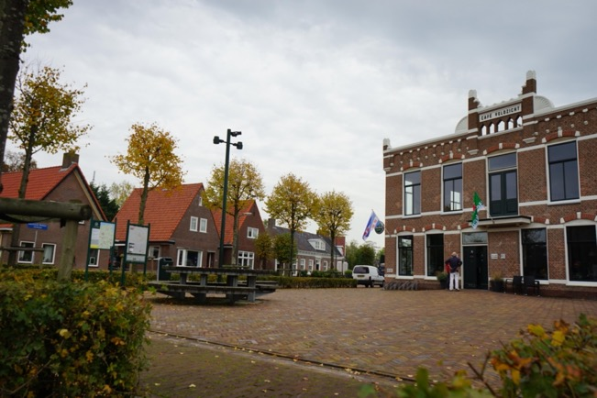
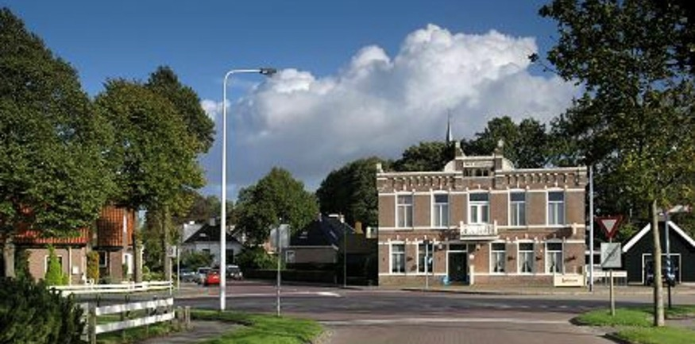
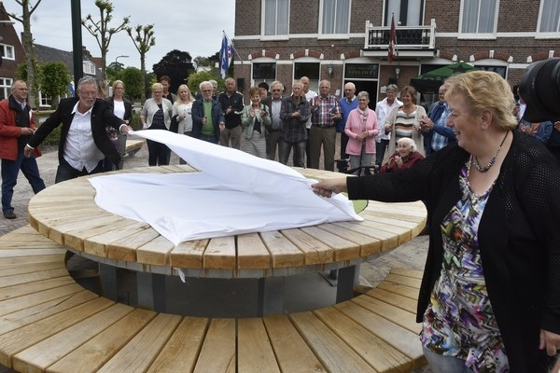
DOM: Metslawier
After
Before

