Slide 1
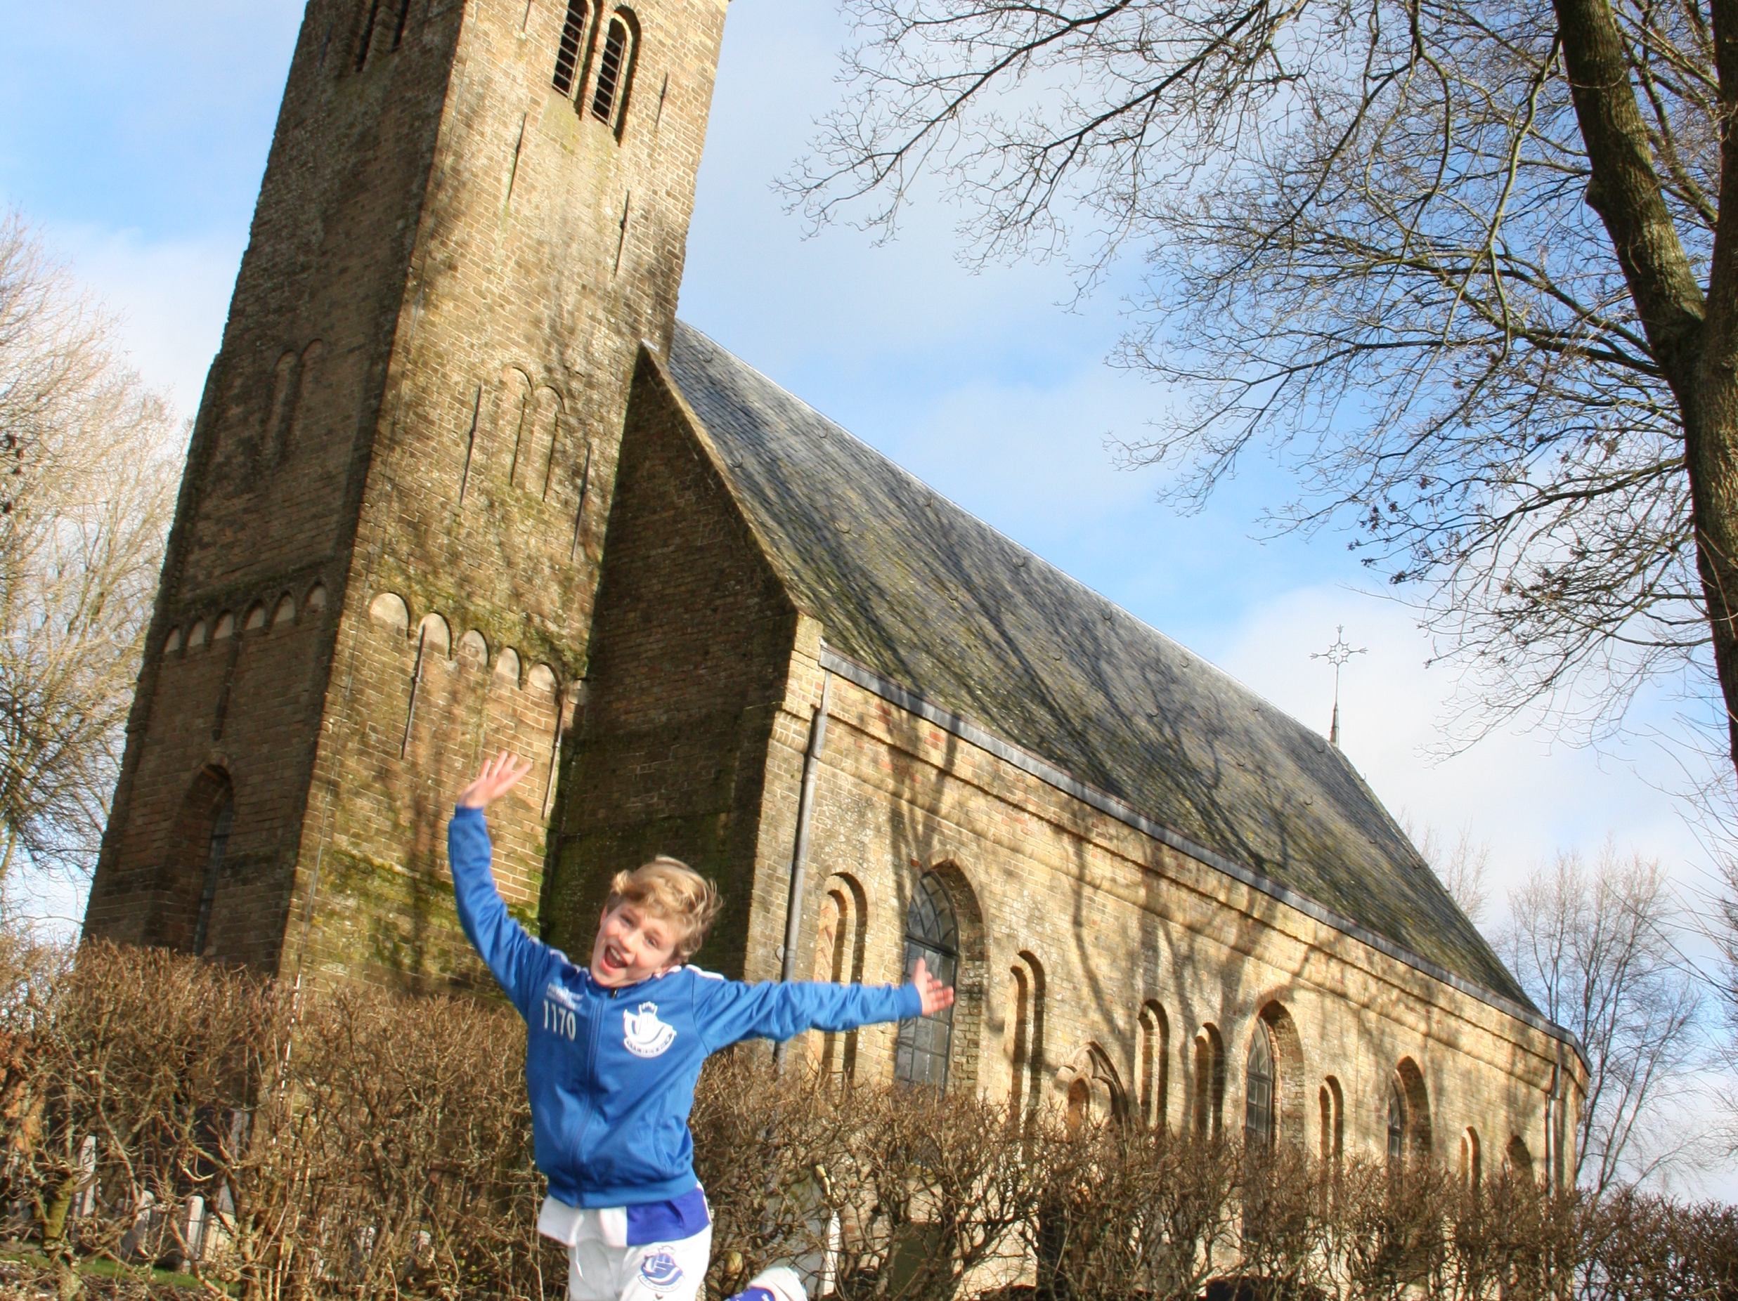

“OLD CHURCHES, NEW SOUNDS”
STICHTING ALDE FRYSKE TSJERKEN
HESTER SIMONS
DIRECTOR OF THE FOUNDATION
ALDE FRYSKE TSJERKEN

Slide 2
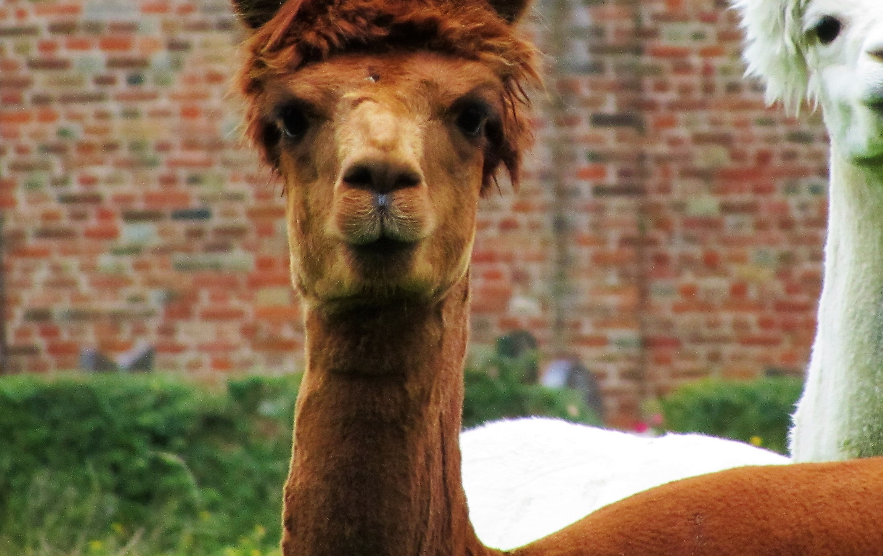
‘WHO WE ARE, A BRIEF INTRODUCTION’:
FOUNDED IN 1970
770 CHURCHES IN FRYSLÂN
350 ARE NATIONAL MONUMENT
WE OWN 55 CHURCHES, 2 ‘BELL’ CHAIRS AND 7 CEMETERIES
POM STATUS (PROFESSIONAL ORGANIZATION MONUMENTMANAGEMENT)
9 PROFESSIONALS, 12 BOARDMEMBERS AND 300 VOLUNTEERS
MANAGED AND PRESERVED BY PROFESSIONALS AND THE LOCAL COMMUNITY

Slide 3
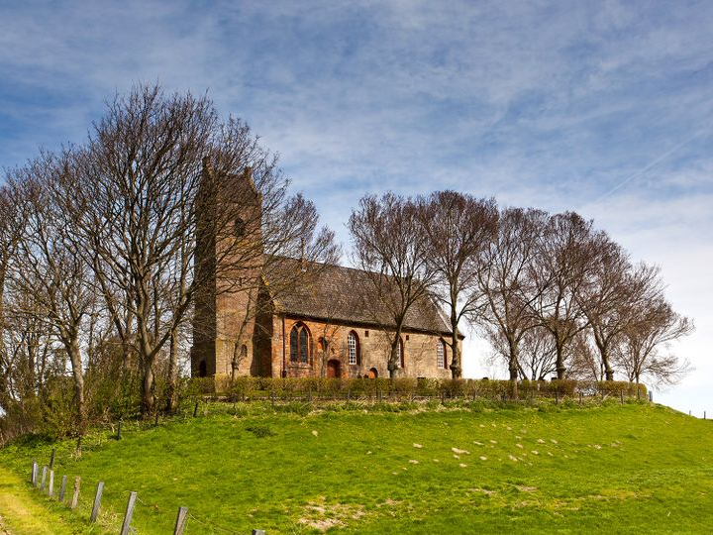

Koptekst voorstel
Start met de tekst vanaf hier
OUR CORE ACTIVITIES:
MANAGE AND PRESERVE FRISIAN CHURCHES AND STIMULATE PUBLIC INTEREST

Slide 4
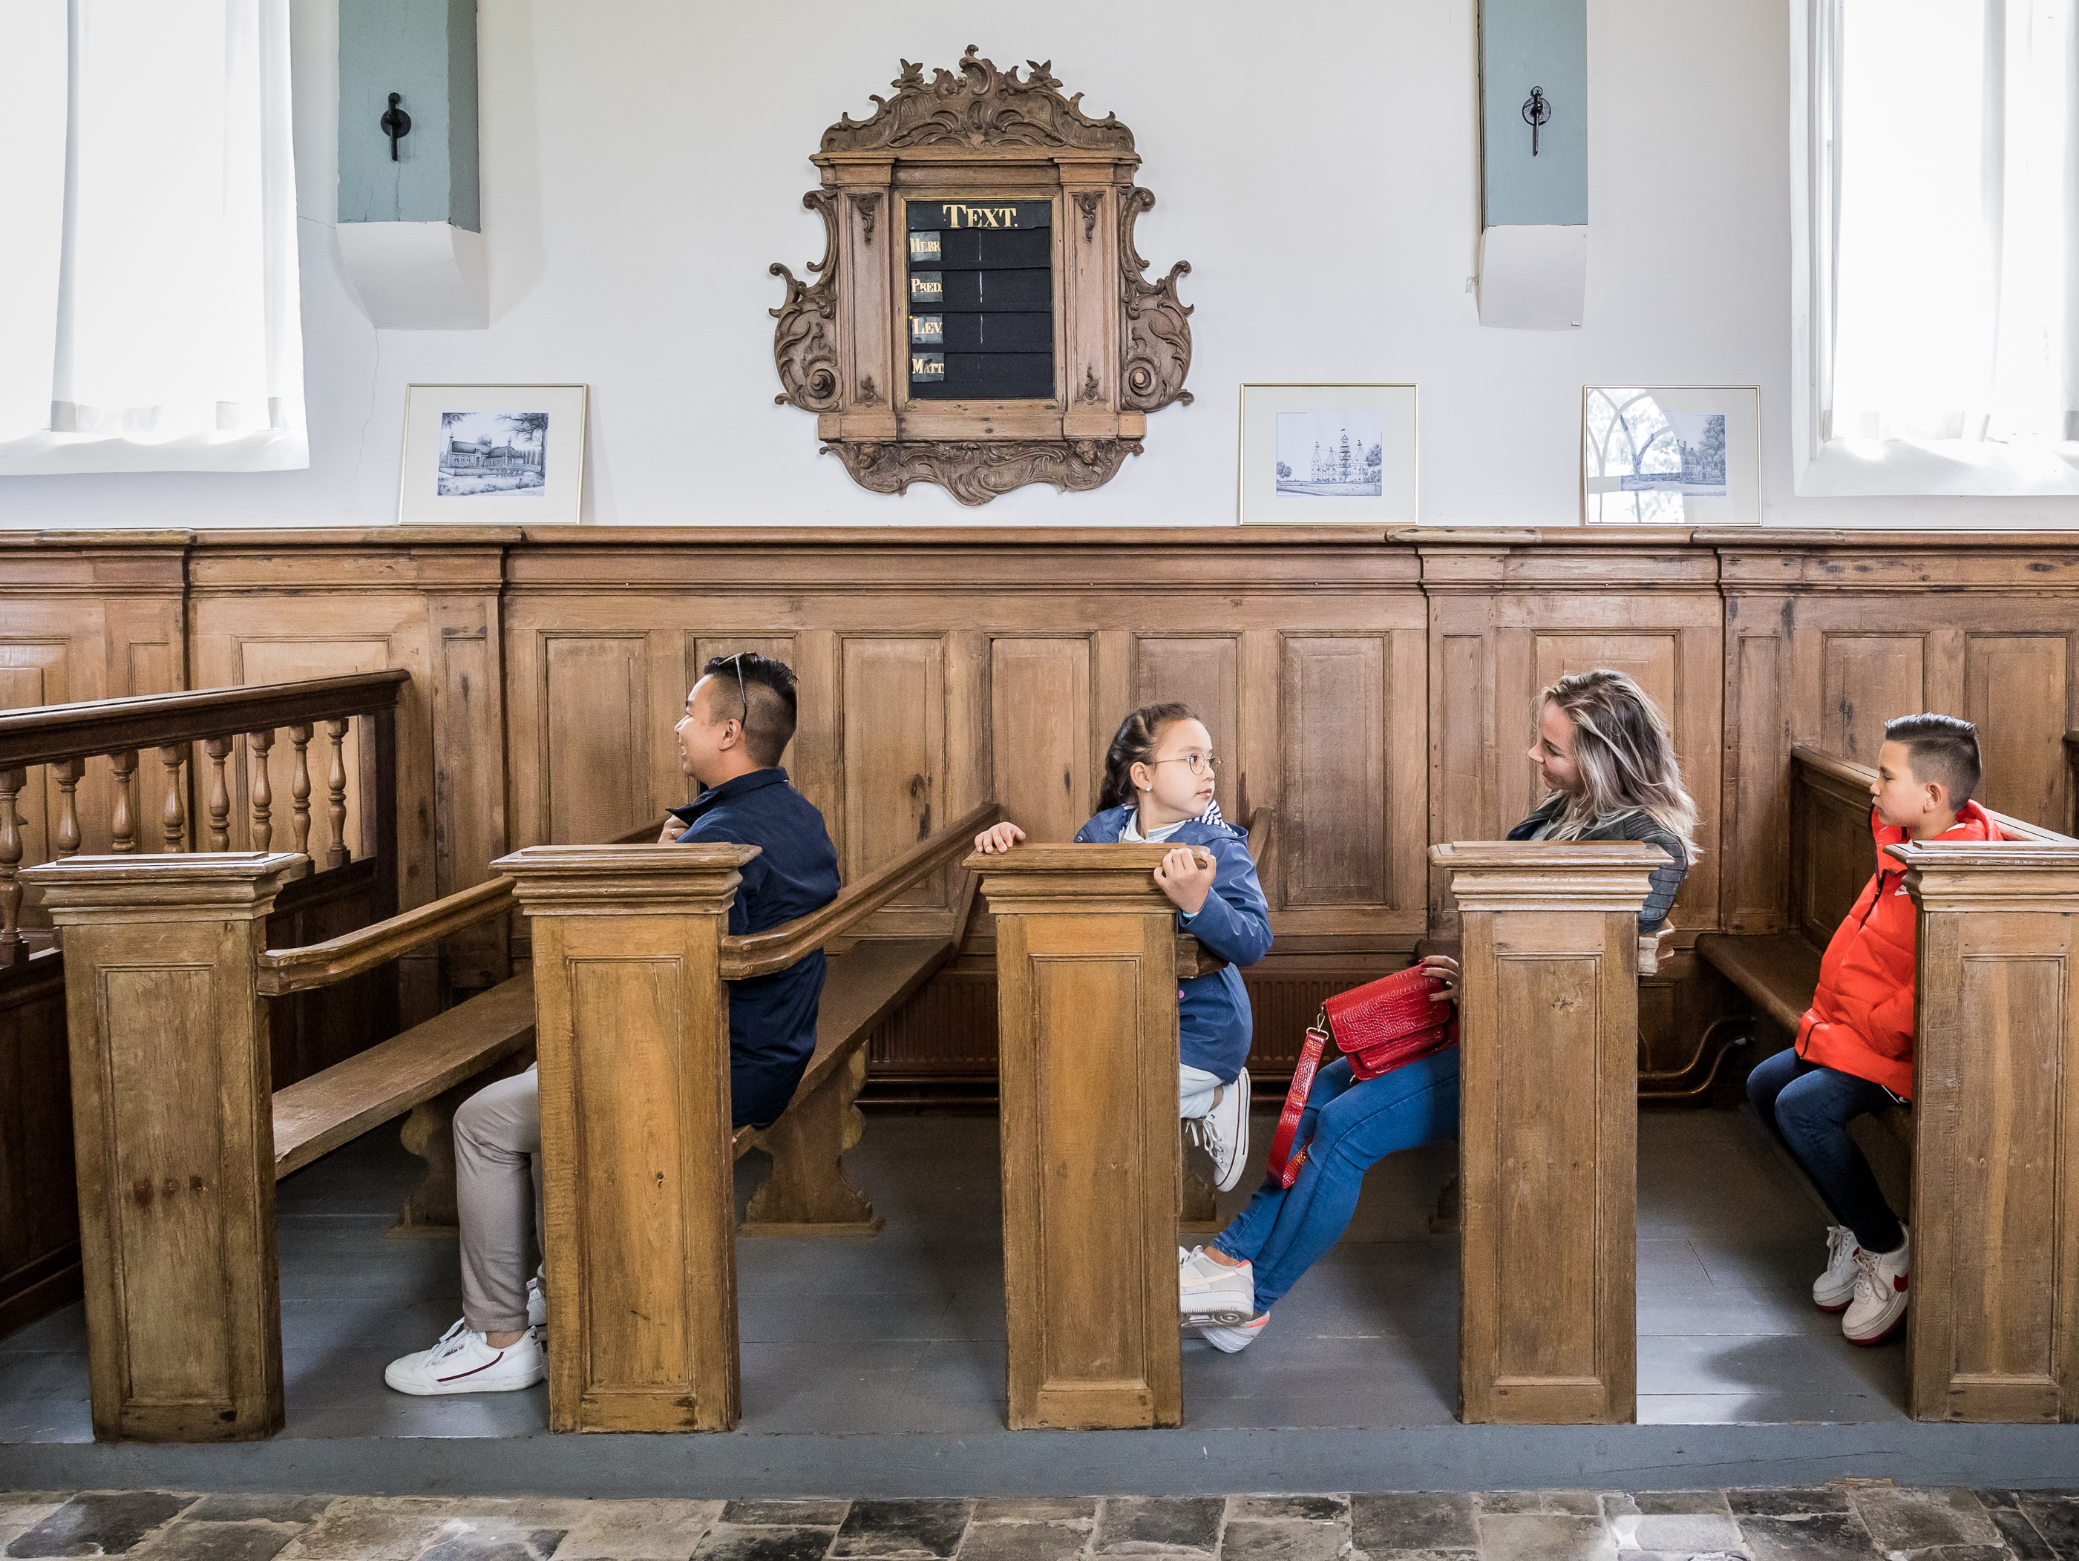
‘ALDE FRYSKE TSJERKEN AND PROVINCE OF FRYSLÂN’
THE PROVINCE OF FRYSLÂN PROVIDES US WITH A YEARLY CONTRIBUTION TO SUPPORT OUR PROFESSIONAL STAFF.
BUT MORE IMPORTANT;
THEY ARE HELPING US CONNECT WITH OTHER FOUNDATIONS, HELP US TO LOOK FOR OPPORTUNITIES TO ATTRACT PEOPLE TO VISIT OUR CHURCHES AND PROVIDE US WITH ADVICE ABOUT SUSTAINABILITY, FUNDING ETC.

Slide 5
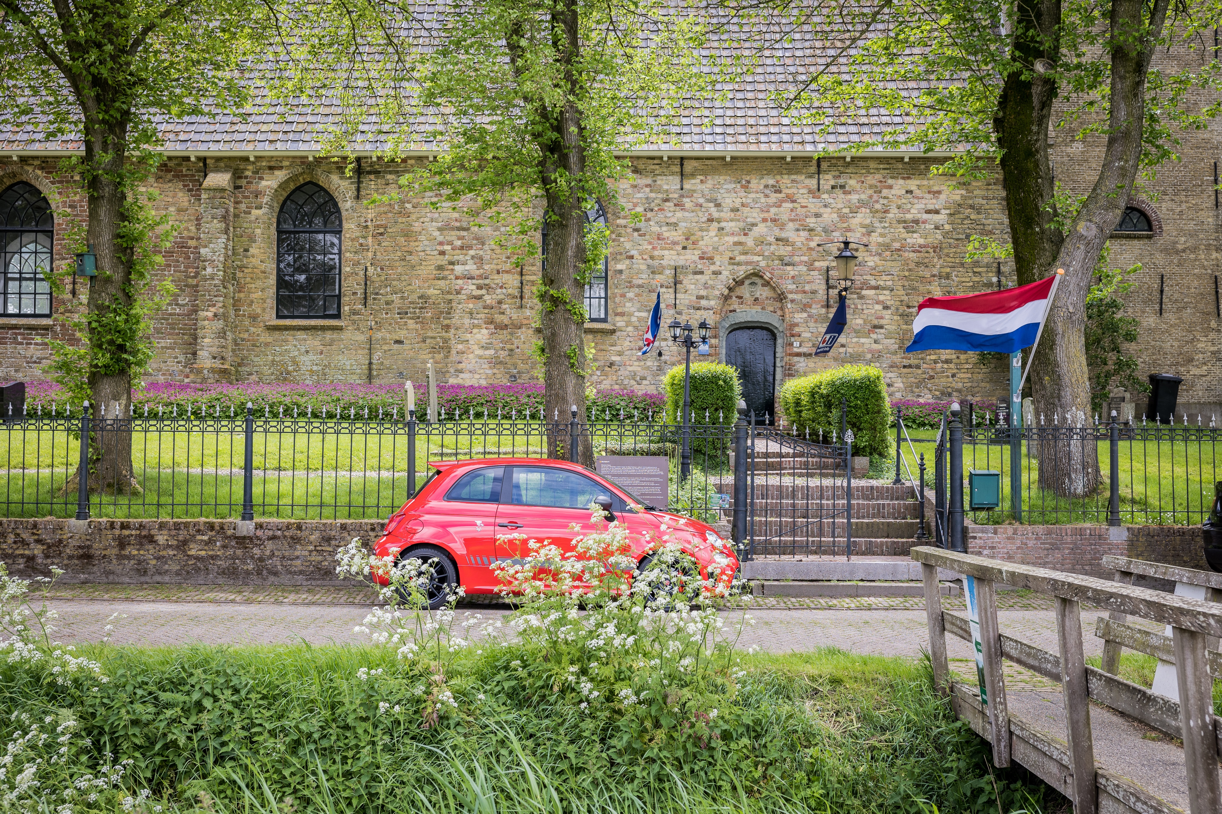
‘OUR INTERACTION WITH PROVINCIE FRYSLÂN’
THE CIVIL SERVANTS OF THE PROVINCIE ARE CHALLENGING US TO MOVE FORWARD AND BROADEN OUR OBJECTIVES WITH GOALS TO ATTRACT SLOW TOURISM AND INVEST IN EDUCATION.

Slide 6
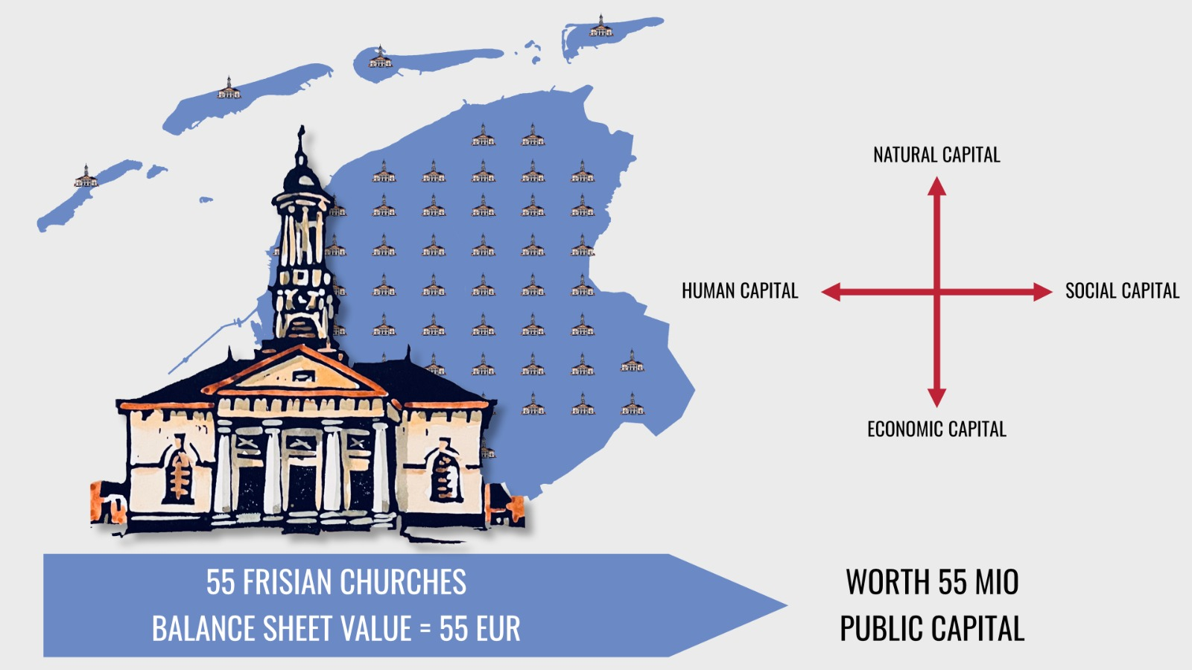

Slide 7
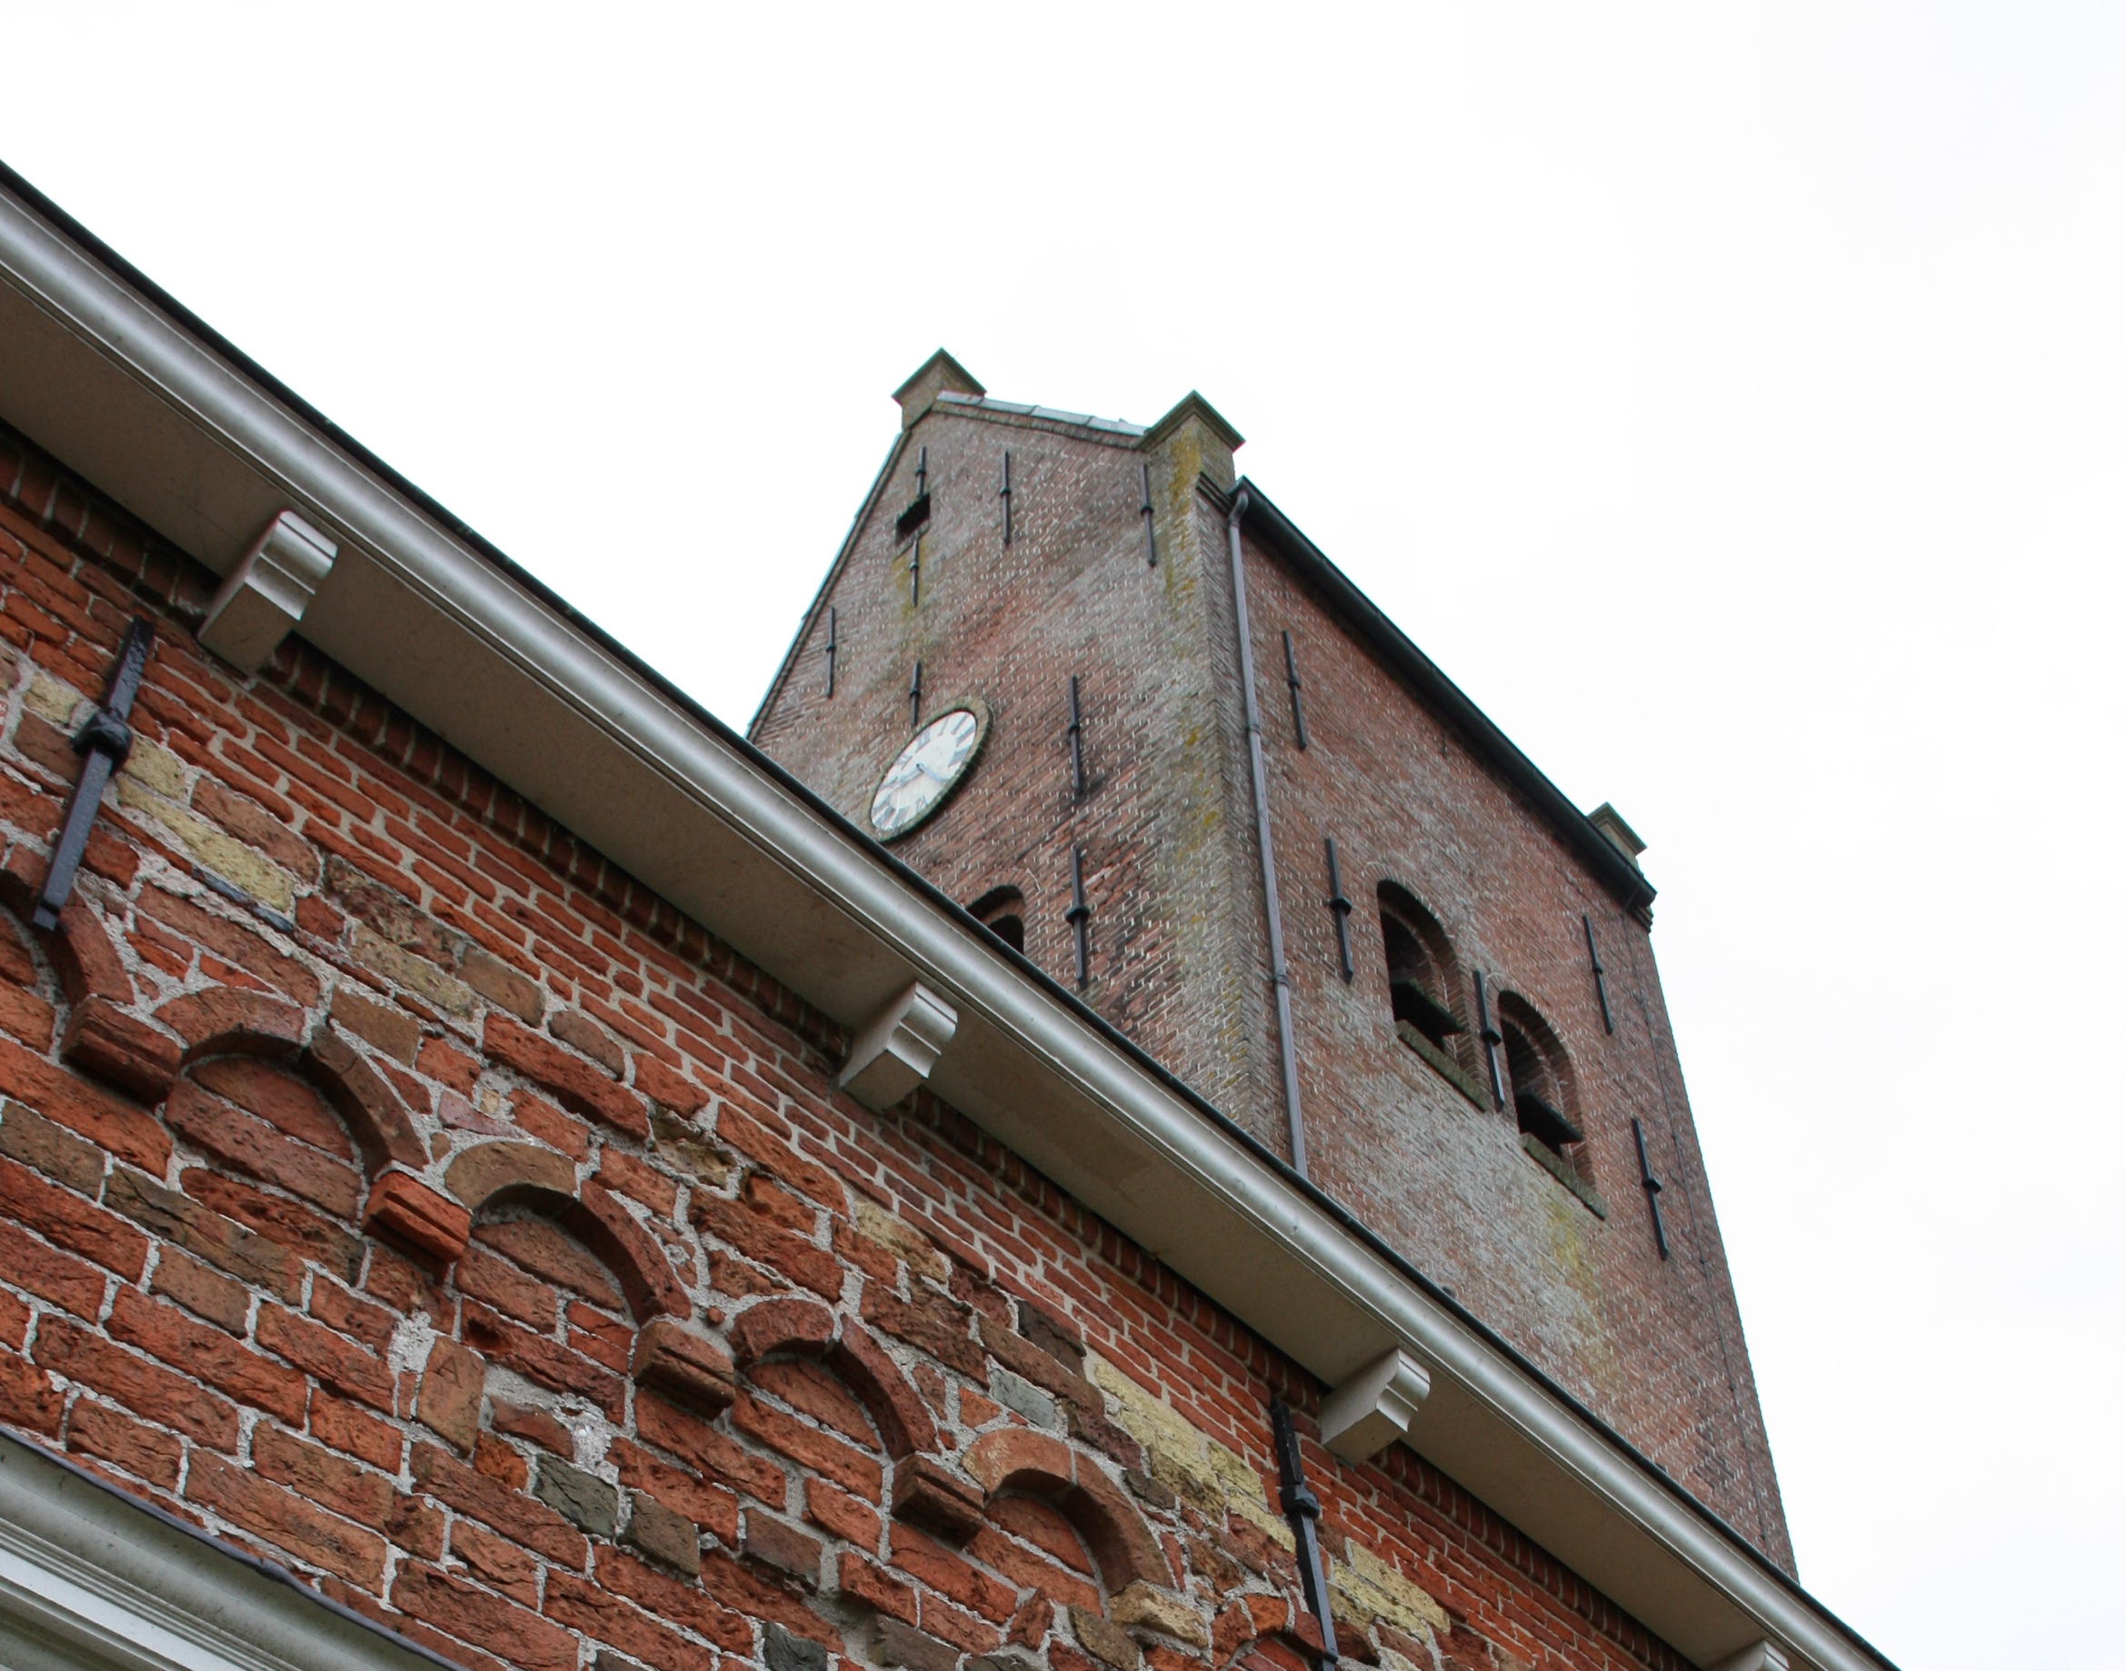
‘SOCIAL CAPITAL’
FOCUS ON THE COMMITMENT OF OUR VOLUNTEERS THROUGH SHARING MUTUAL EXPERIENCES FROM A REGIONAL APPROACH AND COMING TOGETHER IN SMALL GROUPS TO WORK OUT WHAT FITS BEST WHERE

Slide 8
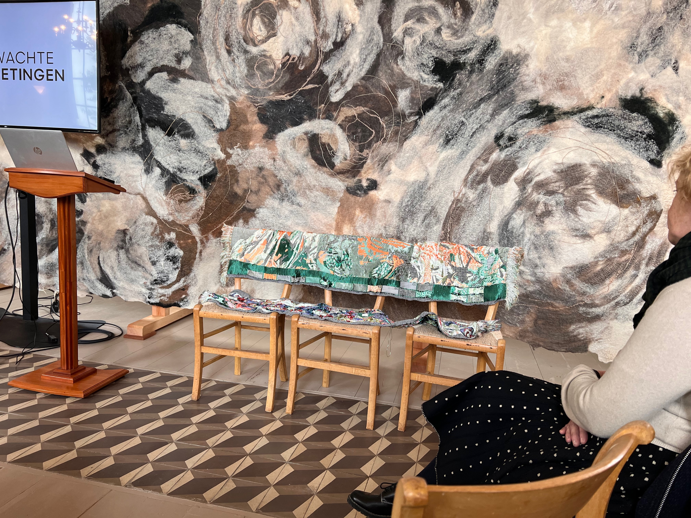
‘THE CHURCH AS A MEETING AND INSPIRATION PLACE’
CREATING UNEXPECTED ENCOUNTERS IN OUR CHURCHES BY OFFERING ART EXHIBITIONS AND CULTURAL ACTIVITIES IN THE CHURCH

Slide 9
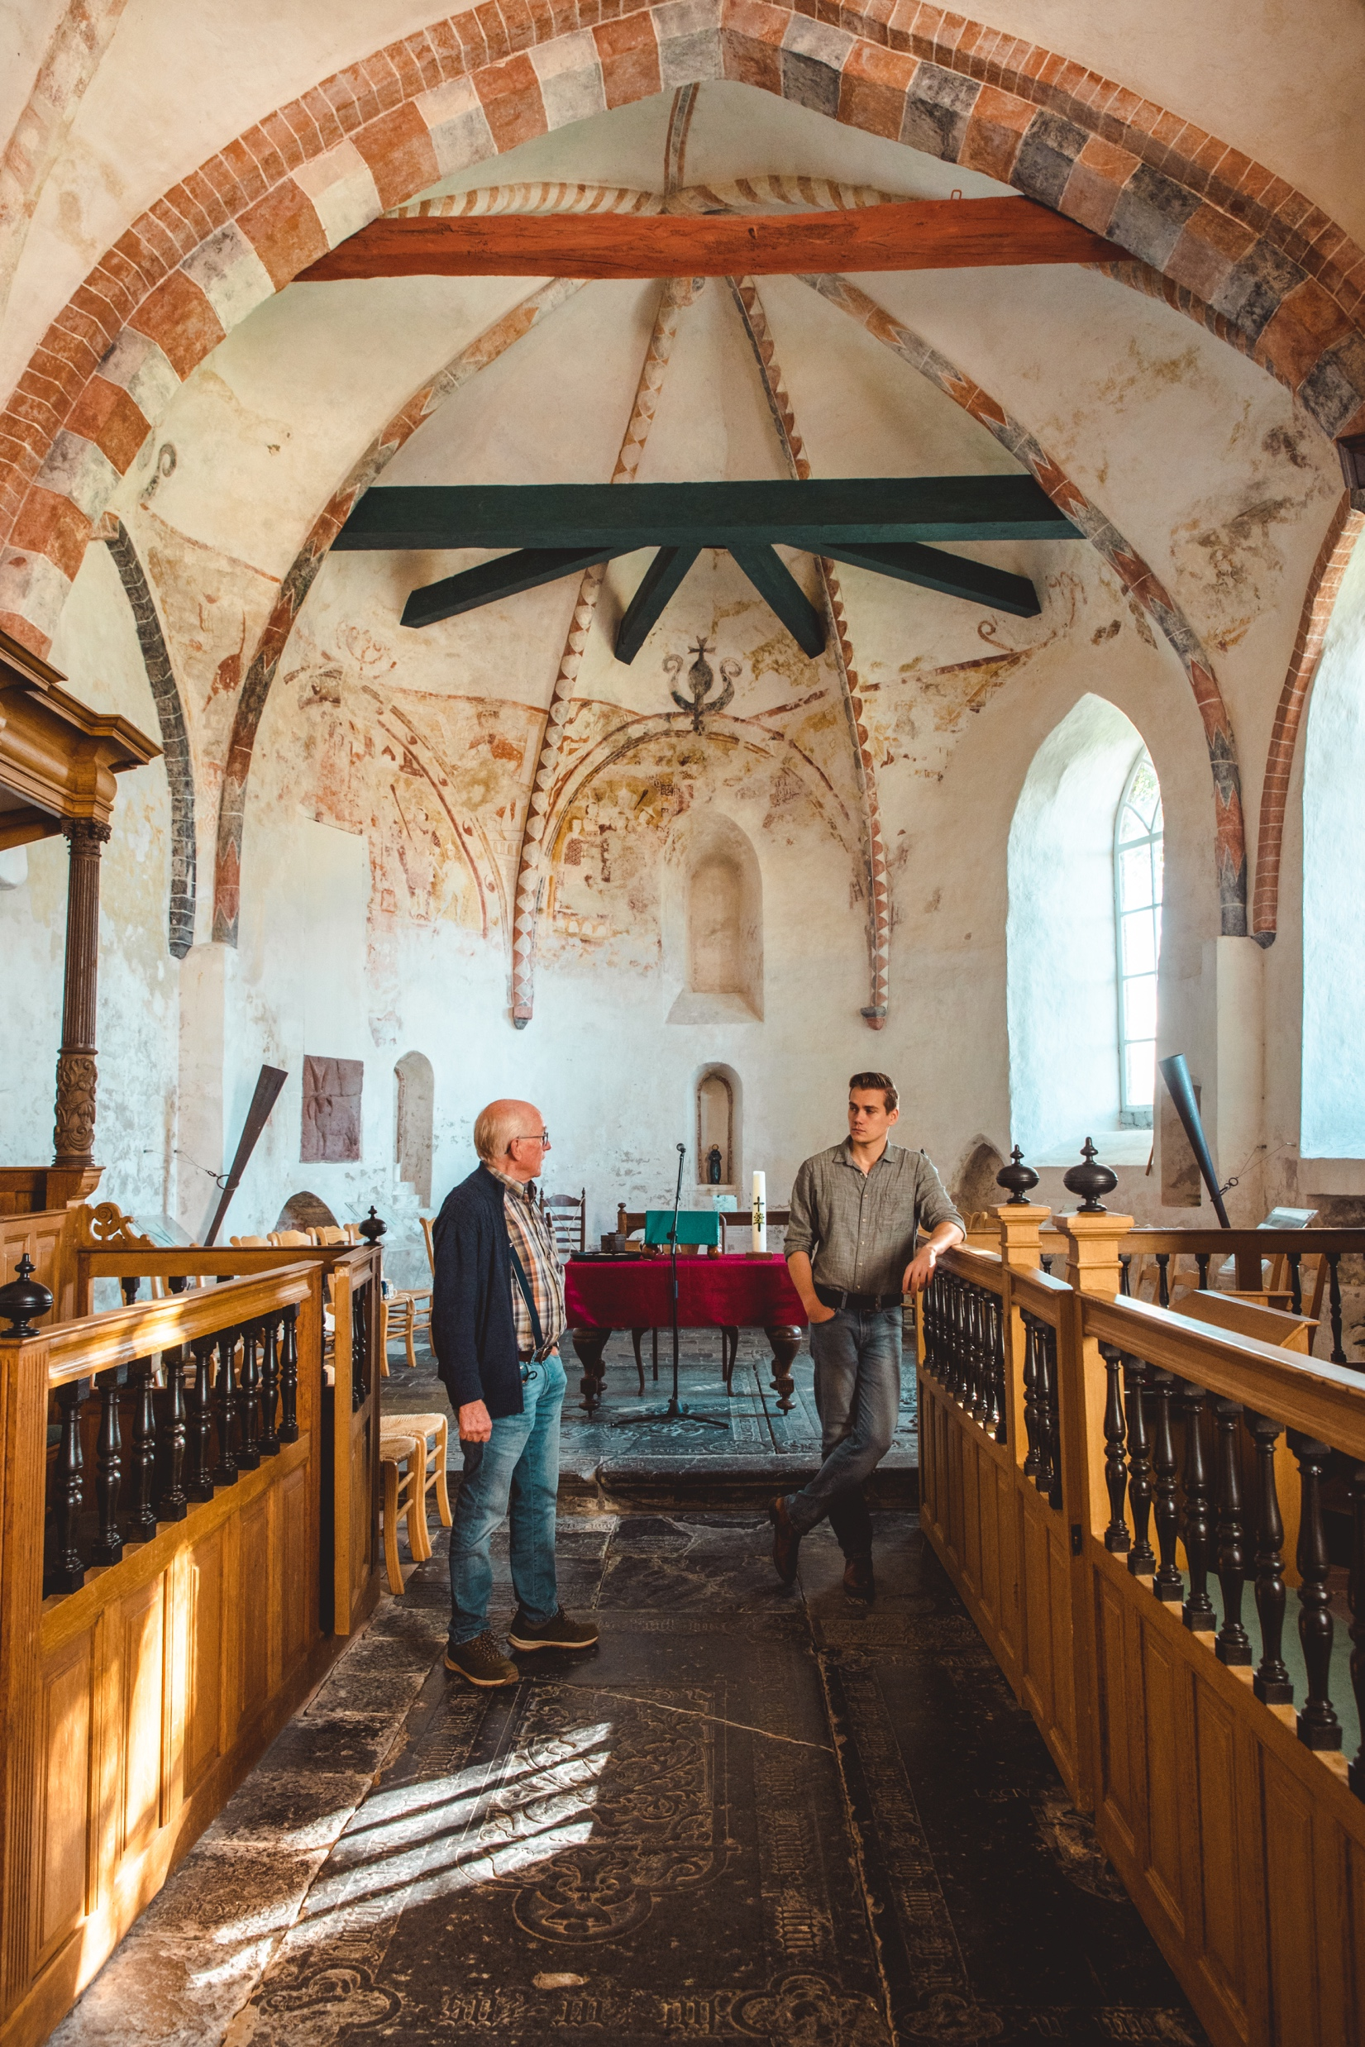
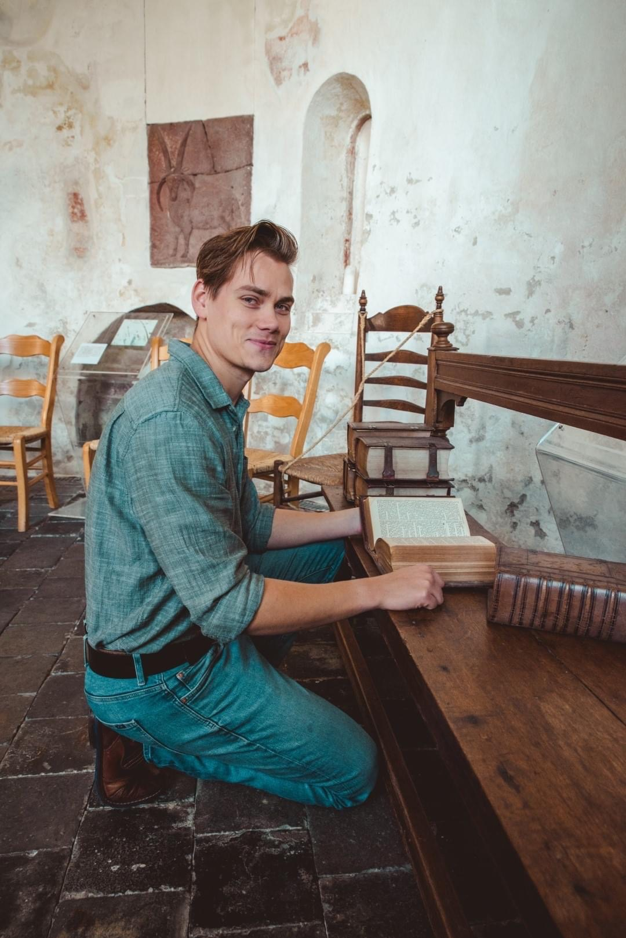
EN NU? WE HOREN GRAAG UW MENING EN IDEEEN OVER HOE WE DE ‘ TSJERKE NEI DE TAKOMST TILLE KINNE’!
‘A PLACE TO LEARN AND SEARCH FOR NEW PATHS TOGETHER ’
COLLABORATING WITH (INTERNATIONAL) STUDENTS: INTERNAL ISSUES ARE
PRESENTED TO STUDENTS BUT THEY CAN ALSO DECIDE FOR THEMSELVES WHAT THEY THINK NEEDS ATTENTION

Slide 10
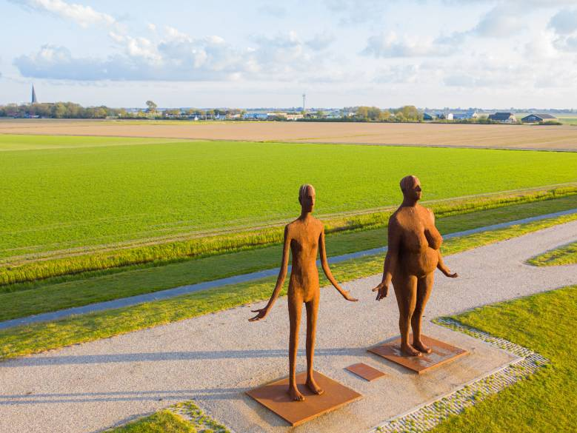
‘HUMAN CAPITAL’
INVESTING IN HEALTHY AGING BY DEVELOPING NEW LONG DISTANCE WALKS AND BICYCLE TOURS (SEE ALSO EASY TRAVEL)

Slide 11
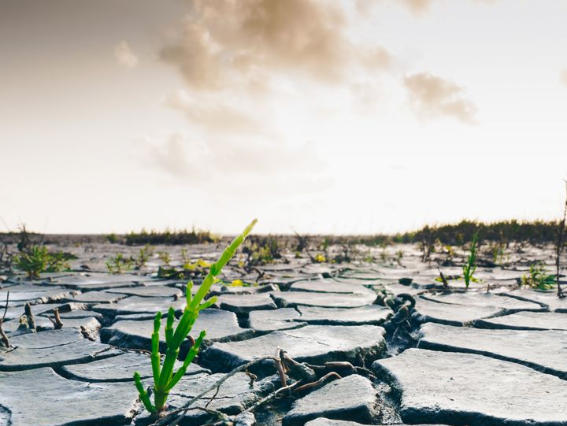
‘THE CHURCH AS A PLACE FOR CONTEMPLATION AND RELAXATION’
WALK ON THE WILD SIDE: PILGRIMING ALONG AND IN CHURCHES, OFFERING MUSIC, ART, REGIONAL FOOD AND HEALTHY ACTIVITIES ALONG THE WADDEN AREA WITH ANOTHER NORTHERN RELIGIOUS HERITAGE FOUNDATION AND INSIGHTS FROM FRH.
Notes:
Voorbeeld samenwerkingen: pelgrimeren, walk on the wild side, popfabryk, kunstenaars

Slide 12
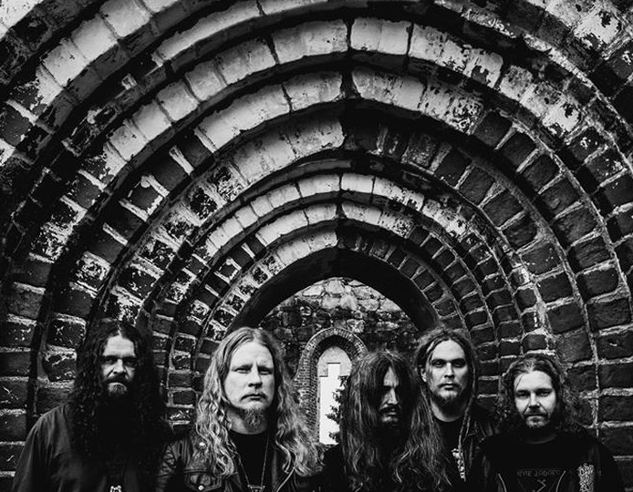
Koptekst voorstel
‘THE CHURCH AS EXPERIMENTAL LABARATORY’
RESEARCHING ONORTHODOX PARTNERSHIPS SUCH AS OFFERING OUR CHURCHES AS RESIDENCES FOR ARTISTS AND FILM MAKERS IN COLLABORATION WITH THE POPFABRYK
Start met de tekst vanaf hier

Slide 13
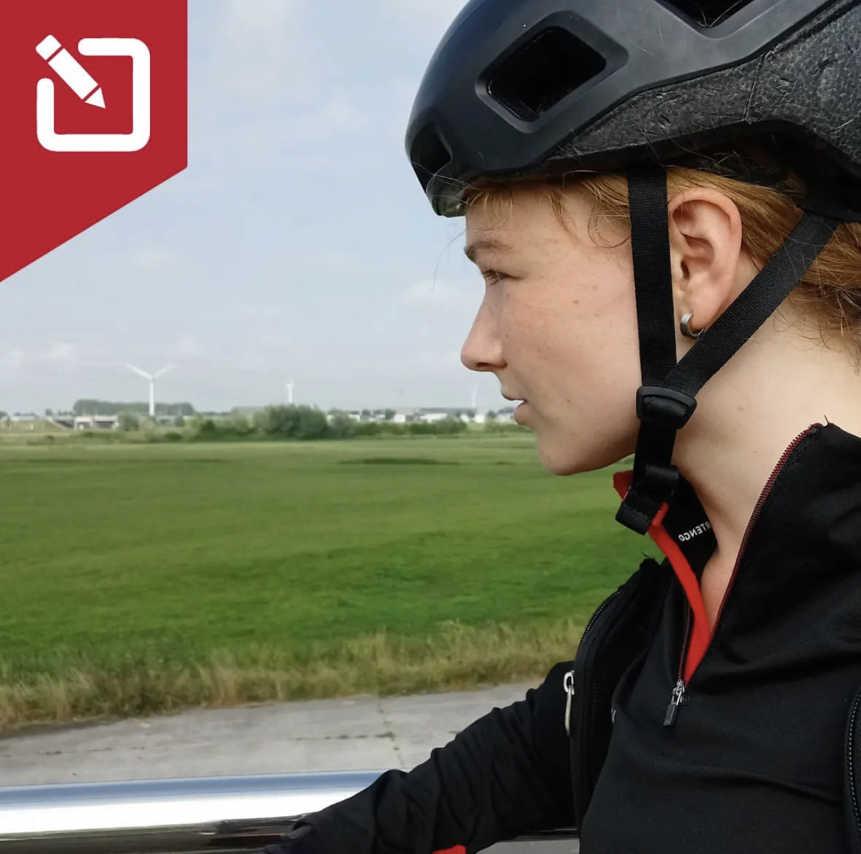
‘ SLEEPING IN THE CHURCH LIKE A PILGRIM’
IN 18 OF OUR CHURCHES YOU CAN STAY OVERNIGHT (WITHOUT ANY LUXURY).
SEE THE BLOGS OF STUDENT KJELDA WHO SPENT THE NIGHT IN 5 OF OUR CHURCHES LAST SUMMER AS A PILGRIM

Slide 14
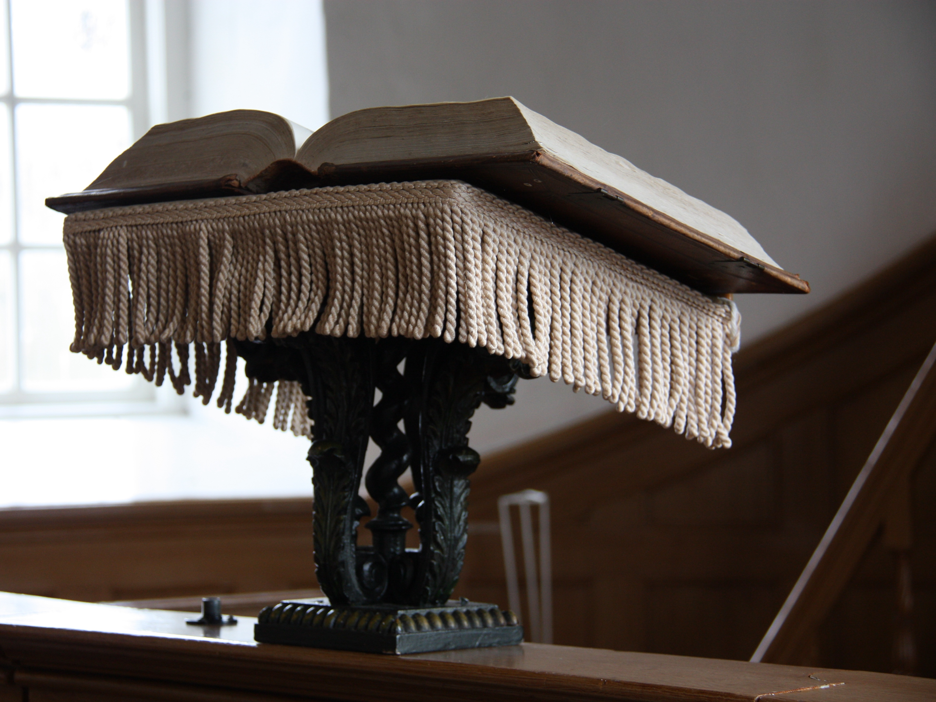
‘NATURAL CAPITAL’
NOT JUST LIFT THE CHURCH TO THE FUTURE BUT ALSO THE GREENERY AND THE CEMETERIES.
AMBITIONS IN THE FIELD OF SUSTAINABILITY AND ACCESIBILITY

Slide 15
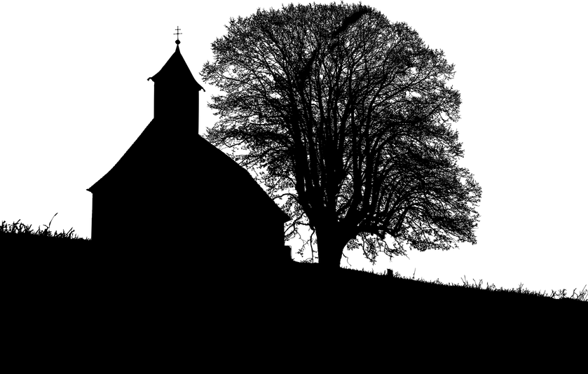
‘ECONOMIC CAPITAL’
LOCAL CONTRACTORS CARRY OUT THE MAINTENANCE AND RESTORATION’. MANY FRISIAN COMPANIES BENEFIT FROM THE WORK ON OUR CHURCHES.

Slide 16
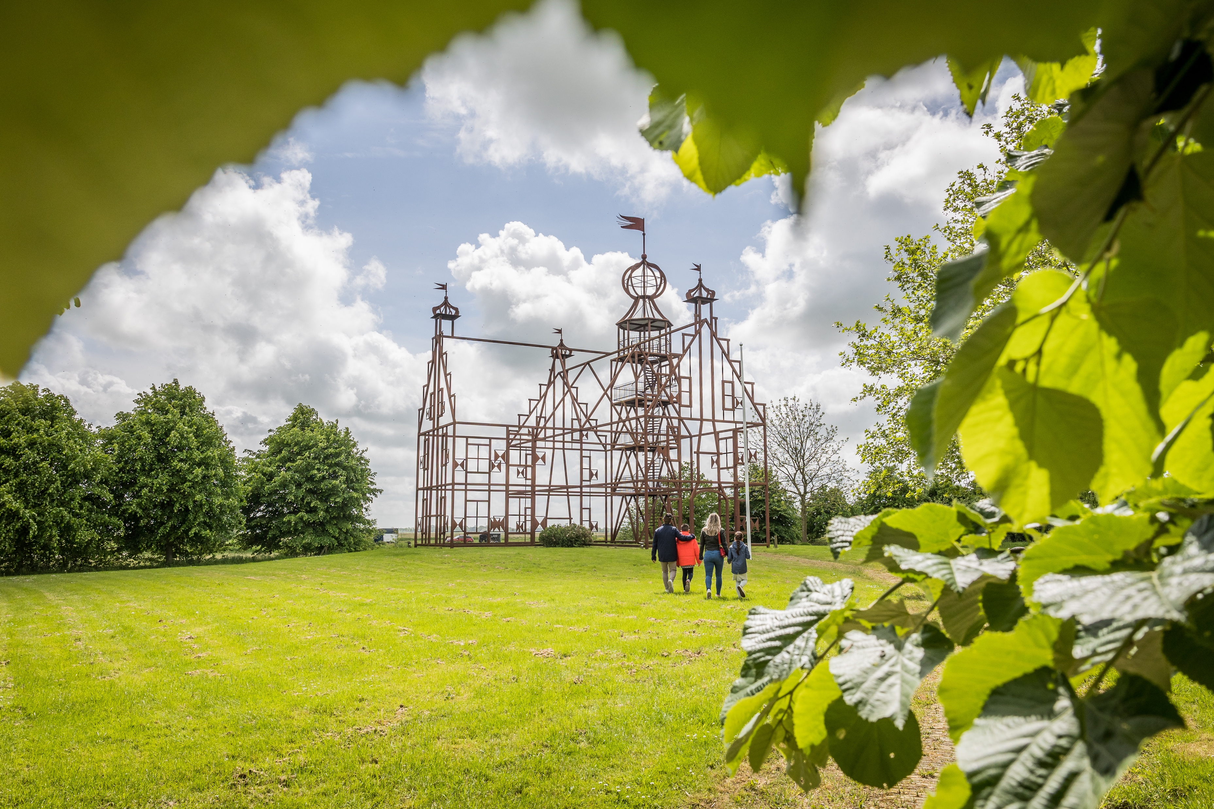
?
‘WORKING WITH THE LOCAL COMMUNITY’
TWO EXAMPLES OF HOW WE MOTIVATE PEOPLE FROM THE COMMUNITY TO REALIZE THEIR WISHES OF WHAT SHOULD BECOME OF THEIR CHURCH:
SINT JORISCHURCH IN DEDGUM
MARIACHURCH IN BLESSUM

Slide 17
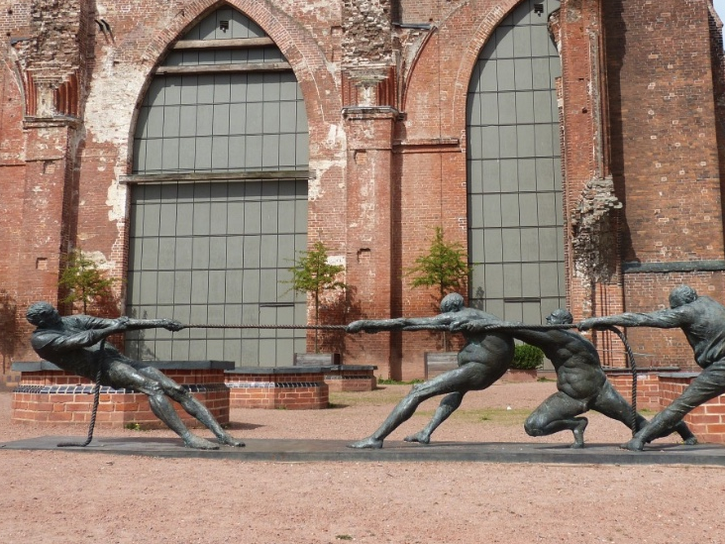
Koptekst voorstel
Start met de tekst vanaf hier
‘CHALLENGING TIMES I’
HOW CAN WE KEEP INVESTING IN ACTIVITIES FOR THE SMALL TOWNS ON THE COUNTRYSIDE WHEN THE COST OF KEEPING THE CHURCHES OPEN ARE FAR ABOVE THE (FINANCIAL) BENEFITS?

Slide 18
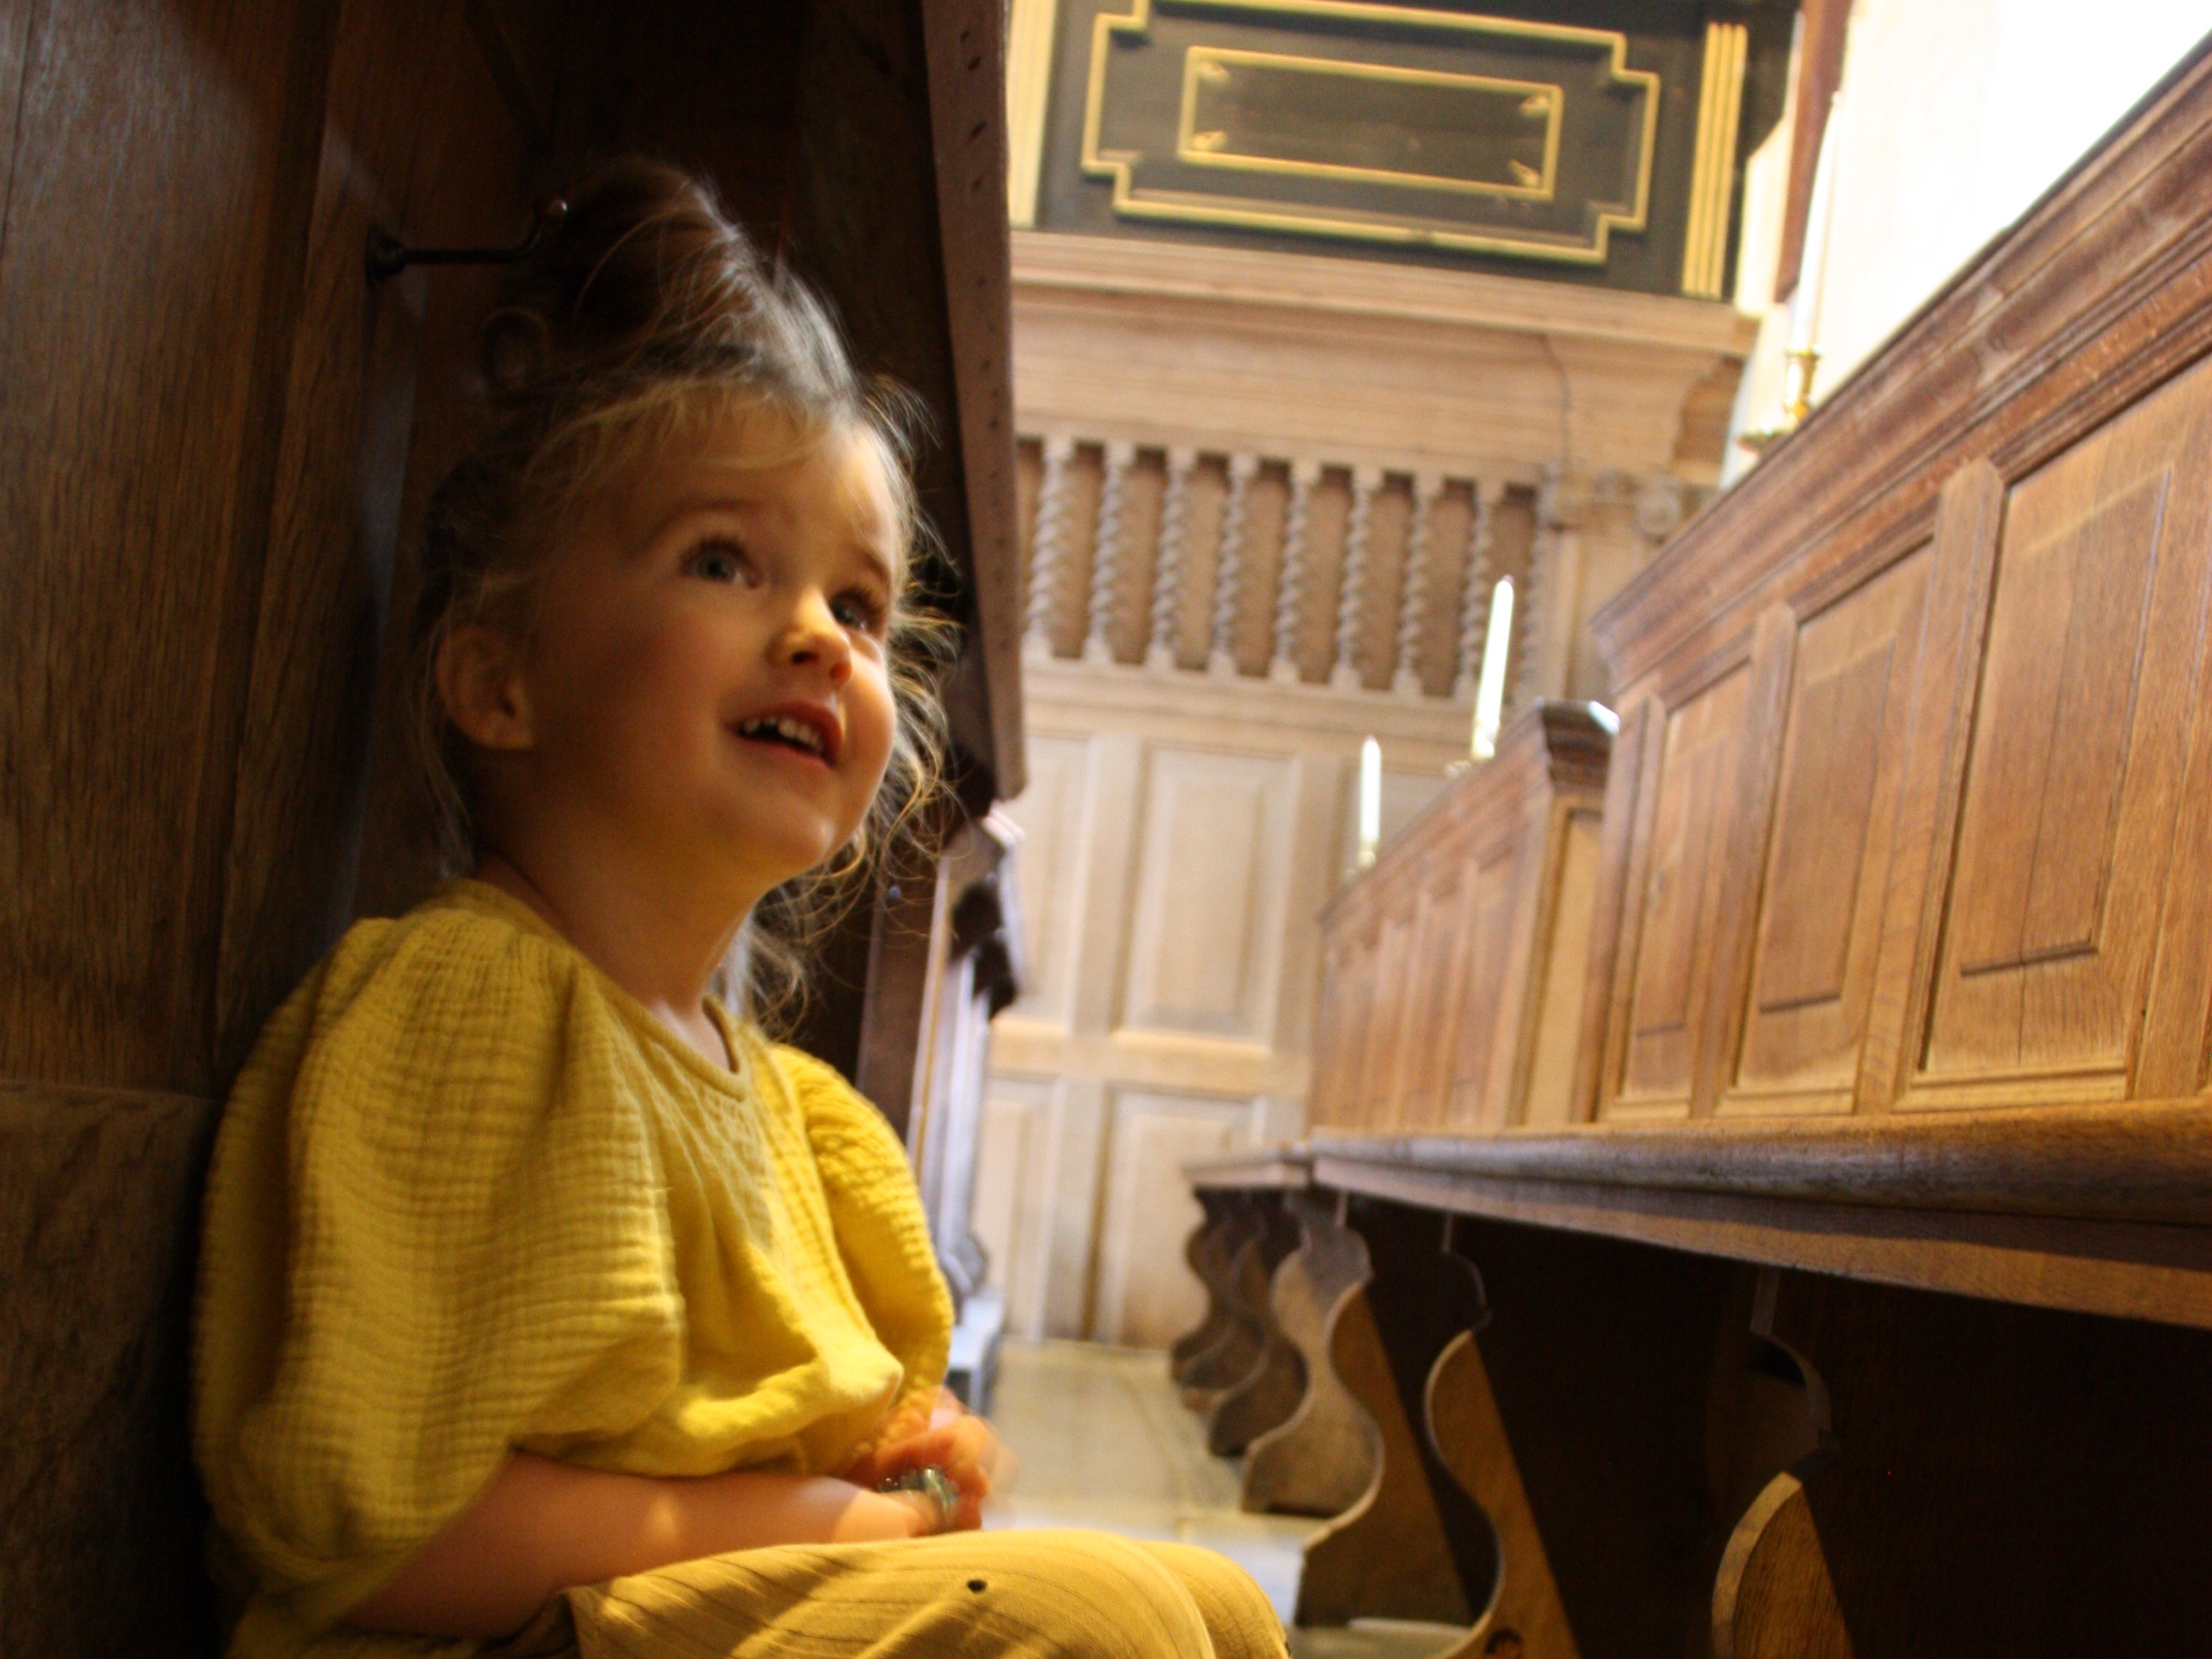
‘CHALLENGING TIMES II’
CUSTOMIZATION BY CHURCH, SUSTAINABILITY RESEARCH, INVESTING IN WHAT IS POSSIBLE WITHIN LAW AND REGULATIONS AND CONTINUOUS RESEARCH FOR POSSIBILITIES TO ENSURE FUTURE USE. EXAMPLE: BUILDING A REVERSIBLE KITCHEN FOR THE COMMUNITY IN OUR CHURCH IN BLESSUM

Slide 19
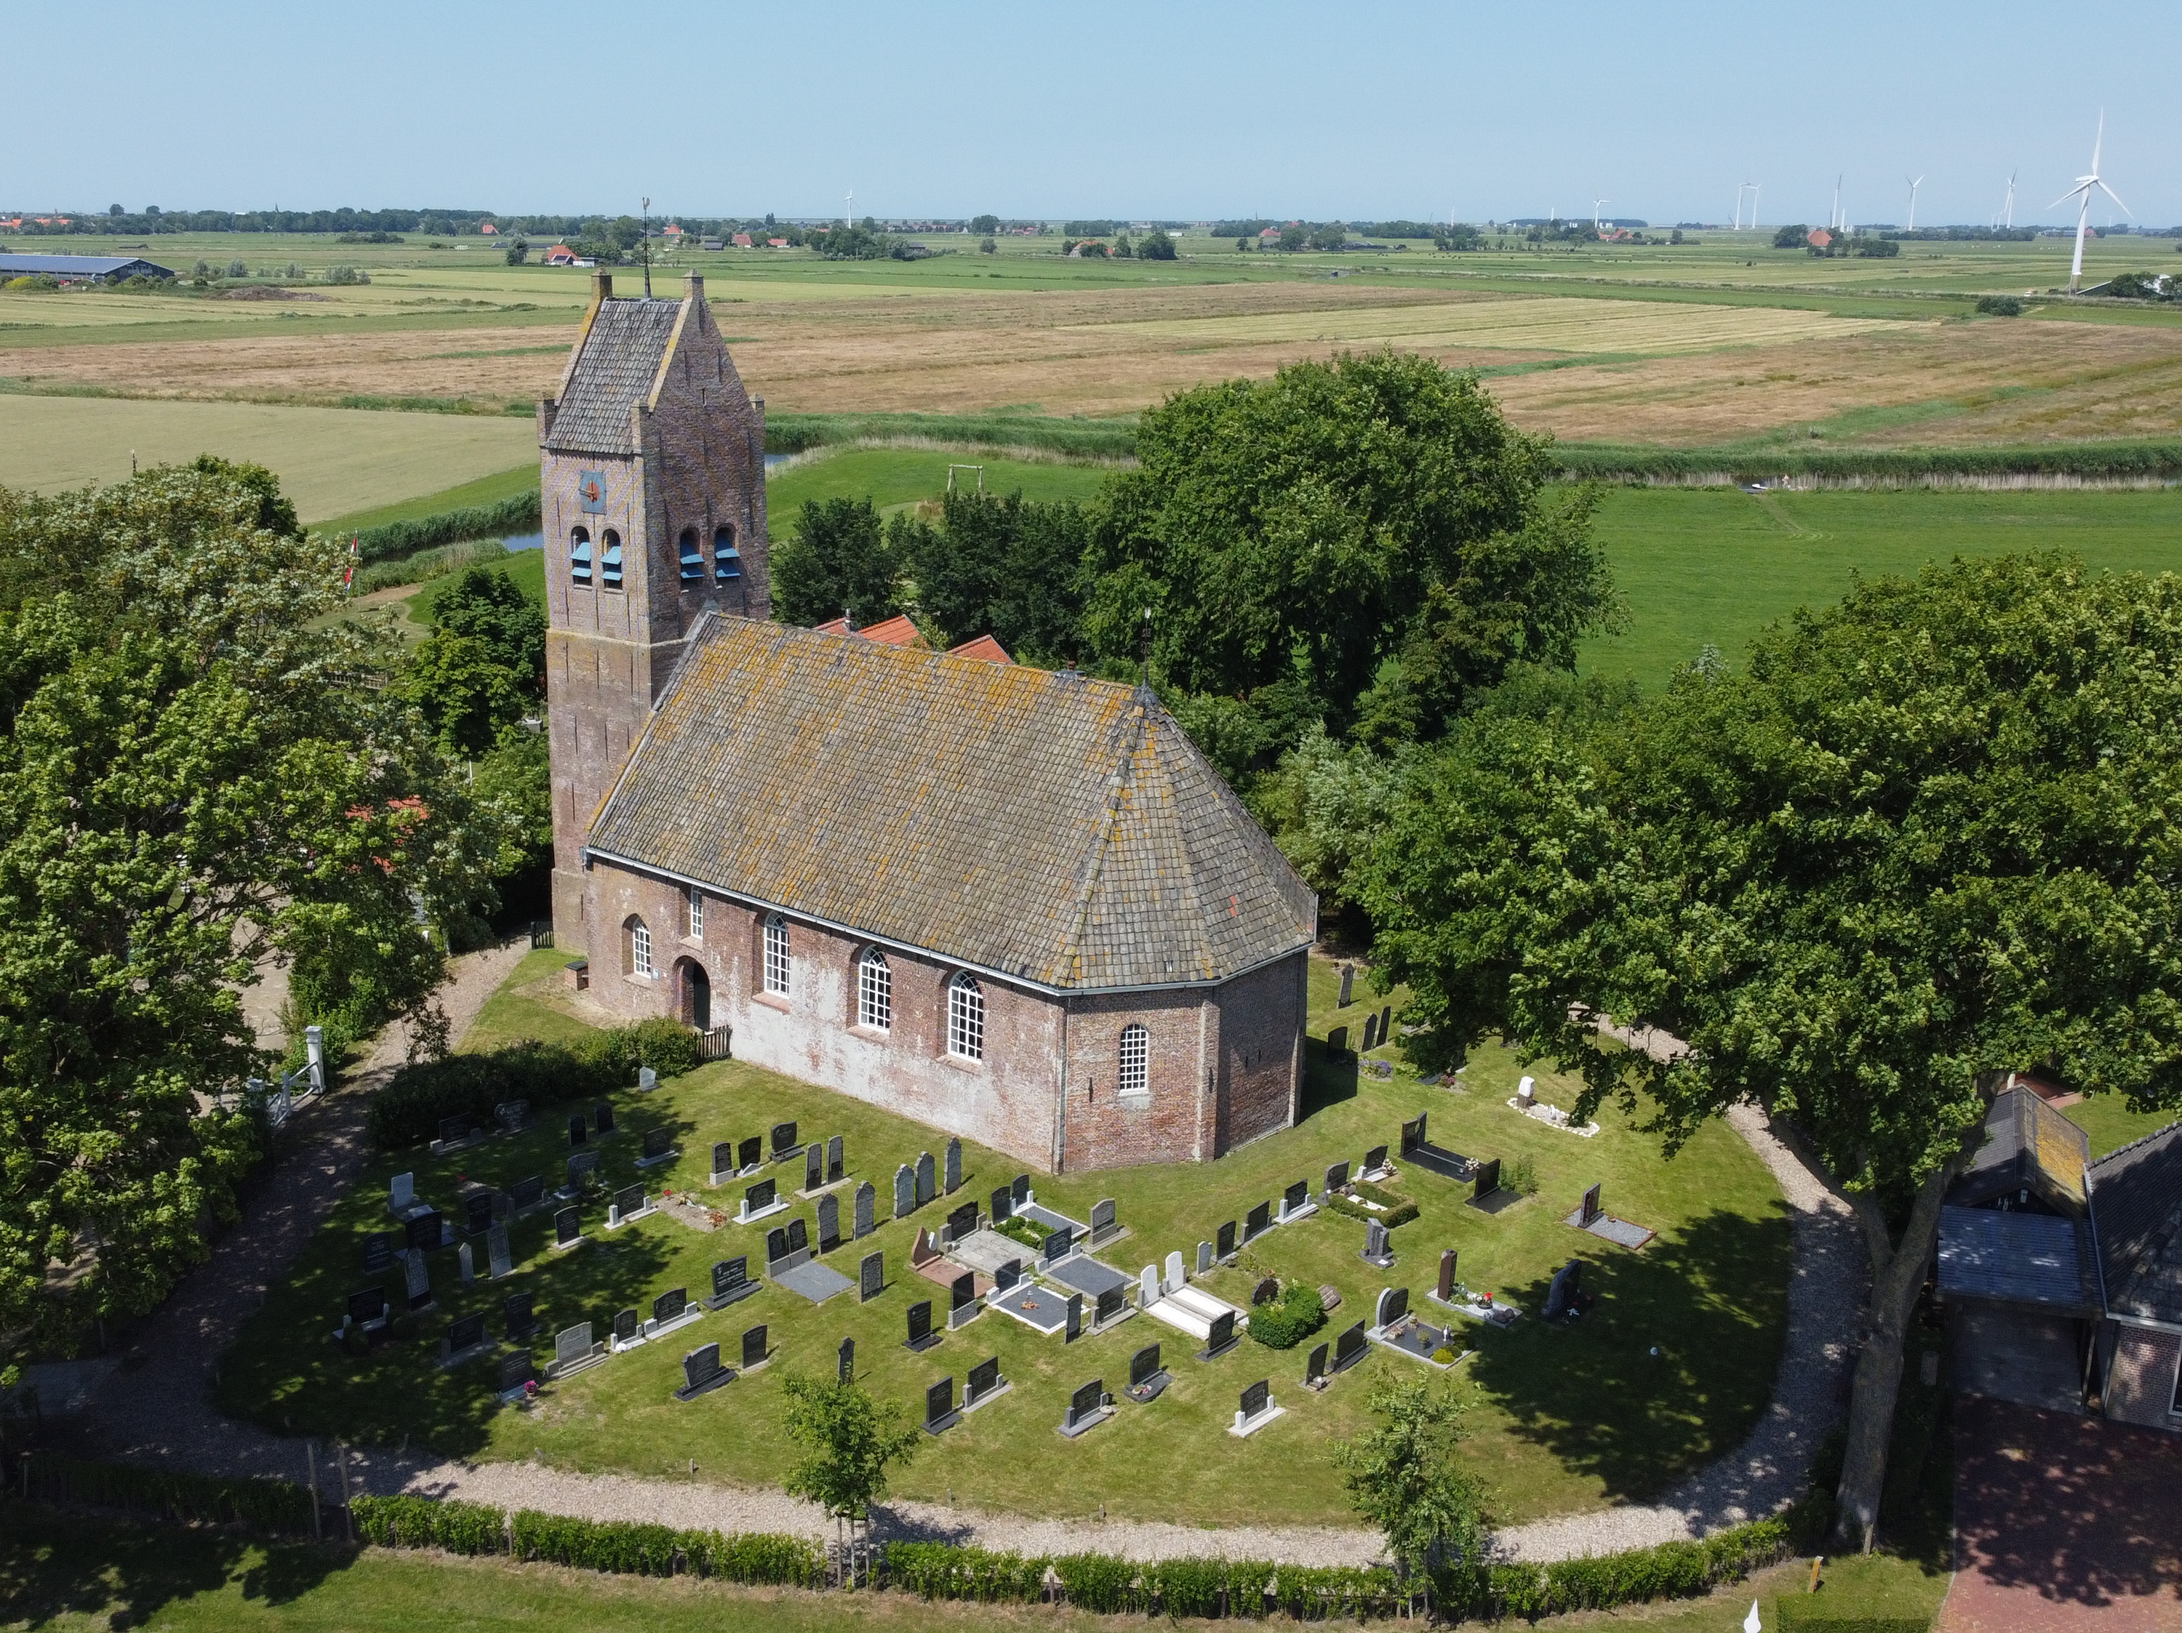
‘CHALLENGING TIMES - III’
CLIMATE CHANGES HAVE IMPACT ON THE SOIL AND THEREFORE ON THE FUTURE MAINTENANCE OF OUR HERITAGE

Slide 20
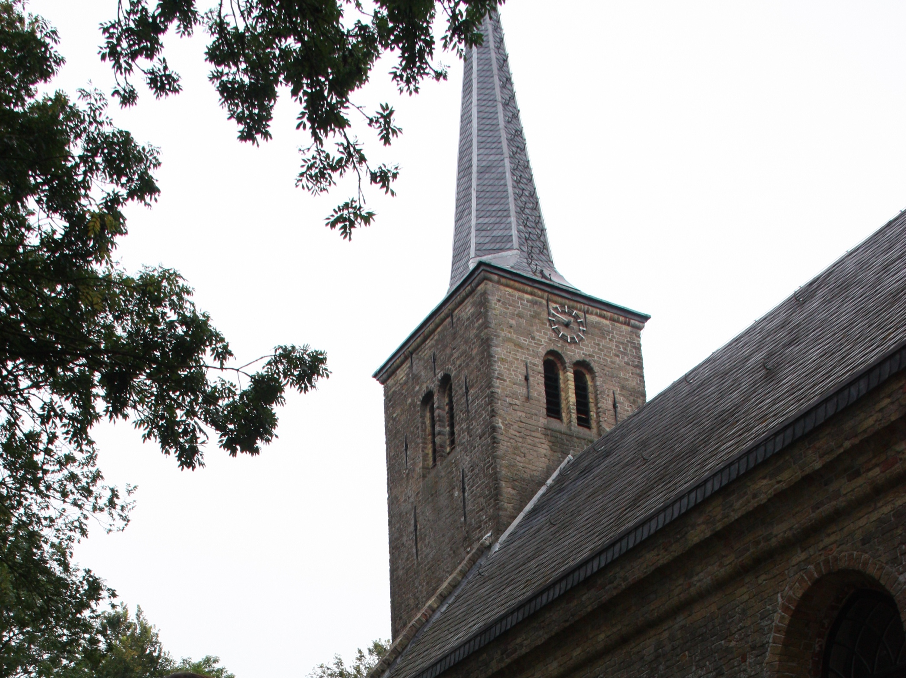
TIGE TANK ELTSENIEN
THANK YOU FOR YOUR ATTENTION
QUESTIONS?
MORE INFO?
HESTER.SIMONS@FRYSKETSJERKEN.NL
www.aldefrysketsjerken.nl

