Slide 1
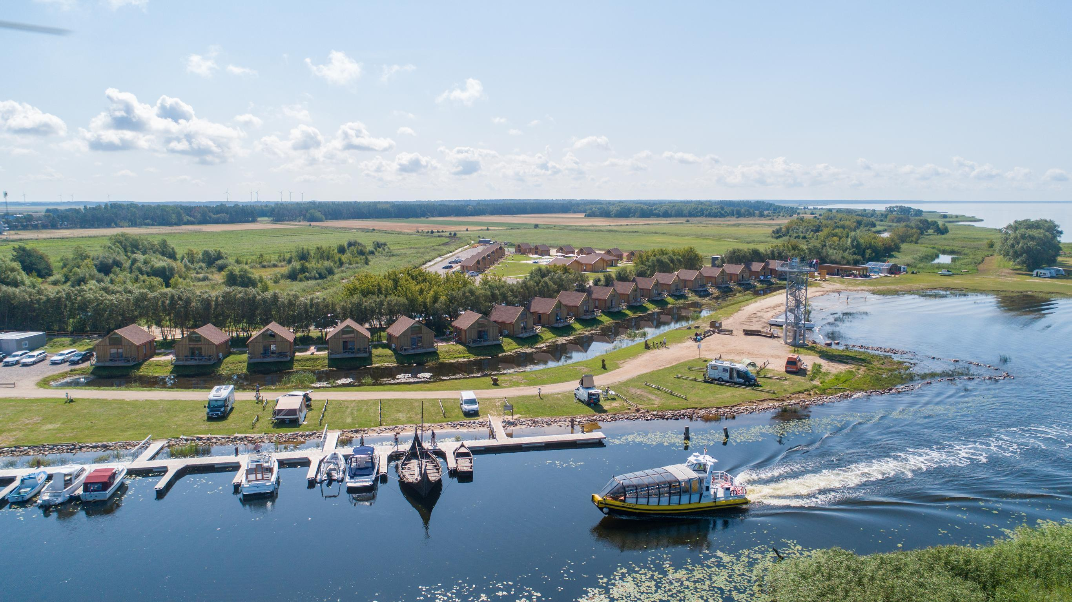
MUNICIPALITY AND BUSINESS COOPERATION IN THE DEVELOPMENT OF DREVERNA SMALL SHIP PORT in LITHUANIA

Slide 2

Whatever the mind of man conceives and believes, his hand can accomplish.
Napoleonas Hilas

Slide 3
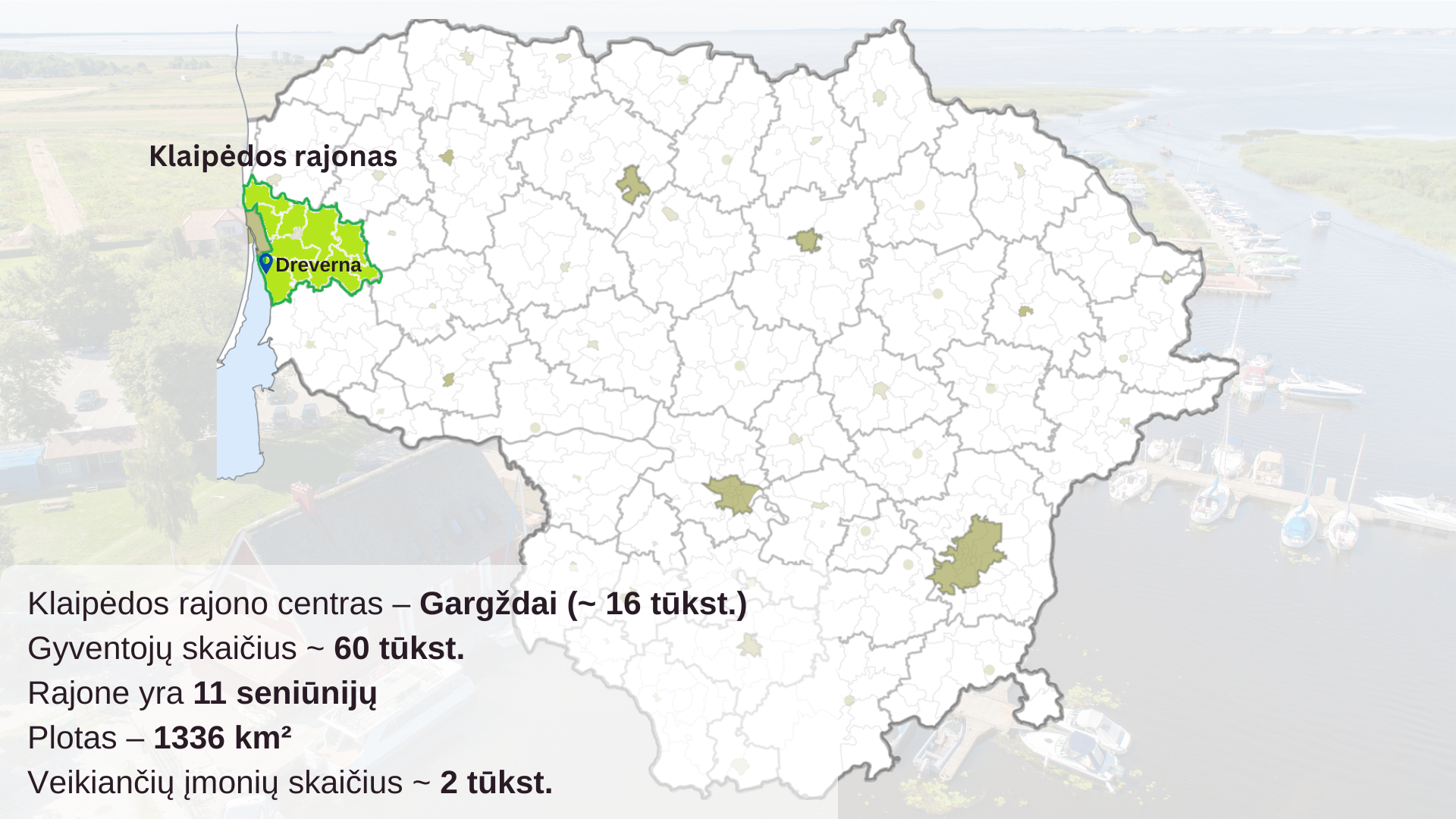
Dreverna ~ 450

Slide 4
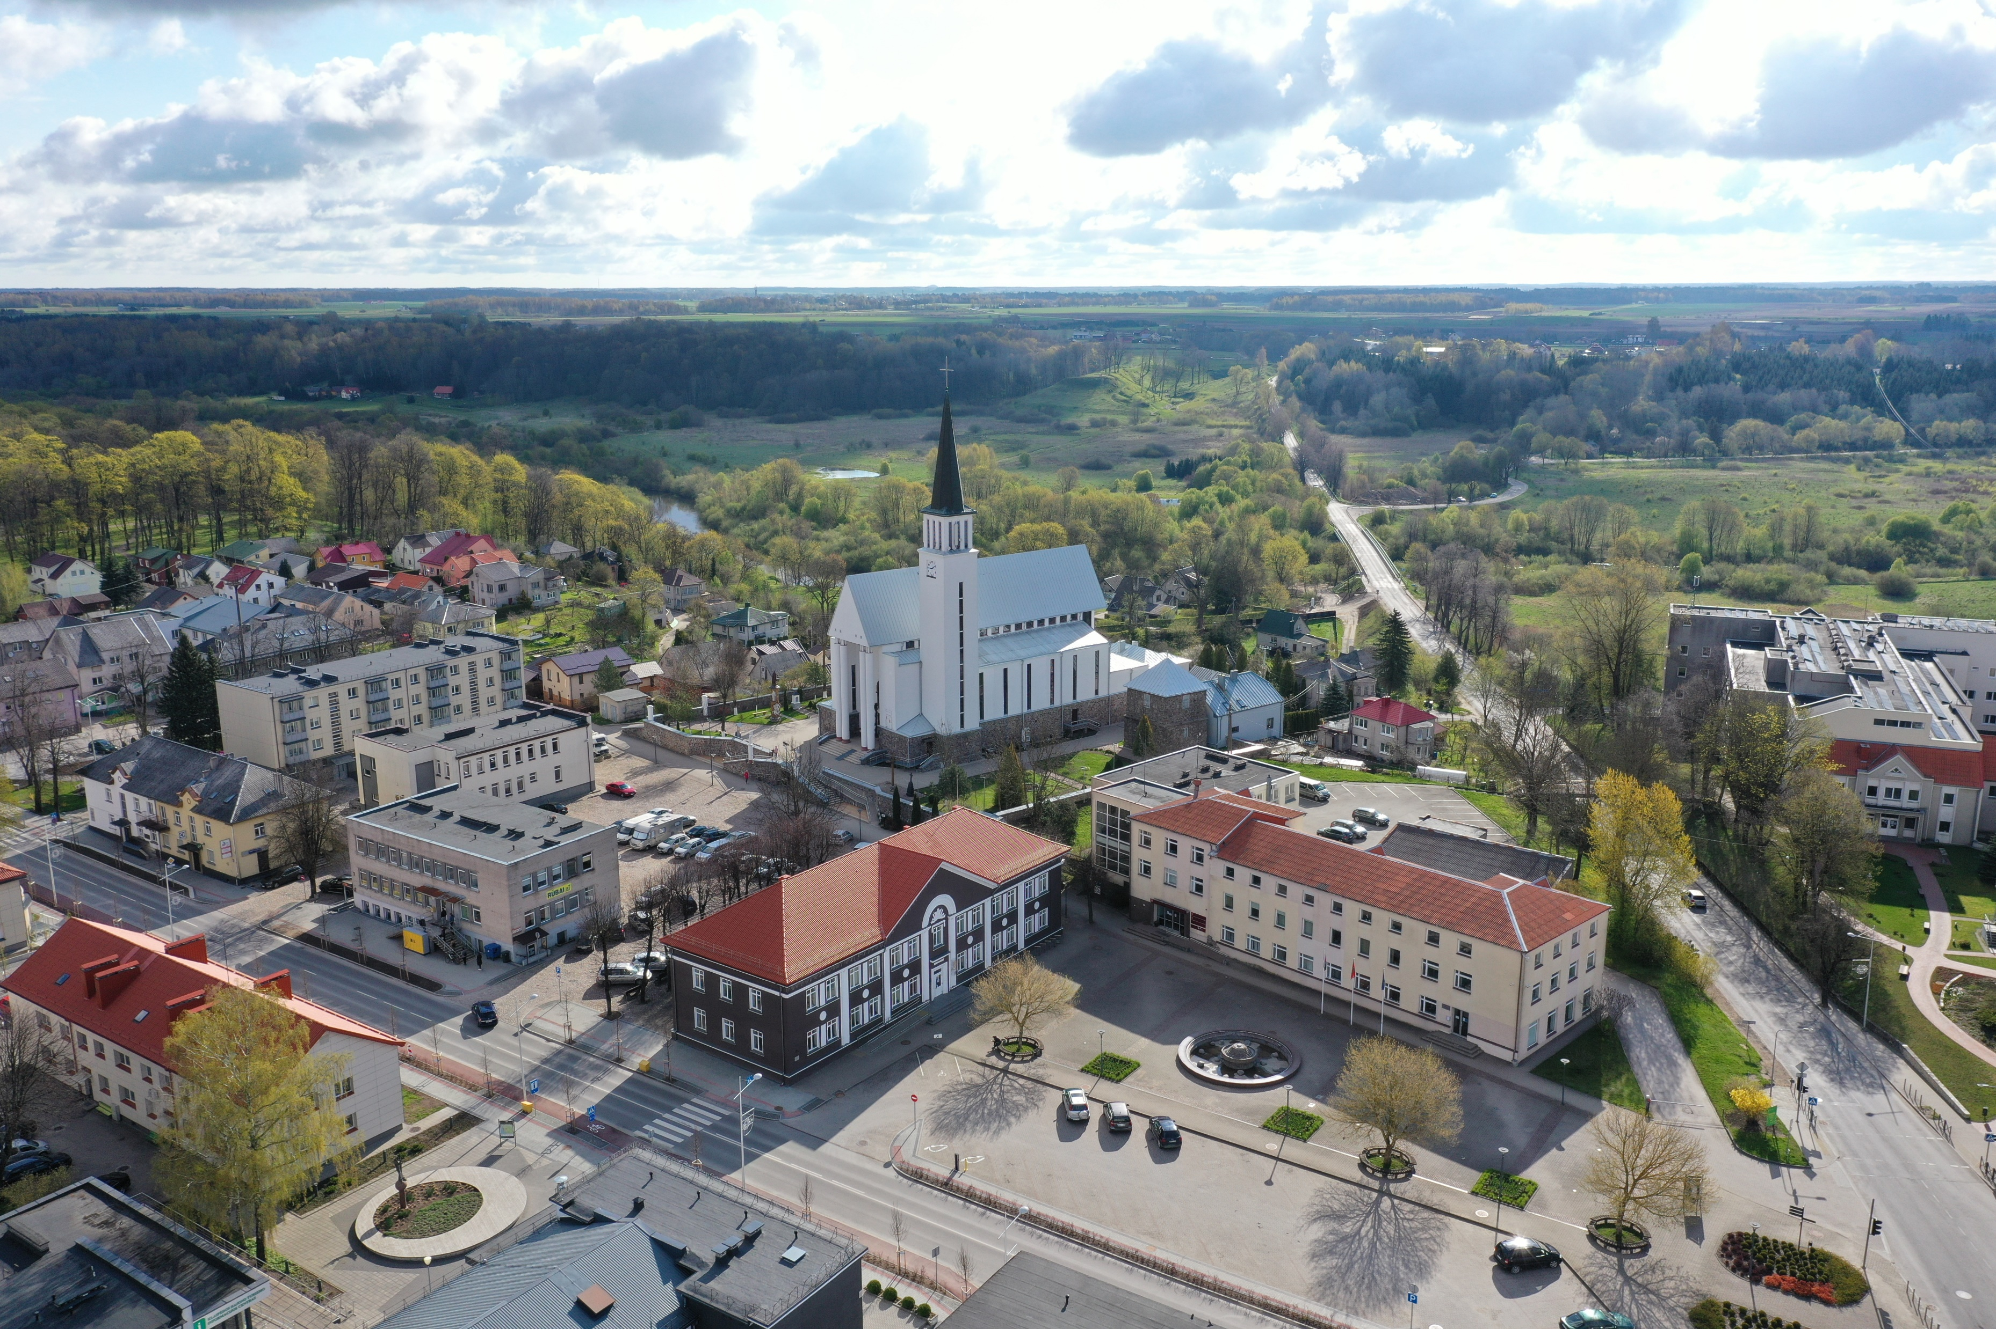
MUNICIPAL INVESTMENTS IN DREVERNA PORT FACILITIES

Slide 5
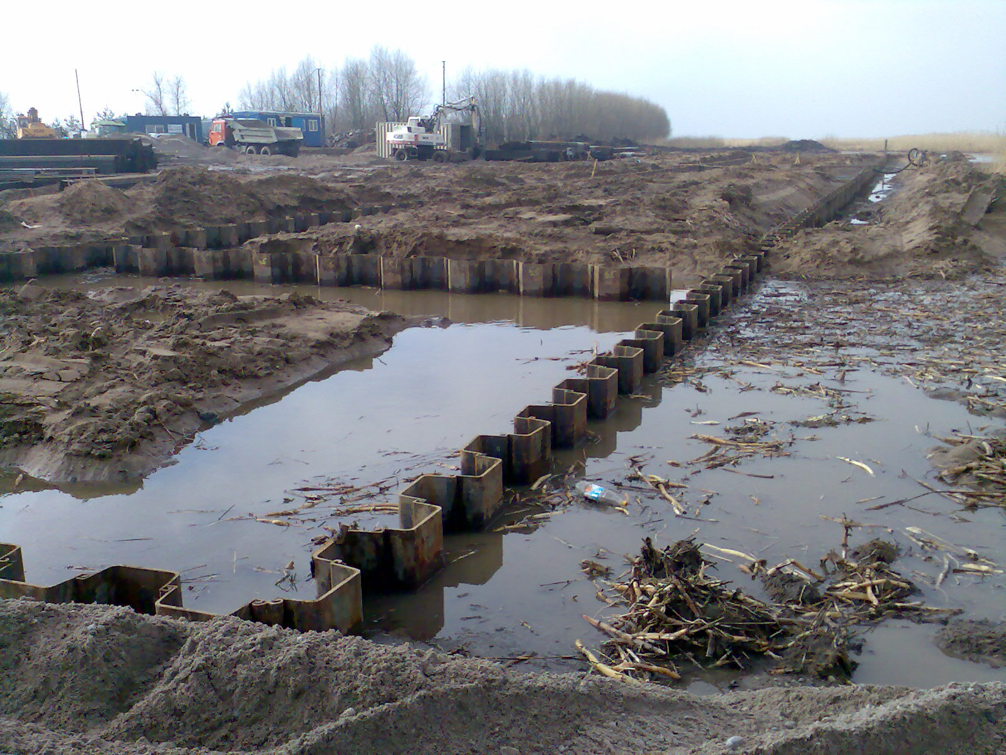
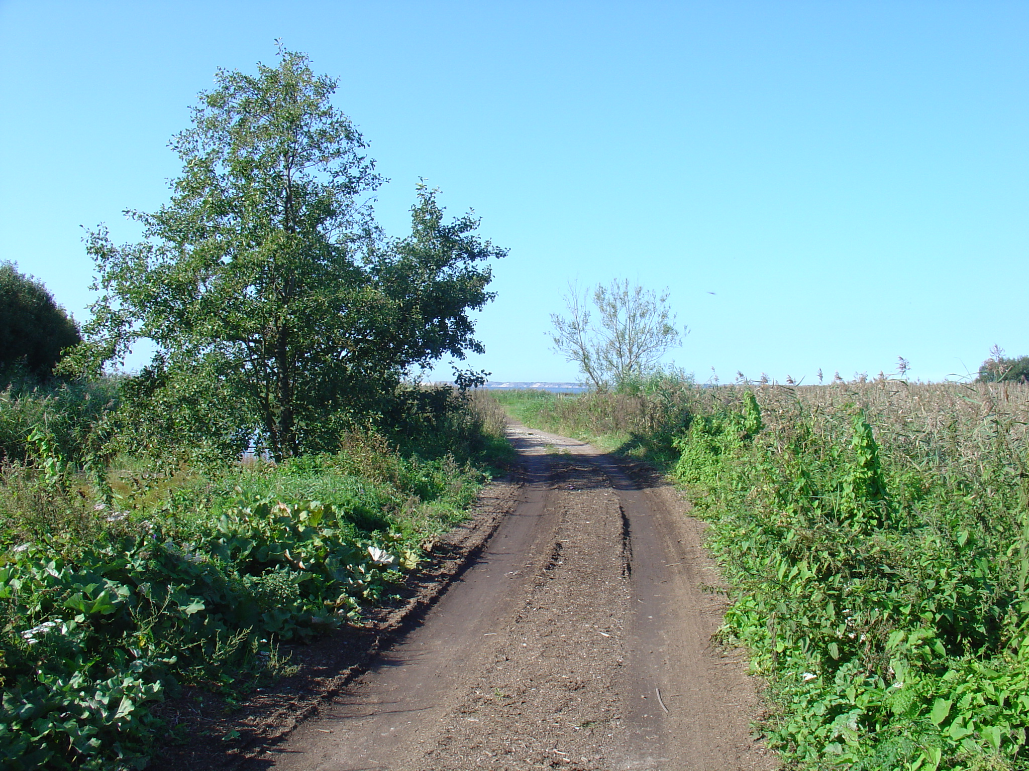
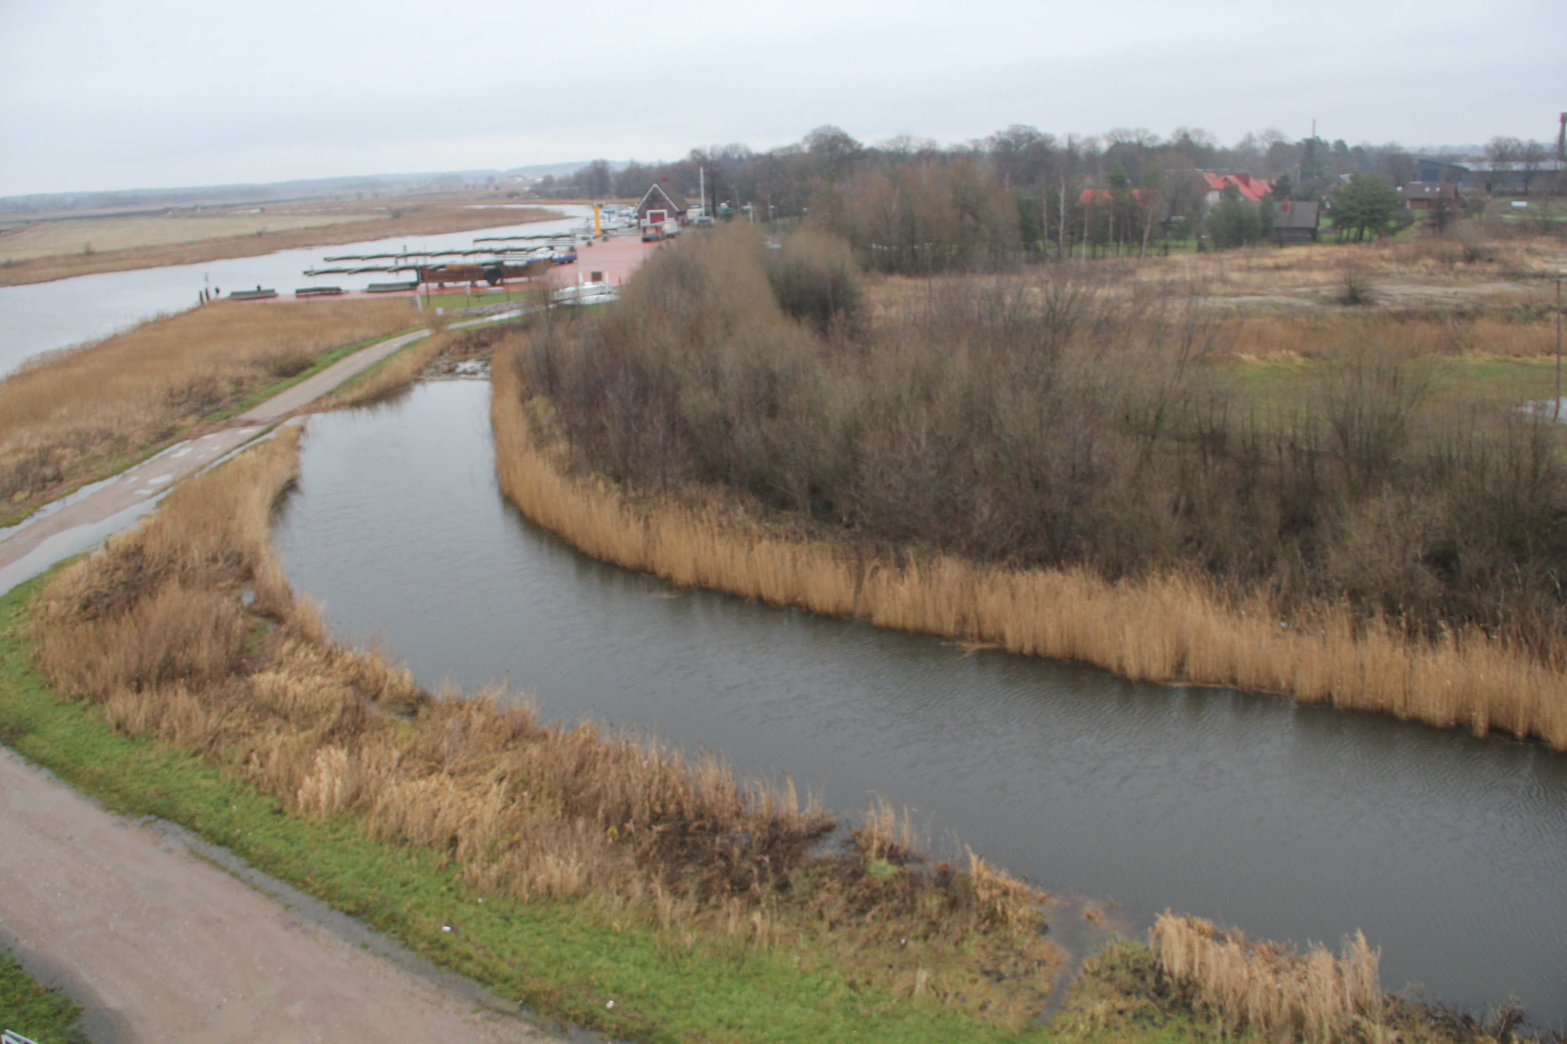
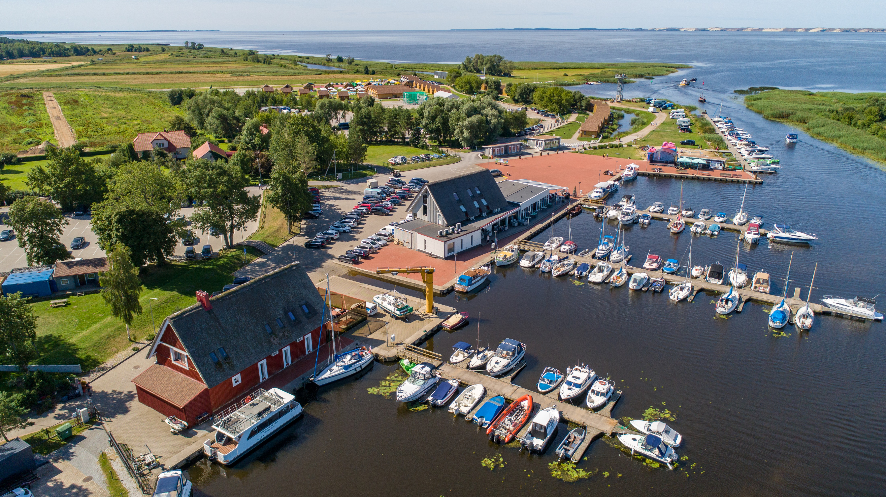
Before municipal investment
After investment
Now

Slide 6
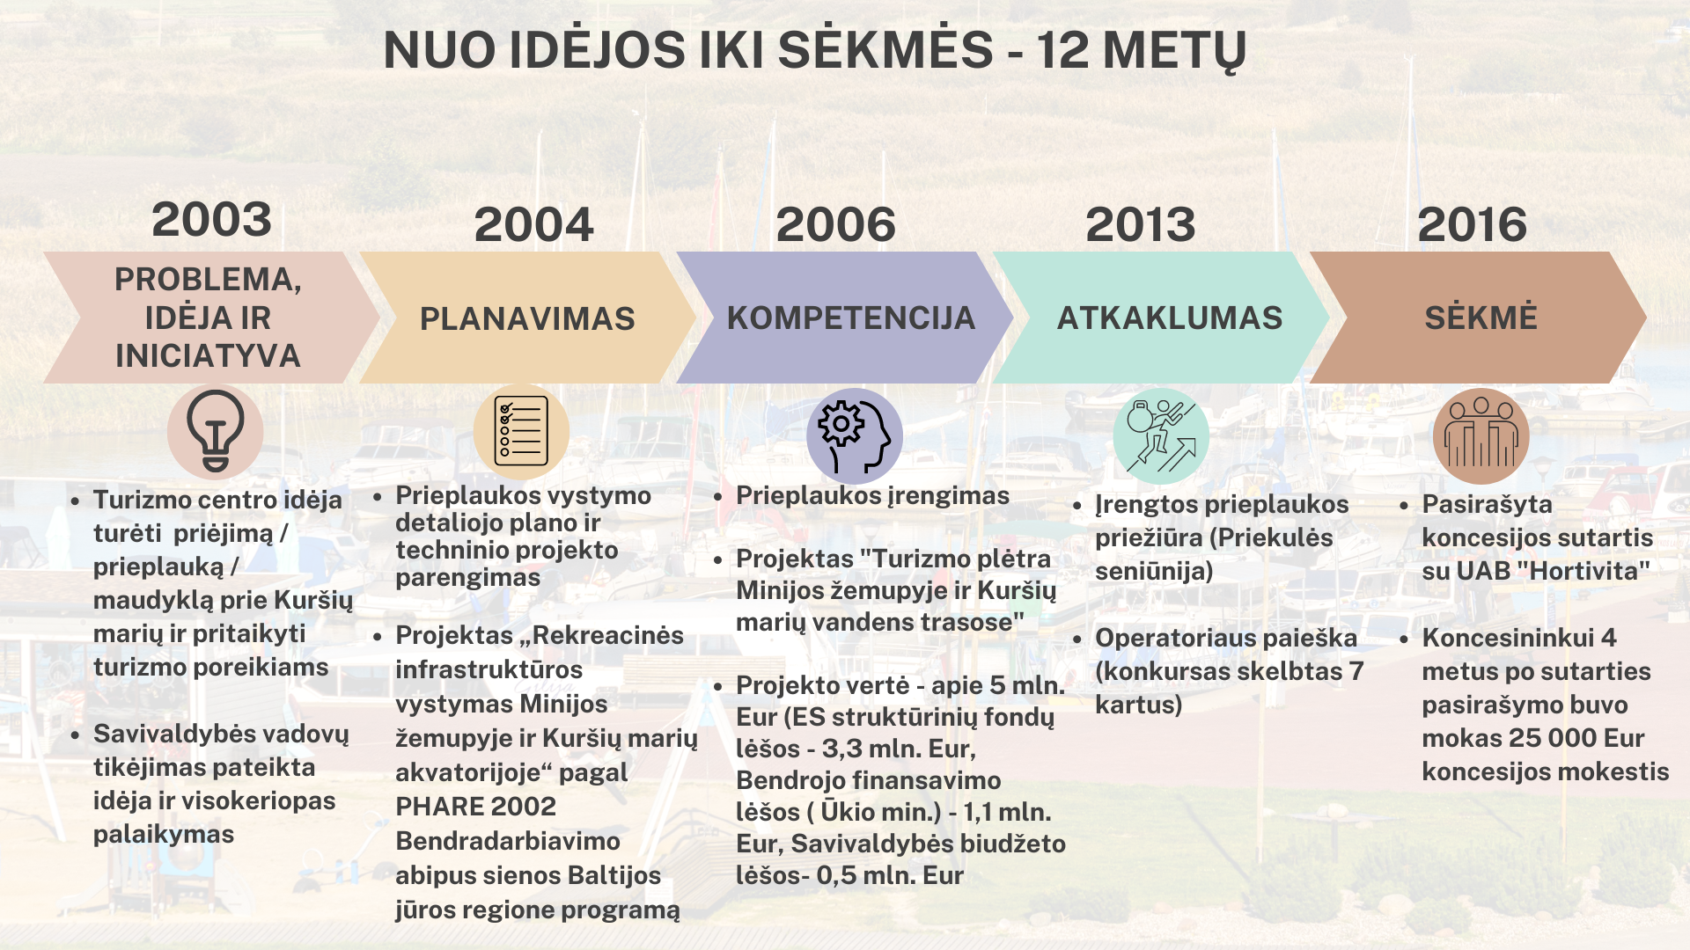

Slide 7
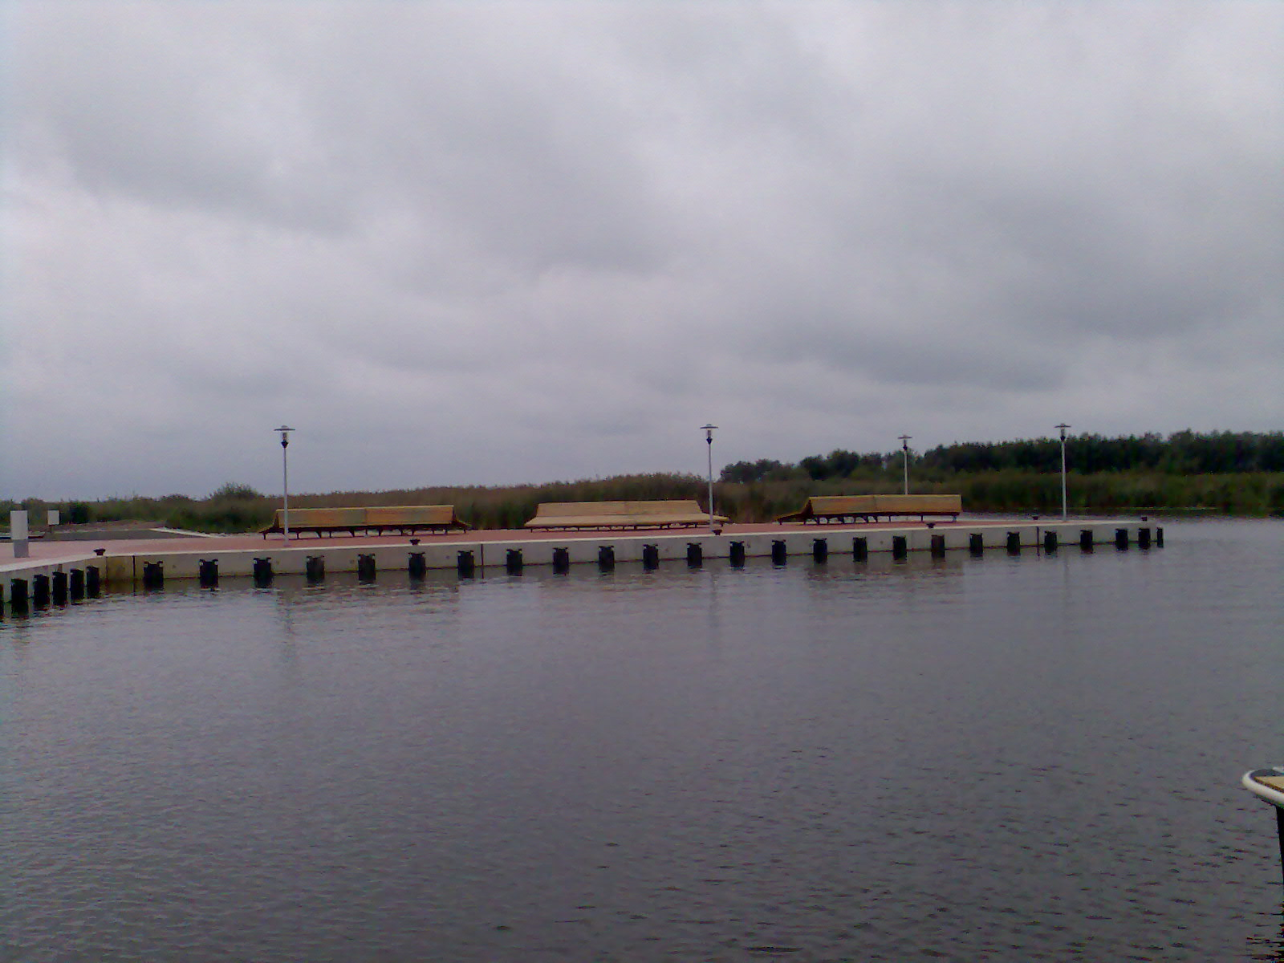
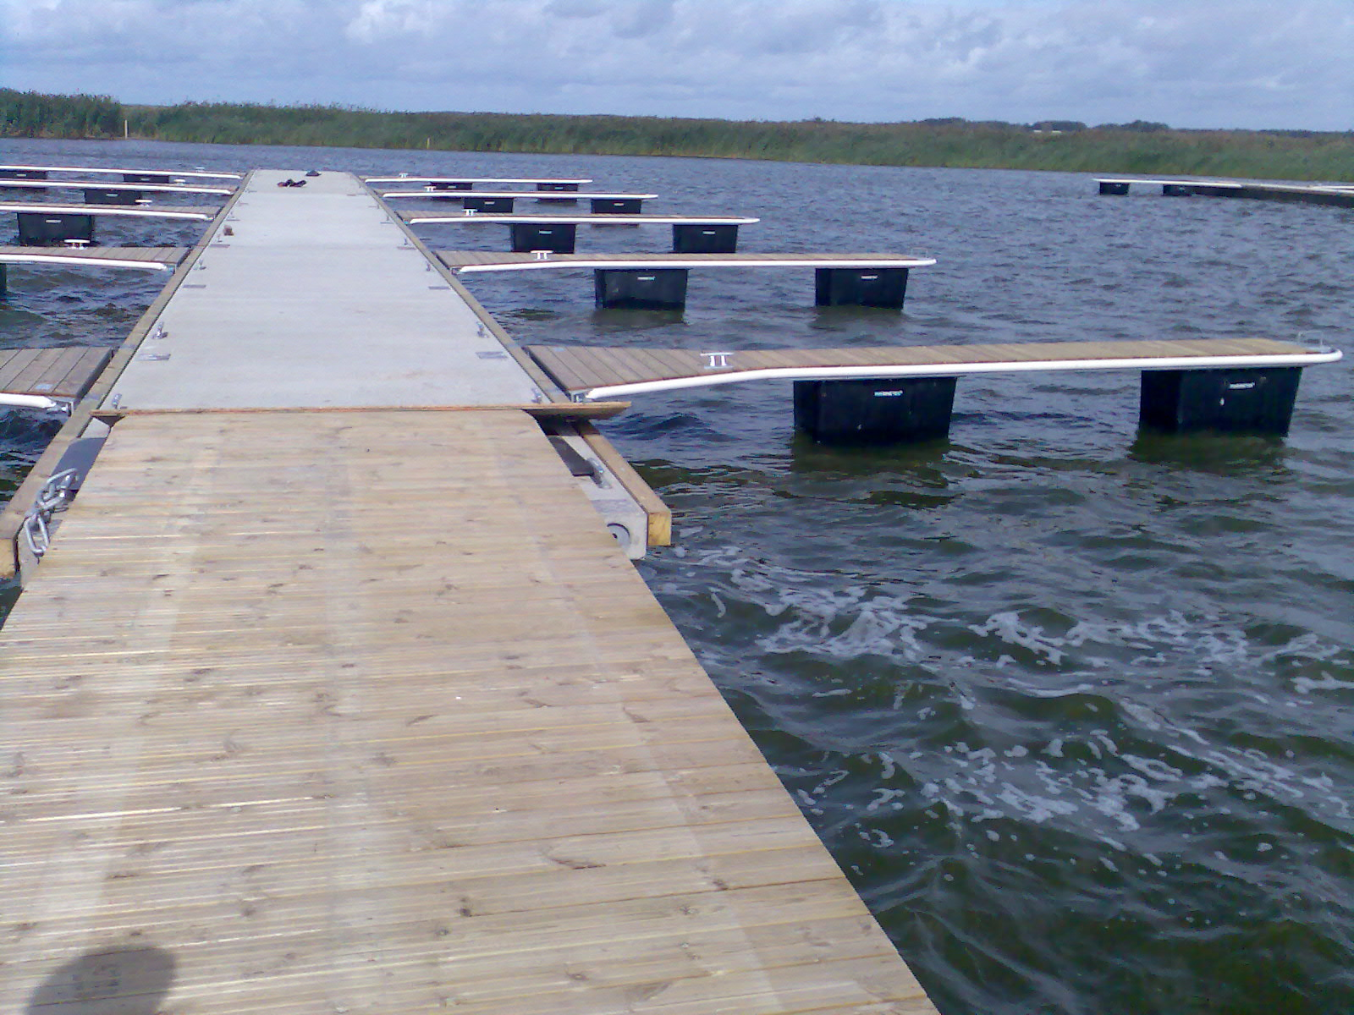
There is a pier with 30 berths (260 m long).

Slide 8
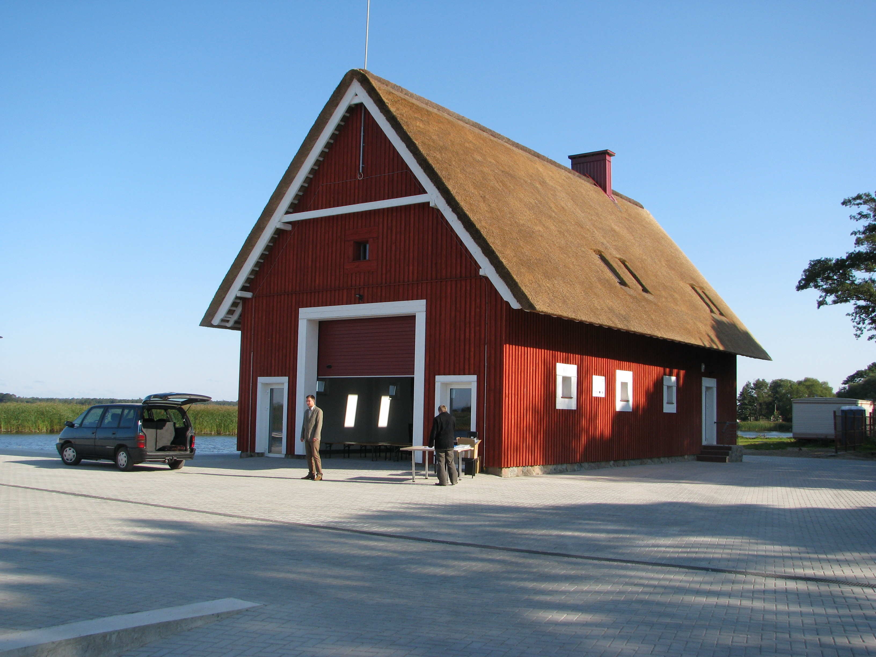
Ship storing buiding (156 kv. m)

Slide 9
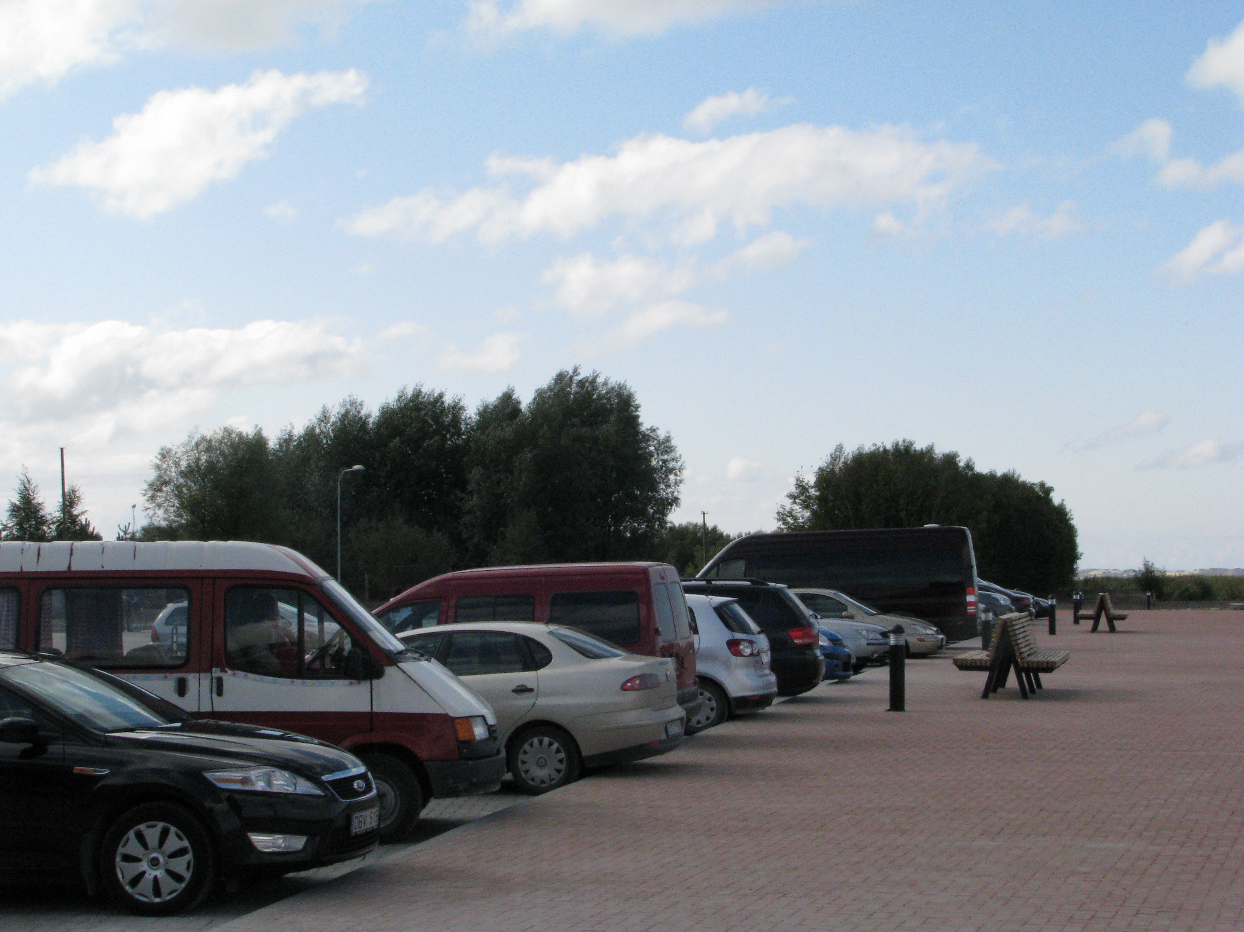
Parking place

Slide 10
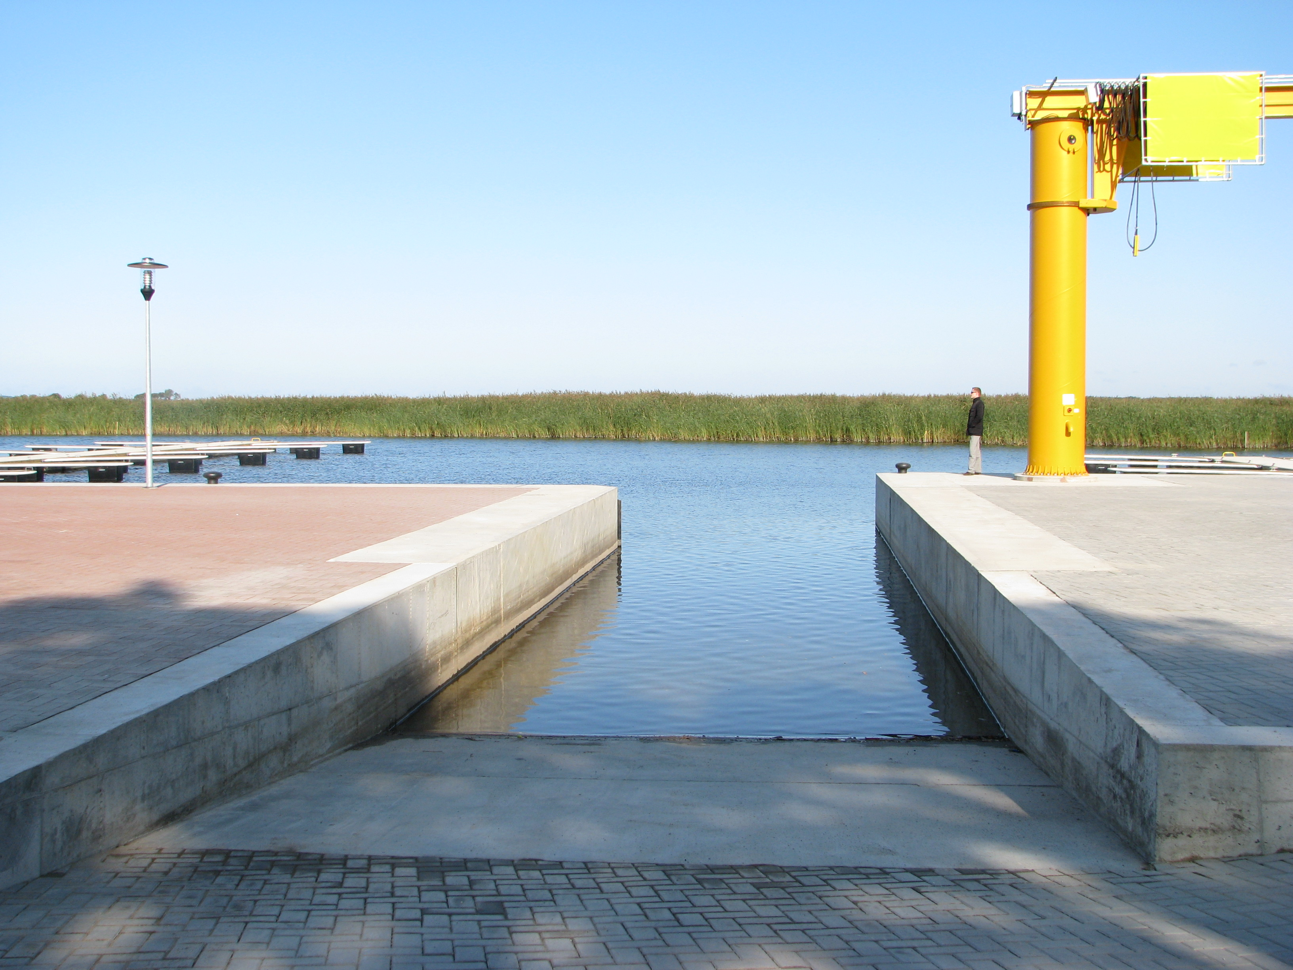
Slip

Slide 11
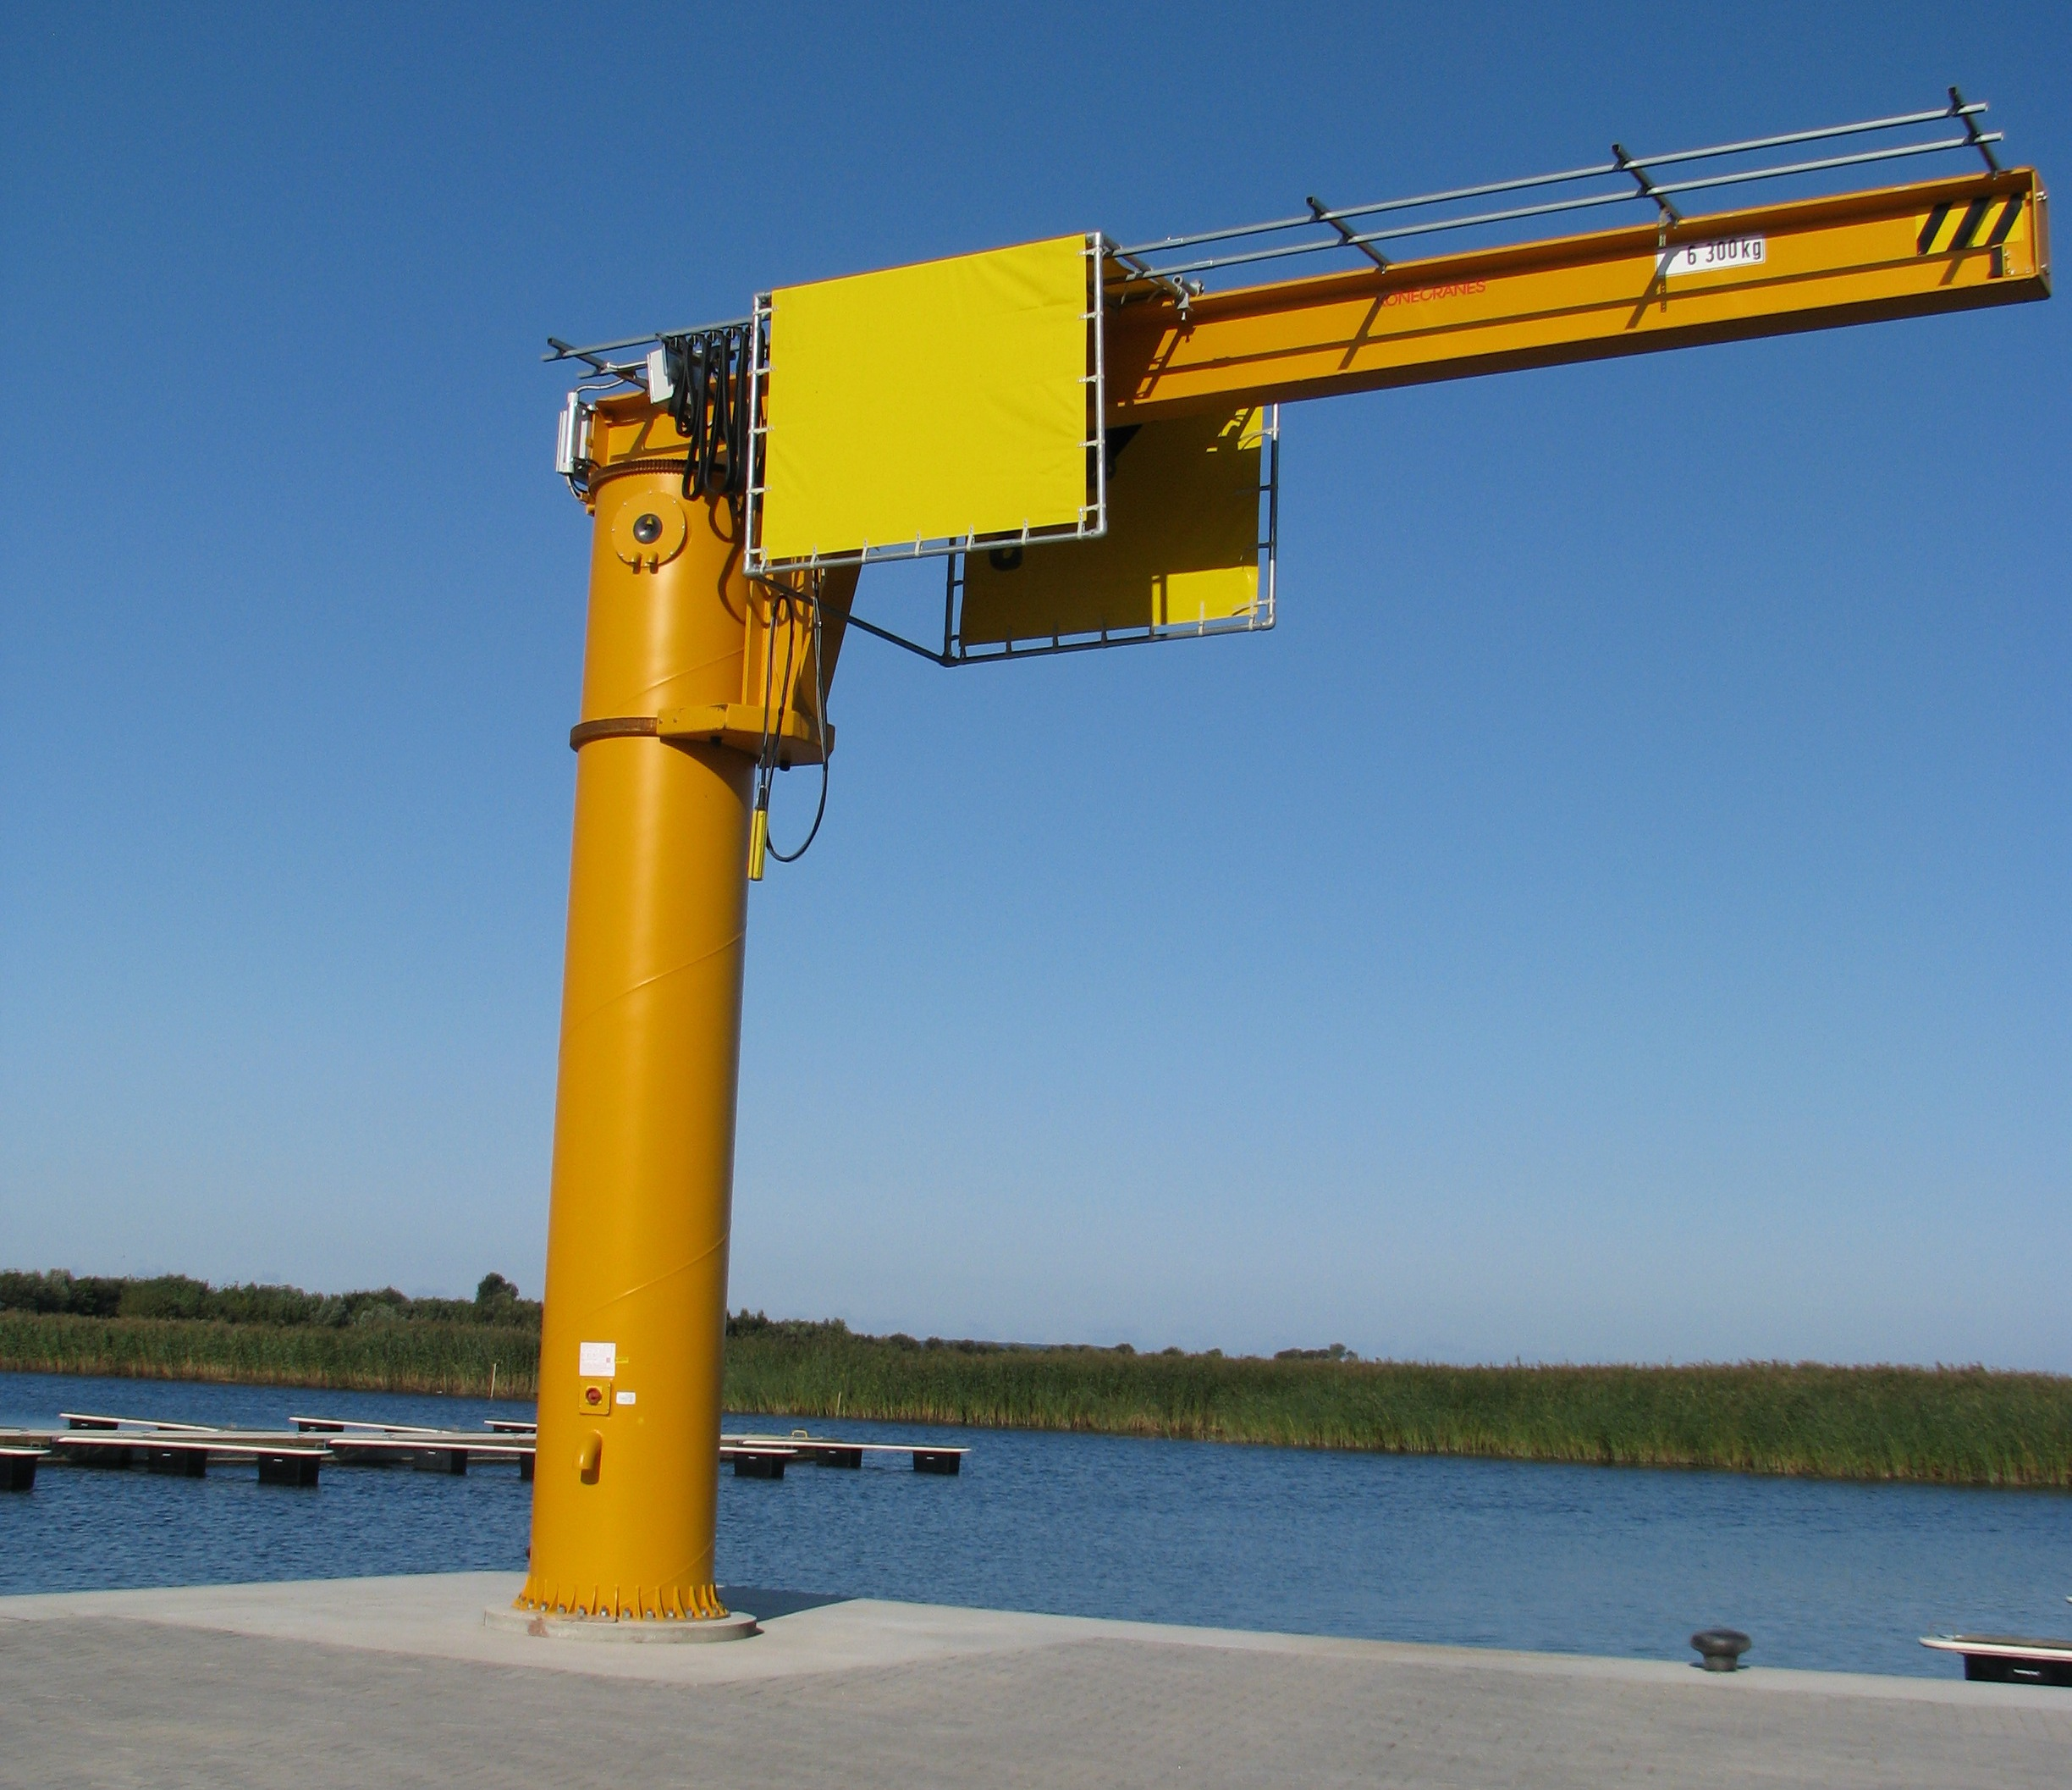
A crane with a lifting capacity of 6 t is equipped to bring larger-sized swimming equipment to the shore

Slide 12
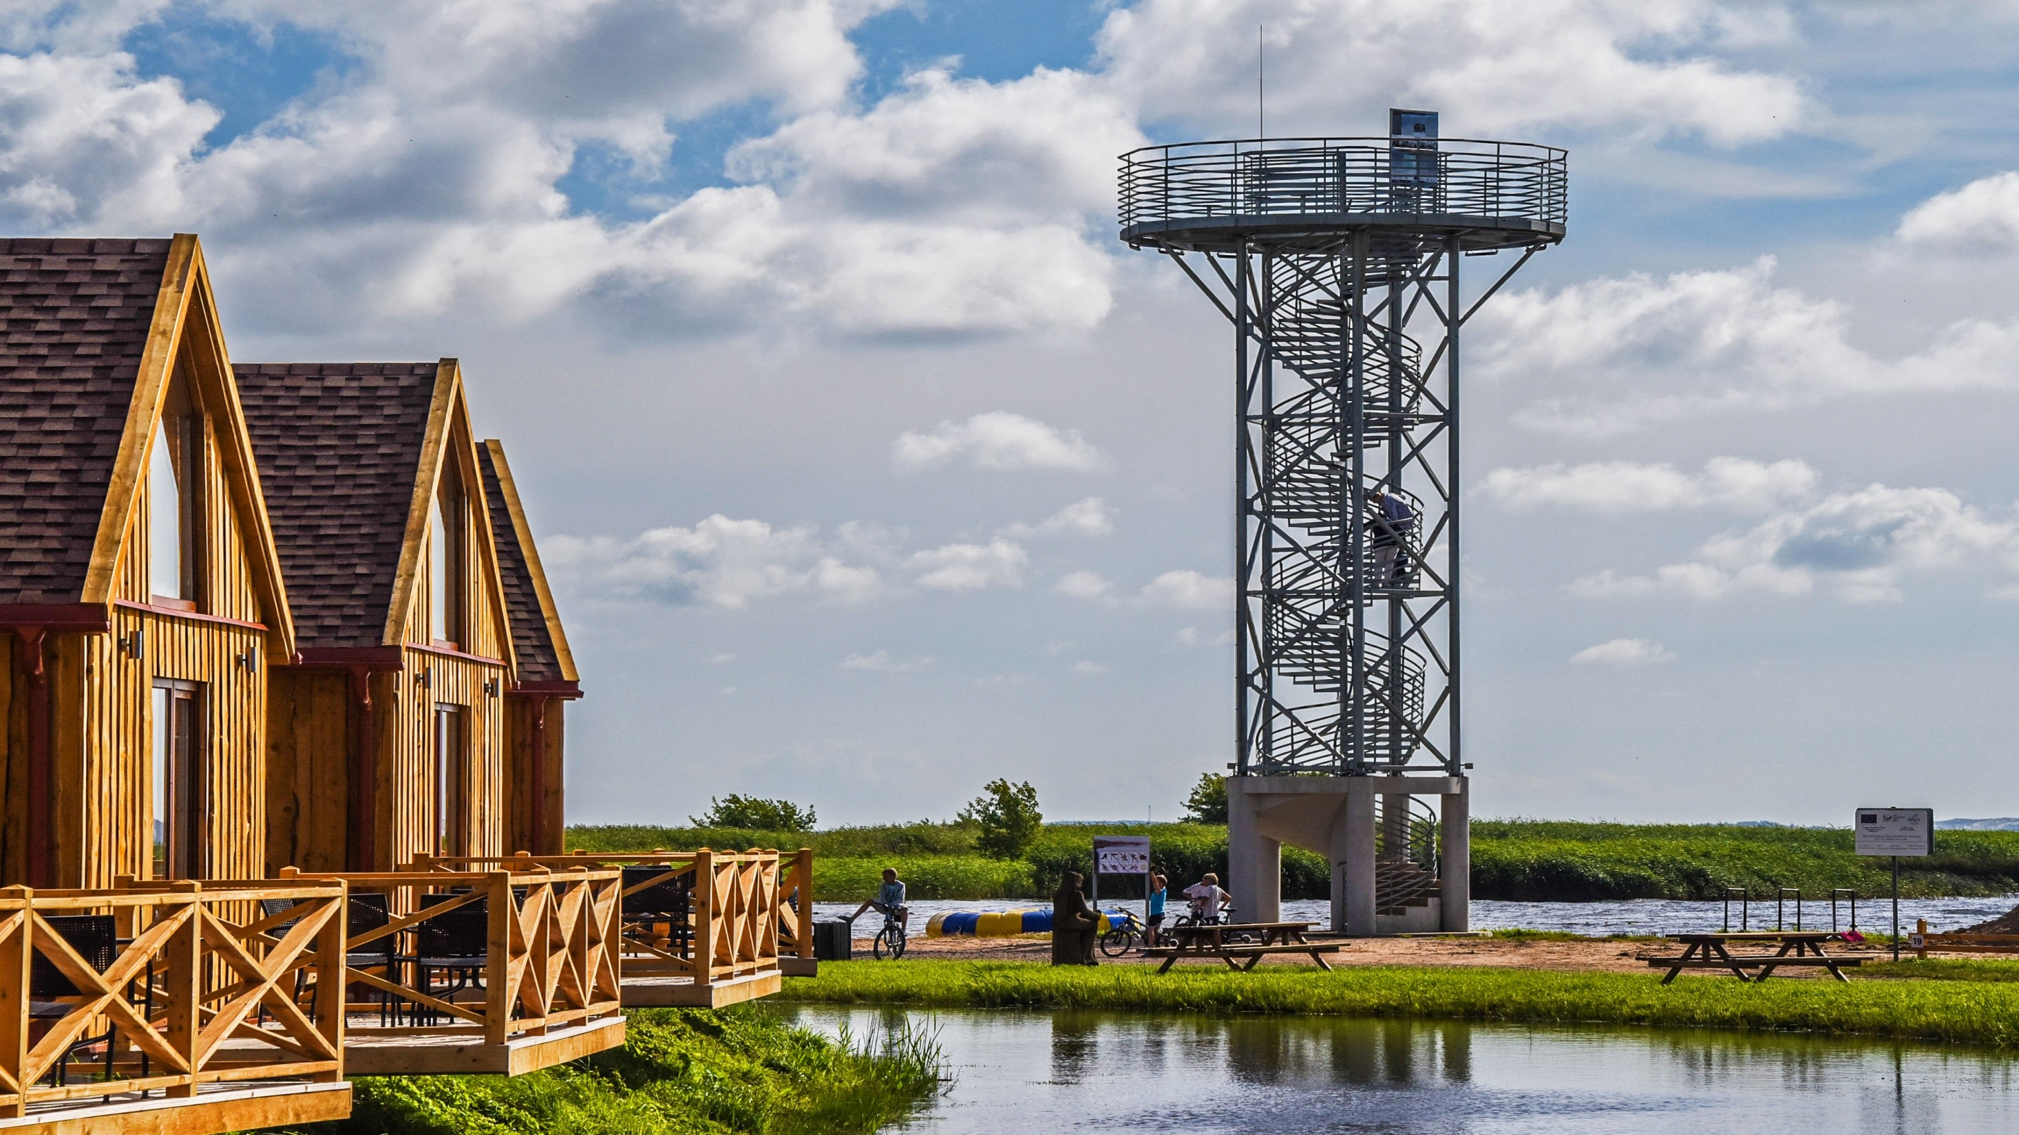
15 m observation tower was built

Slide 13
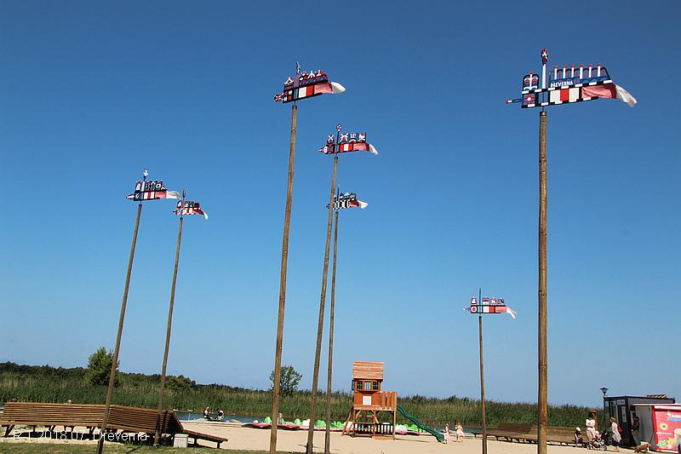
7 vėtrungės

Slide 14
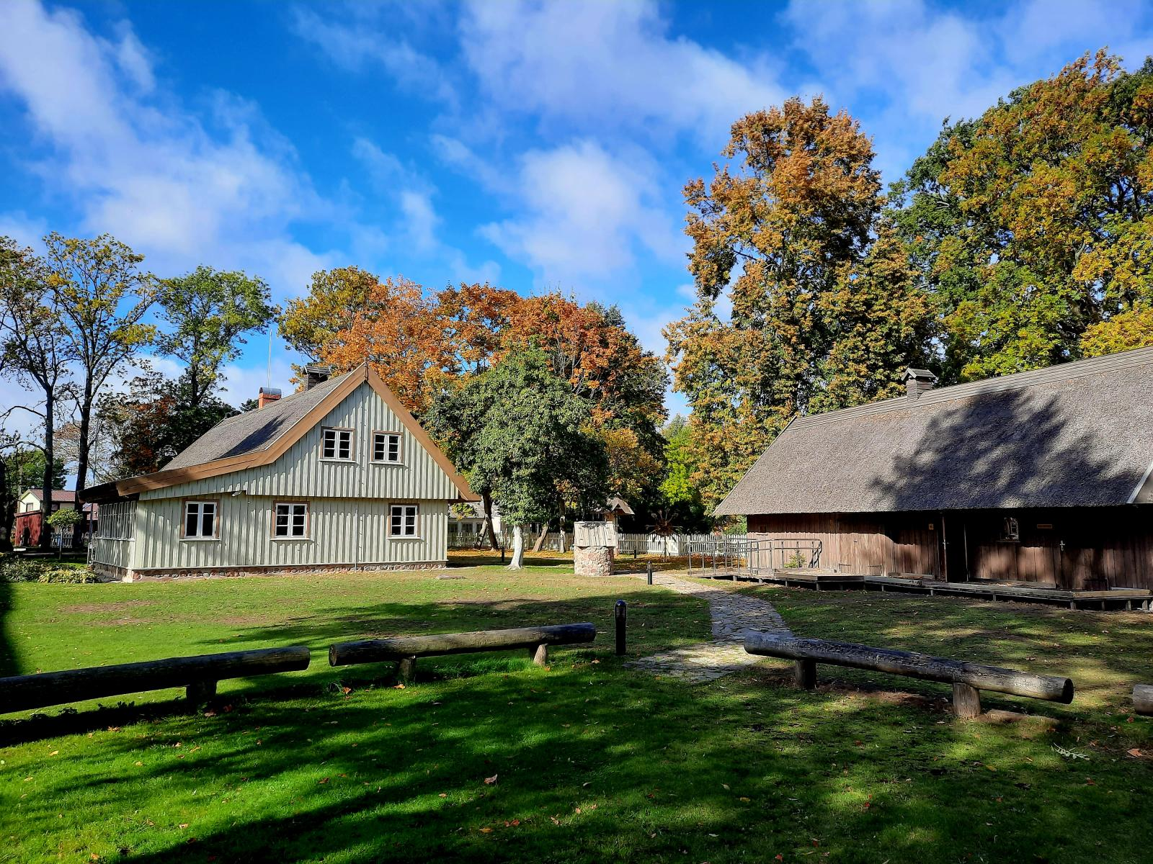
The ethnographic homestead of the shipbuilder J. Gižas has been repaired (now as Tourism information center)

Slide 15
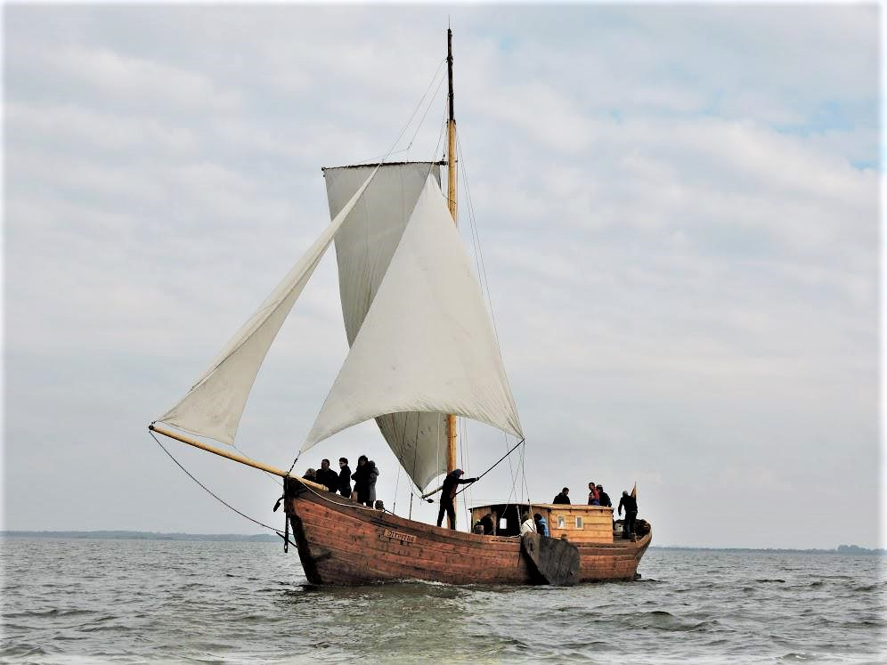
An ancient sailing ship of the Curonian Lagoon was built - the cruise ship "Dreverna" is intended for the educational program "FISH ROAD".

Slide 16
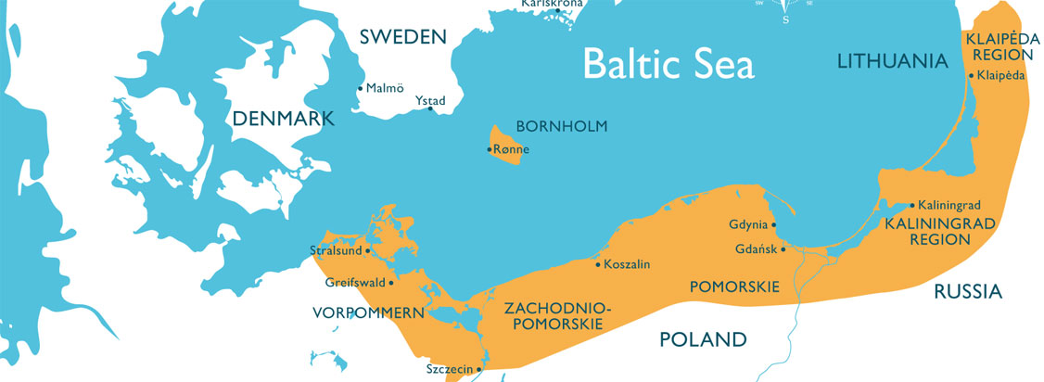

Engagement in International projects
A marketing initiative funded by the European Union, which aims to promote sailing in the southern part of the Baltic Sea, popularize tourism and ports, thereby promoting inbound tourism to the port of Dreverna.

Slide 17
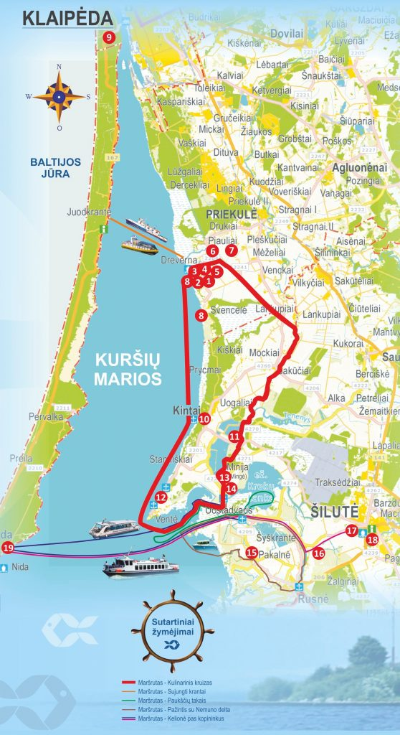
in 2015 Lagoon tourism cluster was established
Pomeranian Tourism Cluster is an association established by the Klaipėda District Tourism Information Center, which unites 19 companies, institutions and individuals providing tourism services in Klaipėda and Šilutė districts, Klaipėda and Neringa.

Slide 18
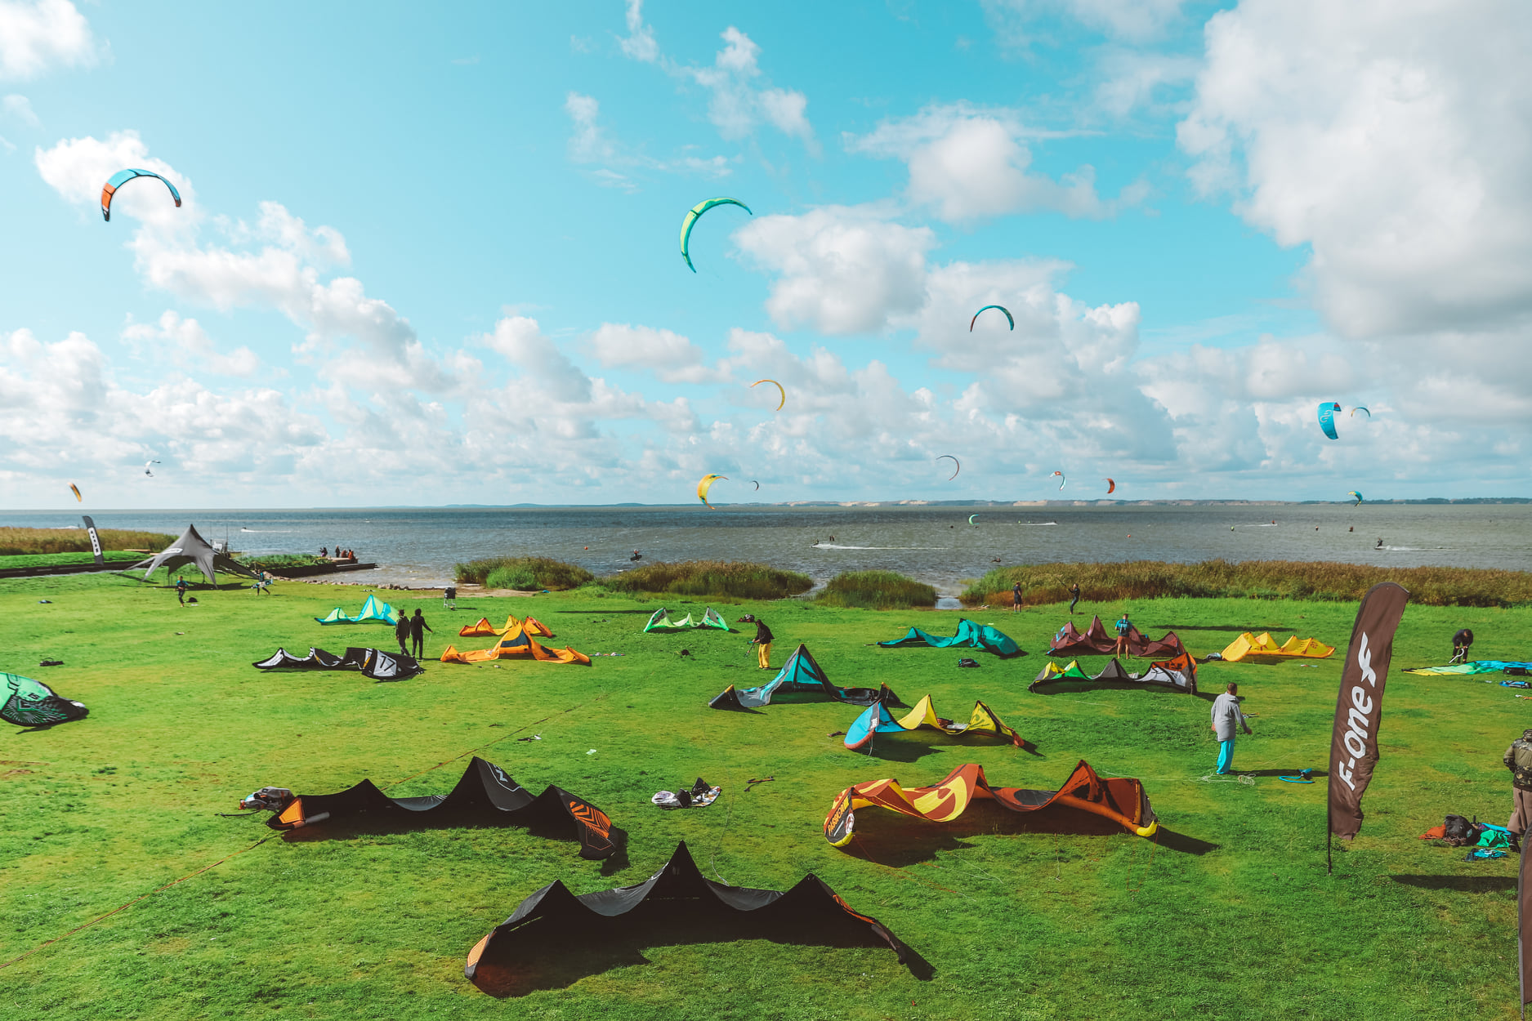
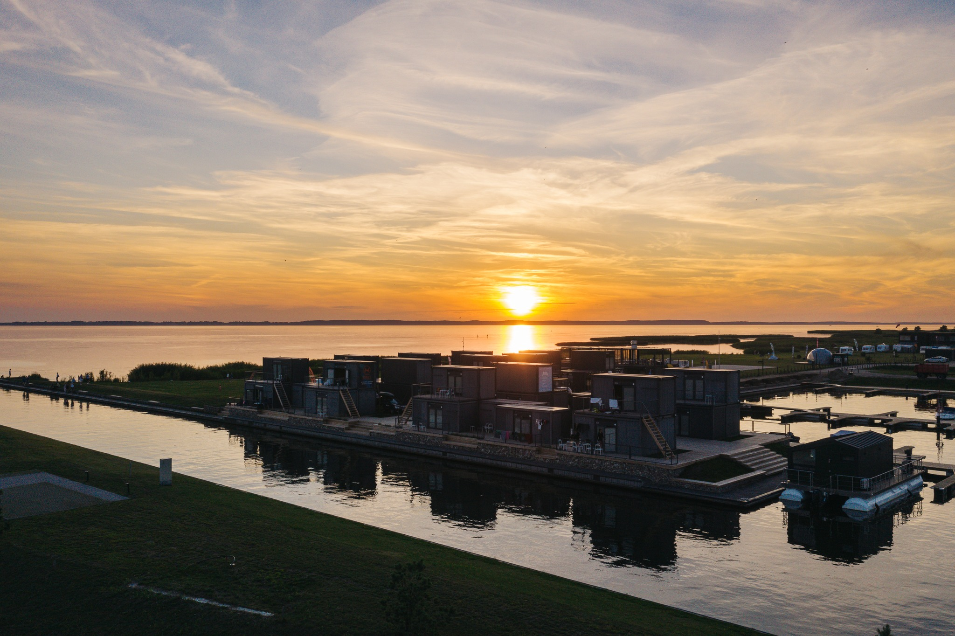
Svencele is the new center of kitesurfing and sailing

Slide 19
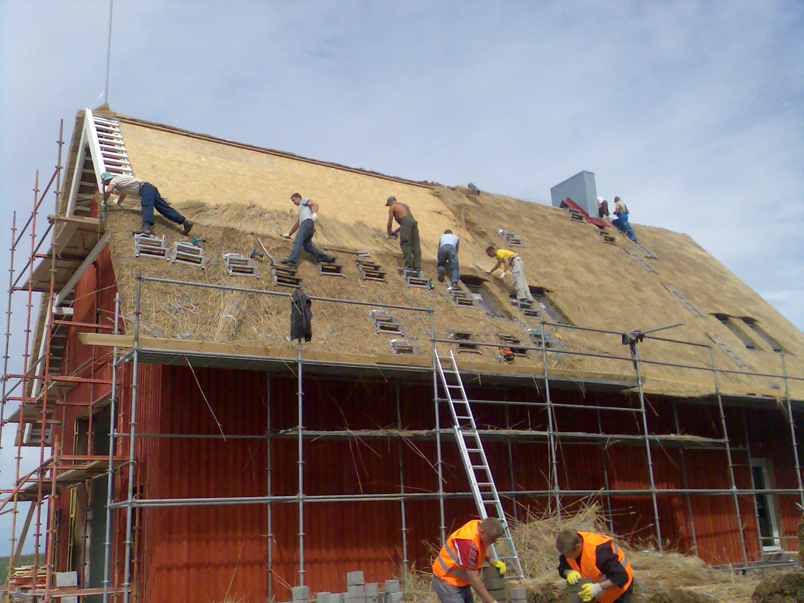

Slide 20
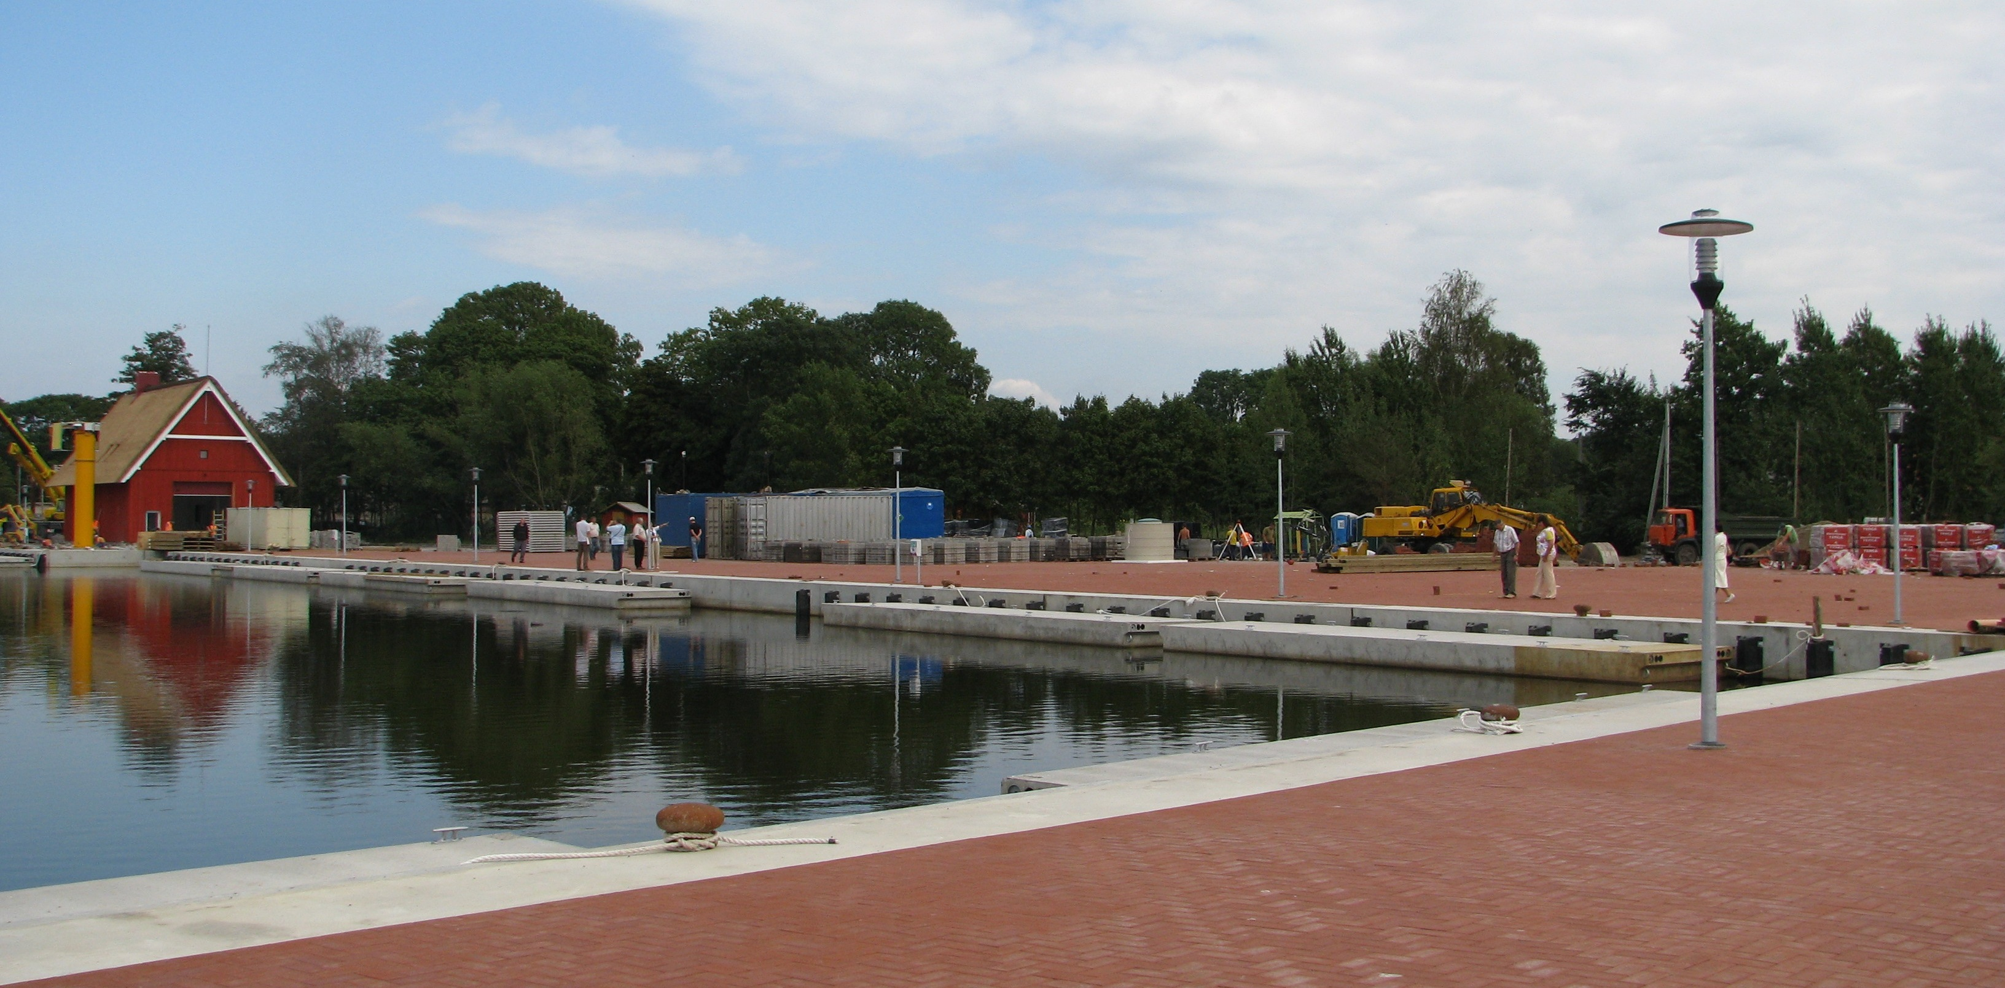

Slide 21
BUSINESS INVESTMENTS IN DREVERNA PORT DEVELOPMENT

Slide 22

On 05 09 2016, a 20-year Concession Agreement was signed with Hortivita UAB

Slide 23
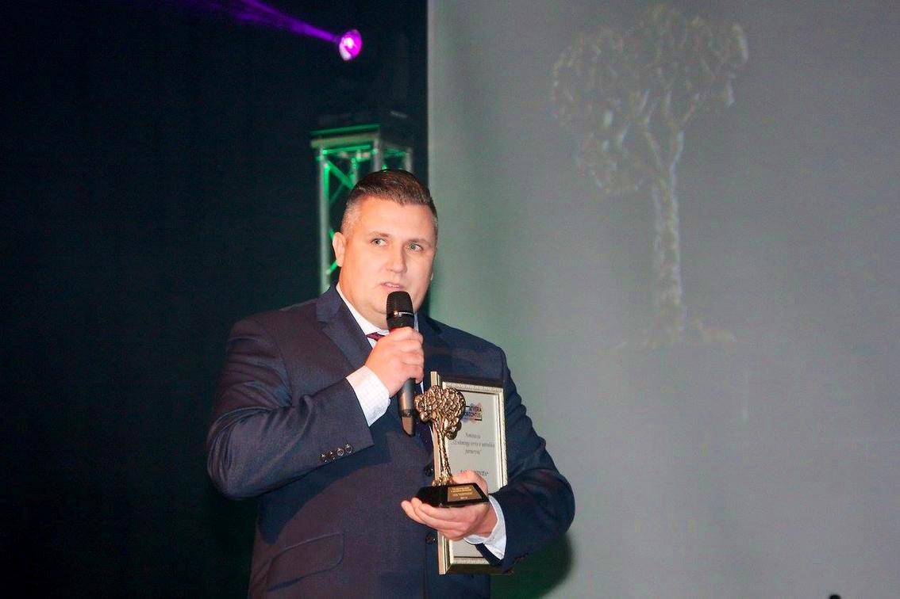

UAB „HORTIVITA“
Established in Gargždai in 2008, it is one of the most promising Lithuanian construction companies, operating not only in Lithuania, but also in Scandinavian countries.
MARTYNAS KLEVINIS
Founder and CEO
In 2019, Hortivita UAB won the national selection of the European Entrepreneurship Promotion Awards (EEPA) for the successful development of Dreverna port and was awarded for improving the business environment.

Slide 24
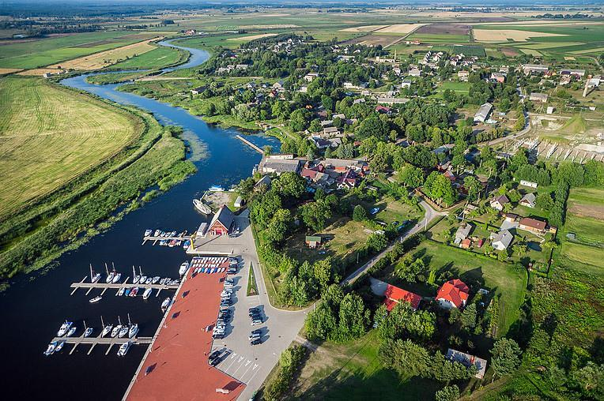
OBLIGATIONS AND IMPLEMENTATION OF THE CONCESSION AGREEMENT
Commitment:
create at least 6 jobs
Execution:
Created more than 60 permanent jobs (a large part of Dreverna residents) and about 120 jobs during the summer season
Commitment:
To serve within a year
at least 5,000 visitors
Execution:
On average, a year is served approx
120,000 visitors
Commitment:
Invest in infrastructure improvement EUR 328,000
Execution:
More than EUR 3,000,000 has been invested

Slide 25
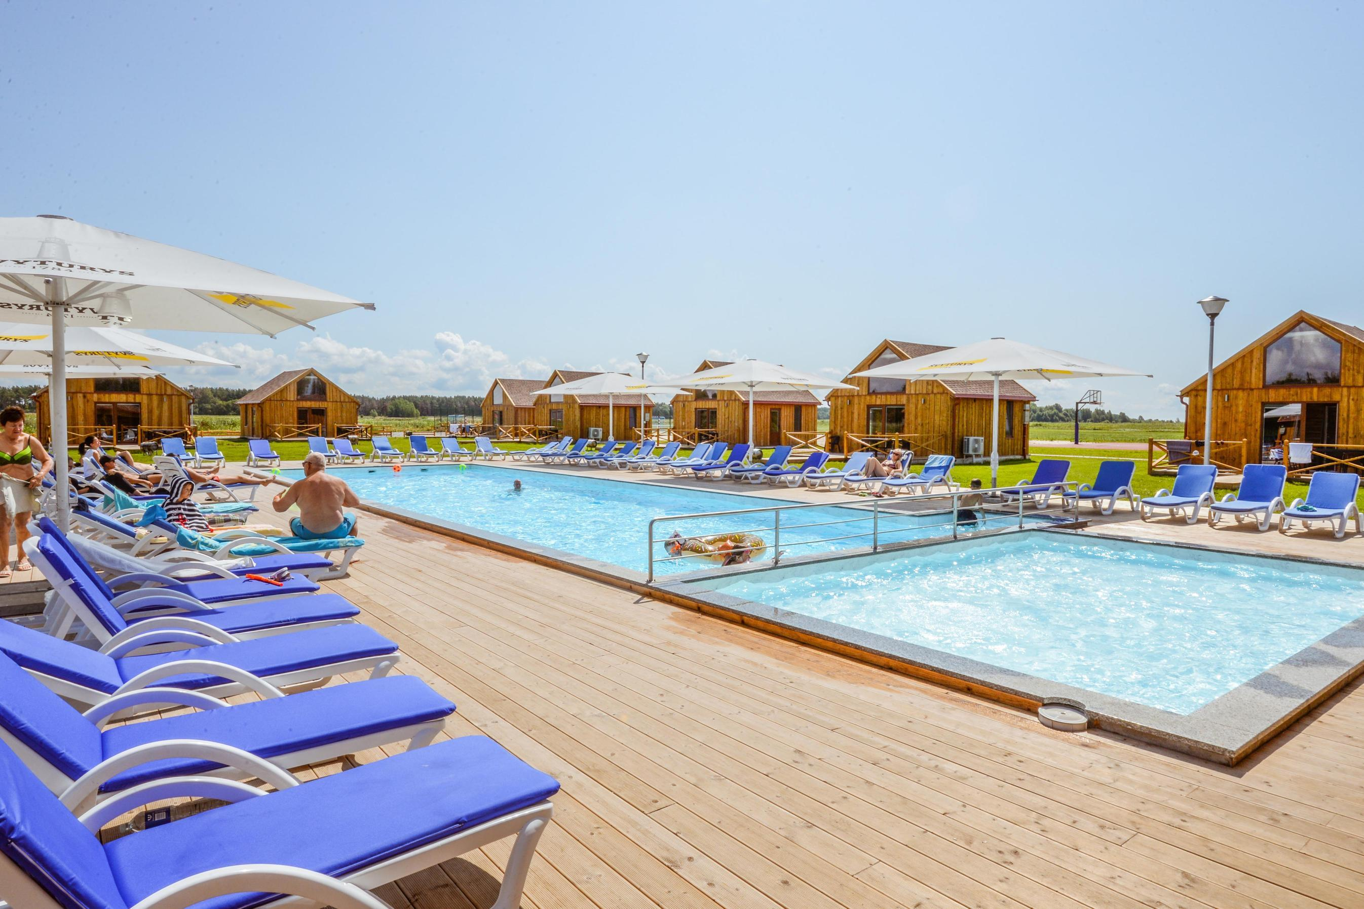
At the moment, UAB "Hortivita" together with its subsidiary UAB "Beno laivynas" provides 14 different recreation and entertainment services in the port of Dreverna

Slide 26
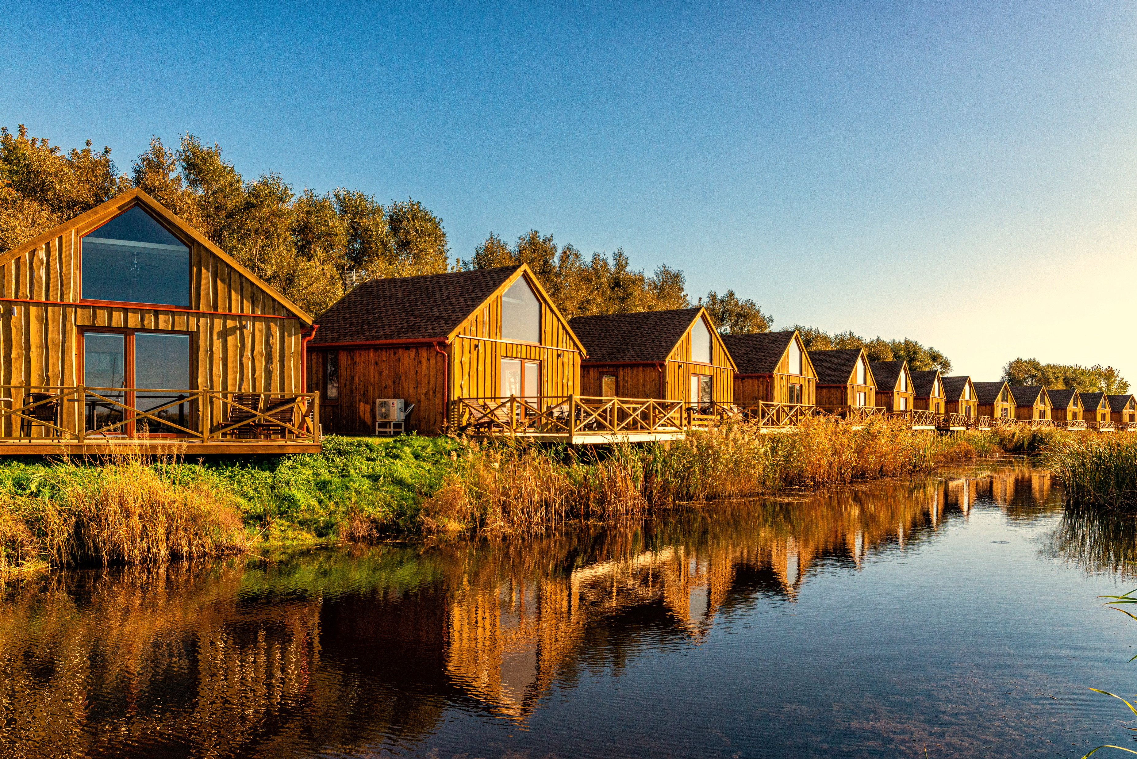
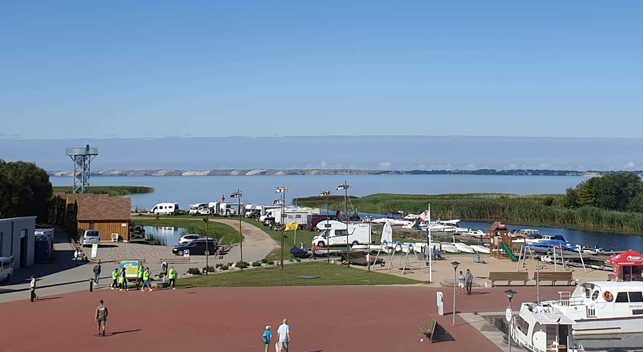
Holiday cottages, modular rooms and camper pitches for rent (572 beds)

Slide 27
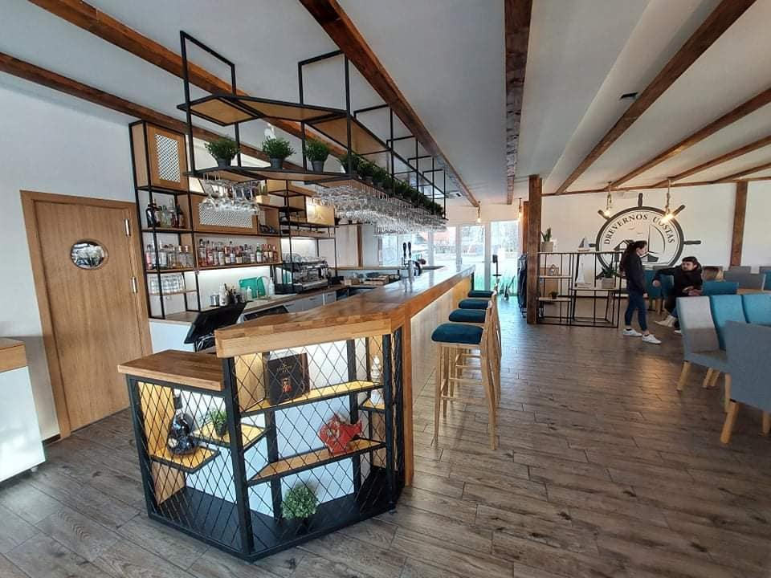
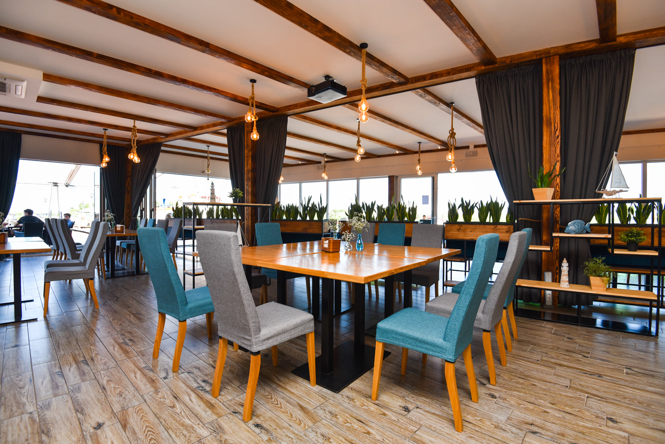
Restaurant (220 seats)

Slide 28
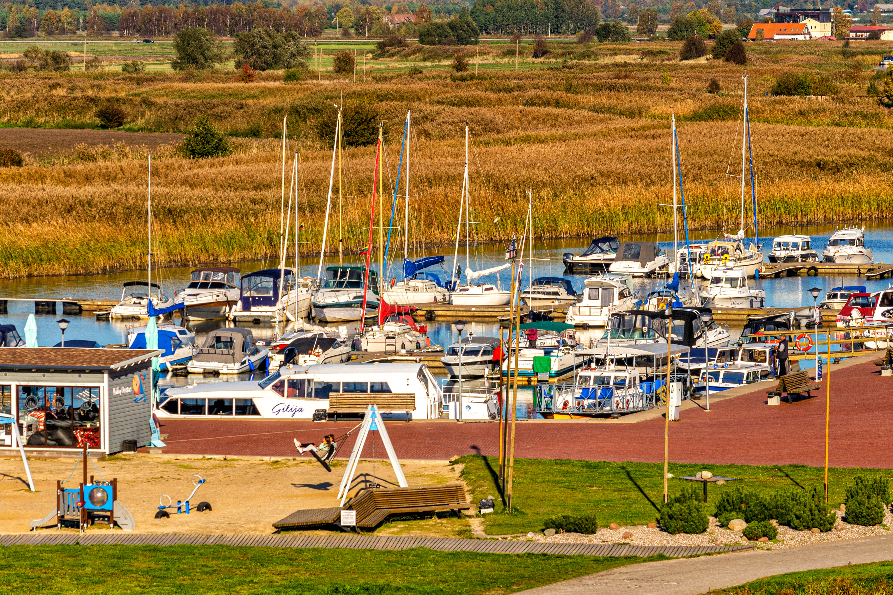
Port services (110 places)

Slide 29
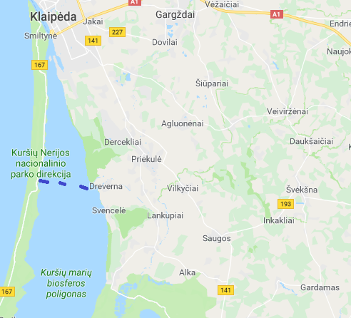
Regular ferry services to Juodkrantė (50 seats)

Slide 30
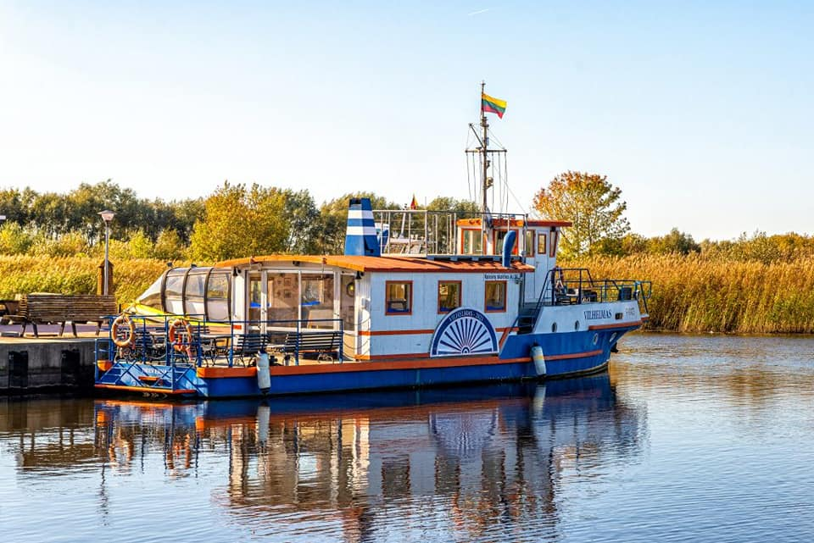
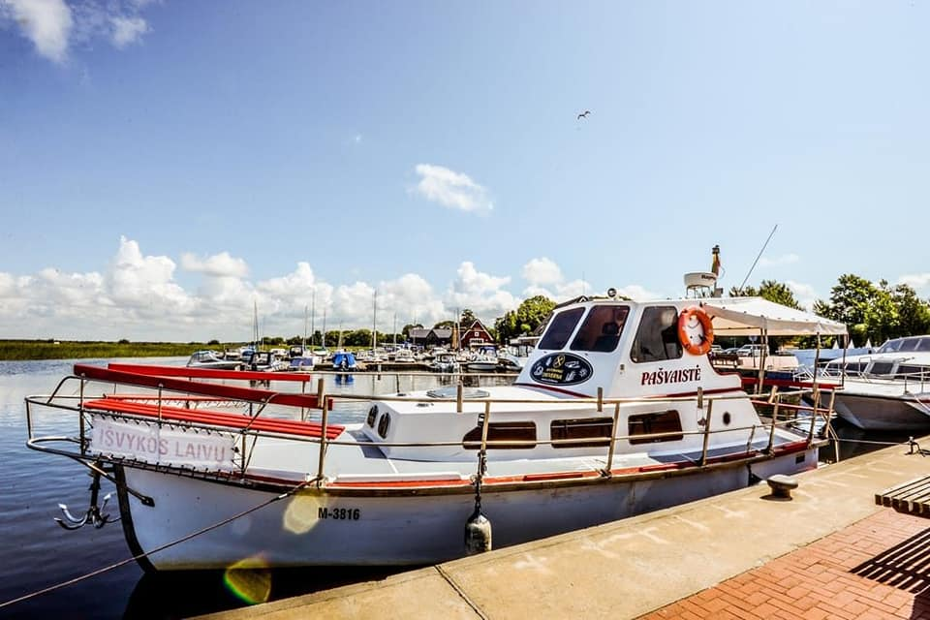
Ship renting (7 ships)

Slide 31
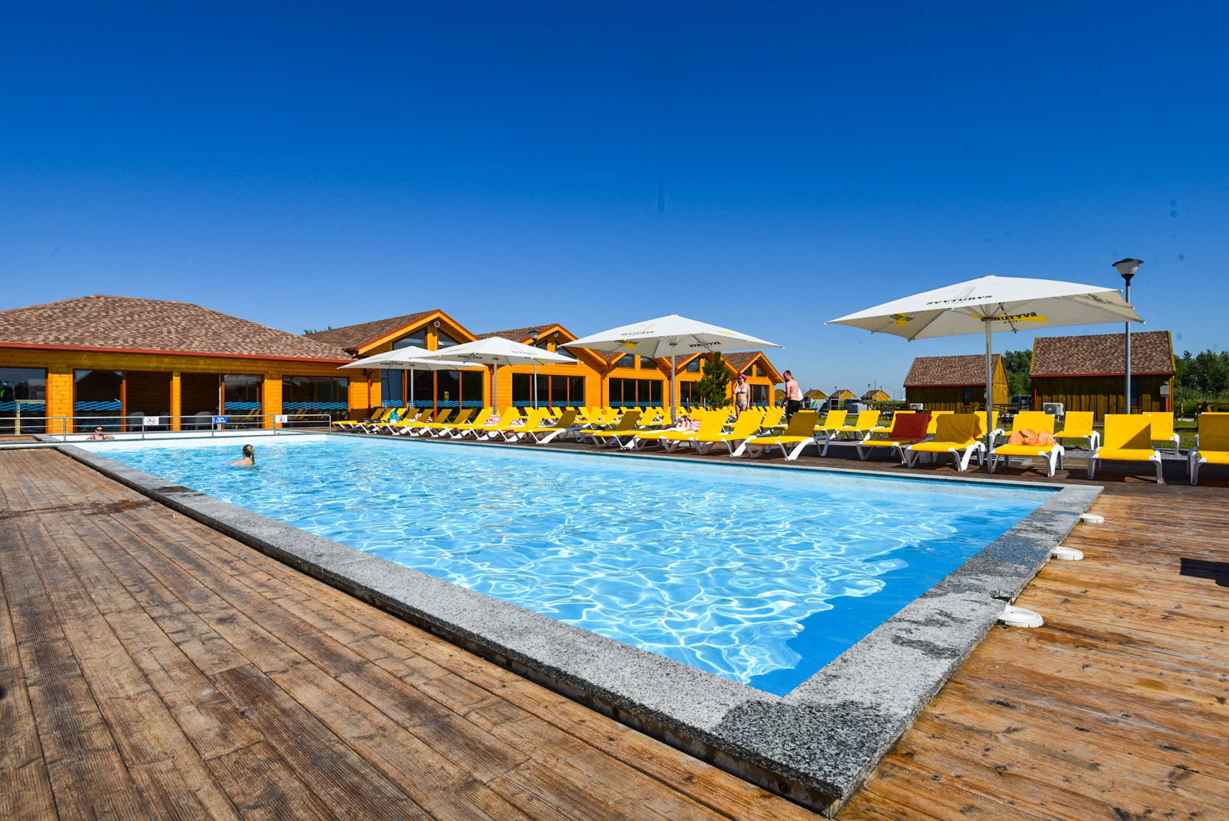
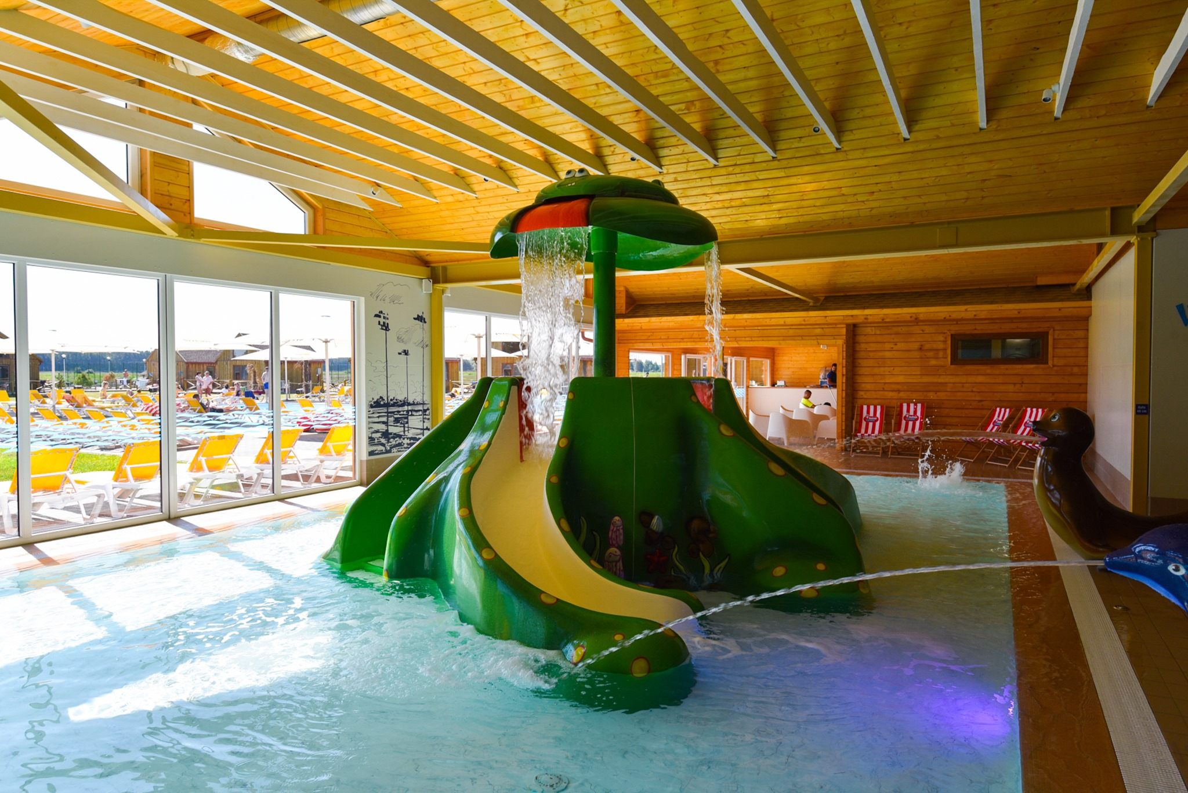
Water entertainment

Slide 32
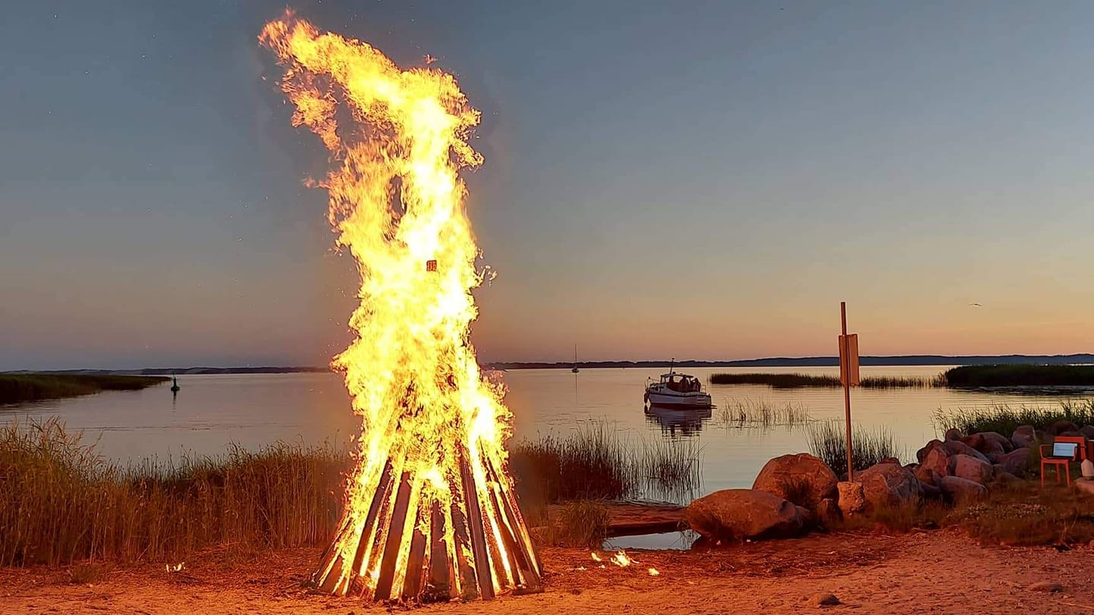
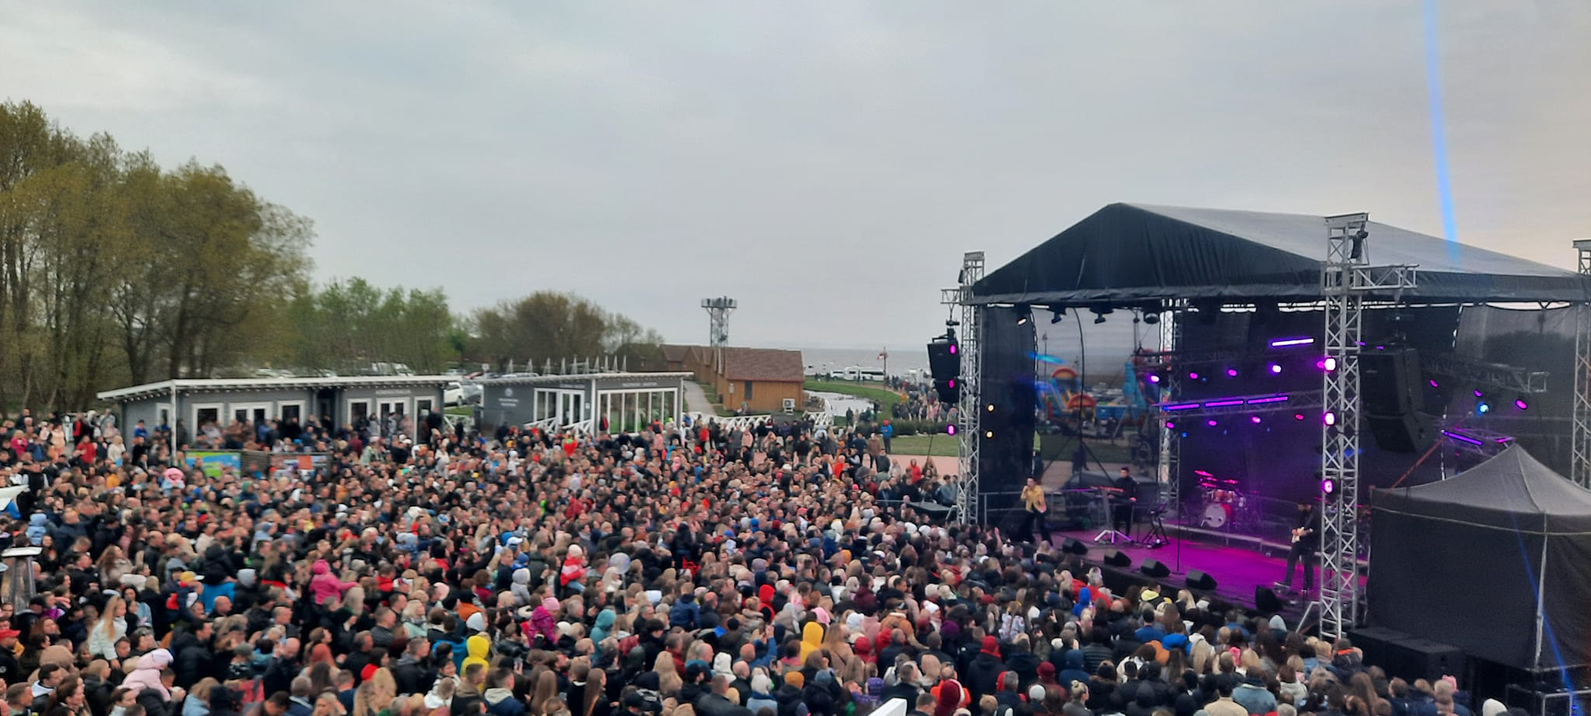
Festivals and cultural events
Joninių šventė Drevernos uoste
2019 m. vykusiame „Vėjo“ festivalyje dalyvavo apie 10 000 svečių

Slide 33
Problems and challenges of setting up a pier (Municipality)
Unplanned increase in construction prices
Long term document reconciliation and public procurement procedures
2008 m. financial crysis
Lack of funds for the implementation of additional projects (installation of the observation tower, road to the observation tower, etc.)
Floods
Lack of understanding among local fishermen and residents as why a new pier was needed, so there was not much support for the project from the local fishermen and local community

Slide 34
Business challenges in order to adapt the port of Dreverna to the provision of tourism services
In a relatively short period of time (less than a year), adapt the port of Dreverna for small ships to provide a full complex of tourism services
The beginning was a complete "anti-resort", so it can be said that it was not started from zero, but from a minus value
Disadvantages of Dreverna village infrastructure for increased customer traffic (pedestrian paths, parking lots, traffic regulation) have become apparent.
How to interest and attract the attention of potential visitors - publicizing activities, raising awareness, advertising. It is difficult for an unknown new resort area to compete with other well-known resort areas.
The Klaipėda District Municipality and the Klaipėda District Tourism Information Center helped a lot in raising awareness.

Slide 35
Practical advices (Municipality)
The most important thing is a person who generates ideas and is not afraid to take responsibility, so it is necessary to find such people, support and encourage them.
Talk to anyone who thinks it might be interesting and relevant
Patience and trust in idea
Trust in business
As much as possible, help the business to start operating as soon as possible (quick issuance of all necessary permits, willingness to help and contribute to get everything done)

Slide 36




Welcome to Dreverna
FACEBOOK
INSTAGRAM
WEB
@dreverna
drevernos_uostas
www.dreverna.lt

