Slide 1
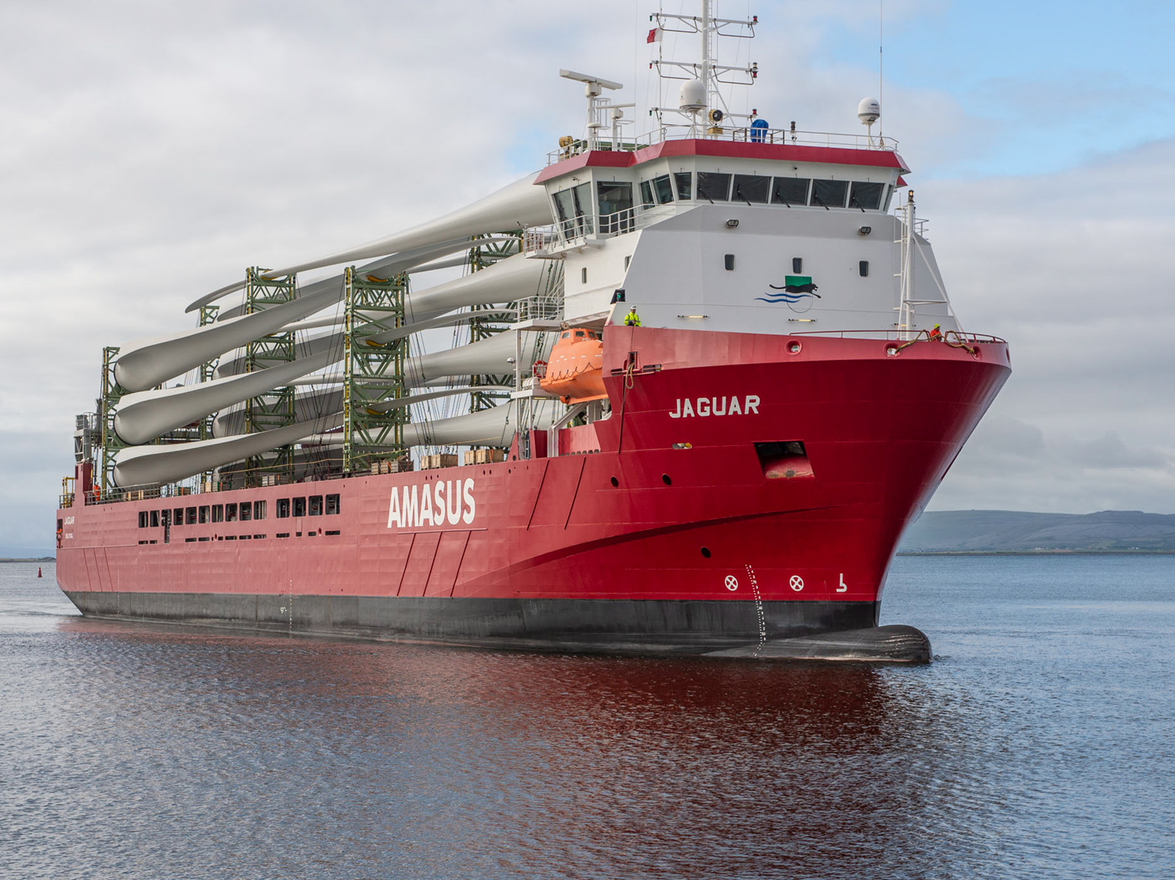
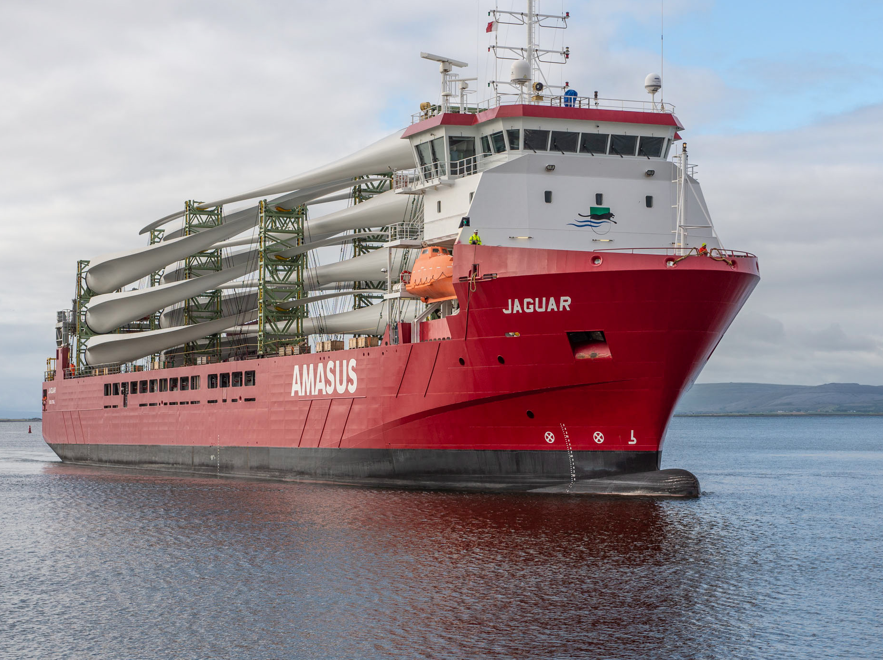
The Port of Galway as a driver for the Maritime Econmy 12 September 2024

Slide 2

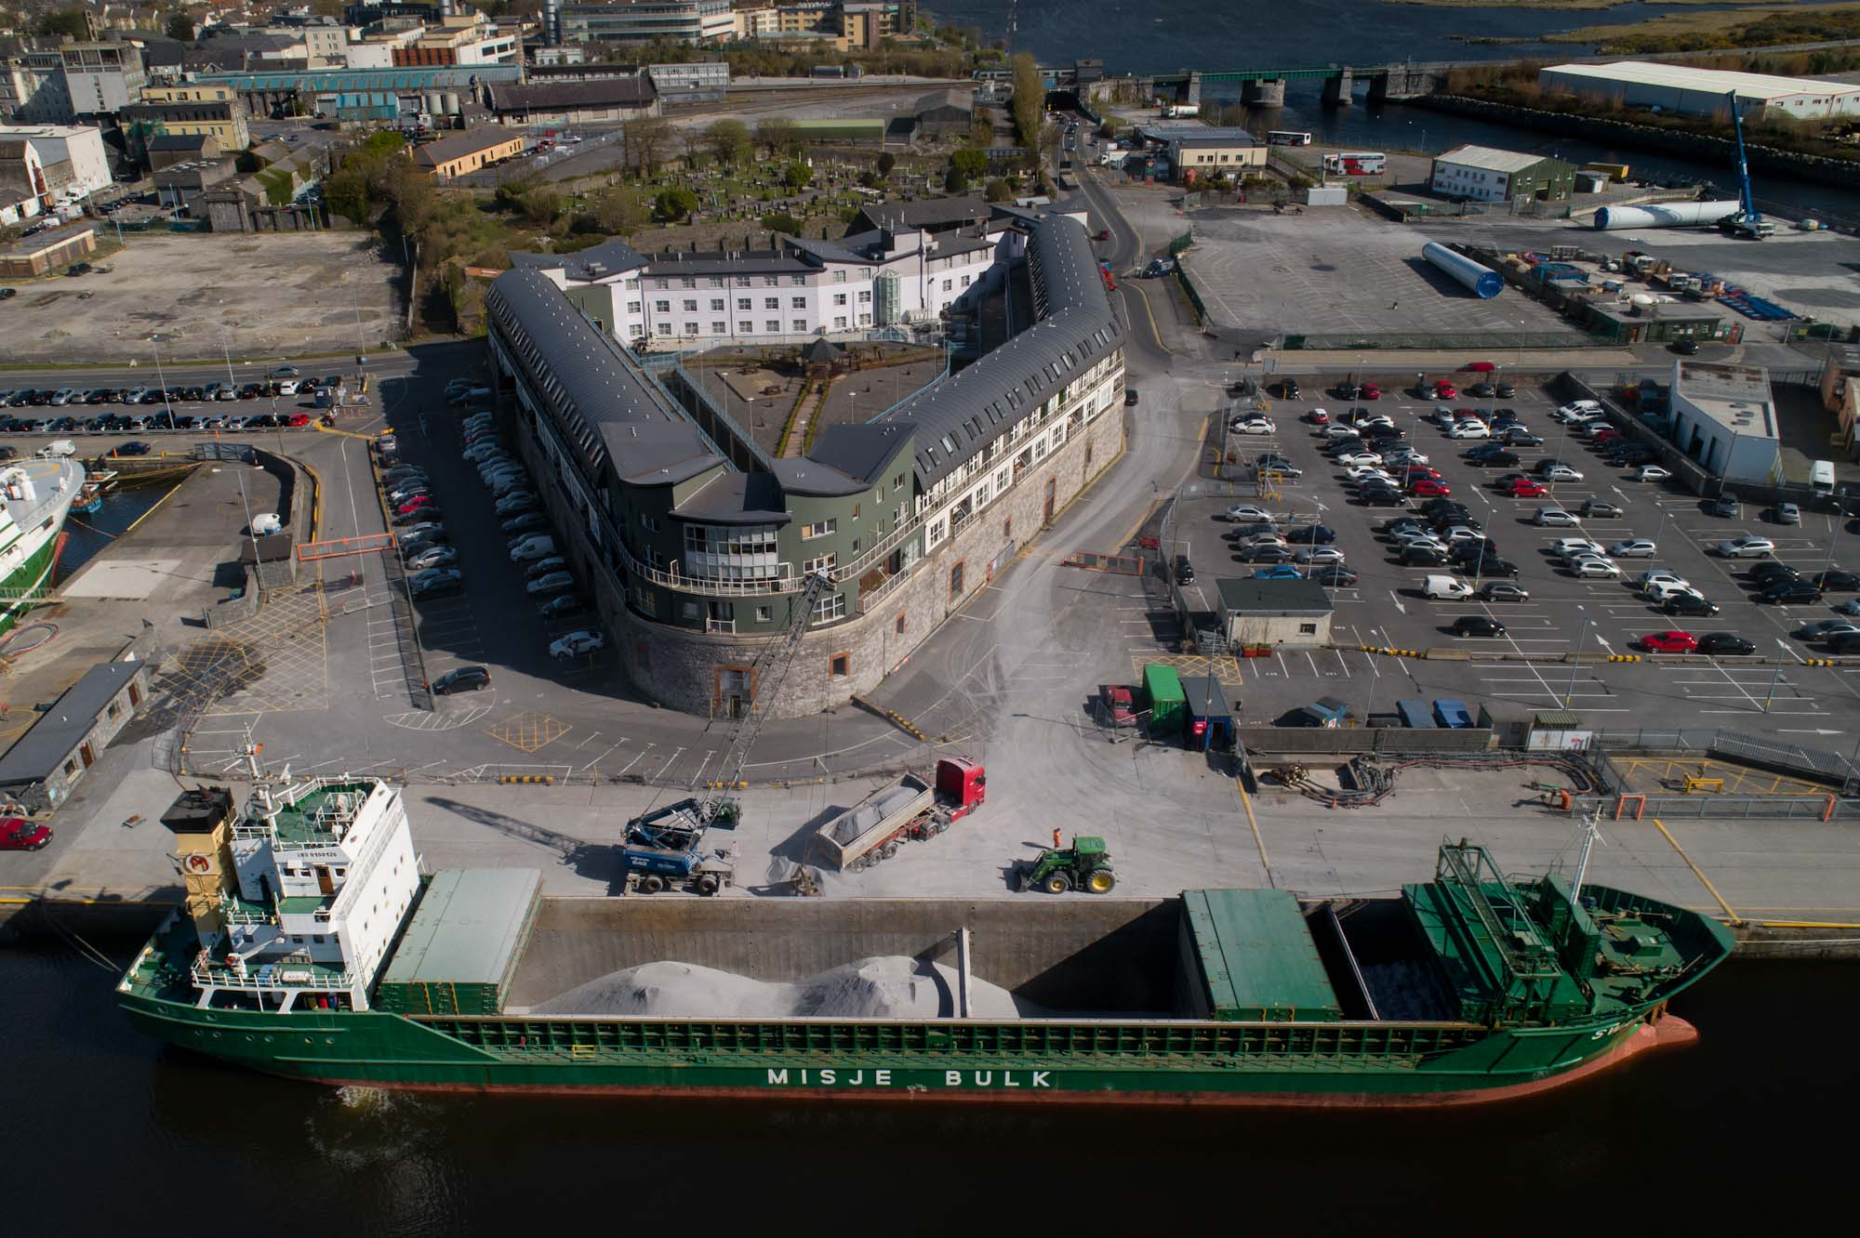
CURRENT OPERATIONS
▪ Principal imports:
Oil
Wind turbine components/project cargo
Bitumen
▪ Principal exports:
RDF
Scrap steel
Granular limestone
▪ Growth in onshore wind turbine business in recent years and strong medium term outlook

Slide 3

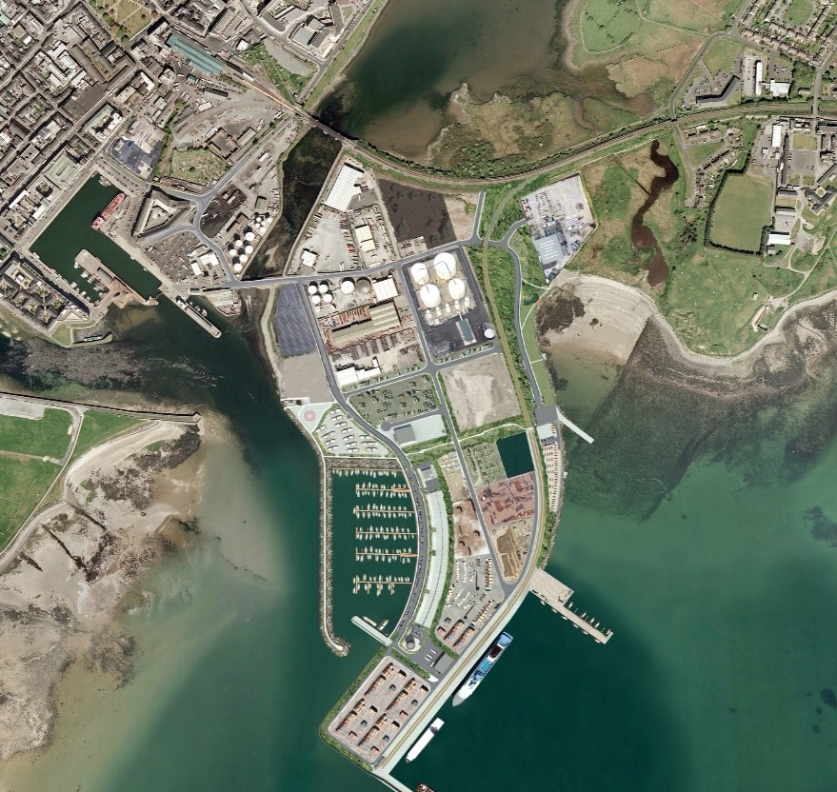
Proposed Port Relocation and Extension
Final planning decision pending
Customer support for new Port
Practical issues with current Port infrastructure:
Dock gates
Customer costs per unit
Research vessels and Irish Lights
Navy
Onshore wind
Existing Port
New Port

Slide 4
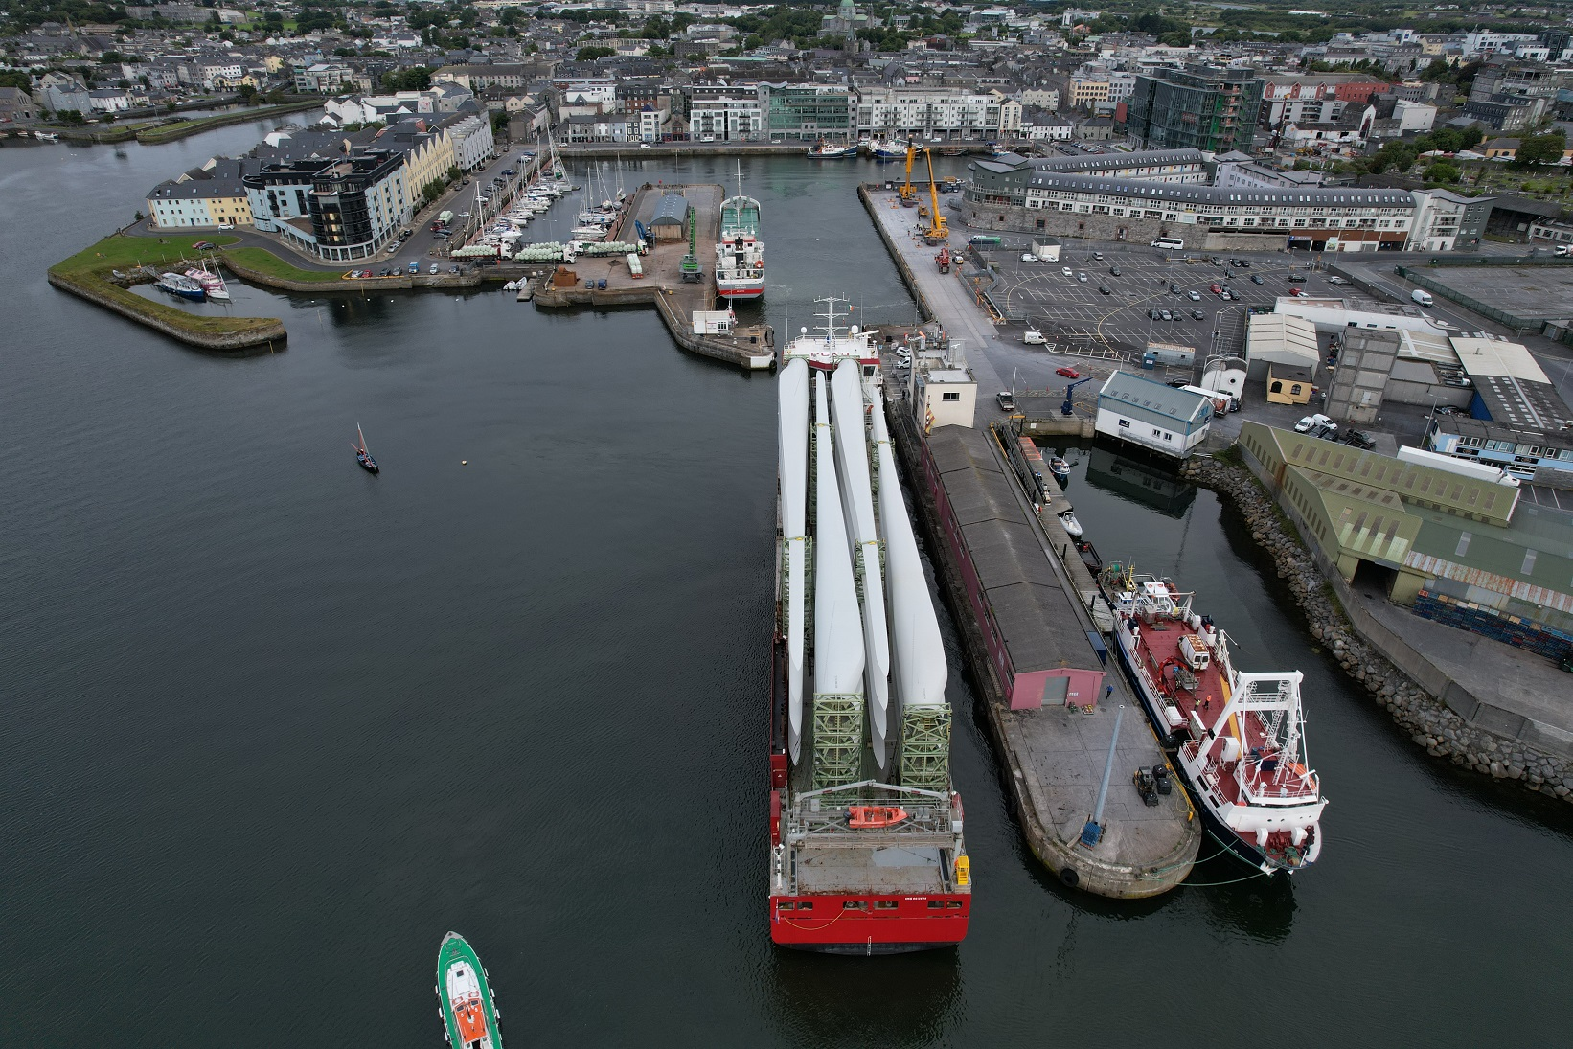
Vessel Capacity
Existing Port Proposed New Port
Maximum ship size 115 LOA and max 250 LOA and
beam 17m max beam 50m
Maximum draft 6.5m (larger vessels on 12m consultation with
Harbour Master)
Quay length 621m 660m
Access Dock gates are open for 24 hr
2 hours before high water
at each tide
Typical ship size 4,000 – 6,000 tonnes up to 35,000 tonnes

Slide 5
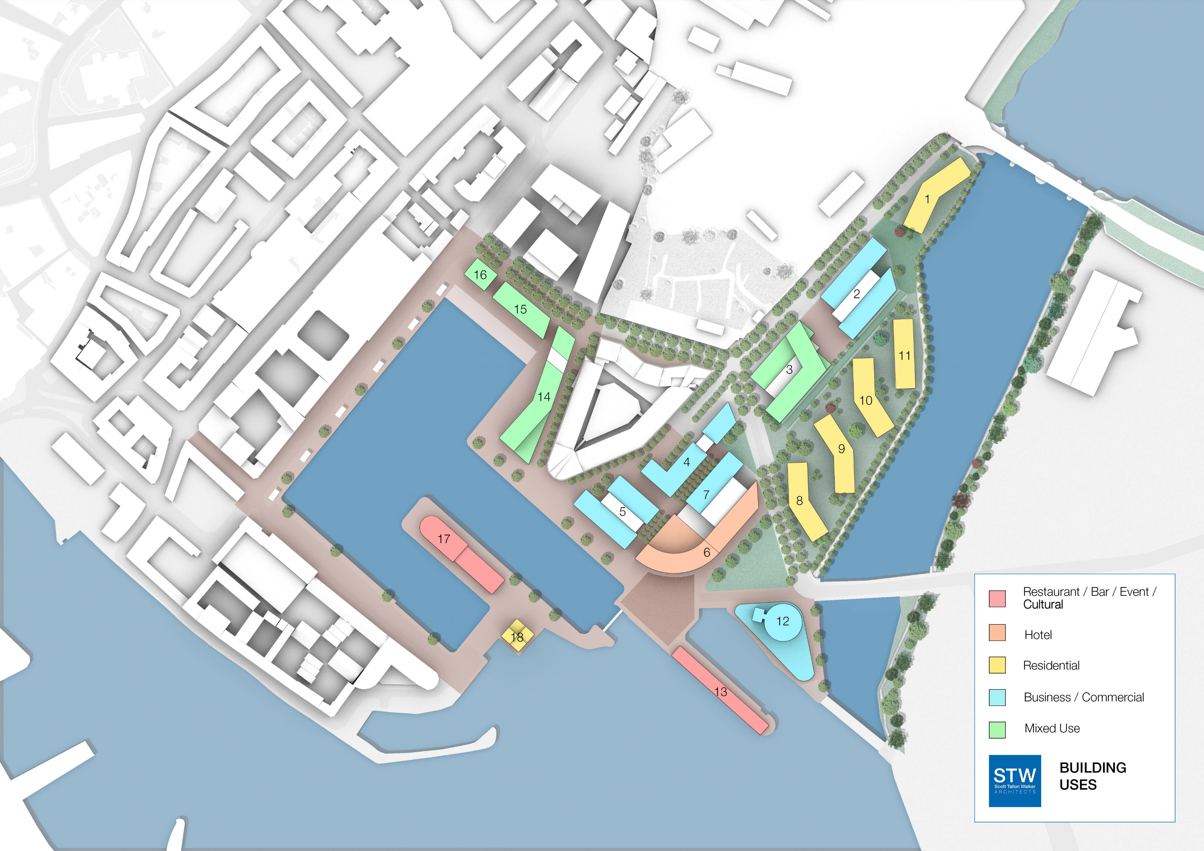
INNER DOCK - POTENTIAL BUILDING MIX
Phase 1

Slide 6
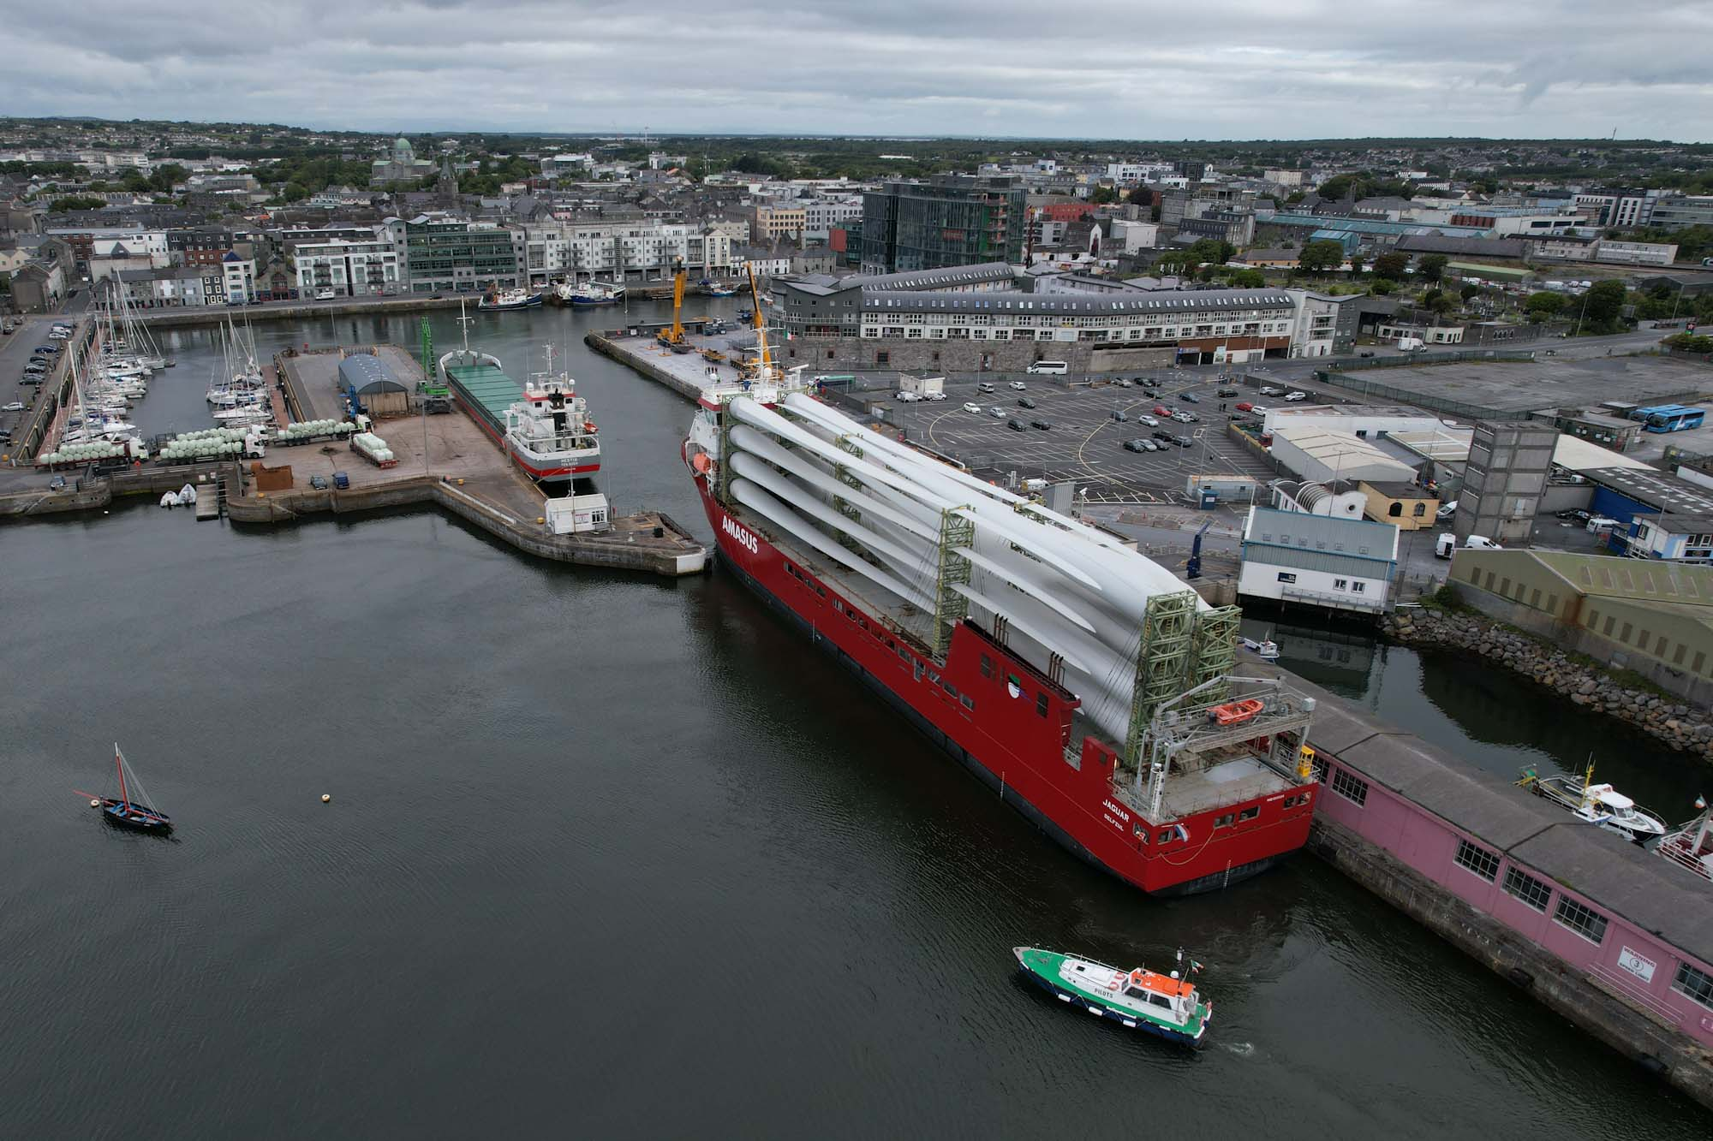
ONSHORE WIND
437 MW (16% of national total) of “connected” onshore wind processed through Galway since 2014
Further c. 250 MW wind will be processed in 2023/2024
Strong outlook for 2024 and beyond
Repowering

Slide 7
Areas for potential growth
Potential for multi modal hydrogen hub based in the Port of Galway
Renewable energy/marine campus – start up/scaling, third level etc
Opportunities for existing bulk customers
New customers
Use of existing and new land bank for existing and new customers, including potential relocations

Slide 8
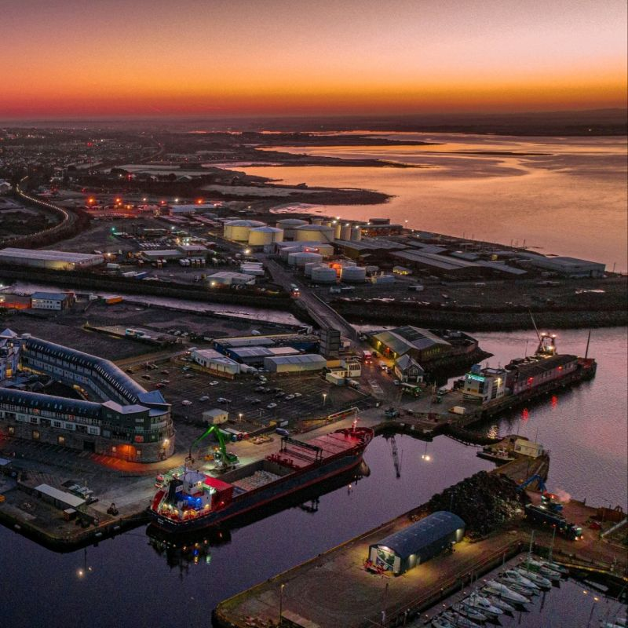
Review of national Ports policy
• Key issues - funding
- port measurement
• Regional infrastructural deficit – our region ranks 218th out of 234 in the EU in terms of infrastructure

Slide 9


Q & A

