Slide 1

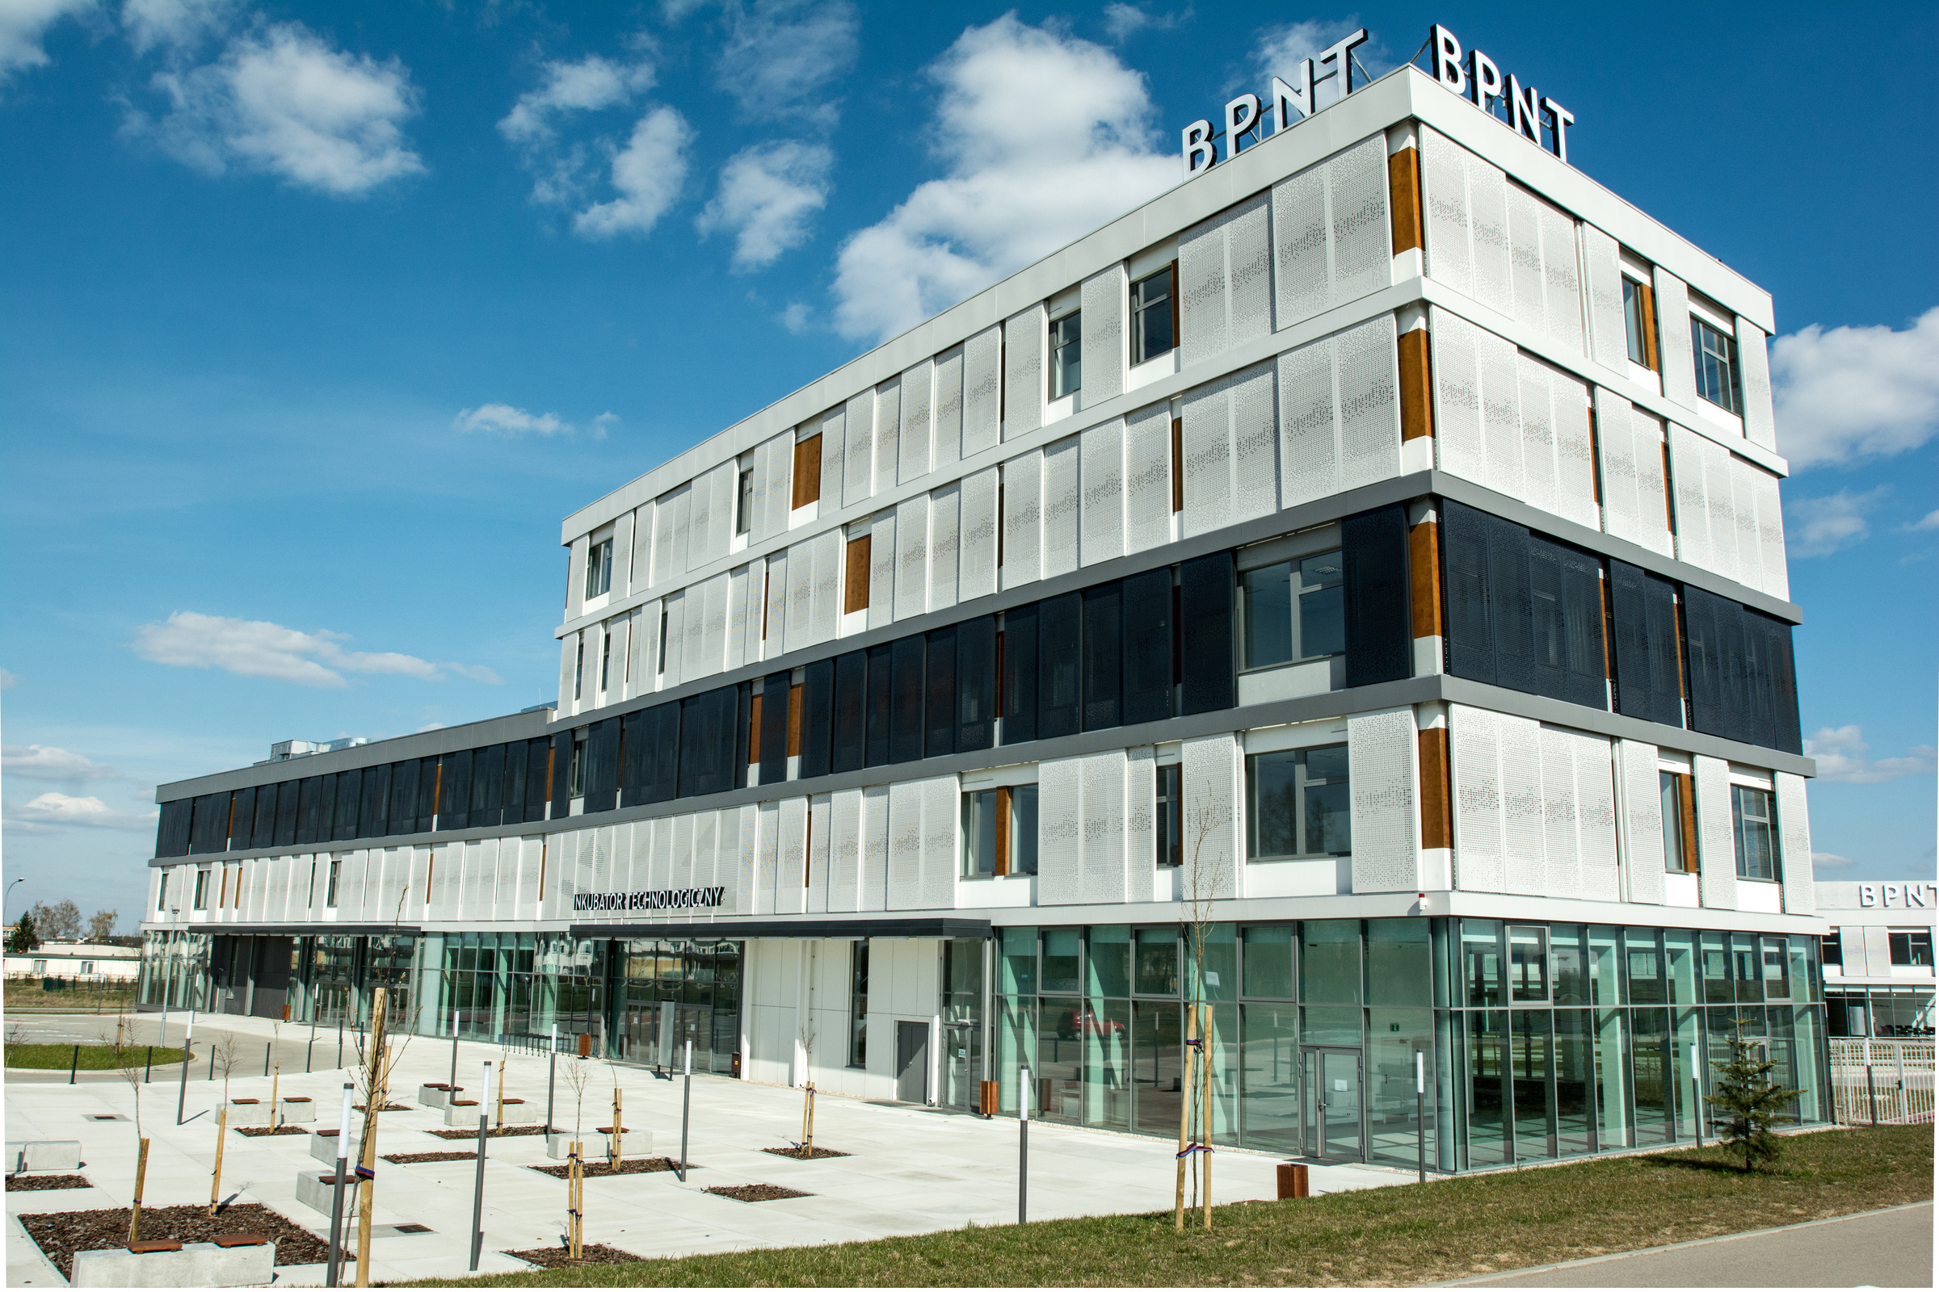

ACTIVE PARTICIPANT
IN THE REGIONAL INNOVATION ECOSYSTEM
Michał Podbielski

Slide 2
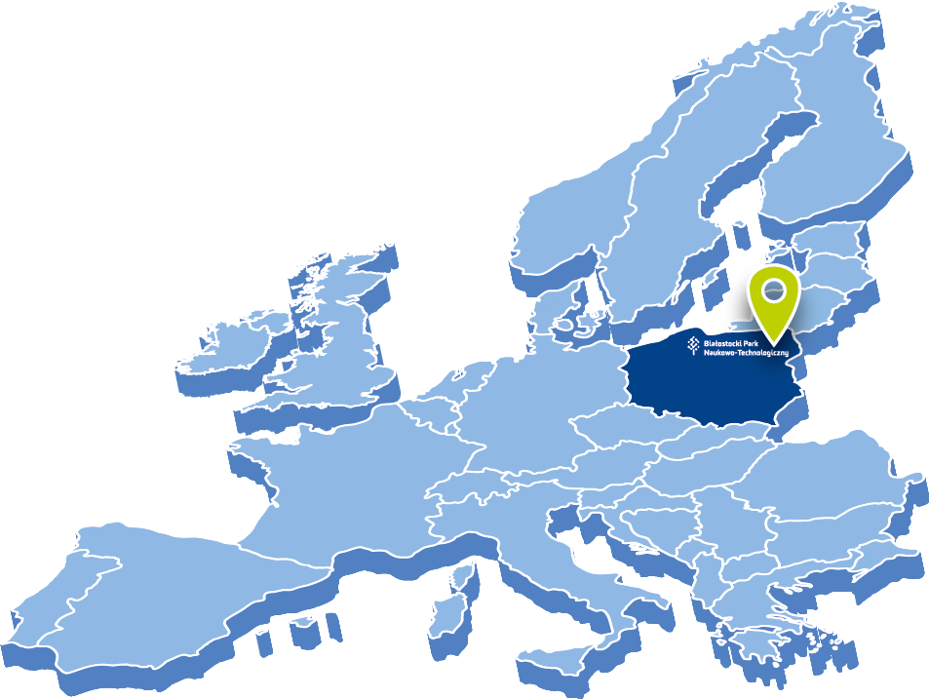
BIAŁYSTOK SCIENCE AND TECHNOLOGY PARK
Located in Białystok – the capital city of Podlaskie Region in north-eastern Poland
Municipal institution established in 2011 to foster local and regional innovation and boost technology-based investments in the city
Government accredited innovation centre
Focal point of innovation ecosystem in
north-eastern Poland

Slide 3
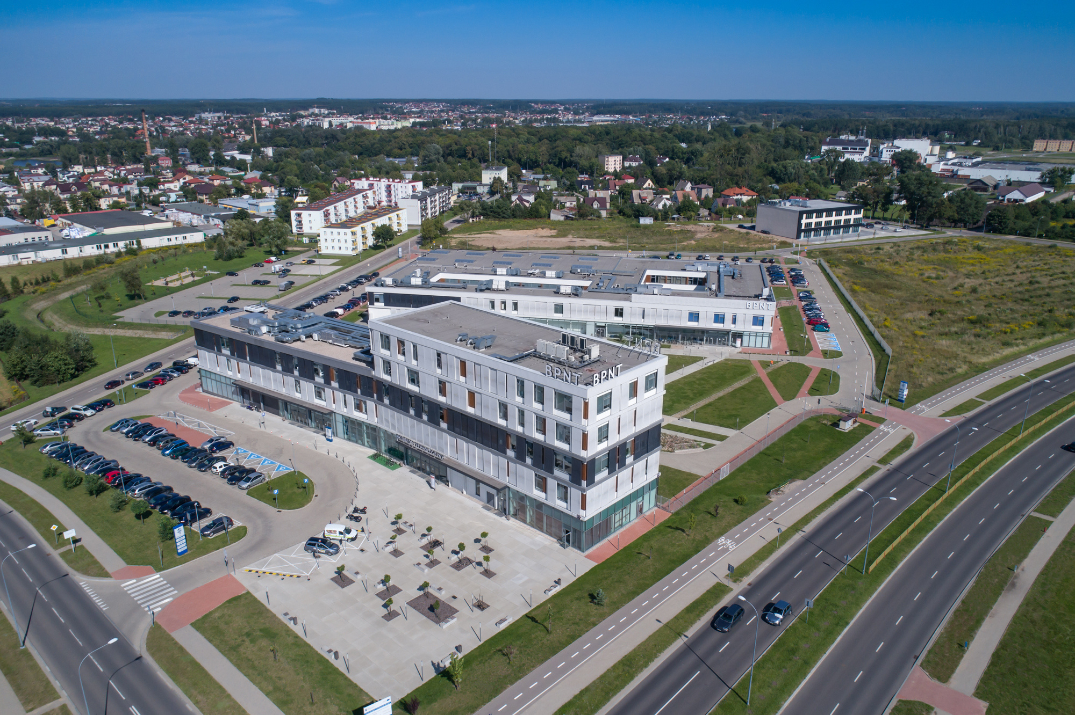
BIAŁYSTOK SCIENCE AND TECHNOLOGY PARK
200
COMPANIES HOSTED
250
COWORKERS
500
CONFERENCES, WORKSHOPS & EVENTS
300
STARTUPS INCUBATED

Slide 4






MAIN FOCUS AREAS
FOSTERING BUSINESS INITIATIVES
PROMOTING SCIENCE, RESEARCH AND INNOVATION
STARTUP INCUBATION AND ACCELERATION

Slide 5


FOSTERING BUSINESS INITIATIVES
Galvanizing cooperation between businesses and academic institutions

Slide 6
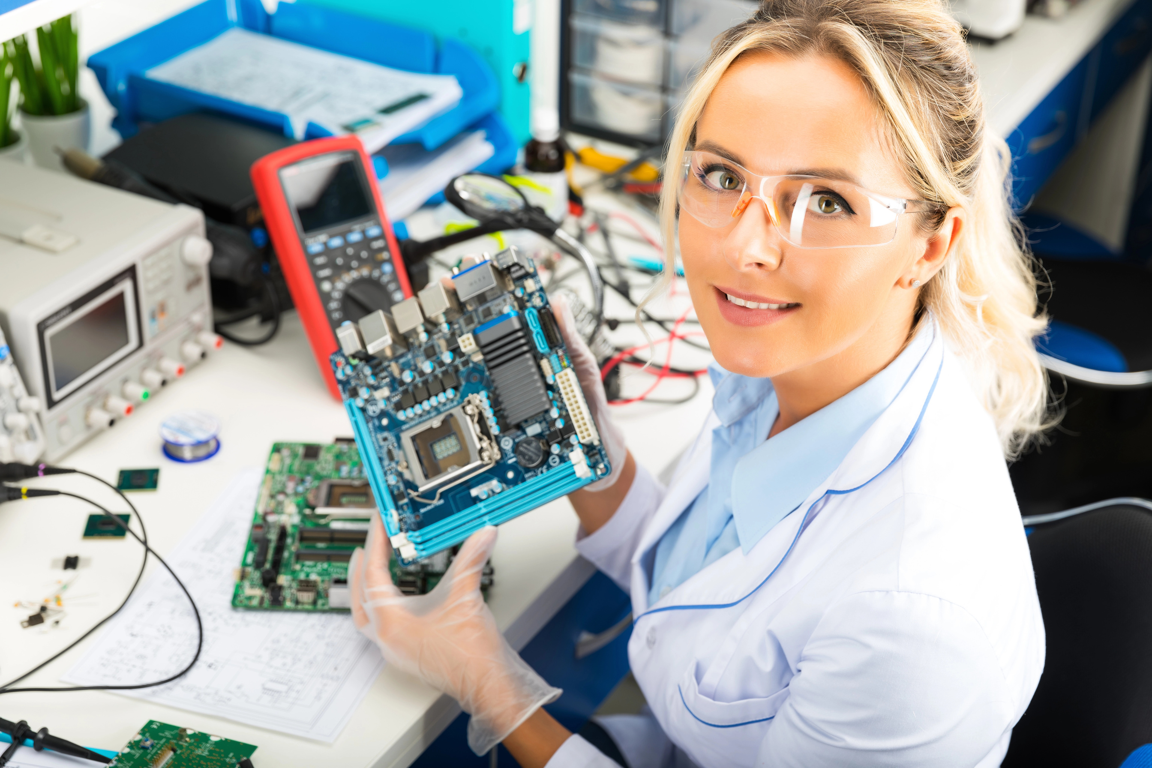
FOSTERING BUSINESS INITIATIVES
Galvanizing cooperation between businesses and academic institutions
Initiating and facilitating technology transfer

Slide 7
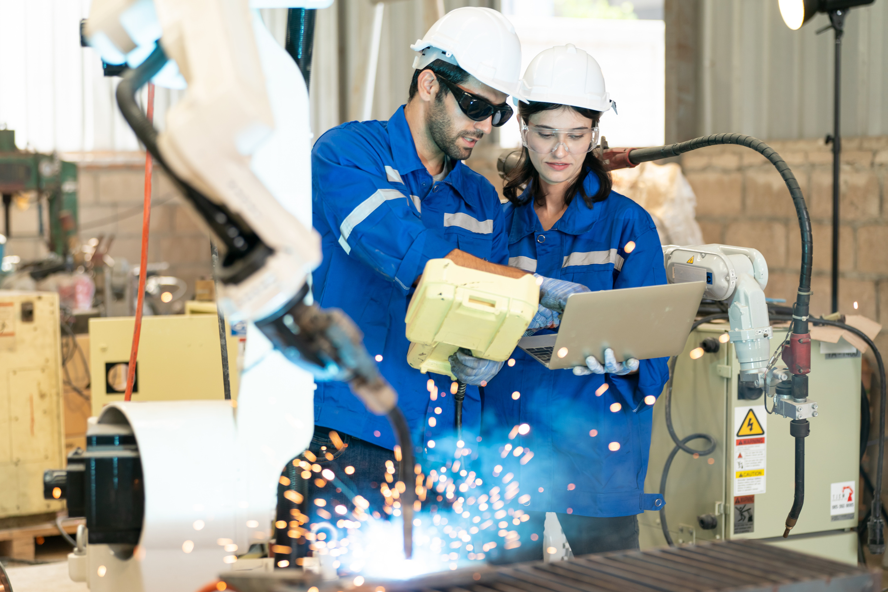
FOSTERING BUSINESS INITIATIVES
Galvanizing cooperation between businesses and academic institutions
Initiating and facilitating technology transfer
Supporting the commercialization of knowledge from scientific research

Slide 8
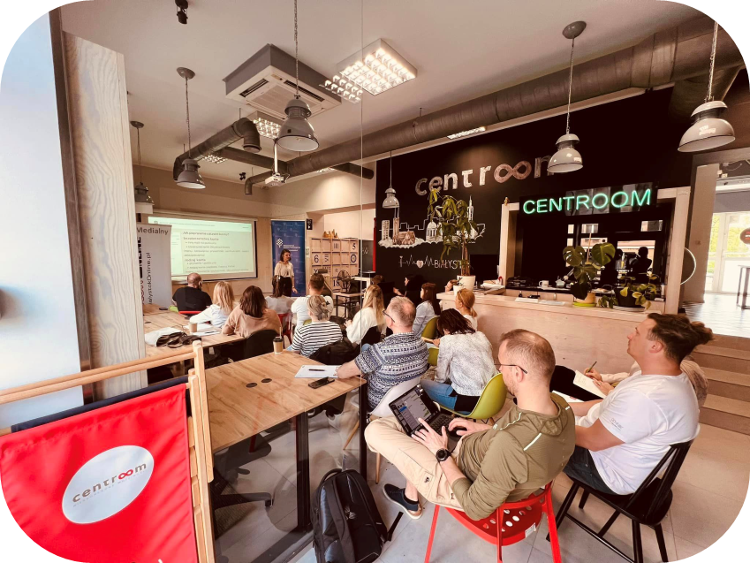
FOSTERING BUSINESS INITIATIVES
Galvanizing cooperation between businesses and academic institutions
Initiating and facilitating technology transfer
Supporting commercialization of knowledge from scientific research
Promoting collaboration and networking in self-operated coworking space

Slide 9

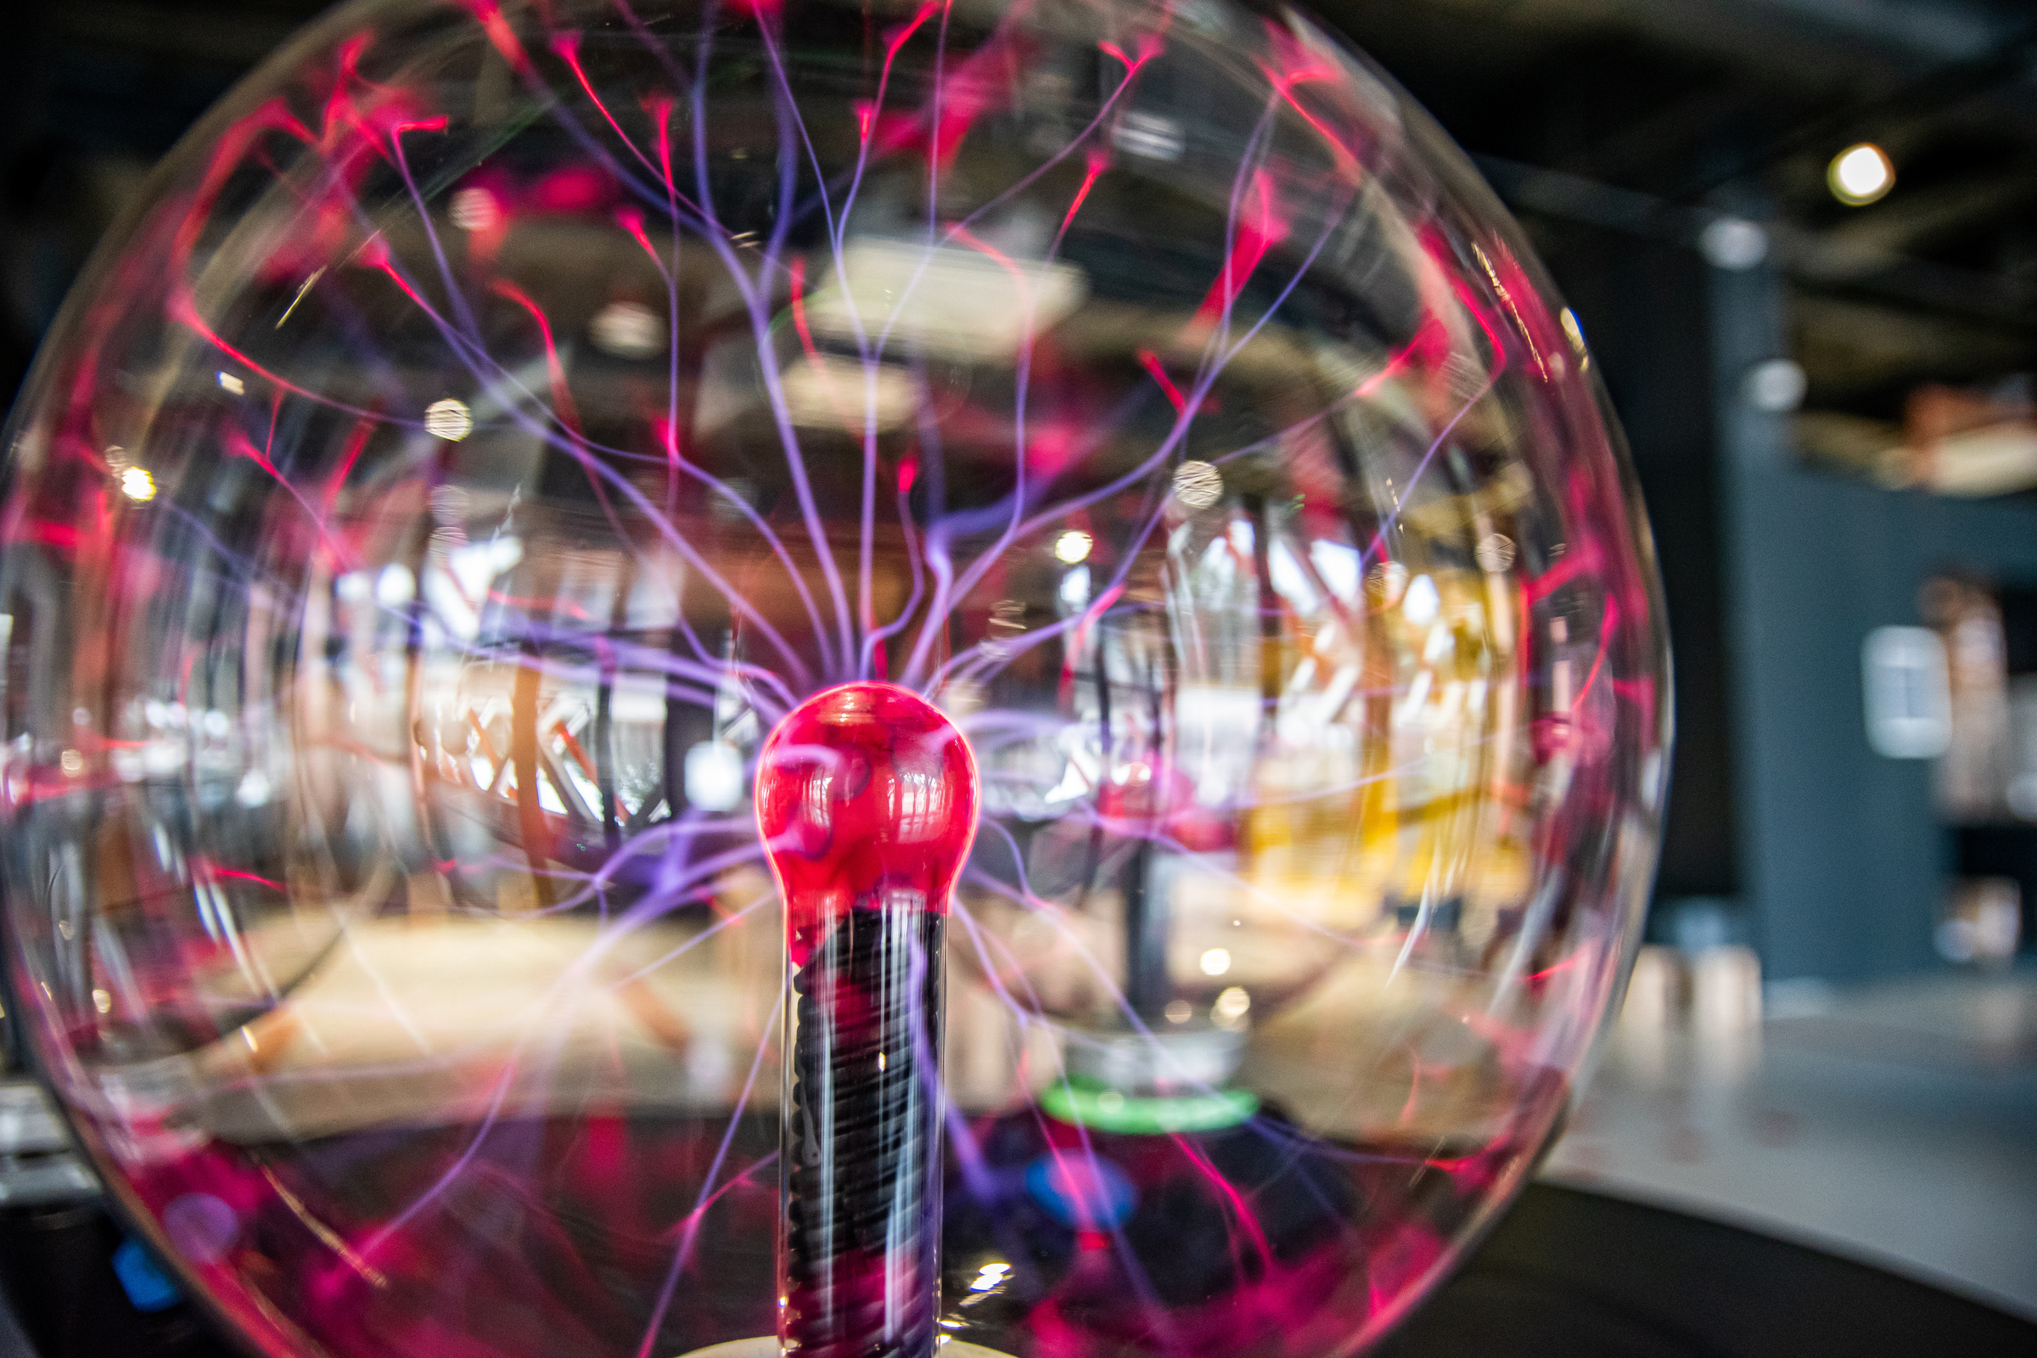
PROMOTING SCIENCE, RESEARCH AND INNOVATION
Operating largest science education centre in eastern Poland

Slide 10
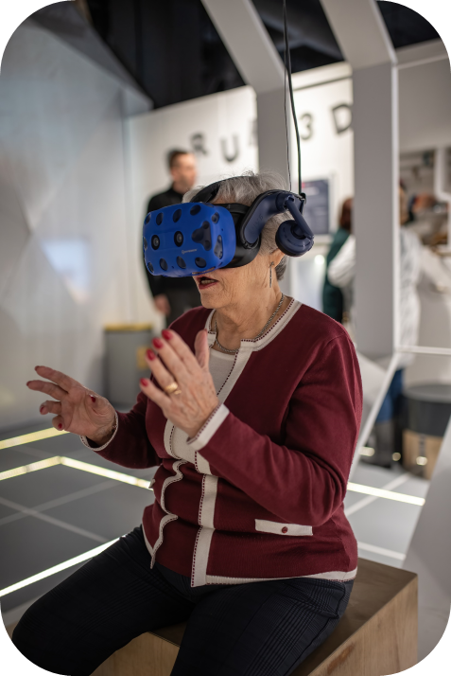
PROMOTING SCIENCE, RESEARCH AND INNOVATION
Operating largest science education centre in eastern Poland
For all ages with a dedicated exhibition for children

Slide 11
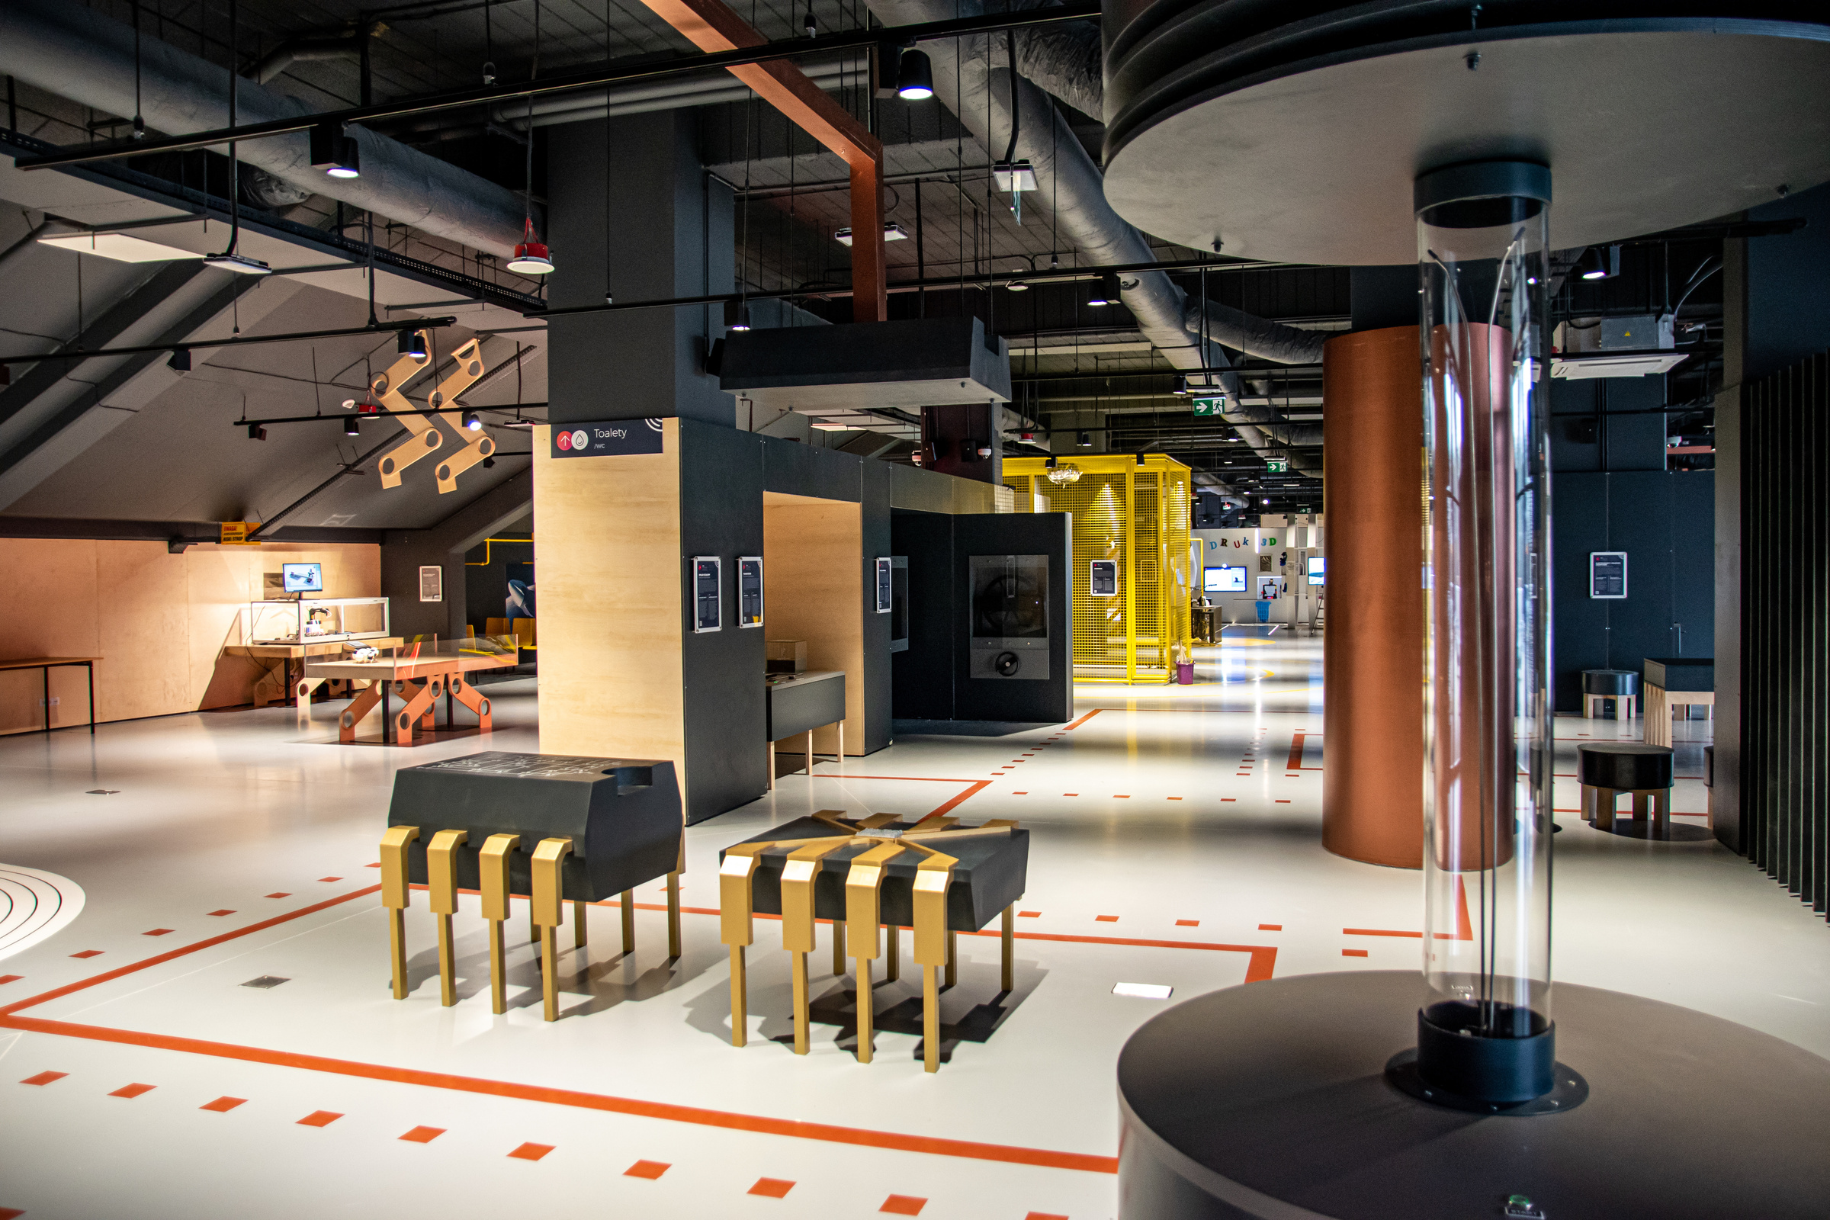
PROMOTING SCIENCE, RESEARCH AND INNOVATION
Operating largest science education centre in eastern Poland
For all ages with a dedicated exhibition for children
3,000 sq. m and over 130 interactive stations

Slide 12
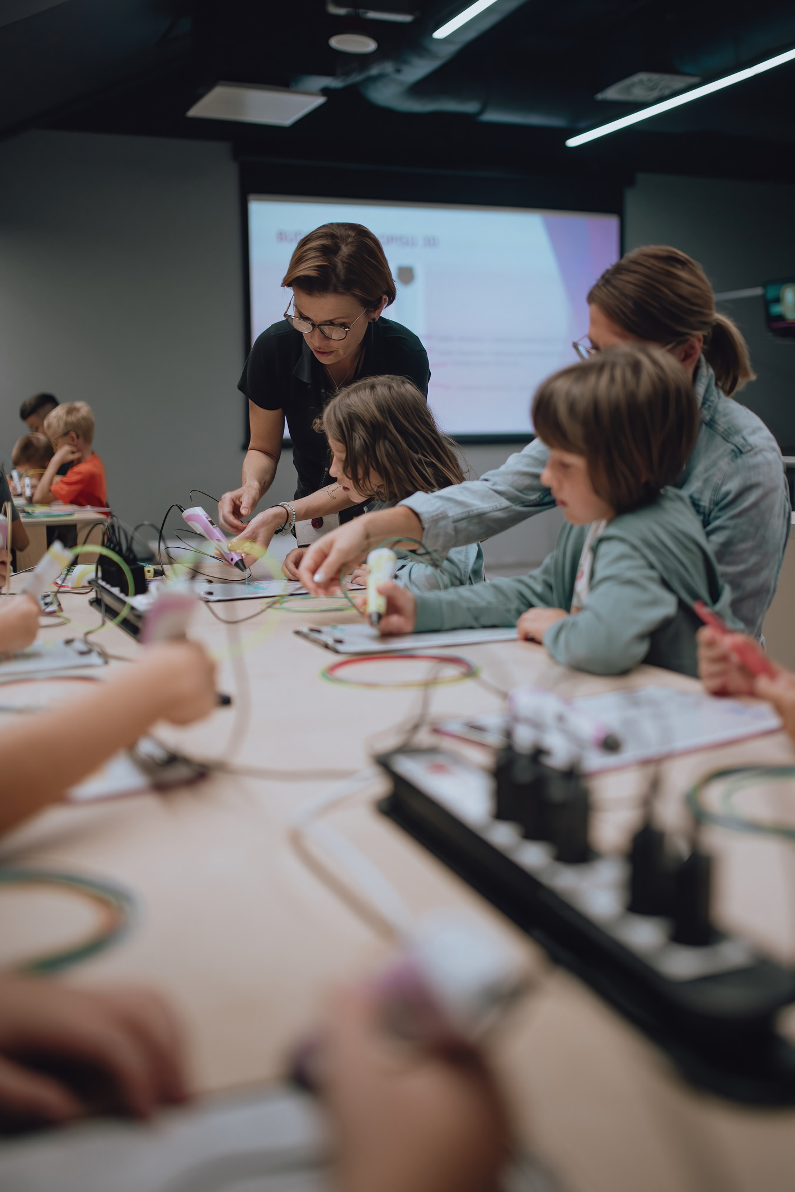
PROMOTING SCIENCE, RESEARCH AND INNOVATION
Operating largest science education centre in eastern Poland
For all ages with a dedicated exhibition for children
3,000 sq. m and over 130 interactive stations
Scientific workshops and events

Slide 13






STARTUP INCUBATION AND ACCELERATION
Office and lab space
Preferential office and lab space rental
Free use of conference and meeting facilities
Location in innovative hub
Startup support services
Consulting (business model, financing sources, networking, audit)
Marketing services
Trade-mark registration assisstance
Dedicated programmes
Hub of Talents - starting platform for new ideas

Slide 14


Main idea
To provide a tailored incubation programme in order to support innovative product or service ideas
Target
150 new innovative, technology startups
Budget
5.6M EUR
Duration
36 months

Slide 15

WHO CAN APPLY
Anyone with an idea for an innovative product or service, at least on national scale
Willing to register their startup in Podlaskie Region
The idea may not be a part of an existing business solution or receiving support from other startup platforms
Bonus points for ideas from metal and machinery industry

Slide 16





WHAT YOU GET
6-month incubation programme guided by dedicated incubation manager in line with Customer Development, Lean Startup, or Design Thinking methodologies
01
Basic services: legal and accounting support, as well as marketing assistance in developing visual identity elements and a marketing strategy
02
Specialised services: open catalogue of individual services tailored to startup’s specific business or technological needs
03
Grants: up to 15K EUR, if project partners are unable to render specific services required by particular startup
04
Market-validated MVP and scalable business model for the venture
Notes:
3D modelling and printing
clickable UX/UI mock-ups for apps
IT/ICT services
market research and analysis
business strategies
GDPR documentation
industrial property rights protection
public speaking, pitching sessions and team building workshops
intellectual property protection
trainings in financing sources
HR strategy and development
optimal organizational structure
sales and negotiation
legal assistance
accounting
marketing strategy
visual identity

Slide 17
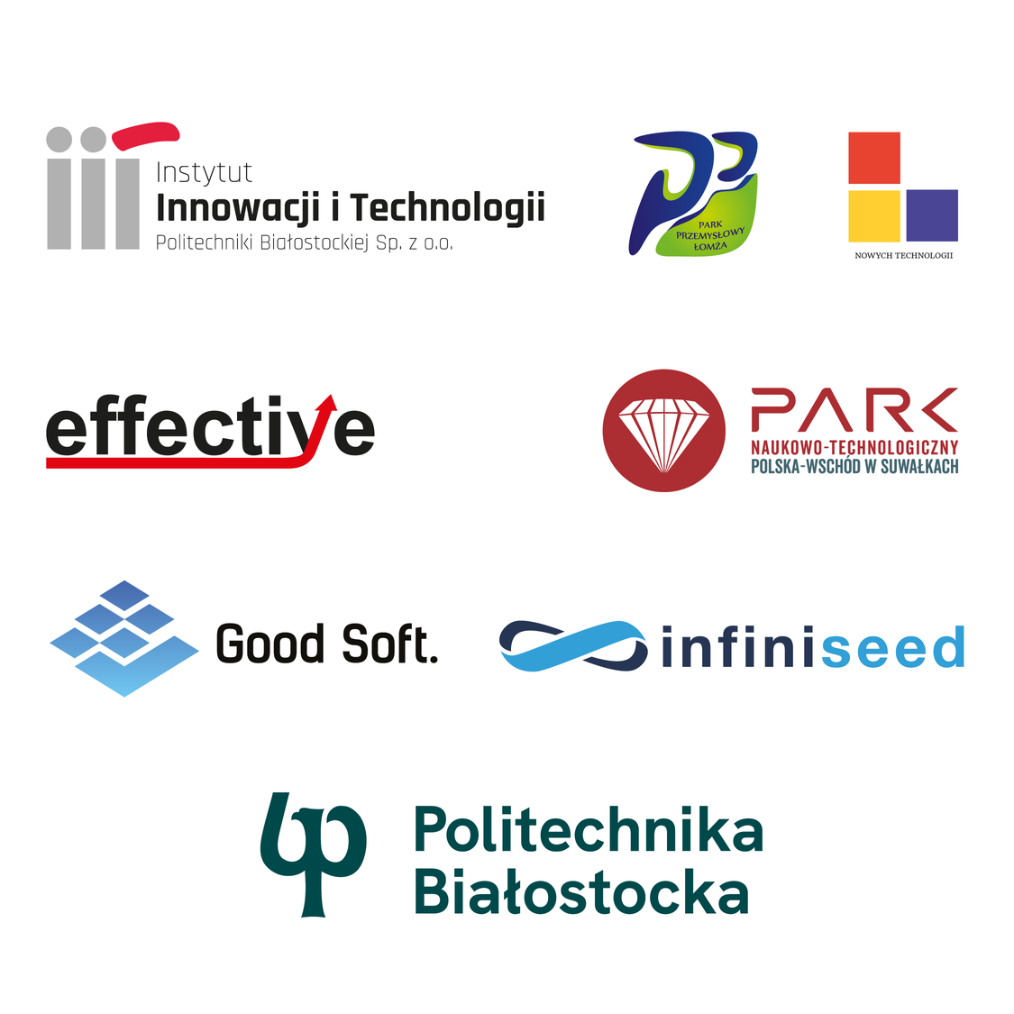
PROJECT PARTNERS
Project realised in broad regional co-operation
Involving 3 tech-parks from 3 largest cities in the region
Strong support from 3 main public universities, including the Białystok University of Technology
Private sector partners provide fundraising and business strategy know-how

Slide 18




PAST EDITIONS
The present platform is driven by over seven years of expertise acquired during the course of two previous editions of the programme
300+ incubated startups
2000+ submitted ideas
100 startups with further financing

Slide 19
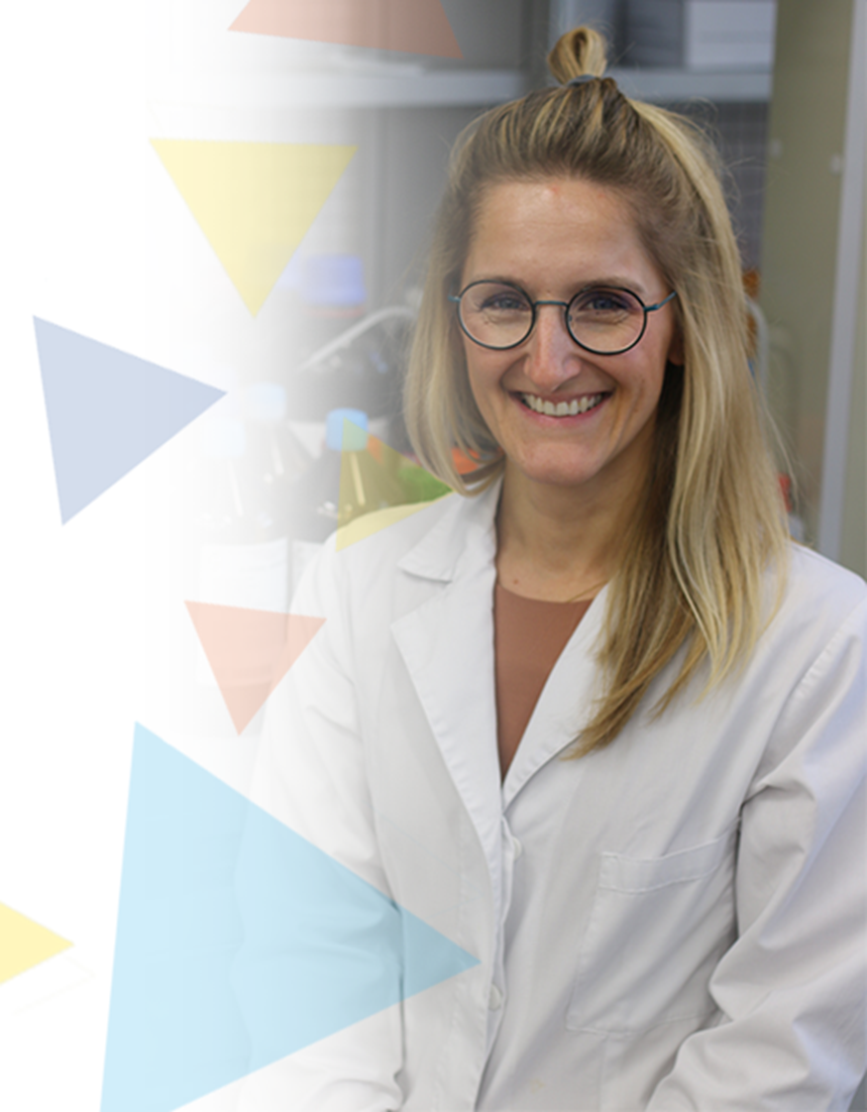
SUCCESS STORIES
LUMEKKO
Nanotechnology-based startup founded by Agata Szczeszak
Designs and produces anti-counterfeit luminous protection features for documents and valuables
Received further funding by Polish Agency for Enterprise Development
In 2022, Agata Szczeszak was voted Businesswoman of the Year in the Startup of the Year category

Slide 20

SUCCESS STORIES
GISE
High-tech security startup
World’s first comprehensive system for protection against laser and seismic eavesdropping
It provides an acoustic and visual barrier, ensuring the highest level of anti-eavesdropping security in rooms with windows
Additional laser eavesdropping detection solution in R&D phase

Slide 21
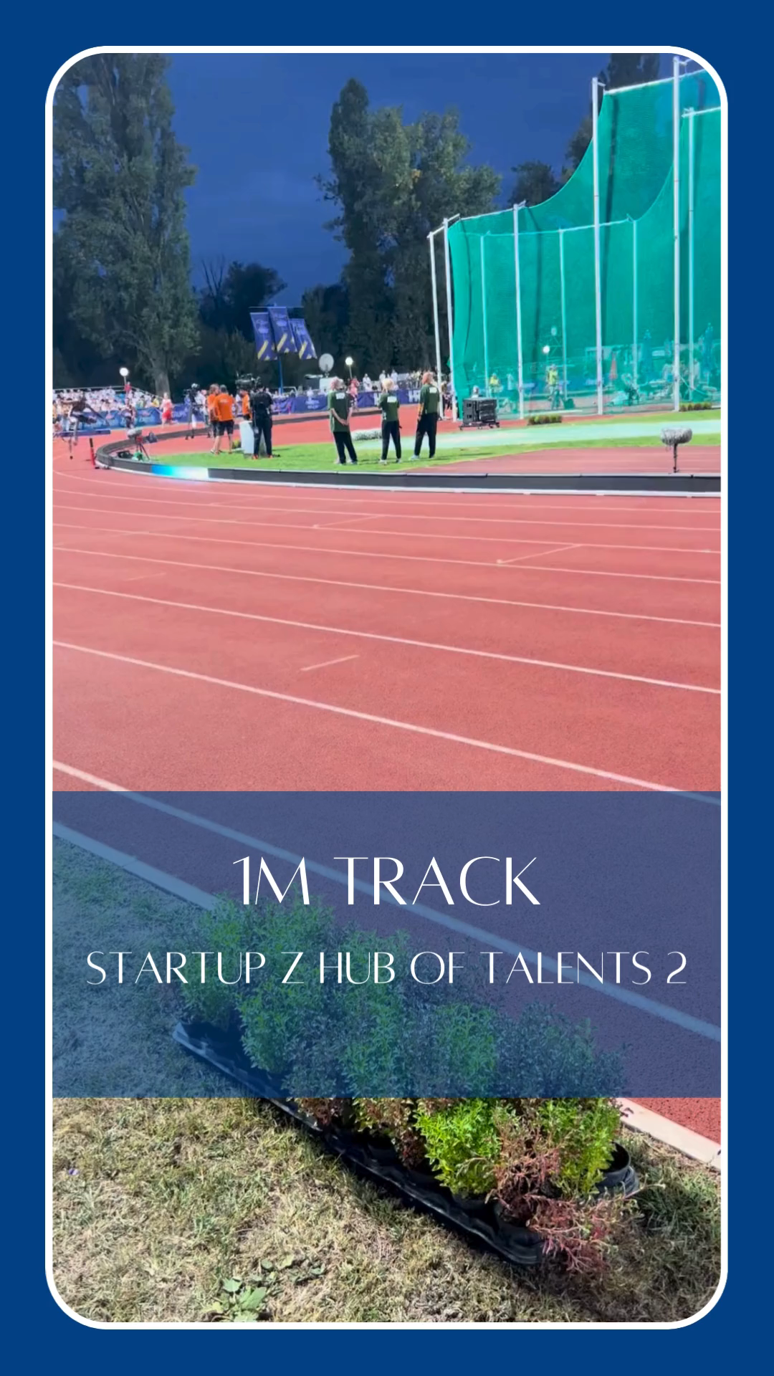
SUCCESS STORIES
1M TRACK
Sports tech startup
Developing a modular training device mounted along the inner side of an athletics track
LED panels are controlled via mobile app, allowing runners to track their pace and rhythm to achieve specific training goals
Secured a private investor, with a cash injection of 1 million PLN

Slide 22



THANK YOU!
Let’s connect.
www.bpnt.bialystok.pl
m.podbielski@bpnt.bialystok.pl

