Slide 1


Driving Regional Growth through Innovation - highlighting best practices
A new dance-floor for Circular Solutions
Sergio Pérez García, General Director of External Action
sergio.perez.garcia@navarra.es

Slide 2
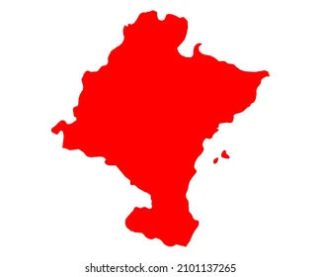

Slide 3

MAY 2022

Slide 4
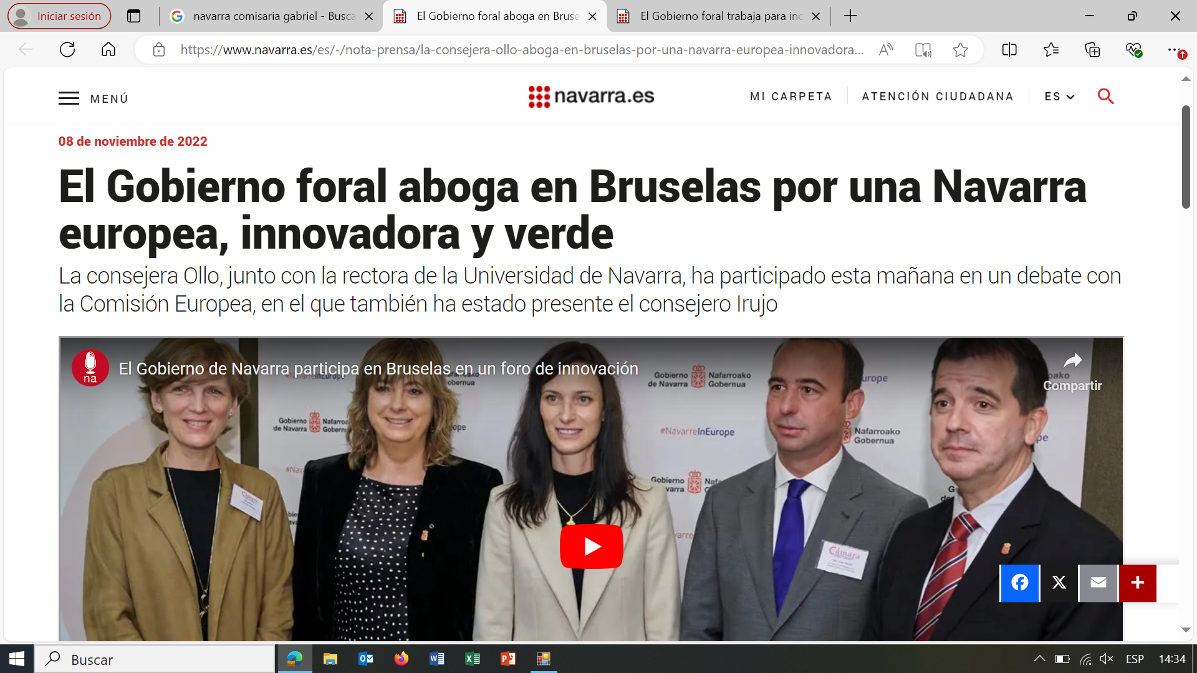

Slide 5
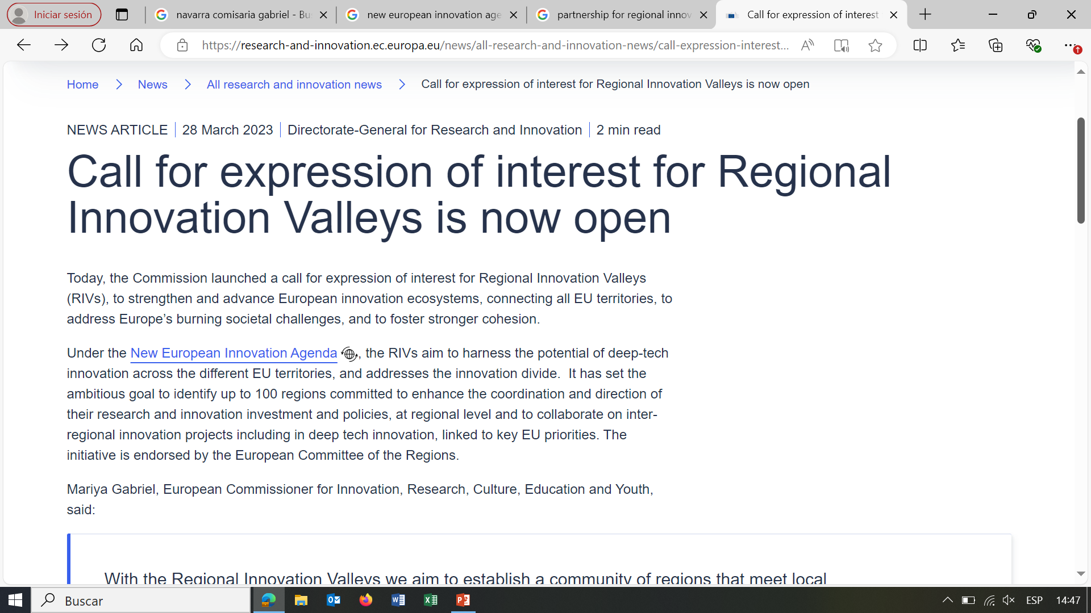

Slide 6

5th July 2023

Slide 7
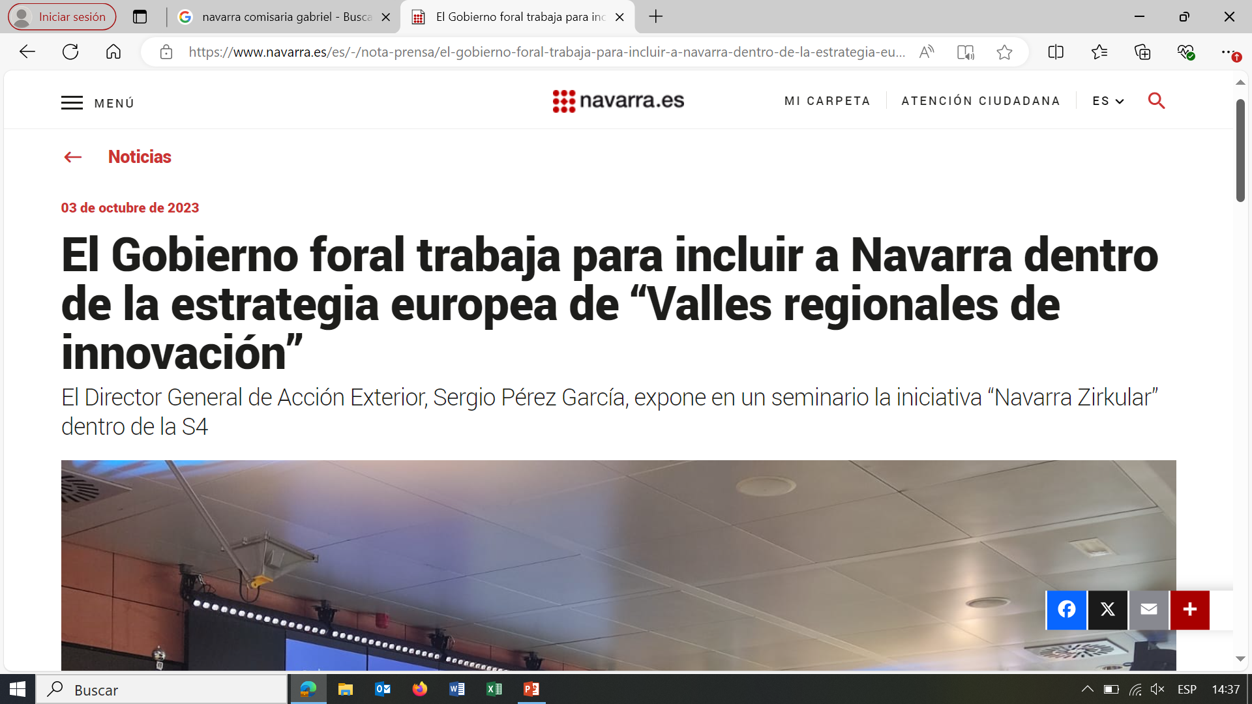
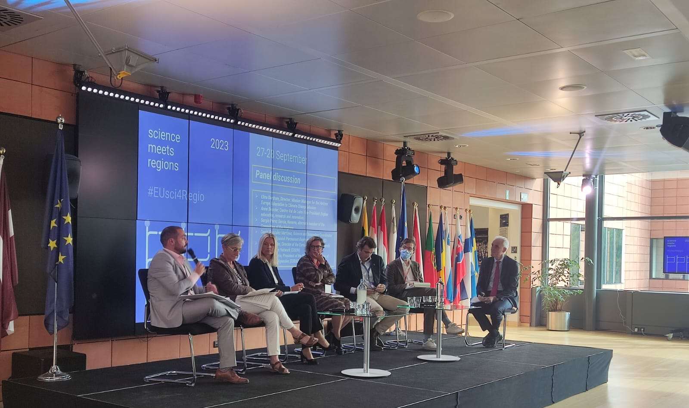
OCTOBER 2023
Science Meets Regions
“Partnerships for Regional Innovation – where next?”

Slide 8
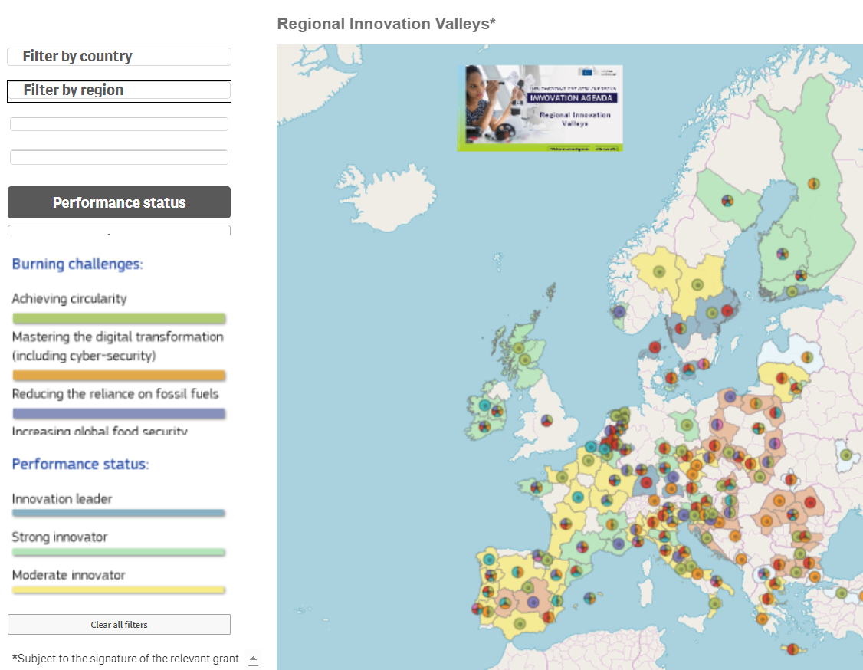

Slide 9

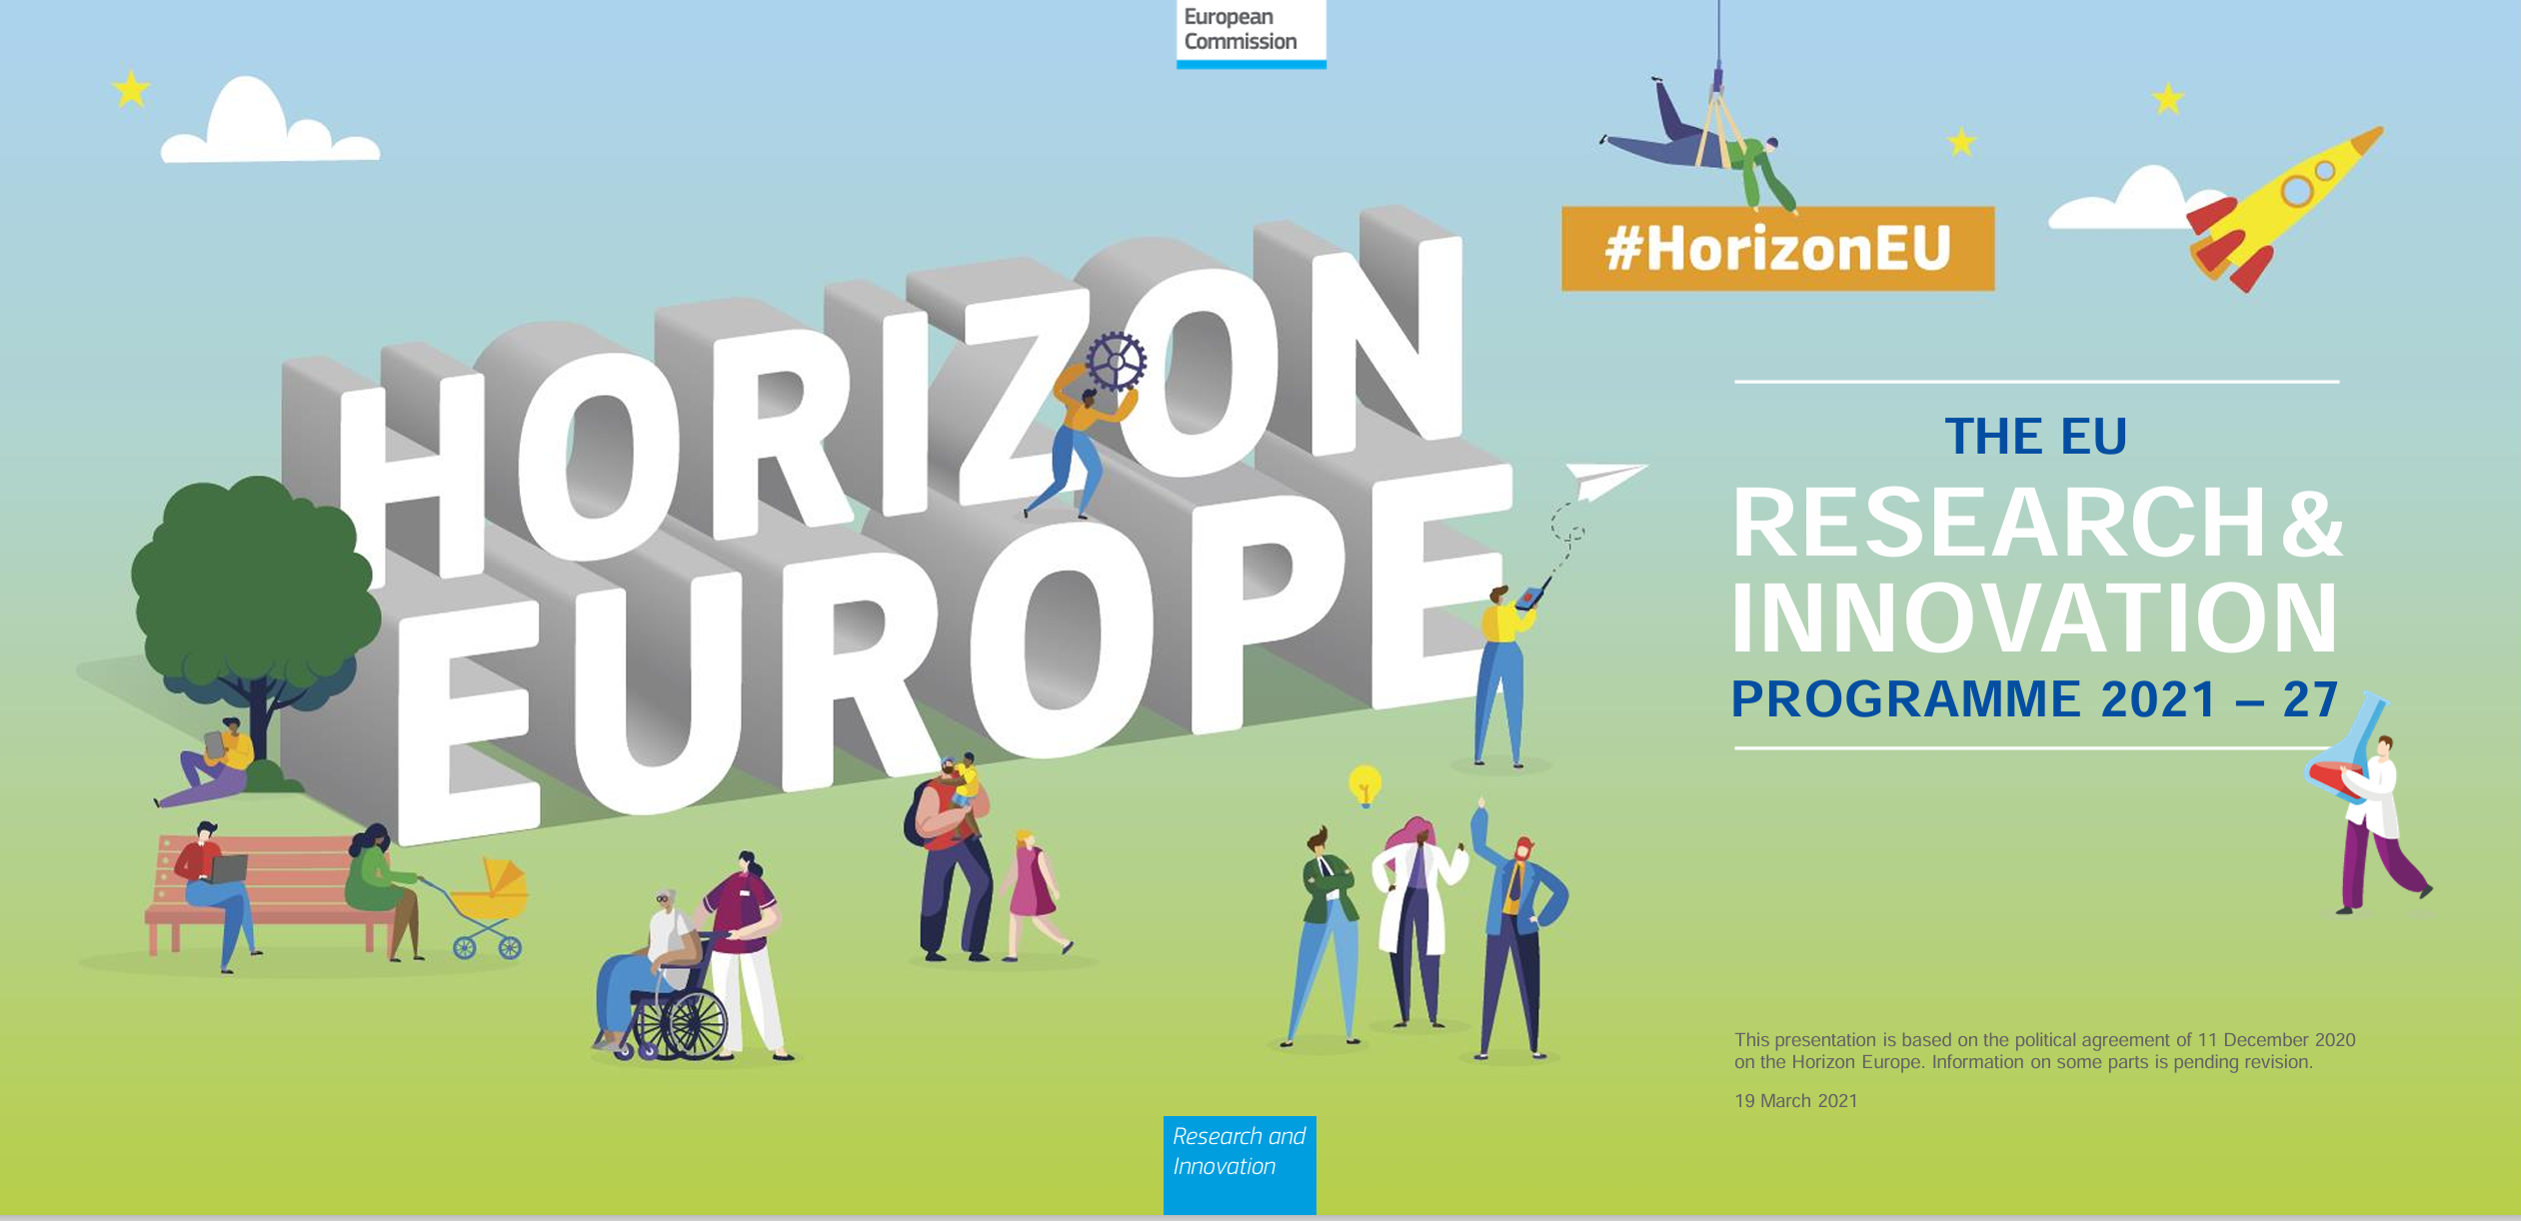

Regional Innovation Valleys
EUROPEAN CIRCULAR INNOVATION VALLEY (ECIV)
The project will create an interregional ecosystem within the European Union to transform value chains with the aim of developing and delivering new circular solutions to the market with a mission-oriented approach.

Slide 10
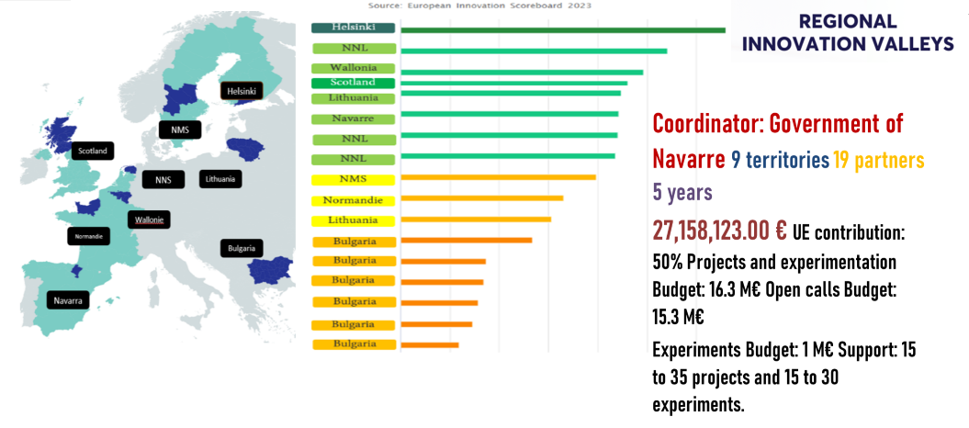
EUROPEAN CIRCULAR INNOVATION VALLEY (ECIV)
Project consortium:
Facilitators: ACR+

Slide 11

EUROPEAN CIRCULAR INNOVATION VALLEY (ECIV)
Objectives:
To create the European Circular Innovation Valley (ECIV), which will connect different EU territories/regions with two interrelated purposes (green & economic):​
Making a significant advance in the transition towards a circular economy of the regions (and of Europe).​
Generating sustainable growth and development in the participating regions (and in Europe as a whole). Taking advantage of the economic opportunities of circularity, creating new markets and new businesses.
ECIV will create a "dance floor" where agents and interest groups from innovation ecosystems will establish connections to propose solutions to the challenges that circular transformation offers working in our main industrial value chains.

Slide 12
EUROPEAN CIRCULAR INNOVATION VALLEY (ECIV)
Metodology:
Analysis of the regional challenges in Circular Economy
Missions and submissions definition to guide the ecosystems connections
Interregional ecosystems conection in sub-misisons approach
Open calls for innovation projects addressing the missions
Transferring the knowledge to other regions
  Analysis of regional contexts and challenges, including policies, strategic planning and actors
  Mission-oriented plans: specific missions and sub-missions to address objectives
  Connecting ecosystems (the dance floor): facilitating contact and collaboration between stakeholders from different regions. Creation of spaces for dialogue, sharing of challenges and development of solutions to specific challenges that mobilize, involve and connect regional actors.
  Solve specific challenges by implementing deep-tech projects selected in the waterfall funding call
  Transfer and replication

Slide 13
EUROPEAN CIRCULAR INNOVATION VALLEY (ECIV)
Territories/Countries:
NAVARRA REGION
1.(Coordinator) – Government of Navarra (GN)
2. Sociedad de Desarrollo de Navarra (SODENA)
NORTHERN NETHERLANDS REGION Alliance or Provinces of Friesland, Groningen and Drenthe)
3. Gemeenschappelijke Regeling Samenwerkingsverband Noord-Nederland (SNN)
4. Provincie Groningen (GRO)
5. Provincie Fryslan (FRY)
4. Provincie Drenthe (DTH)
7. Rijksuniversiteit Groningen (UGRO)
8. Stichting Innovatiepact Fryslan (SIF)
NORRA MELLANSVERIGE REGION -NORTH MIDDLE SWEDEN (Alliance of regions of Dalarna, Värmland, Gävleborg)
9. Region of Dalarna (DAL)
10. Region of Värmland (VÄR)
11. Region of Gävleborg (GÄV)
NORMANDIE REGION
12. Region Normandie (NOR)
BULGARIA
13. Ministry of Innovation and Growth of Bulgaria (MIGB)
WALLONIA REGION
14. Service public de Wallonie Economie (SPW)
LITHUANIA
15. Inovacijų agentūra [Innovation Agency Lithuania] (IAL)
SCOTTLAND
16. Scottish Enterprise
17. Strathclyde University (IbioIC)
HELSINKI - UUSIMAA
18. Helsinki-Uusimaa Regional Council
OTHER STAKEHOLDERS
19.ACR + (Association of Cities and Regions for sustainable Resource management) (ACR+)
19
Entities
9
Territories/ countries

Slide 14
“Co-funded by the European Union. Views and opinions expressed are however those of the author(s) only and do not necessarily reflect those of the European Union or European Innovation Council and SMEs Executive Agency (EISMEA). Neither the European Union nor the granting authority can be held responsible for them.”

