Slide 1
European Week of Regions and Cities 2024:
Driving regional growth through innovation – highlighting best practices
Catherine Wendt
Head of Unit, DG REGIO
Unit G1 - Smart and Sustainable Growth
European Alliance group
European Committee of the Regions
Brussels, 8.10.2024

Slide 2
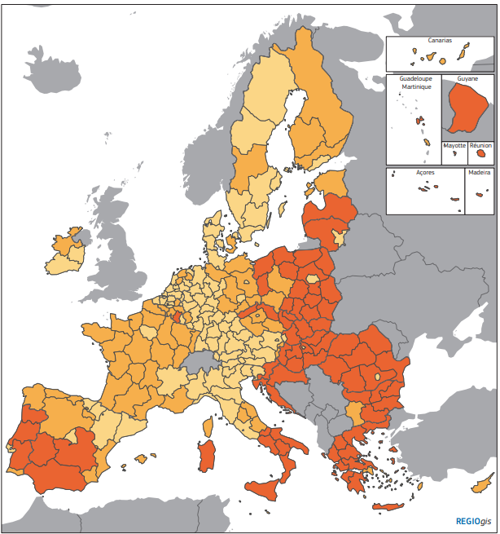

Cohesion policy - the EU’s main investment policy
Cohesion policy targets all regions and cities in the European Union in order to support job creation, business competitiveness, economic growth, sustainable development, and improve citizens’ quality of life.

Slide 3
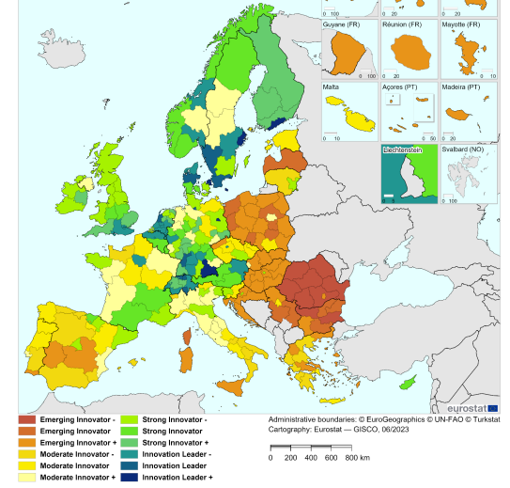
Innovation gap across the EU regions
European Regional Development Fund
Support to Research and Innovation 2021-2027, (SO1.1. in PO1)
Total EUR 34.5 Billion*:
    Less Developed Regions
    EUR 20.3 Billion (58.8%)
    Transition Regions
    EUR 8.7 Billion (25.3%)
    More Developed Regions
    EUR 5.4 Billion (15.6%)
    * incl. the outermost regions /N. sparsely populated areas (0,3%)
Transition and less developed regions correspond mostly to the moderate and emerging innovators.
Regional Innovation Scoreboard 2023

Slide 4

Policy objective 1: Smarter Europe - highlights and key figures
European Regional and Development Fund
Enhancing Research & Innovation:
  Access for 83,000 researchers to improved facilities.
Supporting Business Growth:
Funding for 725,000 companies in smart growth initiatives.
Modernisation of Public Services & Upgrading of digital skills and infrastructure:
Connecting 3.1 million homes with high-speed networks.
Digitizing Public Administration:
Transformation of 22,500 public administrations.
  Key Outcome: Fostering research and innovation and addressing the innovation and digital divide.

Slide 5
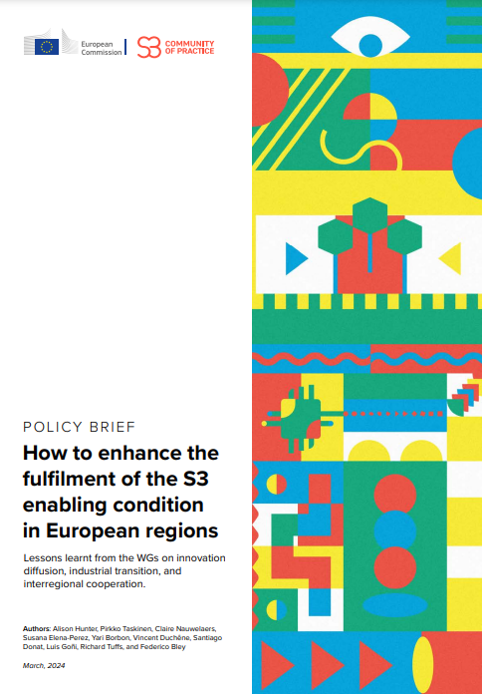

Smart specialisation framework
Smart specialisation strategies (S3) key requirement for Cohesion policy support to research and innovation
S3 reflect regions’ strengths and needs and define their priority areas for R&I investments
175 smart specialization strategies developed across the EU at national/ regional level

Slide 6
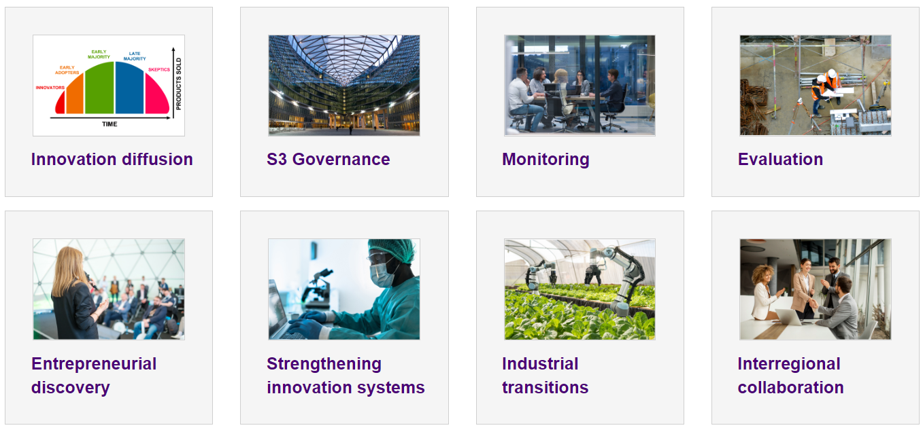
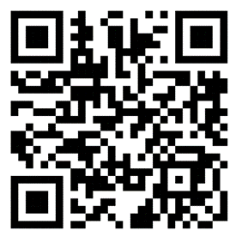
Smart Specialisation Strategy (S3) Community of Practice
Strategic services to S3 practitioners
Follow and join S3 CoP

Slide 7
S3 CoP: Thematic Platforms and Partnerships
Policy advice
Support
S3 Expert Group
Thematic Platform and Partnerships
Targeted support to regions
Community engagement
S3 CoP Website
S3 CoP events
Working Groups
Thematic Platforms and Partnerships: bringing together regions exploring new value chains in specific priority areas based on shared interest in their S3.
Open to participation of regional authorities and/or quadruple helix
Outcomes: development of interregional investment projects, interregional collaboration projects, the alignment of S3 between various regions, ...
Follow and join Smart Specialisation Community of Practice, flagship initiative
of DG REGIO strategic services to S3 practitioners: →

Slide 8
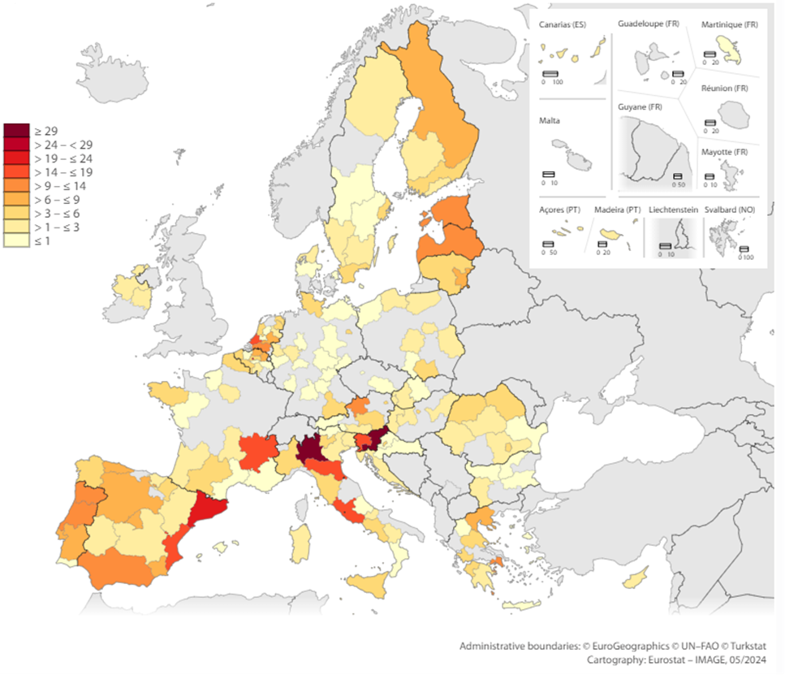
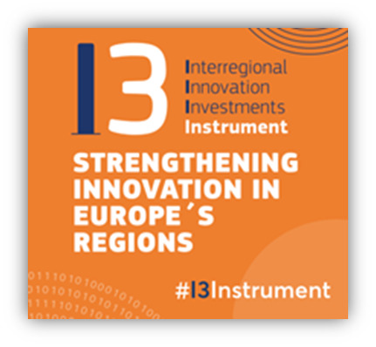
Interregional Innovation Investments (I3) Instrument
Interregional cooperation: I3* - creating new value chains and enhancing the competitiveness of existing ones across the EU
I3 focus: green, digital and smart manufacturing
Calls from 2021-2024 resulted in more than 50 I3 Consortia participating in the I3 Instrument
I3 is relevant for all regions, with partners from almost every Member State* participating in successful projects →
* Includes also partners from outermost regions like Canarias, Martinique, Madeira, and the Azores…
*European Regional and Development Fund, art. 13

Slide 9





New European Innovation Agenda (NEIA)
Enabling deep tech innovation through experimentation spaces and public procurement
Funding for deep tech scale-ups
Accelerating and strengthening innovation in European Innovation Ecosystems across the EU and addressing the innovation divide
Improving policy making tools
Fostering, attracting and retaining deep tech talent
‘Fostering connected Regional innovation valleys across the EU’
[Overall commitment of ERDF and Horizon Europe: EUR 170 million]

Slide 10
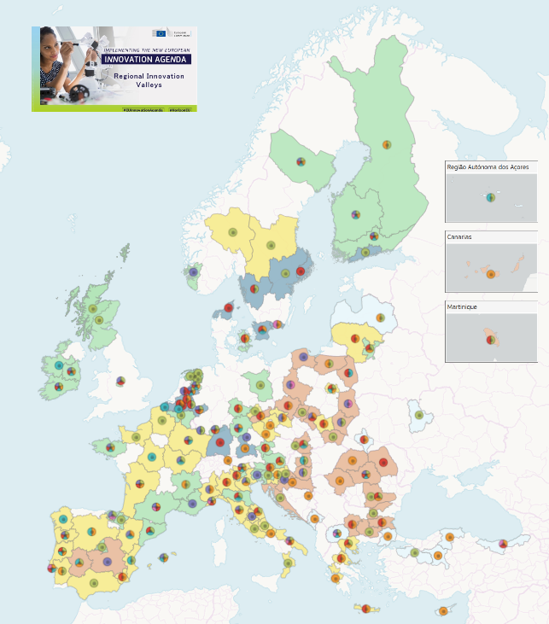
Fostering the Regional Innovation Valleys across the EU
EU Cohesion and R&I policies bring together less and more developed regions committed to enhance the directionality of their R&I investment responding to five EU burning challenges, building on Smart Specialisation Strategies (S3).
149 regions identified as the Regional Innovation Valleys through:
the Interregional Innovation Investments (I3) Instrument 2023 I3 calls for proposals (ERDF)
the European Innovation Ecosystems programme: 2023 EIE WP call for proposals (Horizon Europe)
Additional action: Call of Expression of Interest (no funding)

Slide 11
Regional Innovation Valleys – what’s next?
RIVs selected under the avenues of the 2023 EIE and I3 Instrument calls: participants of the EIE and I3 successful projects will receive specific funding from Horizon Europe and ERDF to implement their projects.
All regions identified as Regional Innovation Valleys (RIVs) will benefit from:
Increased visibility, including through dedicated communication actions and events
Facilitated matchmaking and identification of relevant partners, for example, to support the generation of new projects
Facilitated exchanges of best practices and cooperation with other Regional Innovation Valleys >> S3 CoP in Rimini

Slide 12


Slide 13
Thank you!

