Slide 1



Energy in Flanders
Improving energy efficiency and promoting renewable energy production:
Flanders' experience
Andries Gryffroy
Member of the Flemish Parliament
Senate

Slide 2
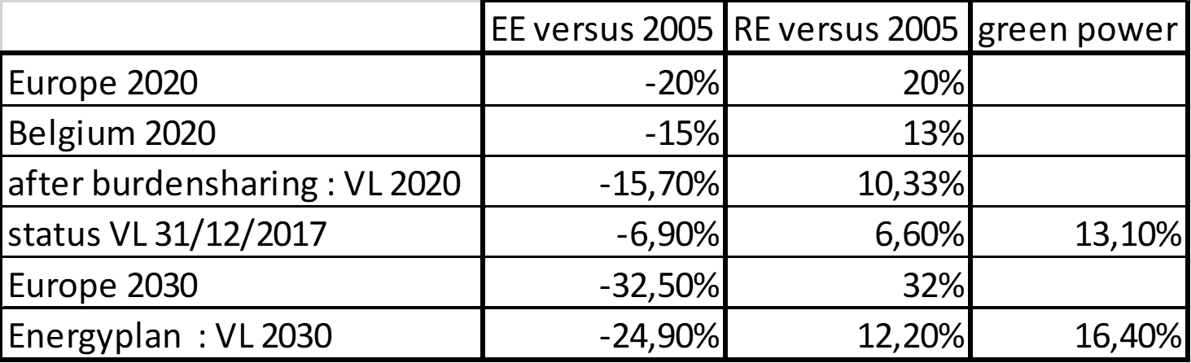

Some figures about energy in Flanders (1)

Slide 3
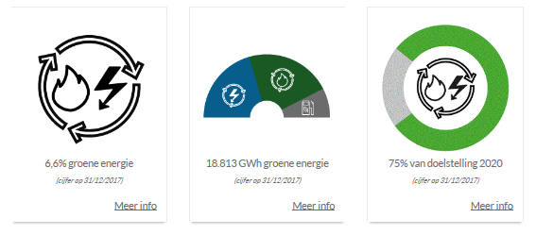
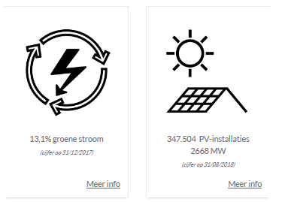
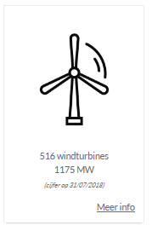
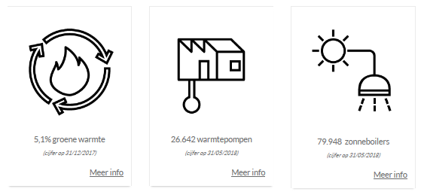
Some figures about energy in Flanders (2)
www.energiesparen.be

Slide 4
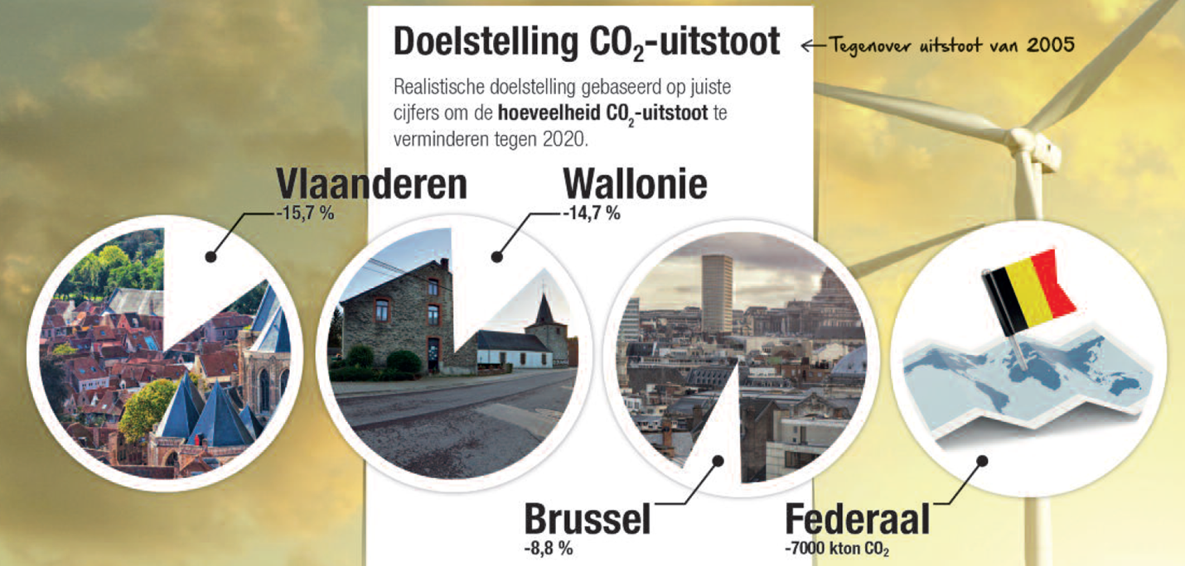
Some figures about energy in Flanders (3)

Slide 5
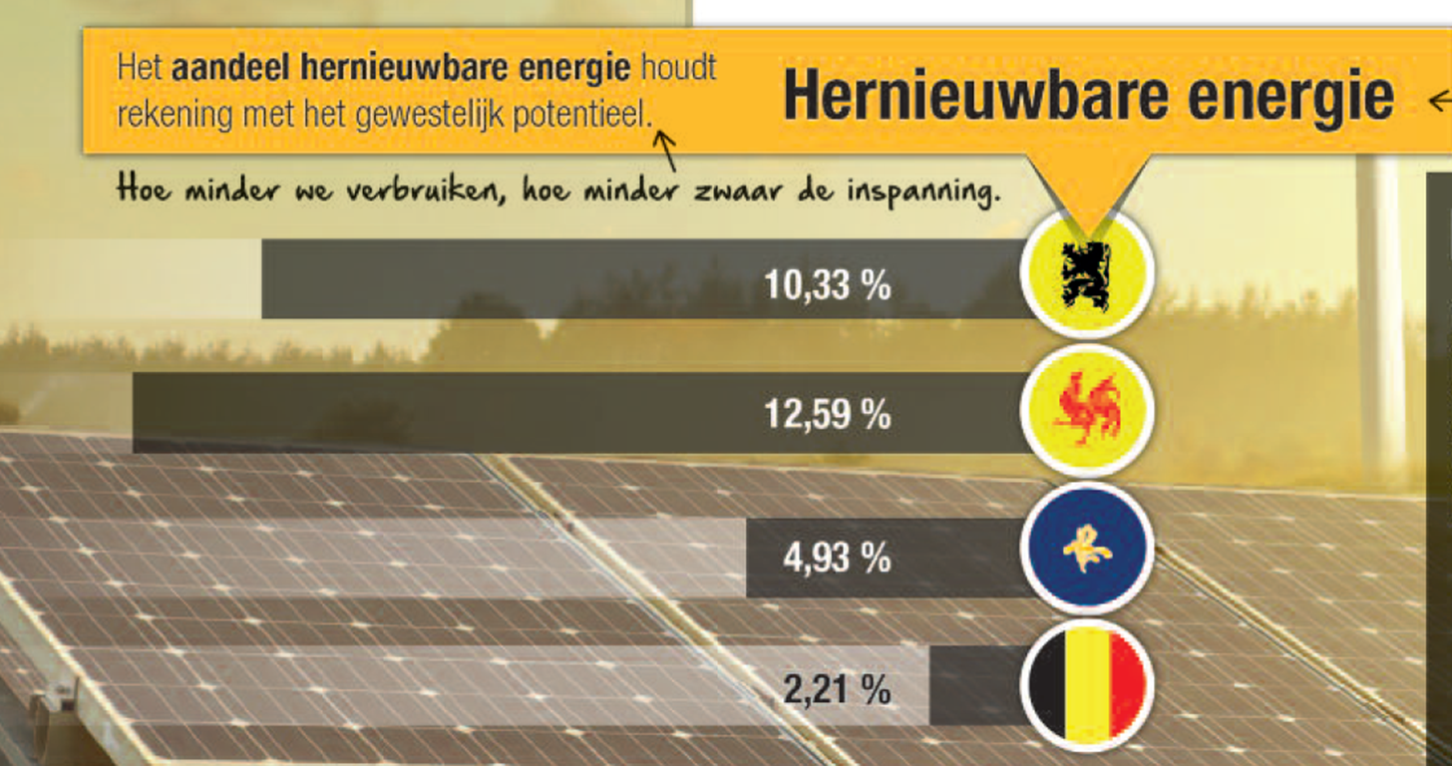
Some figures about energy in Flanders (4)

Slide 6
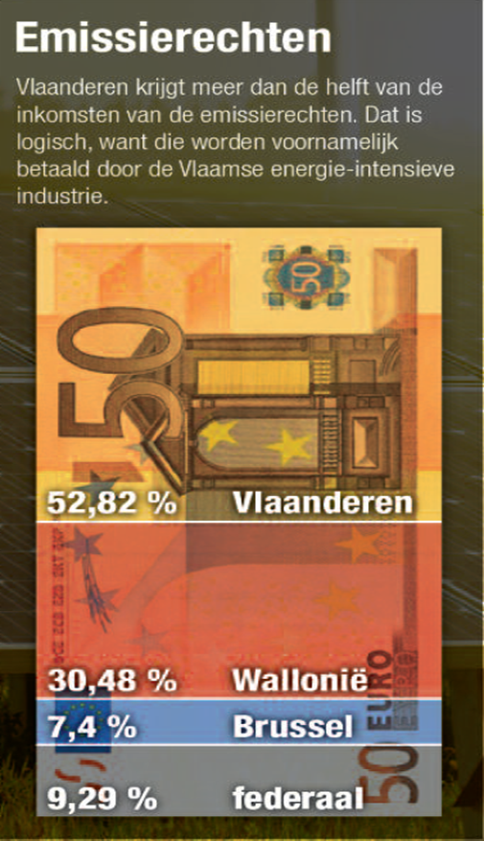
Some figures about energy in Flanders (5)

Slide 7
Some figures about energy in Flanders (6)

Slide 8
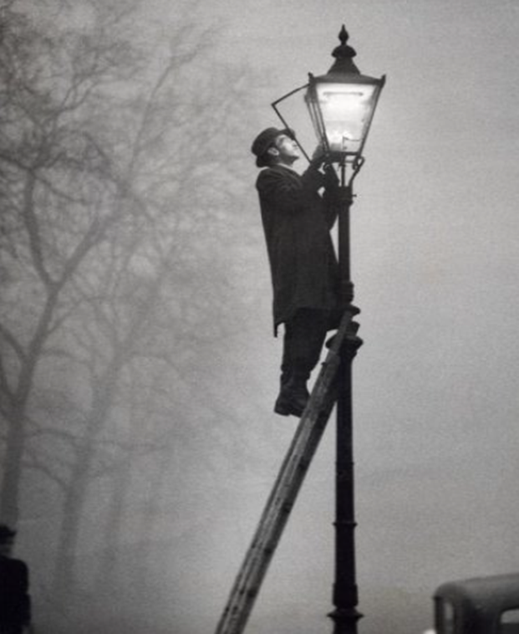
EE : measures
Renovation of public – private – multi household houses
– retail – offices
Public lighting : LED + light control
ESCO + EPC : just started
Capex support (part of the electricity bill : 125 milj €/year) for EE – heat pumps – sunboilers
Demonstration projects for SME’s en ME’s
Benchmark- & auditconvenant for big consumers (future
also for medium consumers each sector : dutch model)

Slide 9
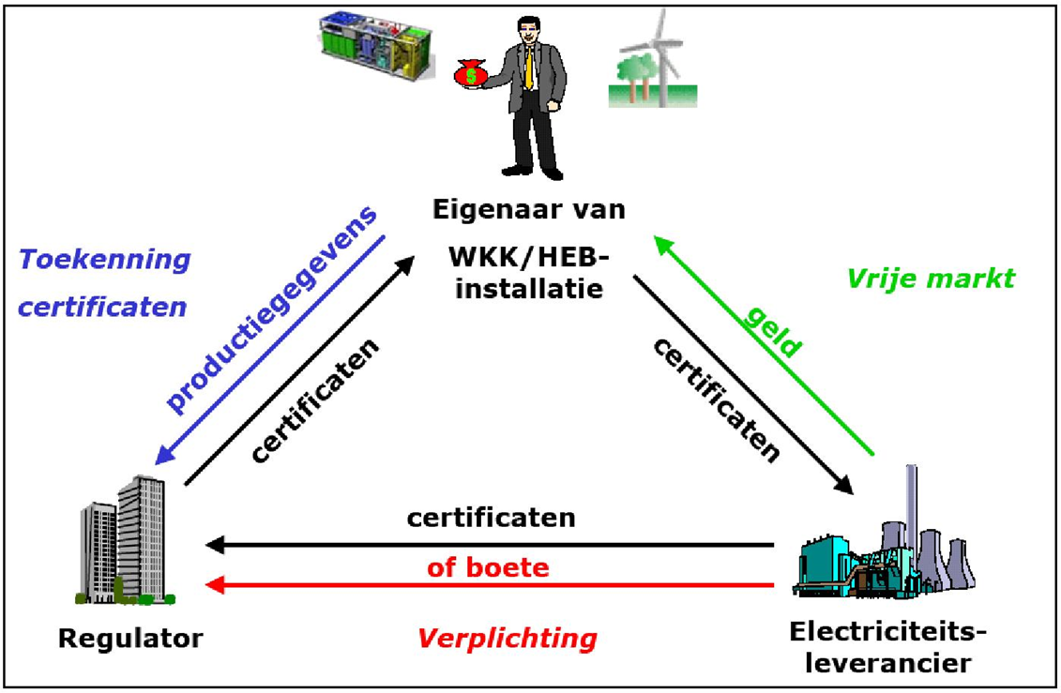
RE: Capex or Opex, green power certificates
OPEX support, but in the future : tendering? CAPEX support?

Slide 10
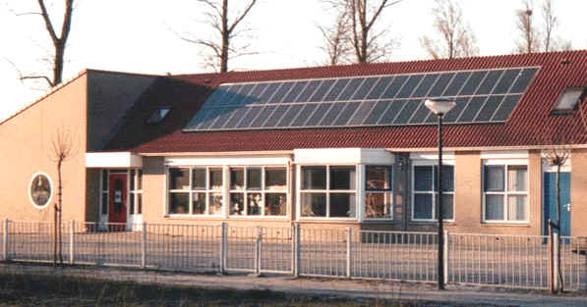
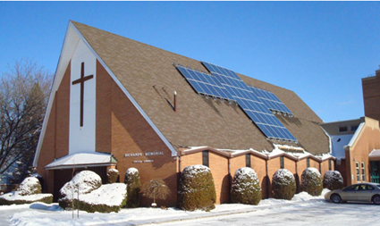
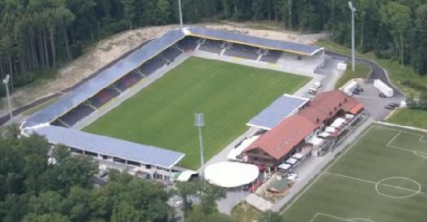
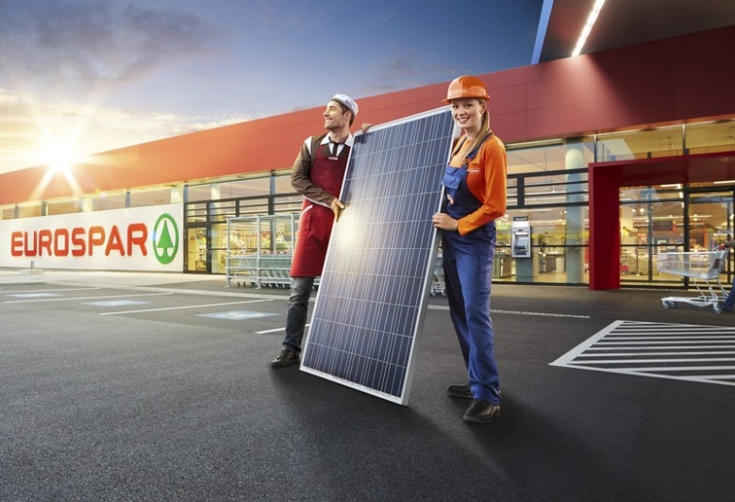
RE : examples : cooperative company – crowdlending – sunsharing - …

Slide 11
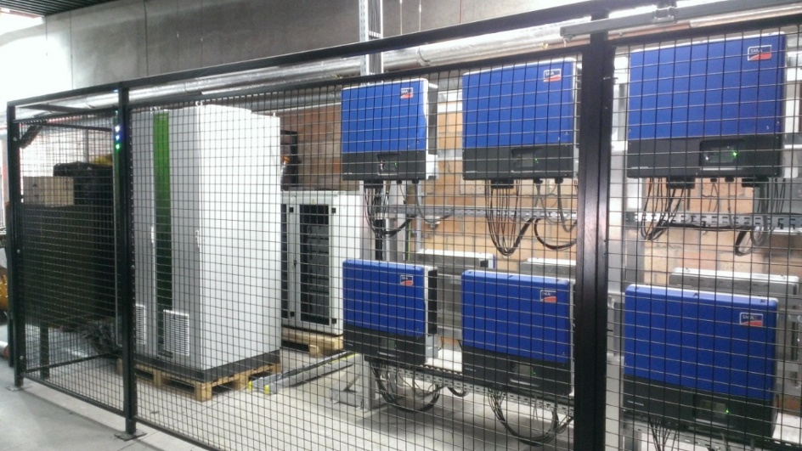
RE : others
Battery
Regulation for heat network
Smart digital meter
New tarrifs : capacity driven – flexibel - dynamic

Slide 12
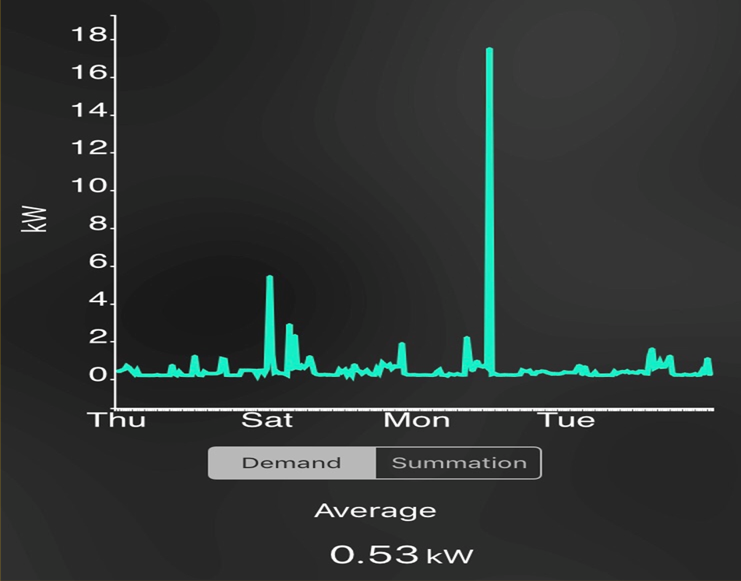
Involve the consumer in the green energy market
Consumers profile ?? : day – night bill, we need a electricity cost depending on the presence of reneable energy
What is in for me (€) : load on the net = challenge of the future

Slide 13
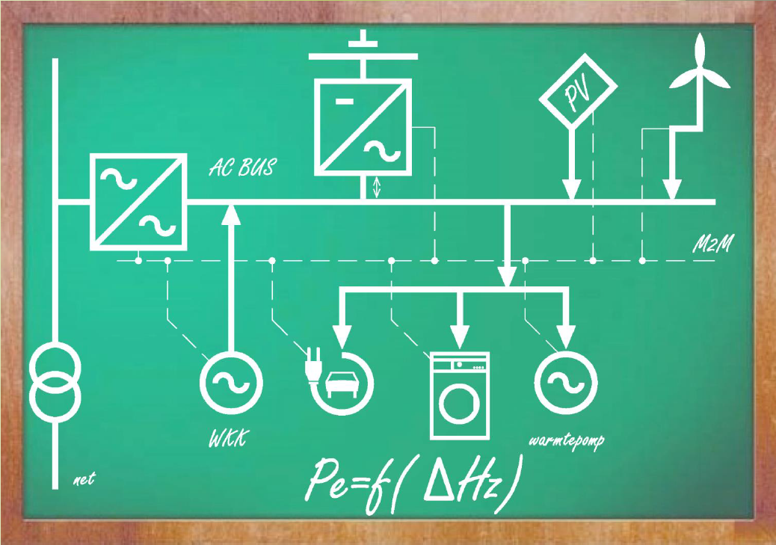
Energytransition : the grid of the future

Slide 14
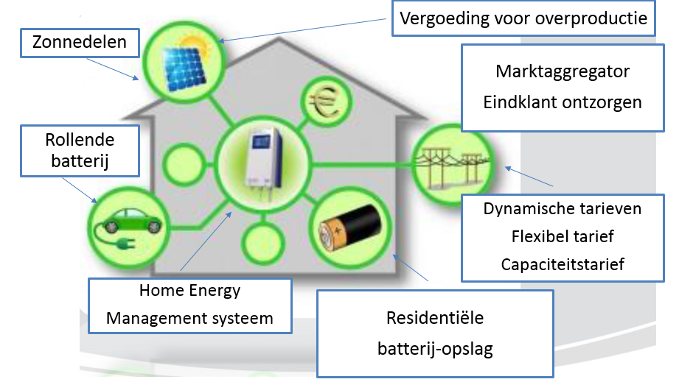
Conclusion :
PV for public houses
Sunsharing
New players on the
Energy market
o
Energy
Mobility
Dynamic prices
Flexibel prices
Capacity driven
Home energy
Management system
Home battery – Heat network – heatpump – sun boilers
o

Slide 15
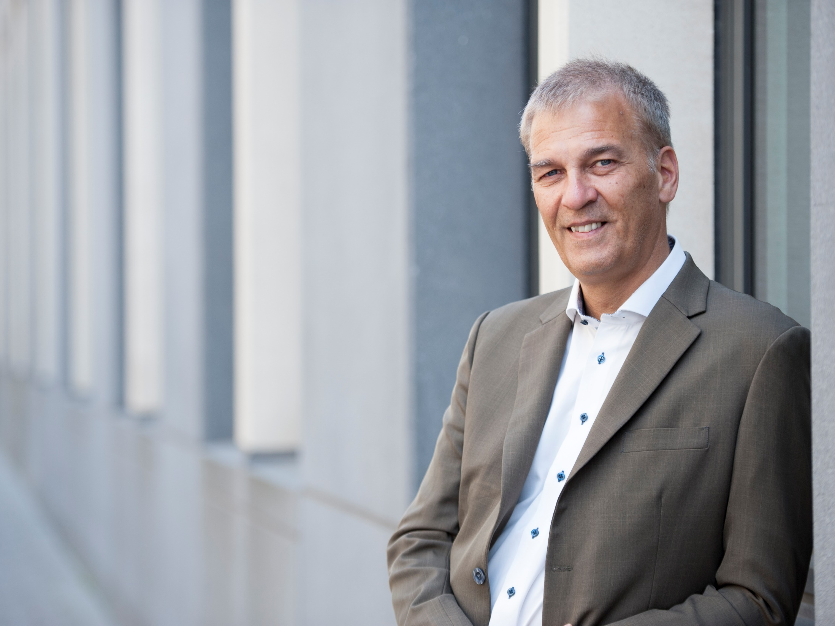




Andries Gryffroy Member of the Flemish Parliament Member of the Senate of Belgium
Contact
andries.gryffroy@vlaamsparlement.be
www.andriesgryffroy.be
www.facebook.com/gryffroy
www.twitter.com/gryffroy

