Slide 1
Catalonia's experience in the use of European funding and the importance of simplification.
Teresa Medina Plans
Deputy General Director of Economic Programming
Bucharest, 26th November 2018

Slide 2

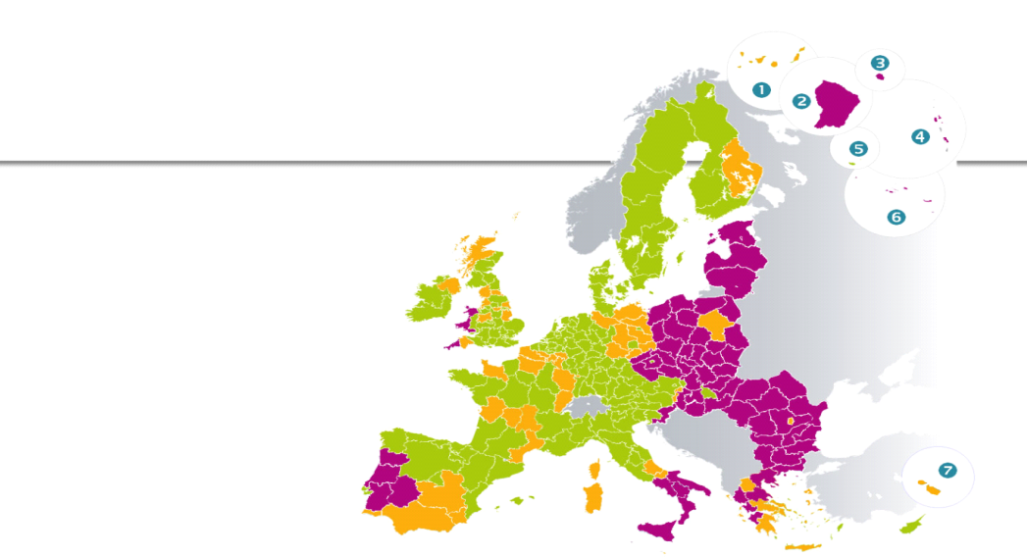
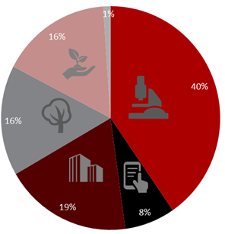
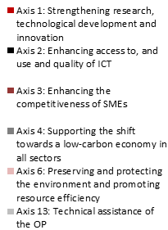

Characteristics of ERDF Operational Programme Catalonia 2014-20
1
2
835 M
More developed region
50%
> 90 %
3
75 -
90 %
Thematic Concentration
< 75% GDP of the EU average
4
Intervention logic
RIS3CAT Strategy

Slide 3

Organisational chart of ERDF Operational Programme Catalonia 2014-20
Complex system
Control overlaps
Different interpretations
European Commission
Audit Authority
Managing Authority
Certifying Authority
Ministry of Treasury
Ministry of Treasury
Ministry of Treasury
IGAE
Intermediate body Government of Catalonia
Coordinating body. Directorate General for Economic Promotion, Competence and Regulation
Granting entity
beneficiaries
beneficiaries
beneficiaries
beneficiaries

Slide 4

Evaluation of the experience (I). Strengths
Strengths
The ERDF funding boosts and accelerates the investments in high impact projects for the region.
Management of the EU programmes permits long-term planning.
The application of the structural funds has favoured the introduction of horizontal policies such as equal opportunities and respect for the environment.
Generate financing capacity to implement public policies.
Capitalize European resources to attract the private sector to carry out actions of public interest
The rule n+3 allows for an efficient management of funds, by adjusting the term of payment to the committed funds.
Ministry of Treasury
IGAE
DGEF
DGEF

Slide 5

Evaluation of the experience (II). Weaknesses
Weaknesses
The controls demanded by the European Commission are not proportionate to the amount of the funds received.
Existence of several “indeterminate legal concepts”, such as intensity and scope of the controls.
Changes on the rule interpretation to be applied
Complex system.
Control overlaps
Pool of external auditors with insufficient knowledge.
Low level of knowledge of some beneficiaries
Rigidity and bureaucratization of management and control
Ministry of Treasury
IGAE
DGEF
DGEF

Slide 6
Simplification proposals. Programming tasks
More confidence of the European Commission in the Member States and the management of the destination of the funds.
Yes to thematic concentration but with freedom for regions to choose prioritization.
Designation of programme authorities in the OP.
Designation of a Managing Authority in regions.

Slide 7
Simplification proposals. Management and execution tasks
N+3.
Flexibility of OP indicators monitoring system.
Freedom for the Member States and the regions both in choice and definition of indicators, given that they are aware of those that best fit the co-financed operations.
Indicators as instruments to check the actual execution of a programme but not as a penalising instrument.
Simplification of the annual report and of the OP monitoring reports.

Slide 8
Simplification proposals - Control tasks
Proportionality between the controls and the verifications to carry out.
Proportionality between the amount to be co-financed and the verification system to be carried out. The audits based on the result must be enhanced.
Avoid overlays of controls for different units that intervene in the selection of controls.
Establish guidelines and clear criteria from the beginning of the OP, to avoid different interpretations that are applied retroactively.

Slide 9
Thank you for you attention! http://fonseuropeus.gencat.cat/

