Slide 1
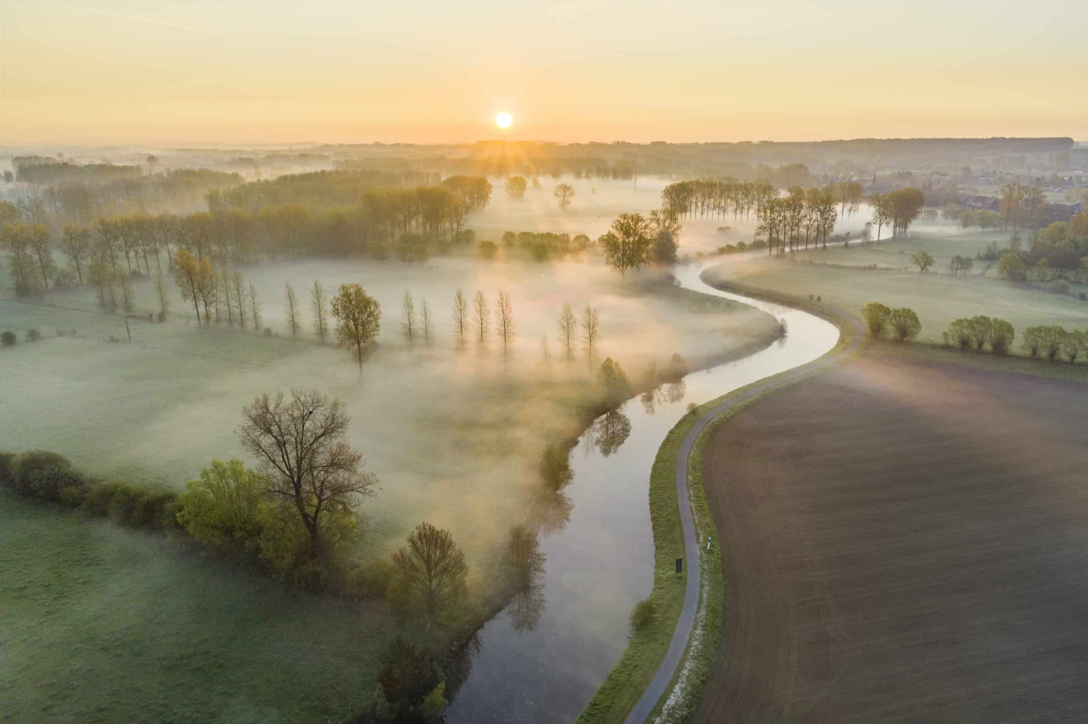
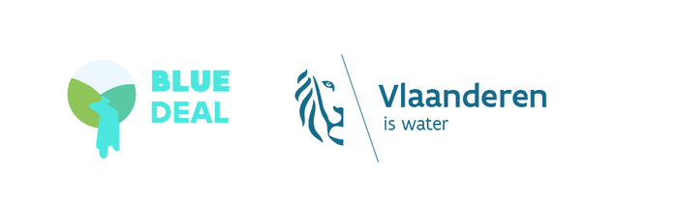
Blue Deal
Solving drought and water scarcity in Flanders

Slide 2
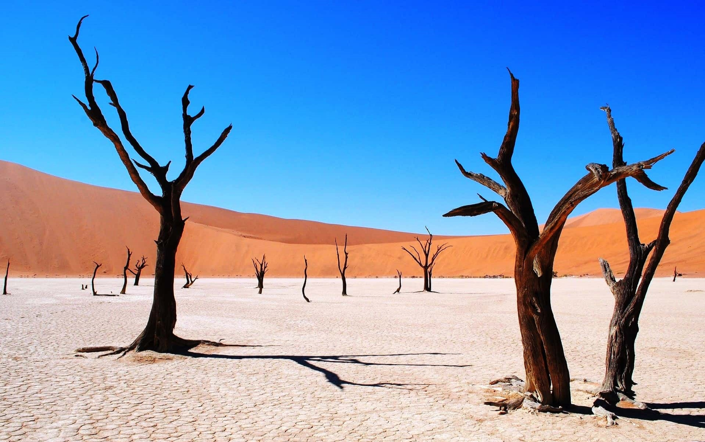
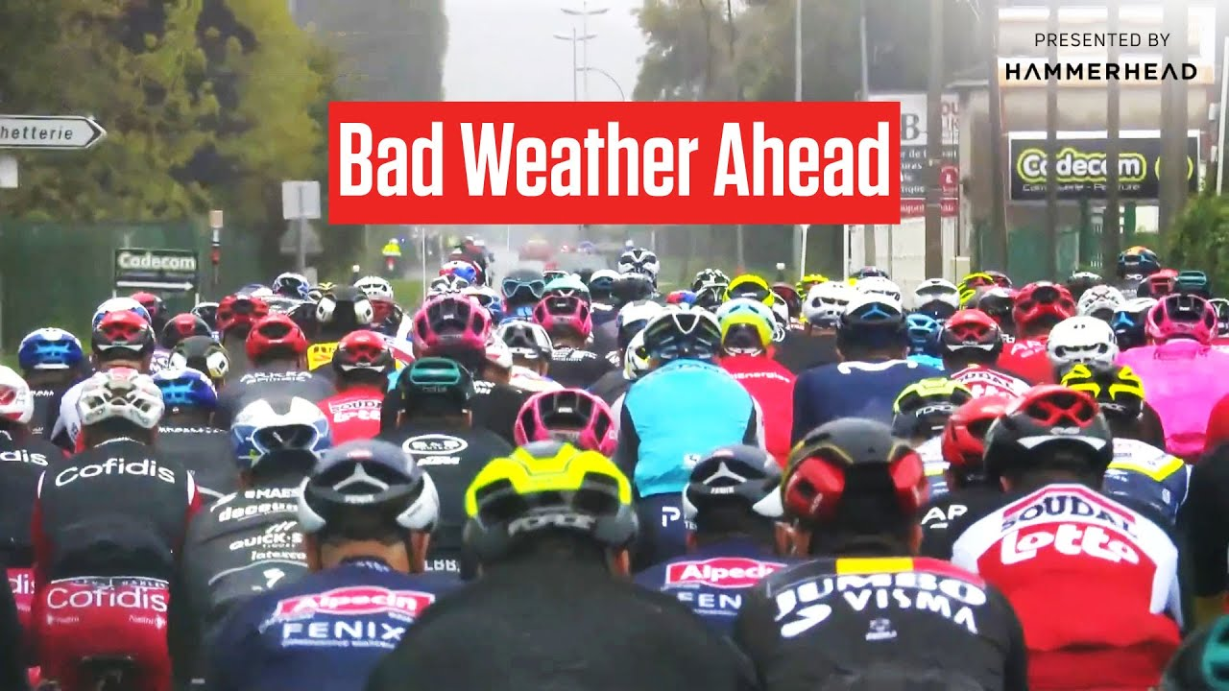
Why a Blue Deal?

Slide 3
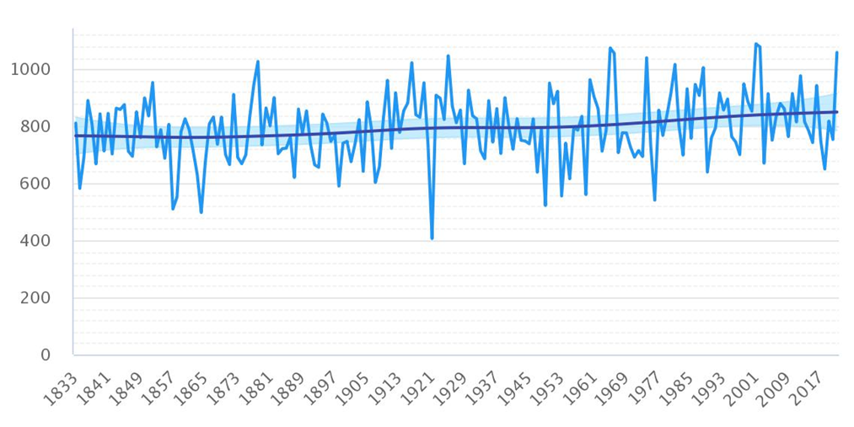
Why a Blue Deal?
Evolution of annual rainfall 1833 - 2021

Slide 4
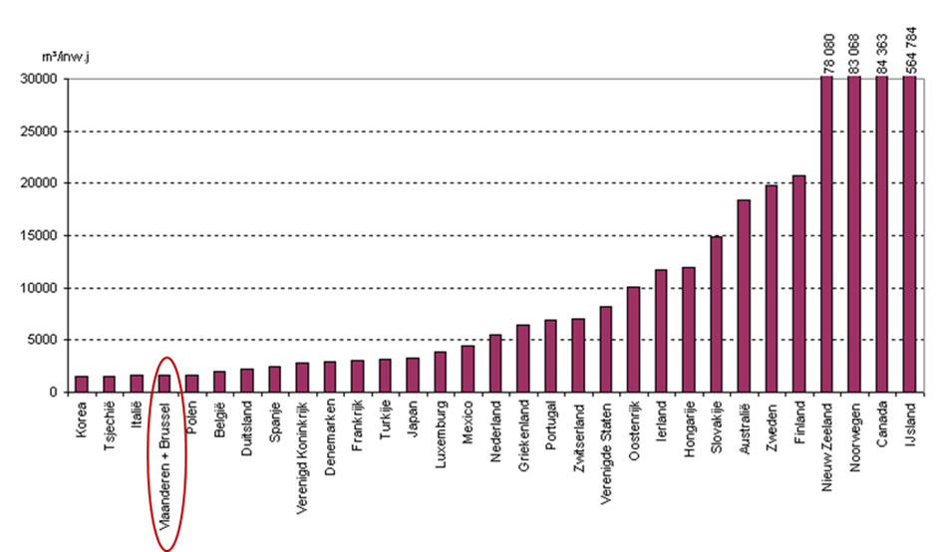
Why a Blue Deal?

Slide 5
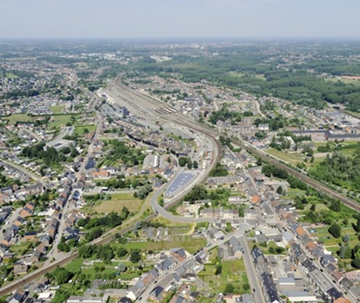
Why a Blue Deal?
Low water availability
High consumption
Many economic activities
Small area, much of which is paved
Water management focused on drainage
+ Climate change

Slide 6
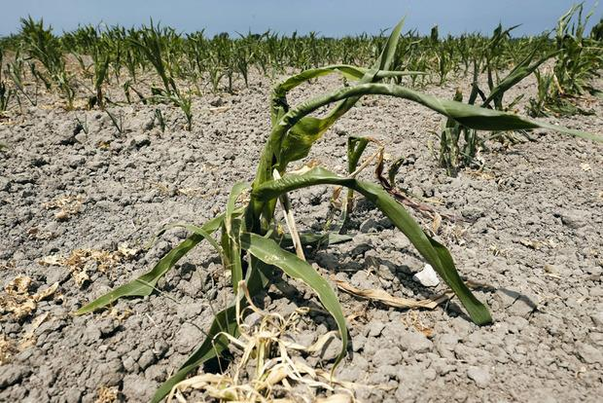
Why a Blue Deal?
Last 6 years: 5 dry years
Cumulative deficit of +- 6 months
Effects already tangible:
Peaking drinking water supply
Economy: agriculture and transport
Nature, environment and recreation

Slide 7
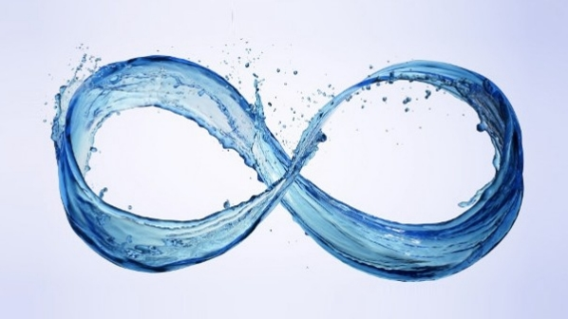
Blue Deal: structural solutions and systemic approach
Adress the roots of the problem
More infiltration
Lesser and smarter use
Valuing water!
Investments
Stimulating new approaches
Regulation

Slide 8
Six pillars:
Lead by example
Circularity becomes the standard
Agriculture and nature as part of the solution
Sensibilisating an stimulating inhabitants
Increasing the security of watersupplies
Investing in innovation

Slide 9
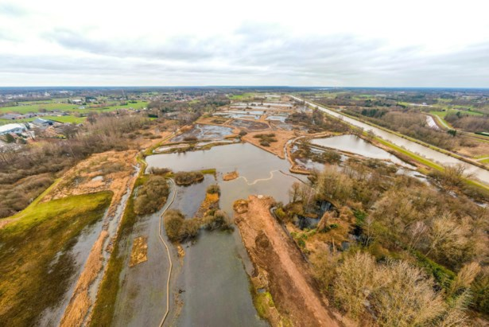
Nature based solutions
Restoring wetlands: 1.420 ha realised, + 1.000 ha will follow + Co-benefit: 3.900 ha
= Total: 6.300 ha wetlands
Natural reconfiguration of +100 km of waterways
Reduction of leakages losses: 9,4 billion L
Reuse: 24 billion L wastewater 4 to 8 billion L rainwater

Slide 10
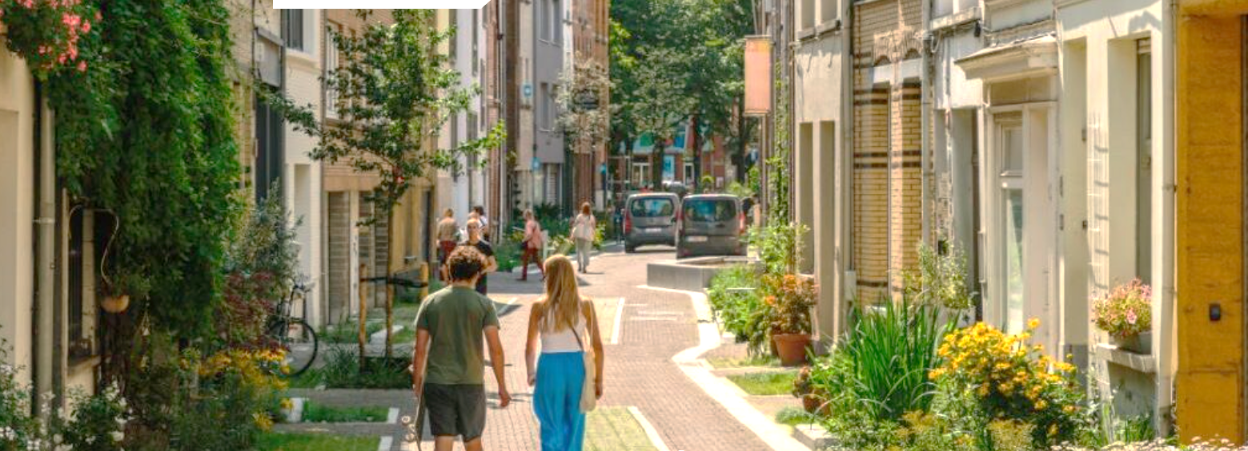
Legislation
New rainwater ordinance
Improved ‘watertoets’
Protection of watersensitive land
Drainage-regulation
Closing network

Slide 11
All good now?
Long term benefits
Sustained efforts: embedding the Blue Deal
New challenges

