Slide 1

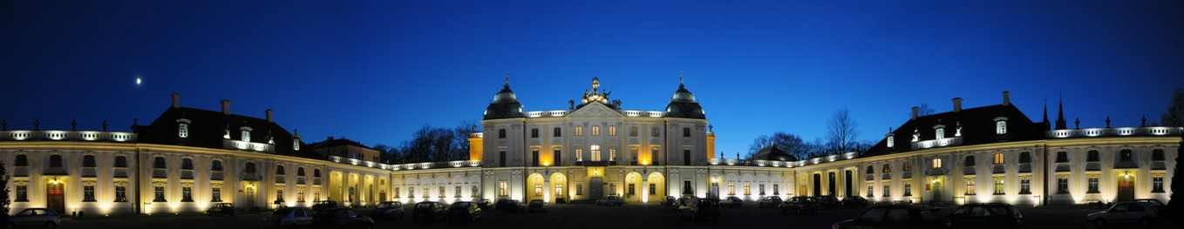
COMING BACK TO THE HEART OF THE CITY
Kościuszko Market Square [Rynek Kościuszki]
and John Paul II Square [Plac Jana Pawła II]
in Białystok

Slide 2
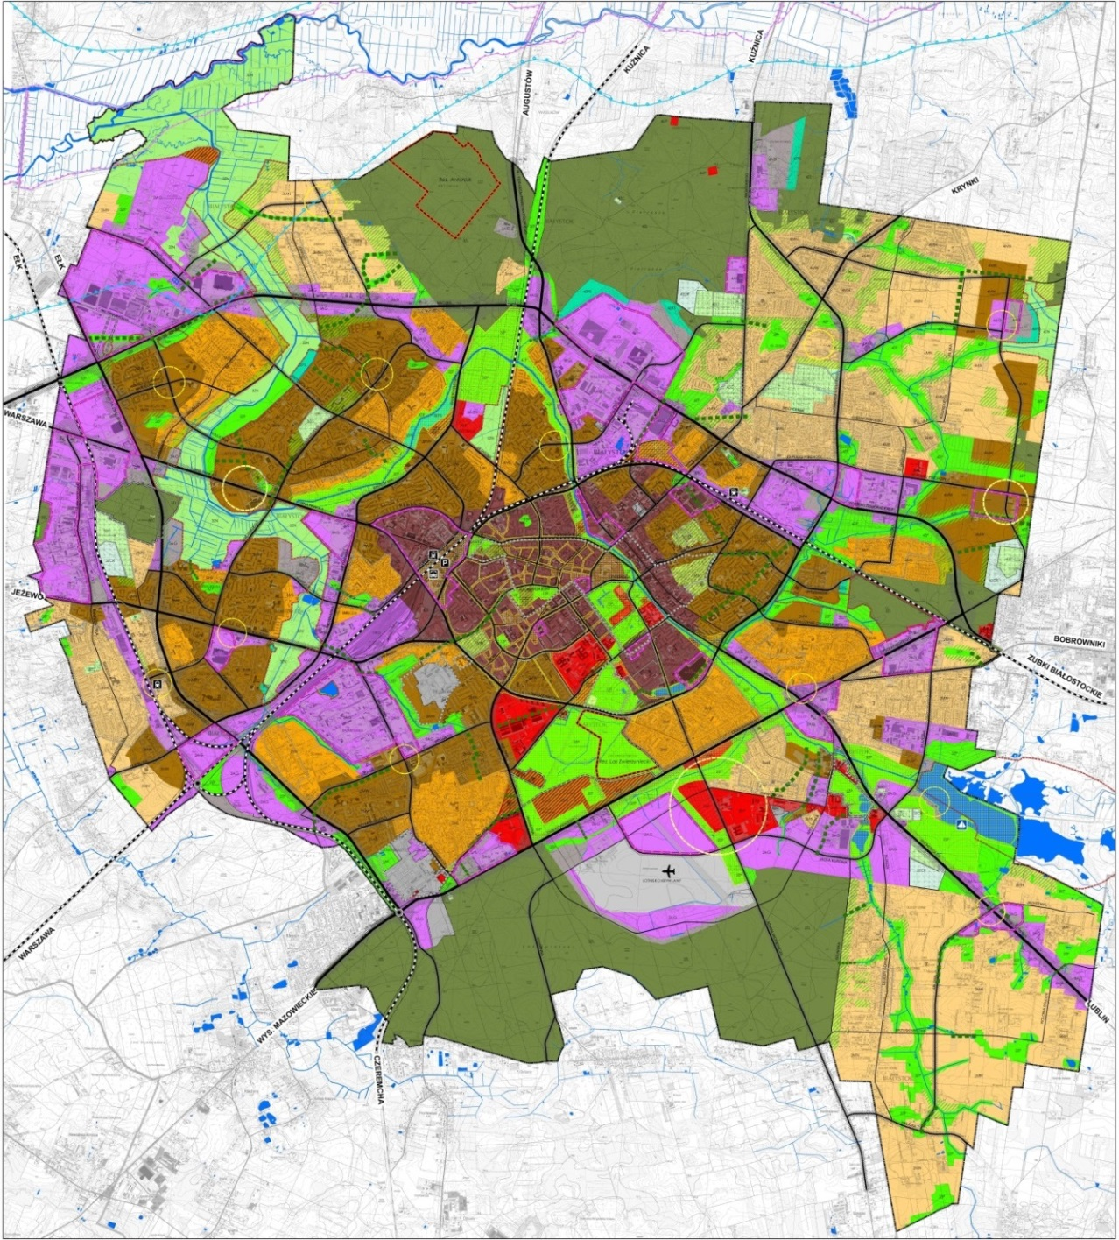
Location of the investment project

Slide 3
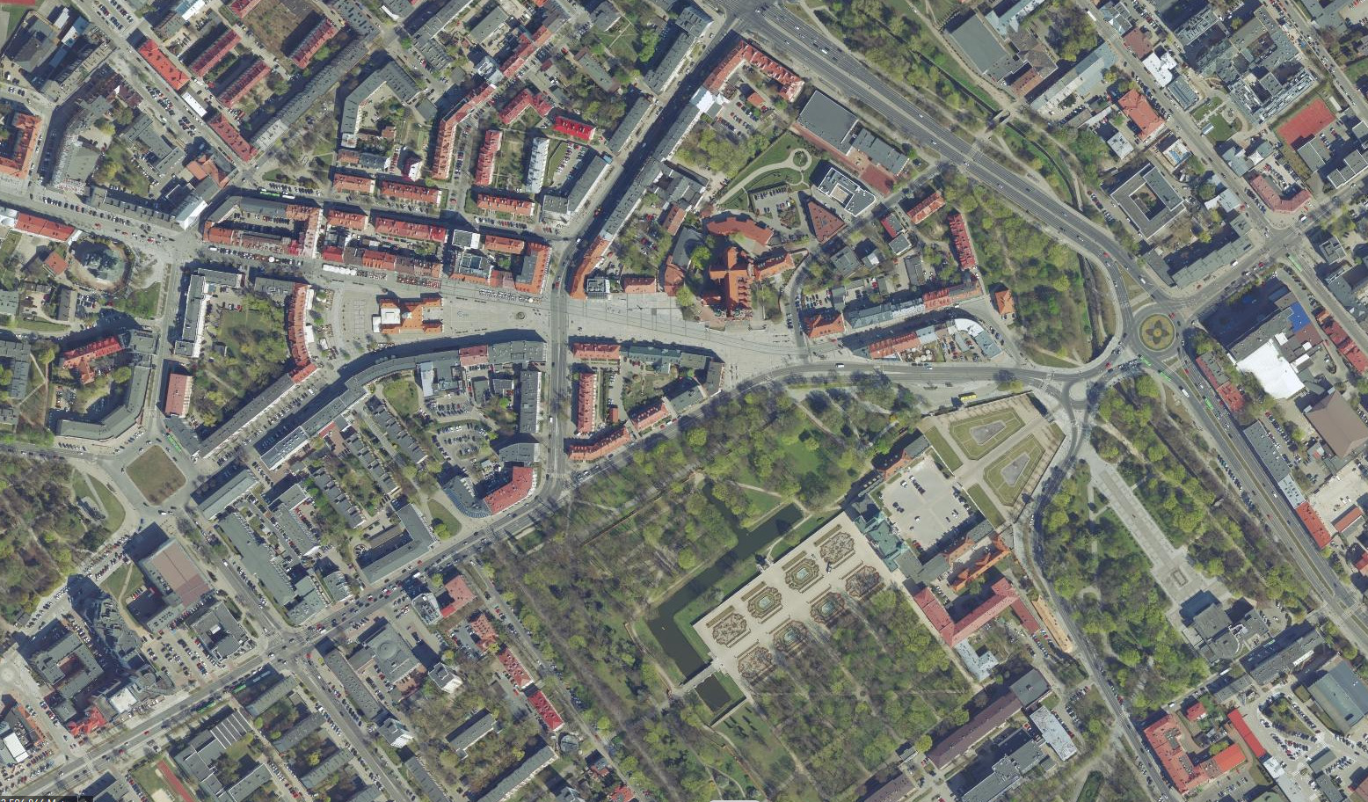
Location of the investment project - orthophotograph 2019

Slide 4
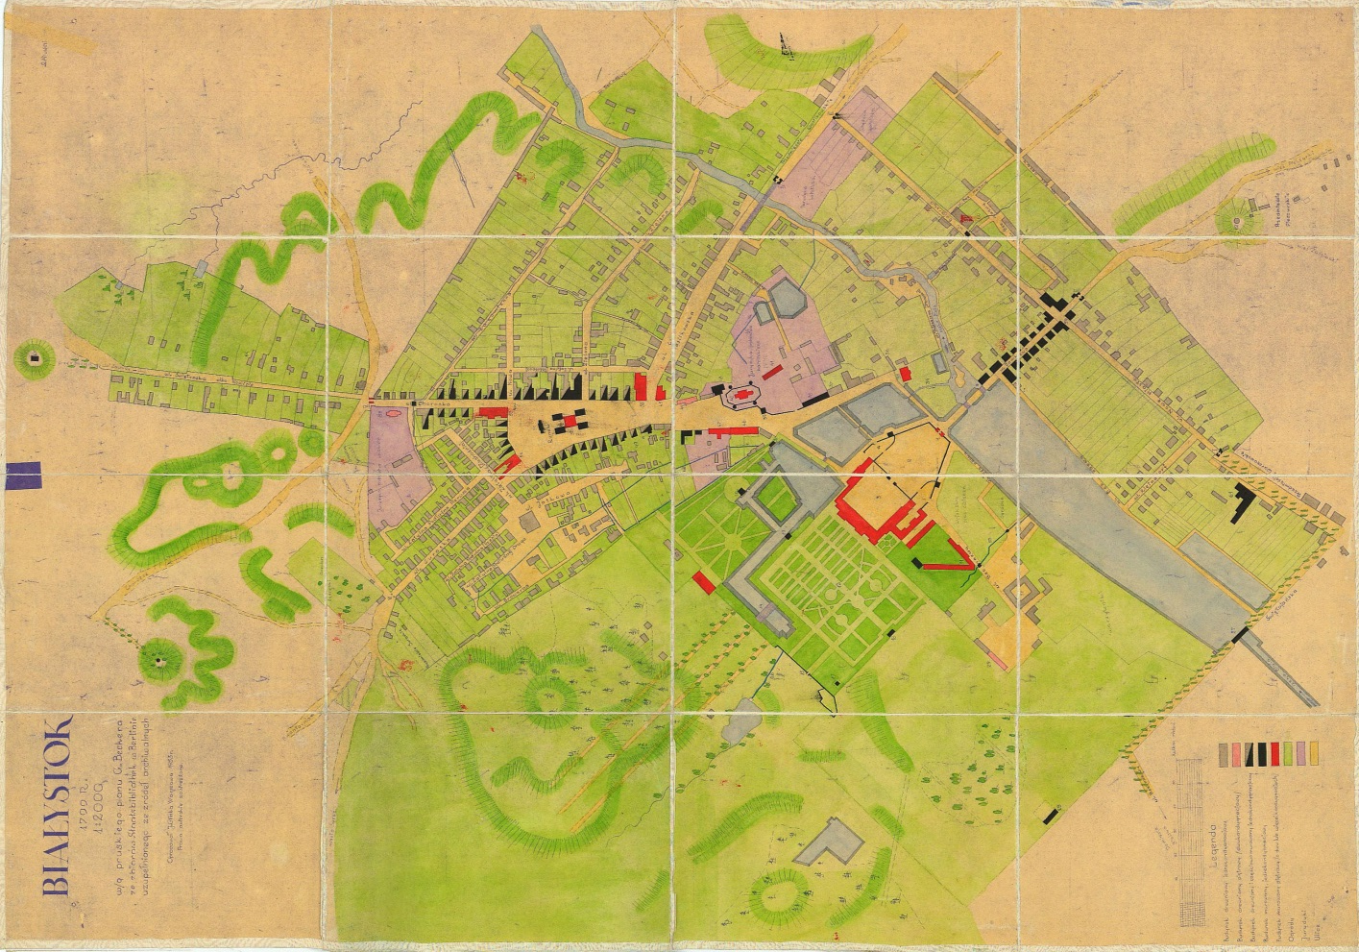
Local plan of 1799 (the Becker Plan)

Slide 5
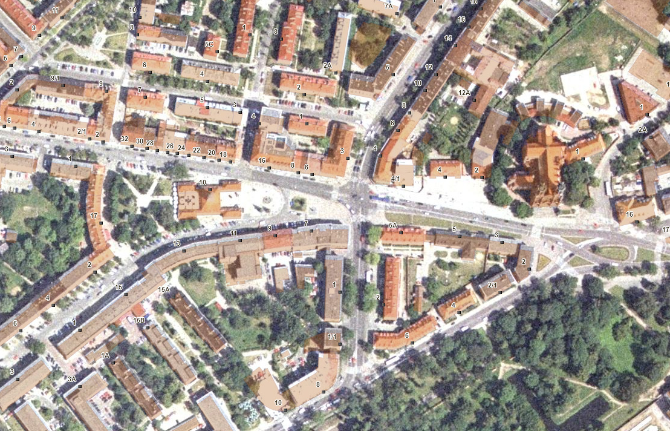
Development status prior to the implementation of the investment project
- orthophotograph 2006

Slide 6
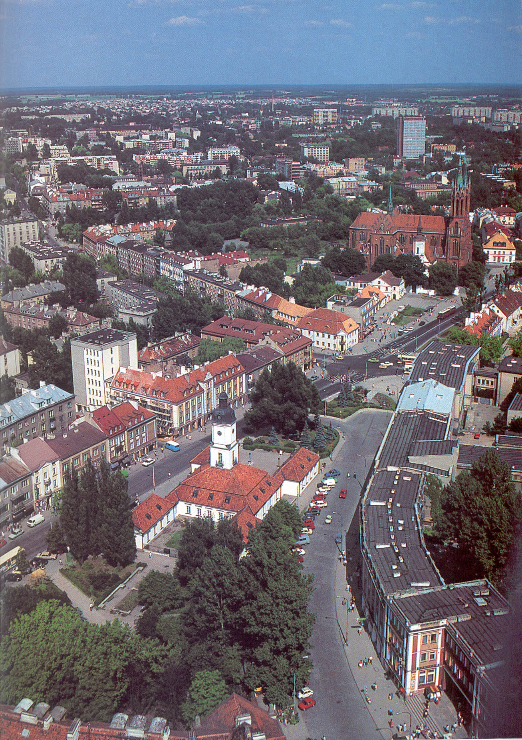
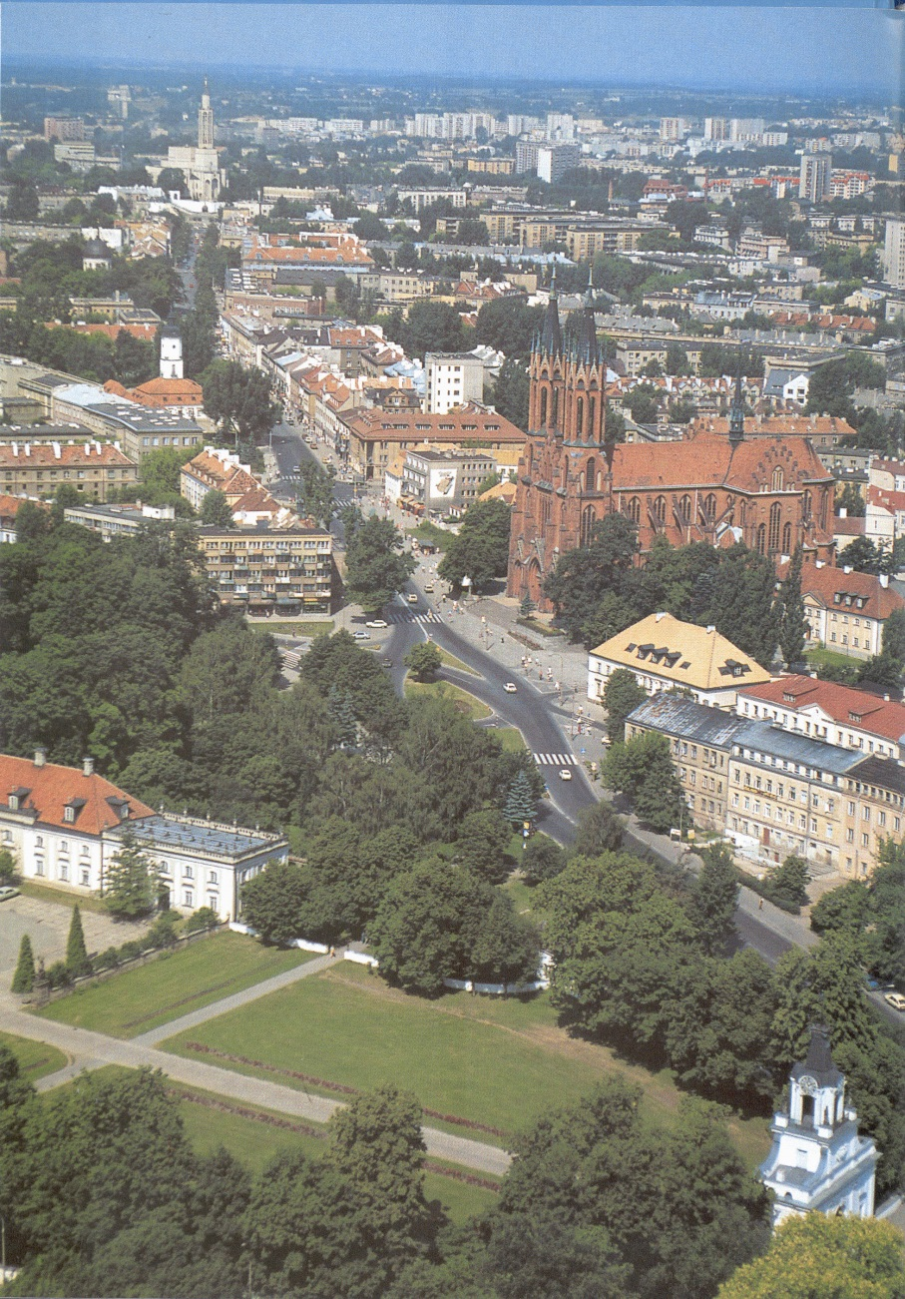
Development status prior to the implementation of the investment project

Slide 7
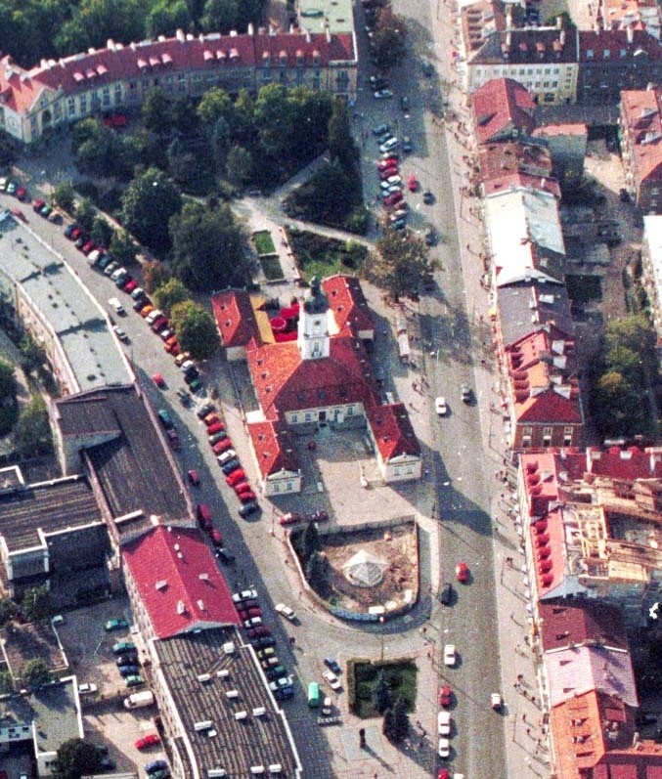
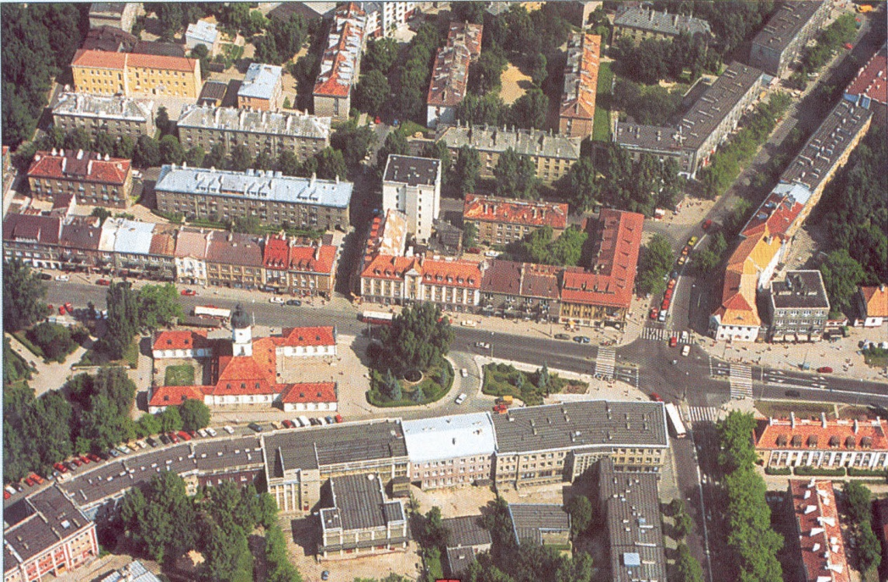
Development status prior to the implementation of the investment project

Slide 8
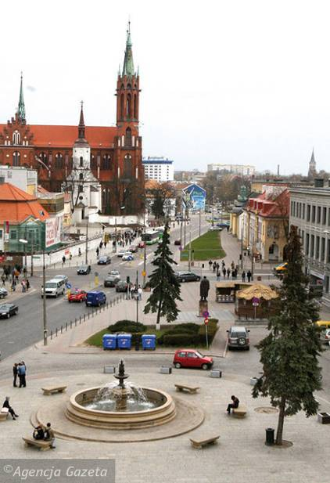
Development status prior to the implementation of the investment project

Slide 9
Basic objectives of the investment project
Redevelopment of the City’s representative space
Restoration of public functions by changing the manner of
development
Promoting the space where urban and commercial events may be held
Improved aesthetics of the Market Square, i.a., supported with
co-financing of renovation of façades and roofs
Introduction of functions creating the unique atmosphere of the place, i.a., by
changing the function of the premises located around the Market Square
into catering facilities and centre-forming outlets

Slide 10
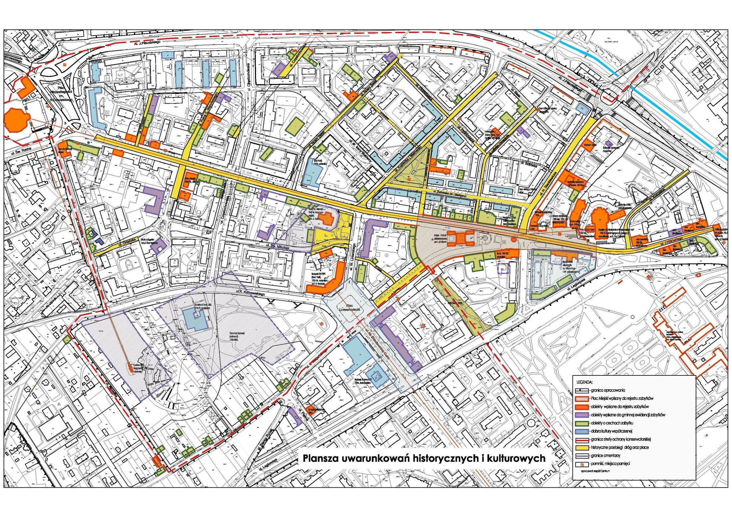
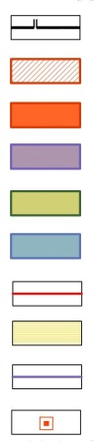
Historical and cultural conditions
LEGEND:
- boundaries of the study
- City Square entered into the register of monuments
- facilities entered into the register of monuments
- facilities entered into the district register of monuments
- facilities having the features of a monument
- contemporary culture assets
- boundary of the preservation maintenance zone
- historical locations of roads and squares
- boundaries of cemeteries
- monuments, memorial sites

Slide 11
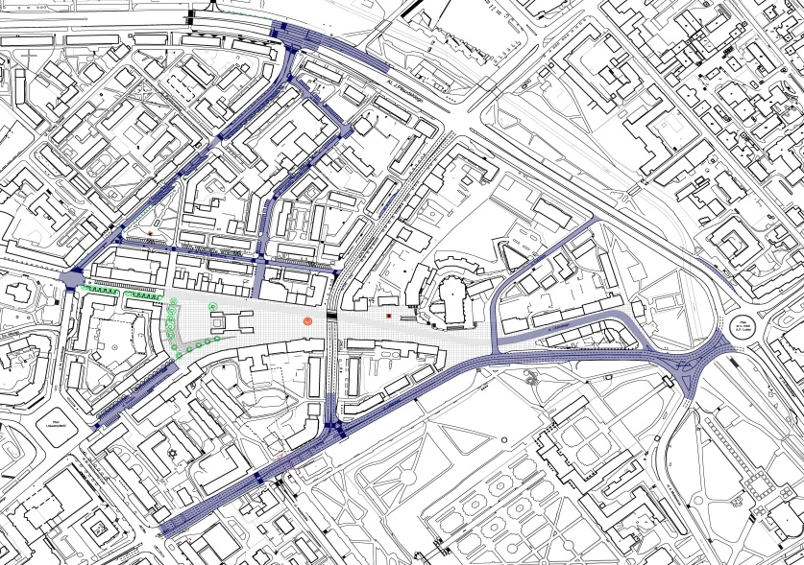
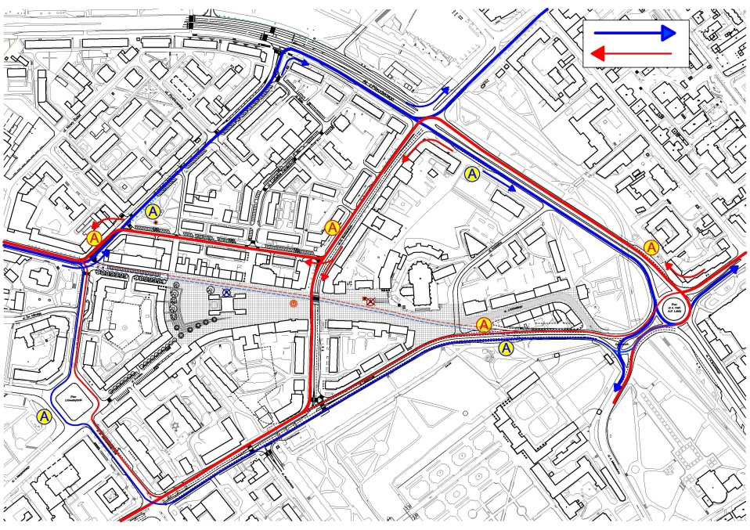
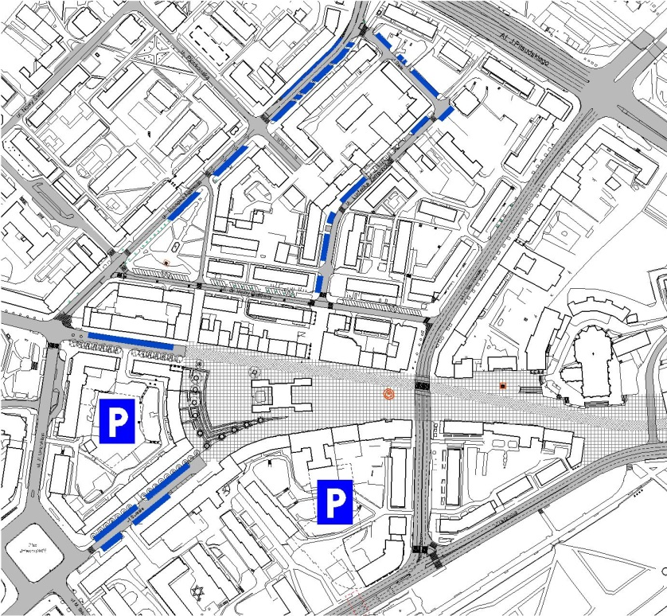
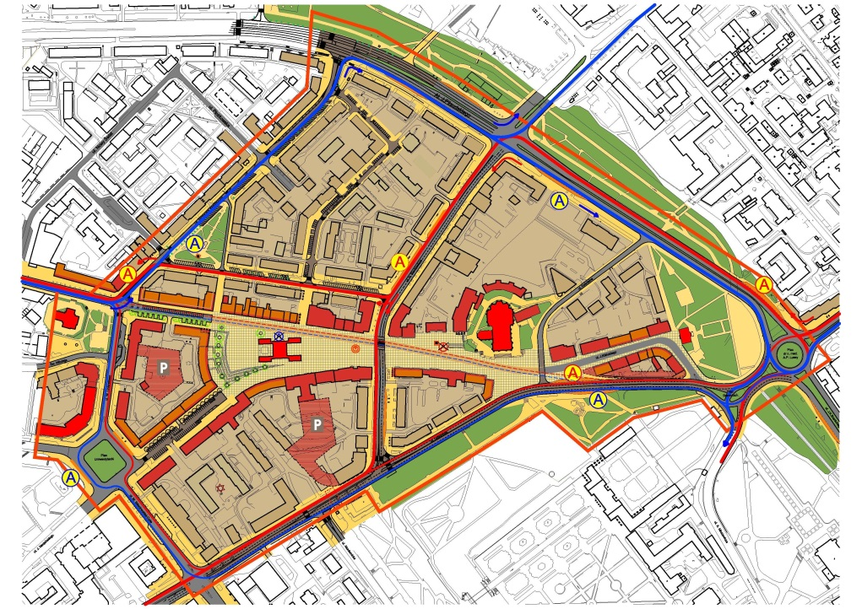
Analysis of communication links

Slide 12
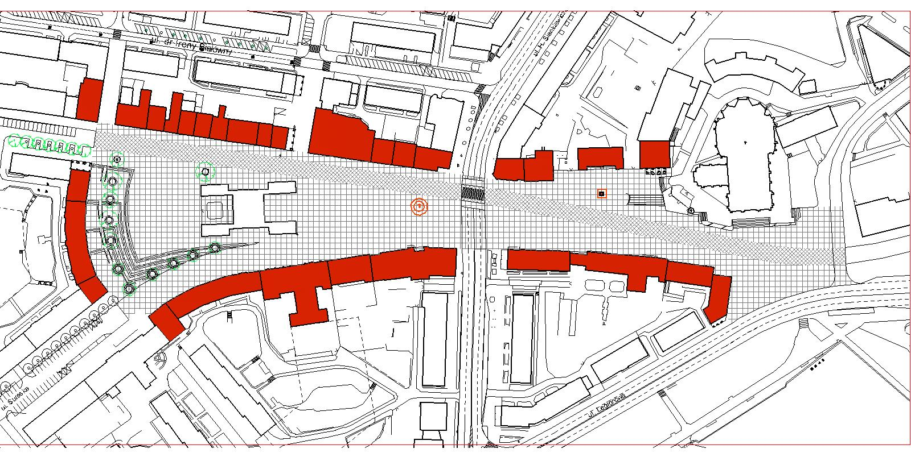
Public space ring

Slide 13
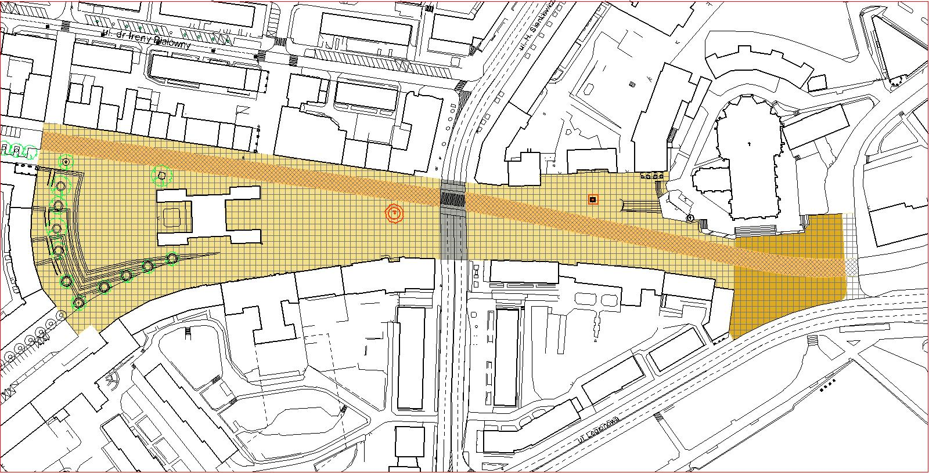
Designed public space

Slide 14
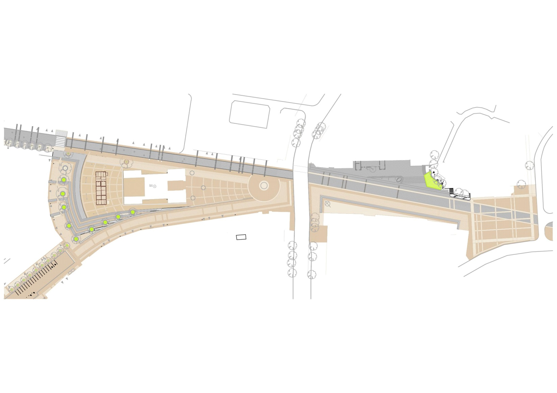
Development concept – designed by Atelier Zetta

Slide 15
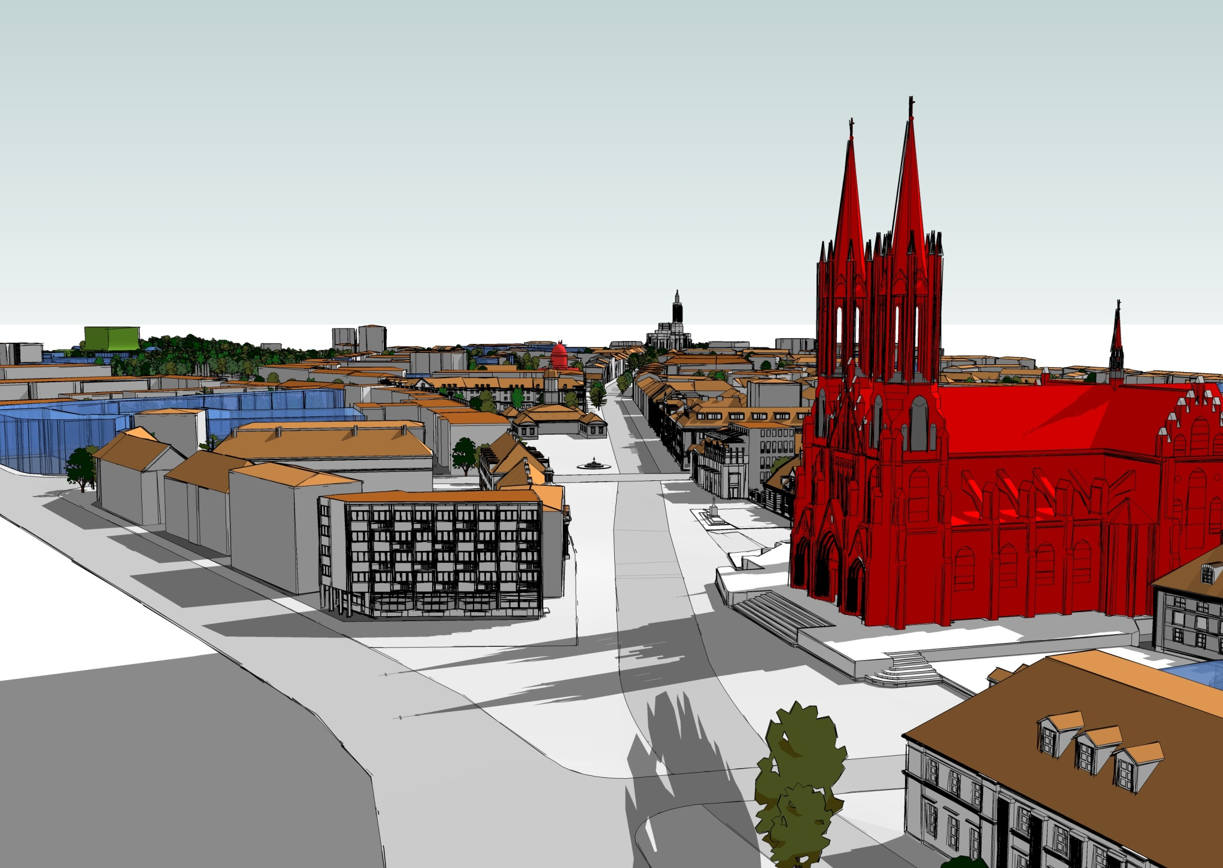
Development concept - visualisations

Slide 16
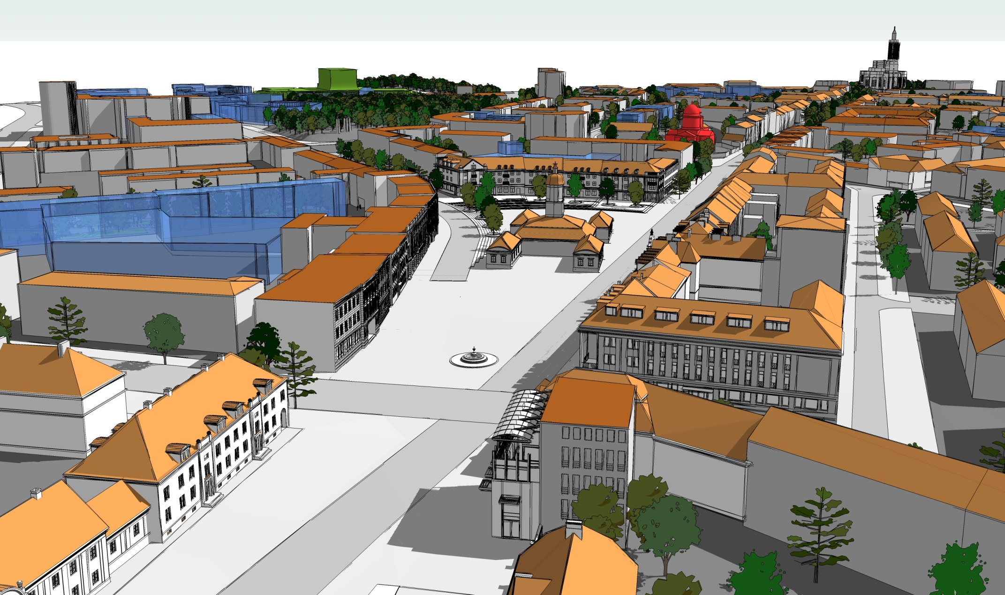
Development concept - visualisations

Slide 17
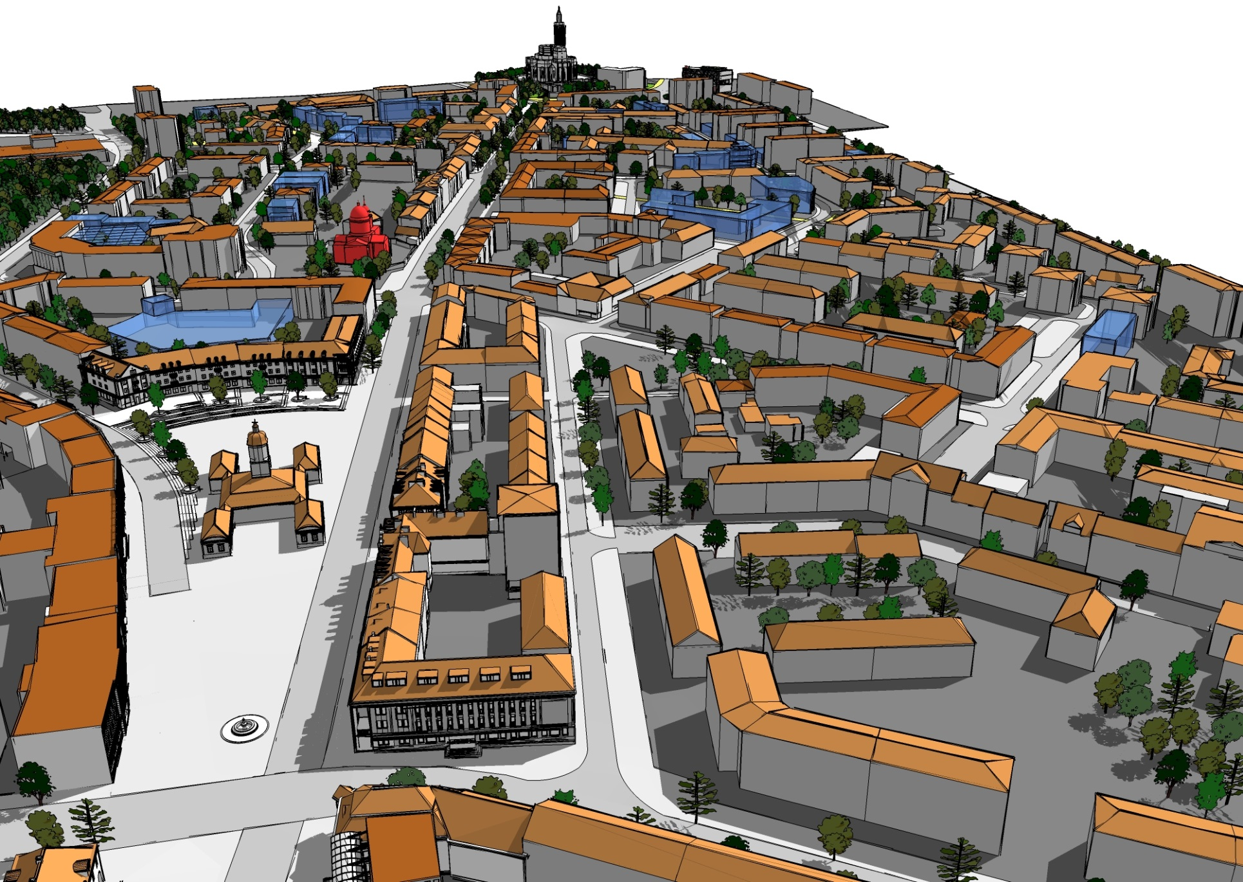
Development concept - visualisations

Slide 18
Investment project implementation - stages
The investment project implemented with the use of the funds from the City Hall
in three stages:
Stage 1 – 2007 – Construction and working design –
Reconstruction of a part of the square located at Rynek Kościuszki Street in
Białystok in order to create a promenade – Western part of the City Market Square
Stage 2 – 2008 – 2009 – Reconstruction of the eastern part of the City Market
Square in Białystok (area between the City Hall) –
Sienkiewicza Street – ring with tenement houses along Rynek Kościuszki Street)
1st Square in front of the City Archive (relocation of the monument of Marshal
J. Piłsudski)
Stage 3 – 2009 – Reconstruction of a part of Rynek Kościuszki Street in Białystok
and Construction of the Square near the Cathedral Church of Assumption of the
Virgin Mary

Slide 19
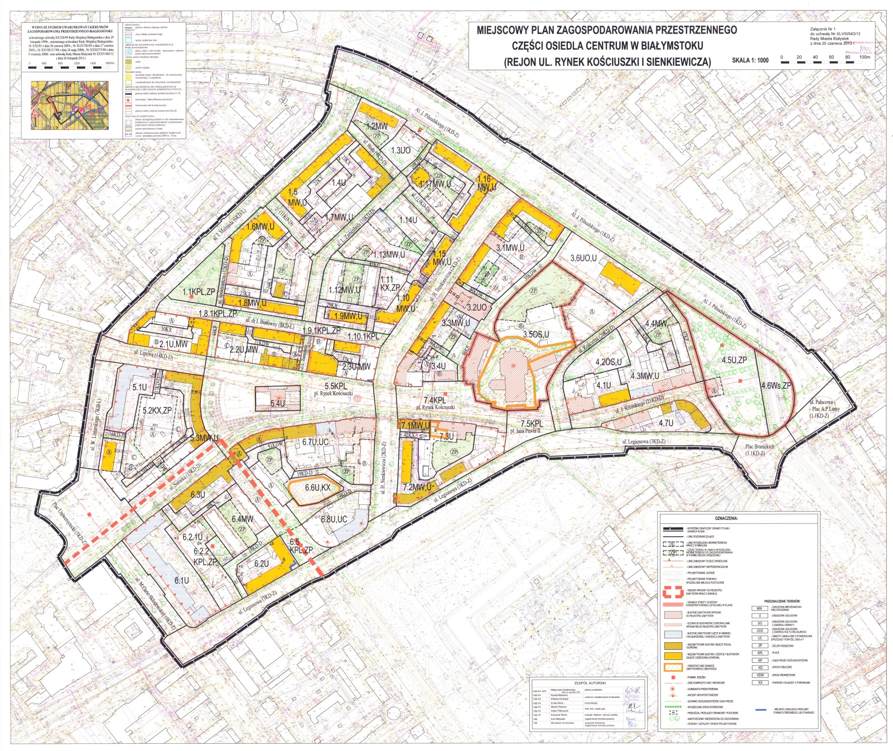
Existing local plan – 2013

Slide 20
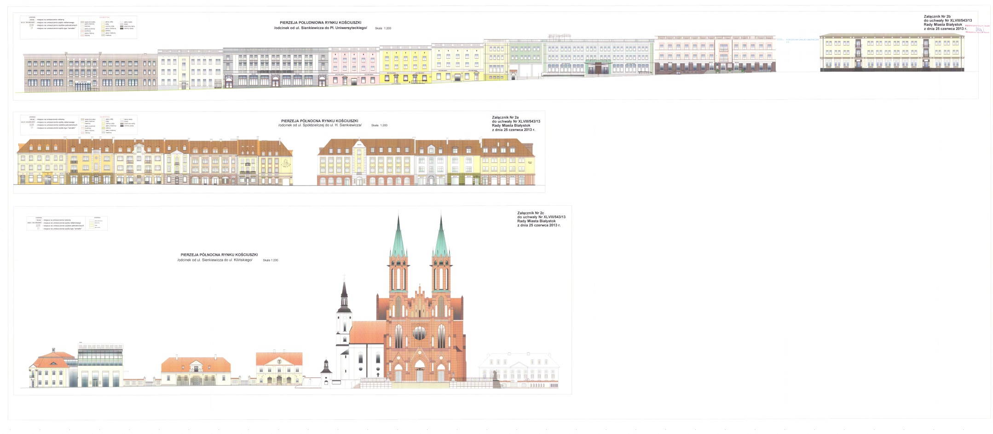
Existing local plan – building façades

Slide 21
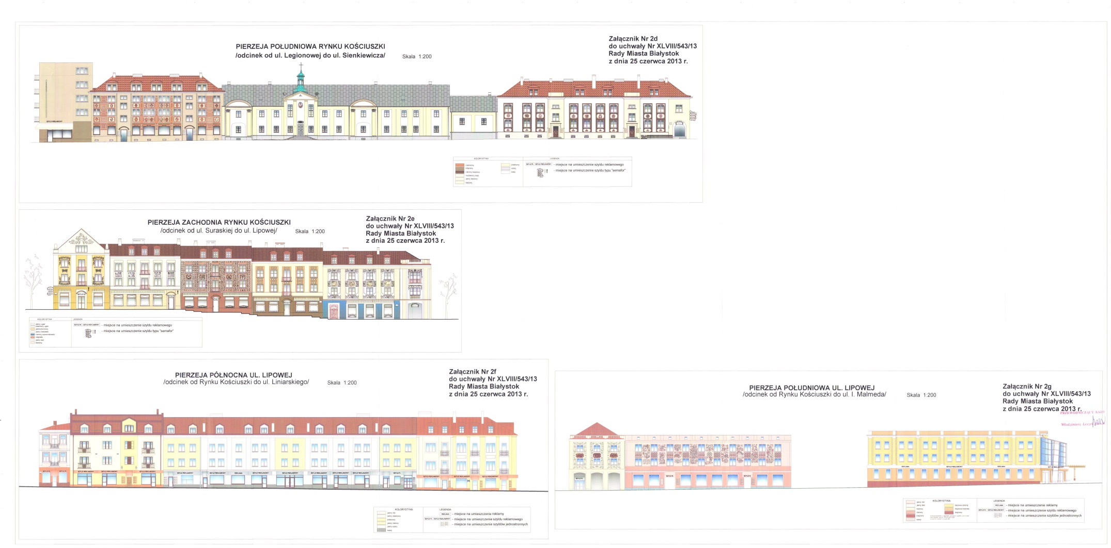
Existing local plan – building façades

Slide 22
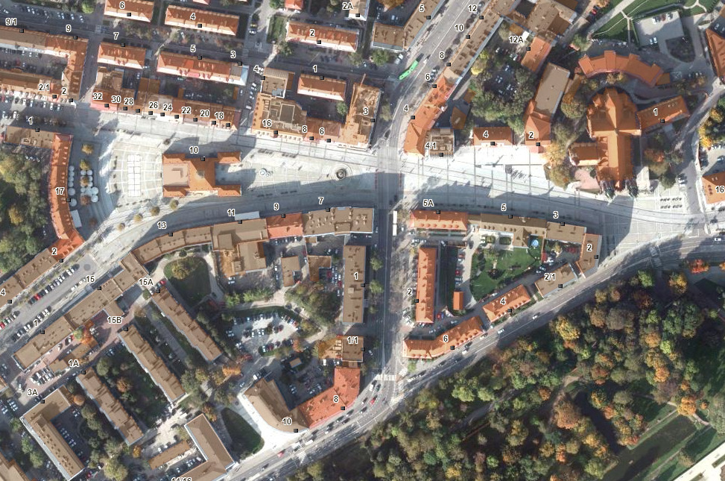
Status of development following the implementation
of the investment project - orthophotograph 2012

Slide 23
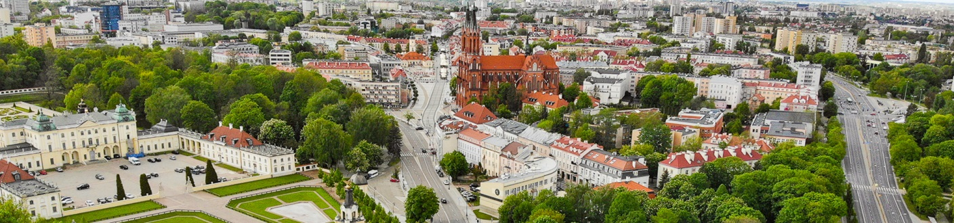
Development status following the implementation
of the investment project

Slide 24
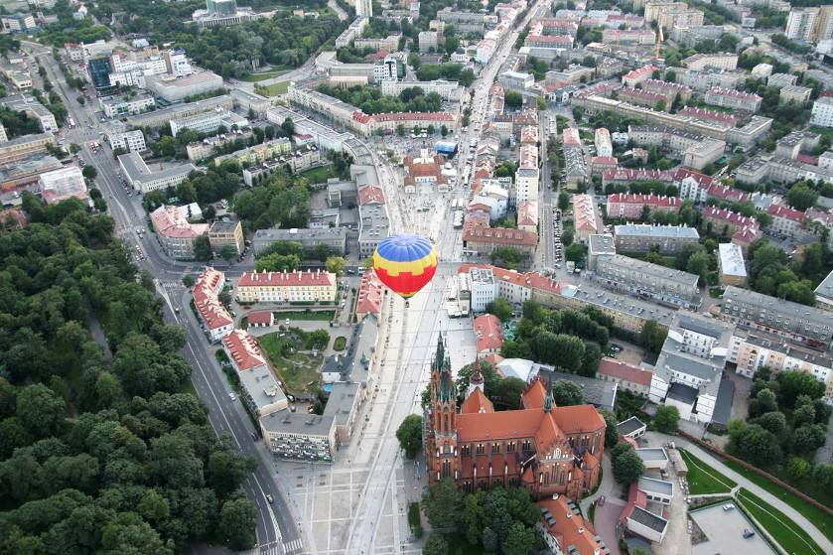
Development status following the implementation
of the investment project

Slide 25
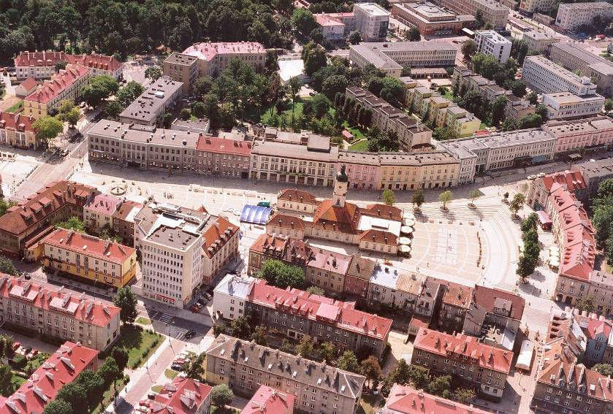
Development status following the implementation
of the investment project

Slide 26
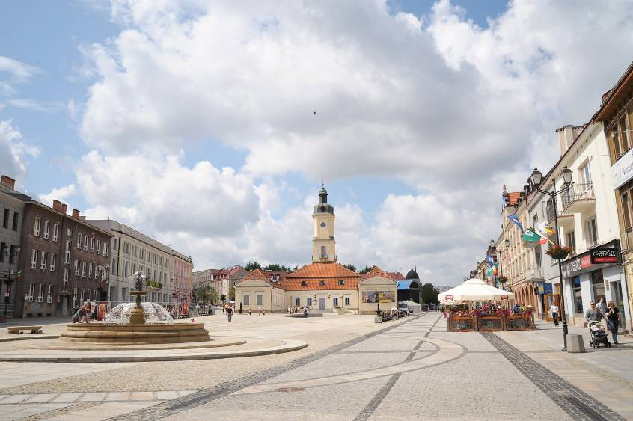
Current development and operations status

Slide 27
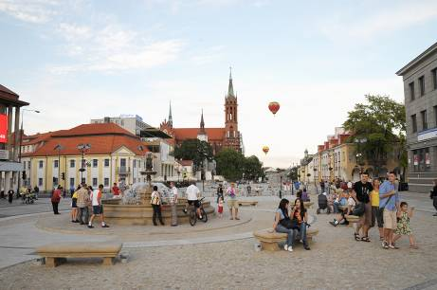
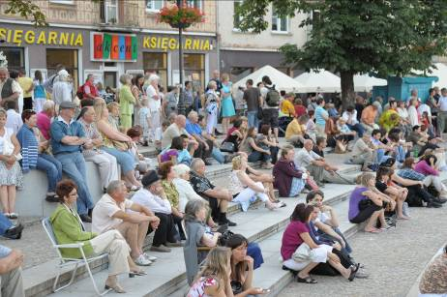
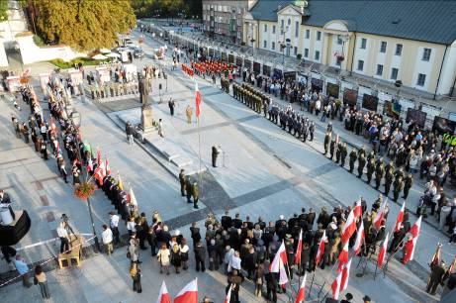
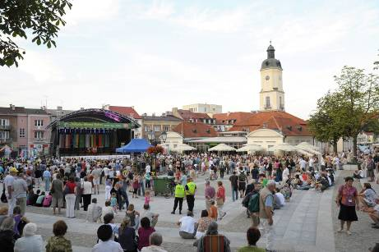
Current development and operations status

Slide 28
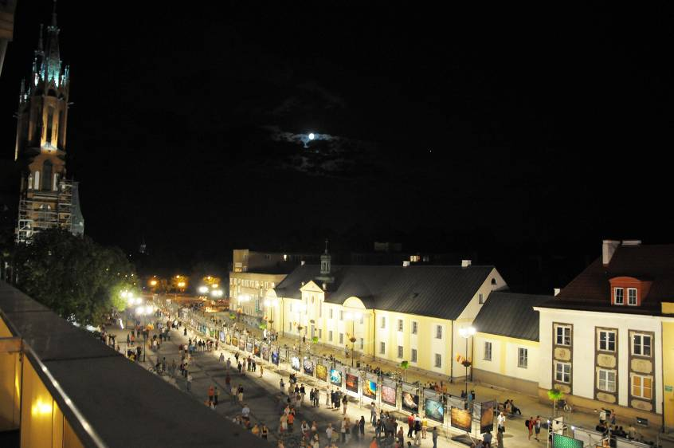
Current development and operations status

Slide 29
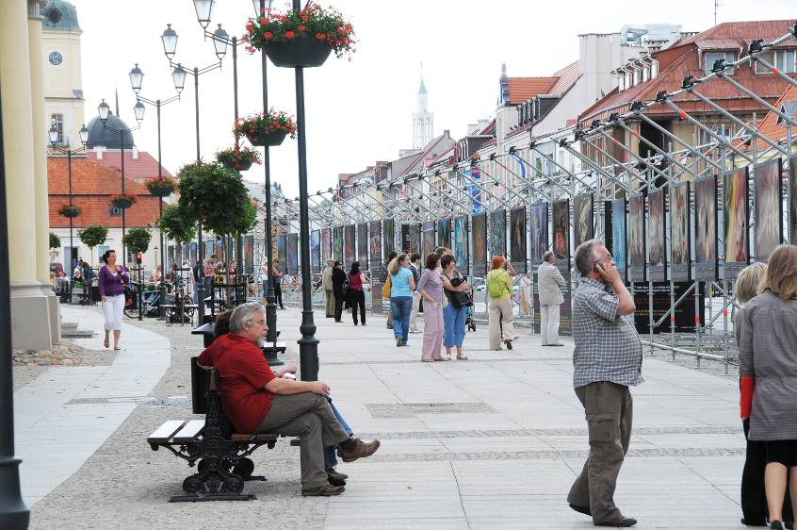
Current development and operations status

Slide 30
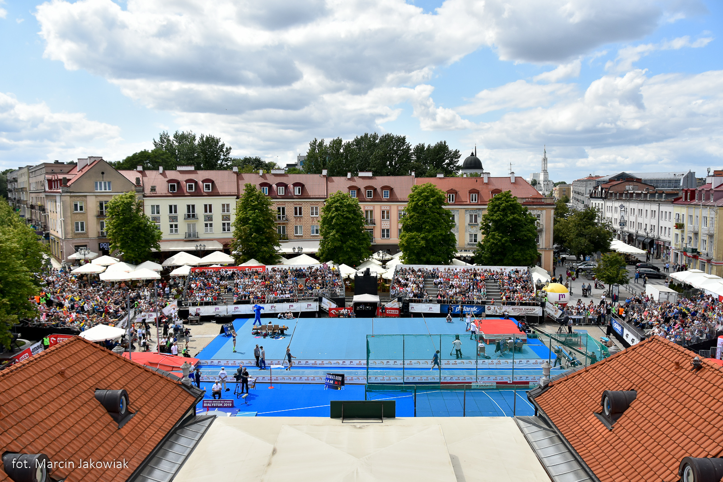
Current development and operations status

Slide 31
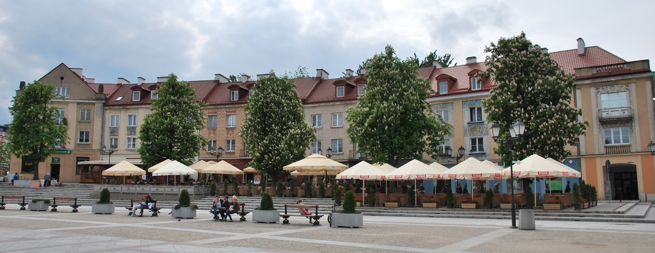
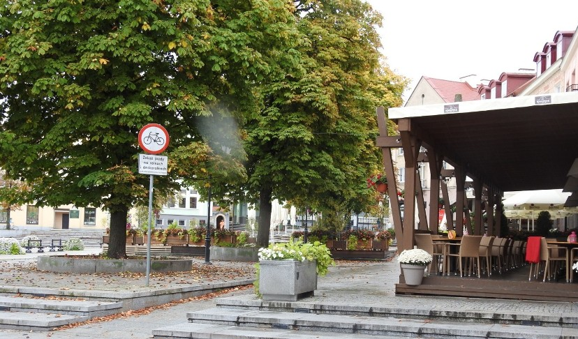
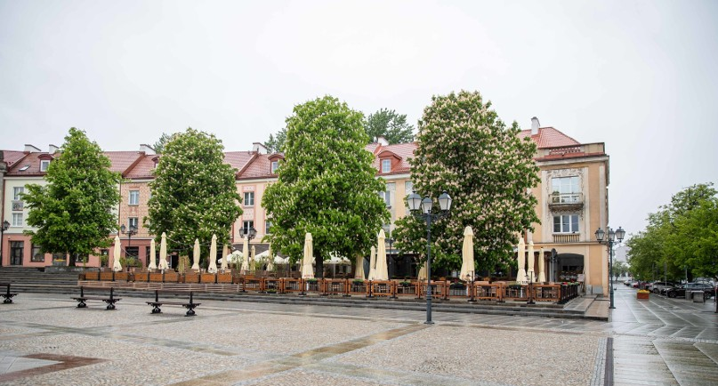
Current development and operations status

Slide 32
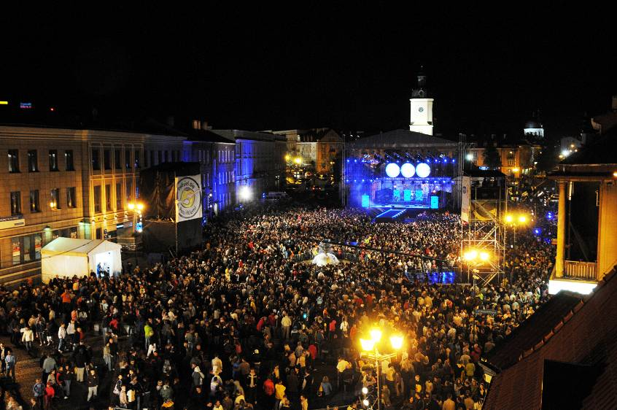
Current development and operations status

Slide 33
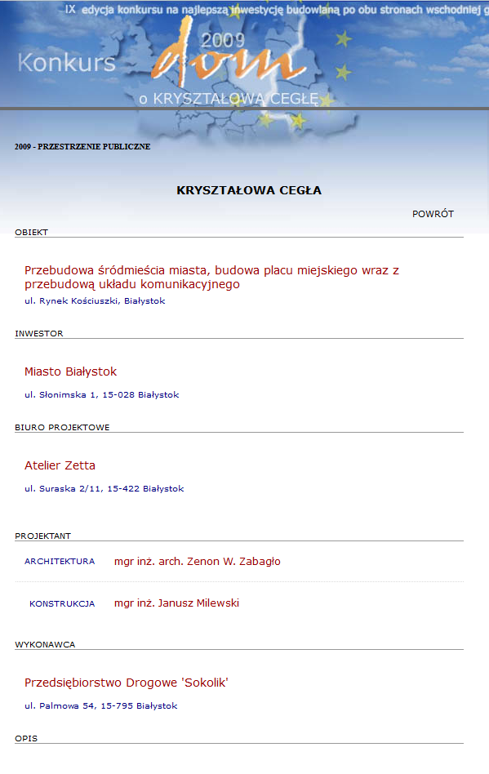
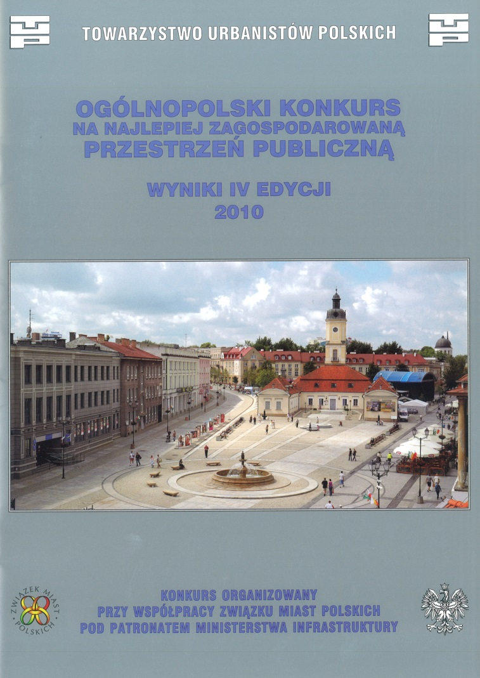
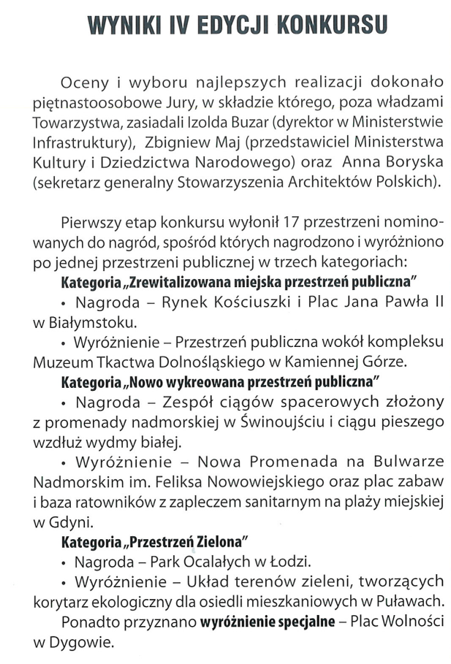
Prizes
2009 – CRYSTAL BRICK AWARD [KRYSZTAŁOWA CEGŁA] in the “Public space” category (international competition)
2009 – PODLASKIE BRAND OF THE YEAR [PODLASKA MARKA ROKU] - distinction
2010 – TUP AWARD [NAGRODA TUP] in the “Redeveloped urban public space” category

Slide 34

Thank you for your attention
COMING BACK TO THE HEART OF THE CITY
Kościuszko Market Square [Rynek Kościuszki]
and John Paul II Square [Plac Jana Pawła II]
in Białystok
Agnieszka Rzosińska

