Slide 1
„Examples of investments in Białystok Functional Area in frame of ITI instrument” Bucharest, 26.11.2018
Anna Busłowska, Ph.D.
Association of Białystok Functional Area
University of Białystok

Slide 2
Presentation plan
Introduction of Bialystok Functional Area (BFA)
Integrated Territorial Investmens Strategy of BFA
Types of investment in supporting innovation and cultural heritage of BFA

Slide 3


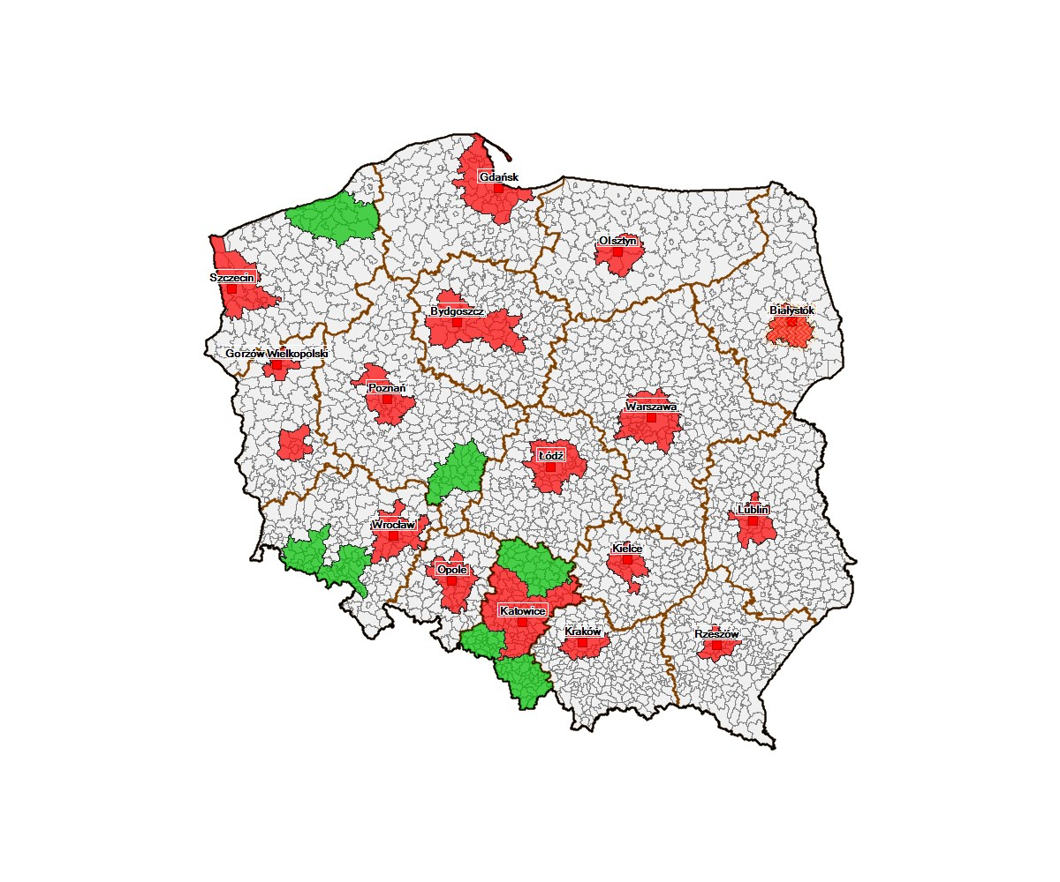
Białystok functional area vs. Europe, Country and voivodeship
Years | BFA Population
2012 | 411 531
2017 | 417 830
Increase | + 6 299
BFA Population: 35% PD
Area: 8,6% PD
Source: stat.gov.pl, September 2017 r.

Slide 4










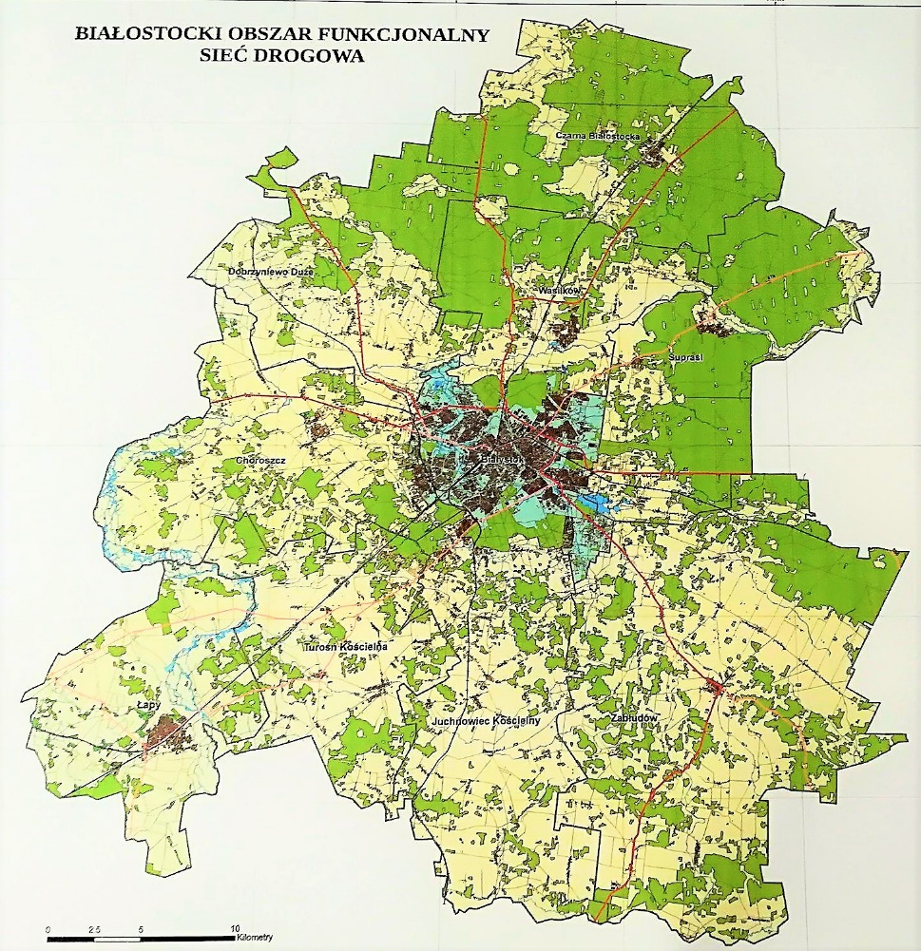
BFA Association consists of 10 municipalities:
Municipalities
Białystok (1)
Choroszcz (3)
Czarna Białostocka (3)
Dobrzyniewo Duże (2)
Juchnowiec Kościelny (2)
Łapy (3)
Supraśl (3)
Turośń Kościelna (2)
Wasilków (3)
Zabłudów (3)
Source: BFA, Oct 2018 r.

Slide 5
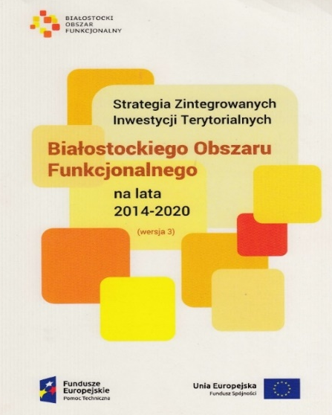
ITI Strategy of BFA 2014-2020
Bialystok Functional Area–
attractive place to work and live
Aim 1.
Investment attractiveness
Aim 2.
Competences to work
Aim 3.
Accessibility to culture
Aim 5.
Low-carbon economy and
environmental protection
Aim 6.
Accessibility of communication
Aim 7.
Integration stategic development management of BFA
Aim 4.
Active social integration
Objectives
implemented within Integrated Territorial Investments instrument

Slide 6
Integrated Territorial investments
TOTAL ITI : ERDF + ESF
76 mln EUR
ERDF
67,2 mln EUR
ESF
8,8 mln EUR
6,26% of ROPPV 2014-2020

Slide 7
Integrated Territorial investments
Allocation in frame of ROPPV 2014-2020
ITI in ROPPV 2014-2020 | Investment priorities | ITI Allocation (mln EUR)
1.4 Promotion of entrepreneurship and raising the investment attractiveness of the voivodship | 3a | 12,1
3.1 Preschool Education | 10i | 1,6
3.3 Youth vocational education for competitiveness | 10iv | 4,3
4.1 Mobility | 7b | 1,6
5.4 Low-emission strategies | 4e | 28,0
7.2 Development of social services | 9iv | 3,0
8.2 Supplementing deficits in the scope of education and training infrastructure | 10a | 22,7
8.4 Social infrastructure | 9a | 2,8
Total |  | 76,0
7,70%
ERDF
2,58%
ESF
Source: ROPPV, ITI BFA Strategy.

Slide 8
Integrated Territorial investments
The structure of projects by types
Project type | Investment priorities | ITI allocation (mln EUR) | Aim of ITI Strategy
Integrated projects | 3a+7b | 4,42 | 1. Investment attractiveness
 | 10i+10a | 6,33 | 2. Competences to work
 | 10iv+10a | 24,85 | 2. Competences to work
 | 9iv+9a | 4,17 | 4. Active social integration
ESF projects | 10iv | 4,27 | 2. Competences to work
 | 9iv | 1,60 | 4. Active social integration
ERDF projects | 3a | 9,30 | 1. Investment attractiveness
 | 4e | 27,97 | 5. Low-carbon economy and environmental protection
 | 10a | 4,00 | 2. Competences to work
Total: |  | 86,91
Source: ROPPV, ITI BFA Strategy.

Slide 9
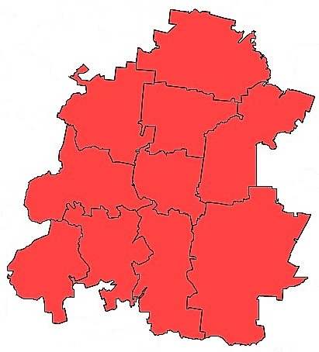

Supporting innovation in BFA (ITI in frame of ERDF)
Objective 1. Investment attractiveness
Cohesion Policy thematic objective 3. Enhancing the competitiveness of SMEs
Cohesion Policy thematic objective 7. Promoting sustainable transport and improving network infrastructures
Improving access to investment areas: in 4 municipalities (Białystok, Supraśl, Zabłudów, Łapy)
Building works: sewerage, rainwater drainage, roads, lighting, etc.)
Total value of projects: 20,3 mln EUR.
Total value of ERDF support: 13,1 mln EUR.
Indicators:
Surface of prepared areas investment - 50,75 ha,
Planned number of companies located on prepared investment areas – 15.

Slide 10



Supporting innovation in BFA (ITI in frame of ERDF)
Objective 2. Competences to work
Cohesion Policy thematic objective 10. Investing in education, training and lifelong learning.
Vocational education development:
Planned total value of ERDF support: 17 mln EUR
Total value of projects (signed agreements): ca. 12 mln EUR.
Total value of ERDF support (signed agreements): ca. 9 mln EUR.
Science Center of BFA (ERDF)
Integrated projects in vocational schools (ERDF+ESF)

Slide 11
Supporting innovation in BFA
Objective 2. Competences to work
What we are planning to achieve?
Indicators (ERDF):
The number of supported infrastructure objects of vocational education – 25
The number of users of supported education infrastructure - 3 500
Indicators (ESF):
The number of pupils supported in the field of competence development - 10 300
The number of pupils participating in internships at the employer – 4500
The number of vocational education teachers supportted in program - 40

Slide 12
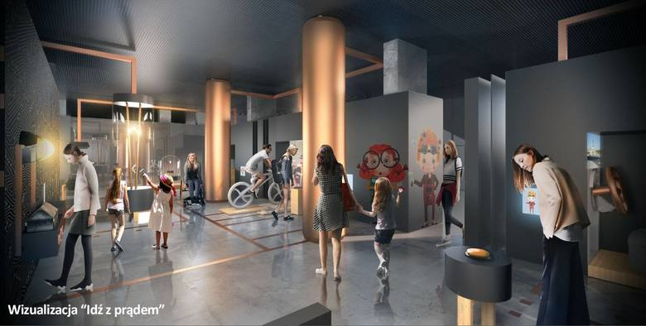
Supporting innovation in BFA (ITI in frame of ERDF)
Science Center of BFA - Laboratory of the Young Master and Explorer in Bialystok
Total value of project : ca. 5,8 mln EUR.
Total value of of ERDF support: ca. 4 mln EUR
Period of implementation: 05/10/2016 – 07/02/2020
Aim of the project:
supporting the development of a knowledge-based economy in the area of the BFA through the creation in Bialystok a center for promoting science and innovation, enabling the development of technological thoughts and providing teaching services using new technologies
Scope of the project:
The junior zone - designed for children age 3-10, in which animators will introduce children to the world of robotics, water energy, construction, or human anatomy.
The main exhibition zone - addressed to young people and adults, where they will be able to participate in individual experiments, team games and laboratory classes in area of electromotorics, robotics and energy. Visitors will have available over 70 experimental stations.

Slide 13











Supporting innovation in BFA (ITI in frame of ERDF)
Objective No 5: Low-carbon economy and environmental protection
Cohesion Policy thematic objective 4. Supporting the shift towards a low-carbon economy
Total value of projects : ca. 45 mln EUR.
Total value of of ERDF support: ca. 27 mln EUR
Modernization of individual energy sources;
Modernization of street lighting;
Development of low-carbon public transport and bicycle transport;
Intermodal passenger transport hub

Slide 14
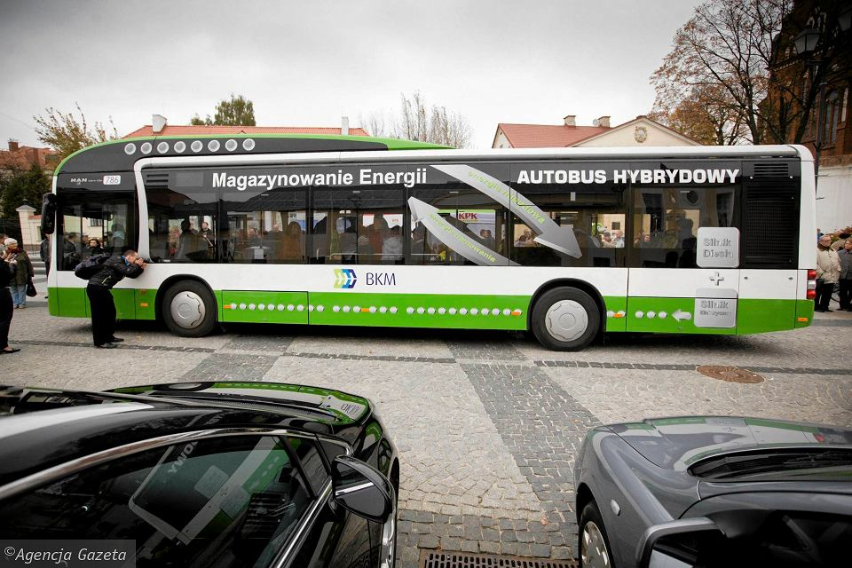
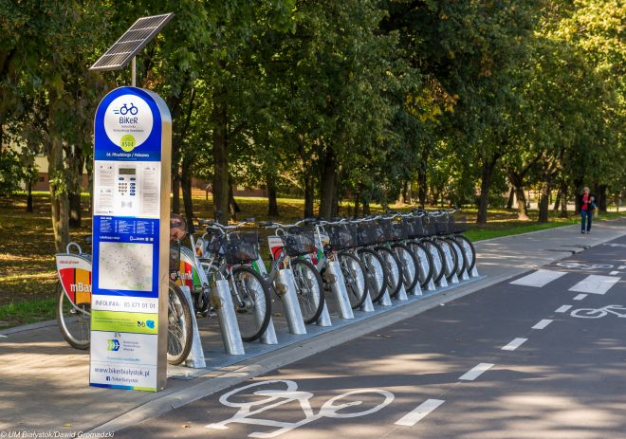
Supporting innovation in BFA (ITI in frame of ERDF)
Objective No 5: Low-carbon economy and environmental protection
Key effects:
Estimated annual reduction in greenhouse gas emissions– 16988 tonnes of CO₂ equivalent;
Households in which individual sources of heat or electricity have been modernized – 1560;
New / modernized points of street lighting– 2494;
Length of built roads for bicycles– 48,27 km;
Length of new or modernized public transport lines– 21,23 km;
Number of new city buses – 12 ;
New Bike&Ride stations – 188 points.

Slide 15
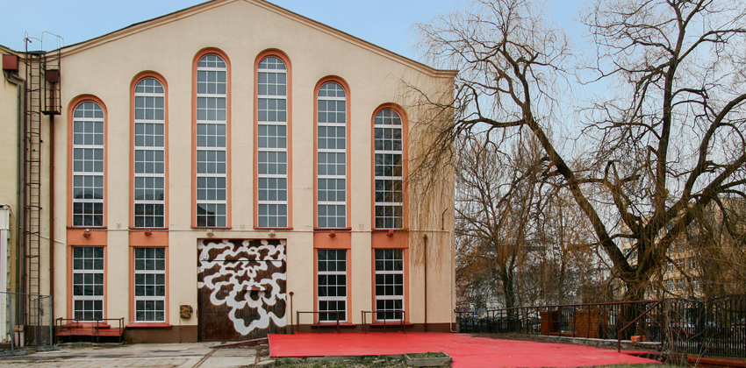
Supporting cultural heritage in BFA
Objective 3. Accessibility to culture
Adaptation of historical objects for cultural activity: Comprehensive renovation of historical objects (post-industrial, post-military) and giving them new functions (cultural activities, especially museum activities).
Projects:
The Sybir Memorial Museum
Adaptation of a degraded post-industrial building - the former municipal power station from 1908-1912.

Slide 16
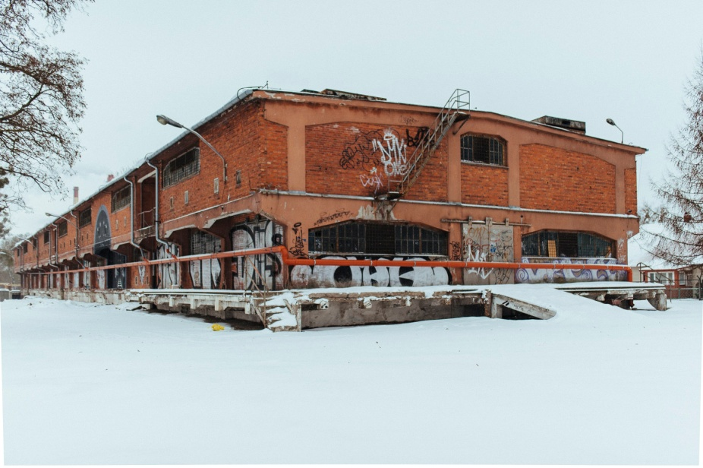
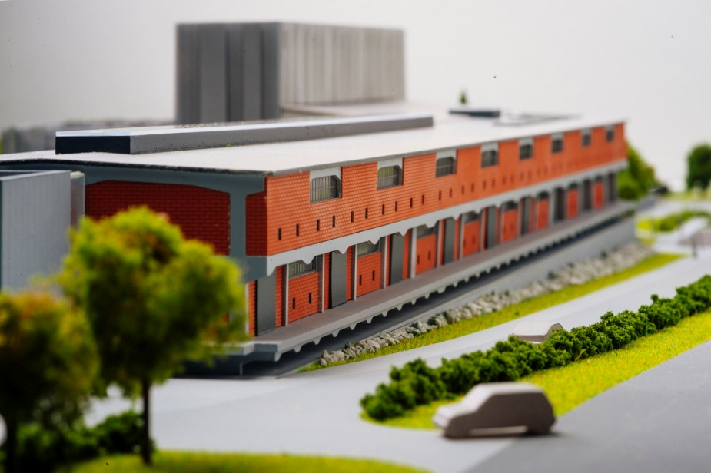
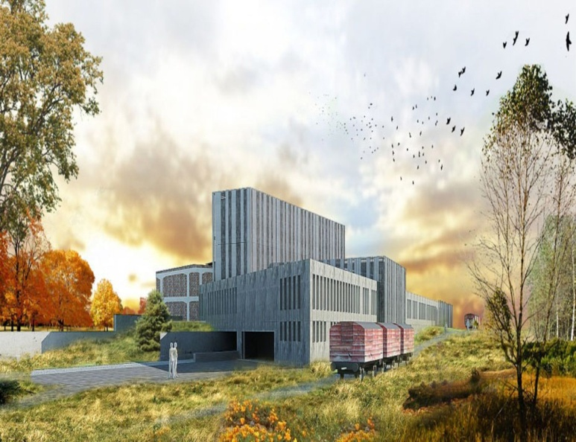
Supporting cultural heritage in BFA
The Sybir Memorial Museum
The idea to establish the Museum is to show Siberia in every dimension, beginning from the 17th century, throughout the 19th century post-uprising deportations and until the 20th century development of the Soviet system. The purpose of the exhibition is to show the history of particular people and their experience through carefully selected exhibits.
Notes:
will rebuild the former military warehouse (with an area of about 3,100 m2) for the needs of a modern exhibition presenting the collection of the Sybir Memorial Museum. It will also build a new part (with an area of almost 2.4 thousand m2) in the form of technical and administrative facilities. The cost of construction works is over PLN 37.5 million.

Slide 17
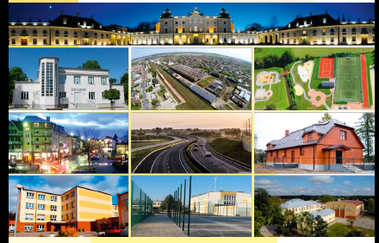
Thank you for your attention!
Anna Busłowska
Association of BFA
www.bof.org.pl
a.buslowska@bof.org.pl

