Slide 1


@DavidMintondire
#ournwassembly

Slide 2


OP & Co
Full drawdown of 07/13 Operational Programme - €457 Million invested in the region
With a 1% error rate in the Fund Management - close to excellence!!!!
14/20 programme started - aim for excellence in our 2014-2020 drawdown of €320Million
Designation complete last Friday with colleagues
Certification of over €1.5Million Interregional Funding this year
Starting to think post 2020 - upskilling in Financial Instruments / state aid etc.....
Collaboration between OP's and Interreg Funding

Slide 3

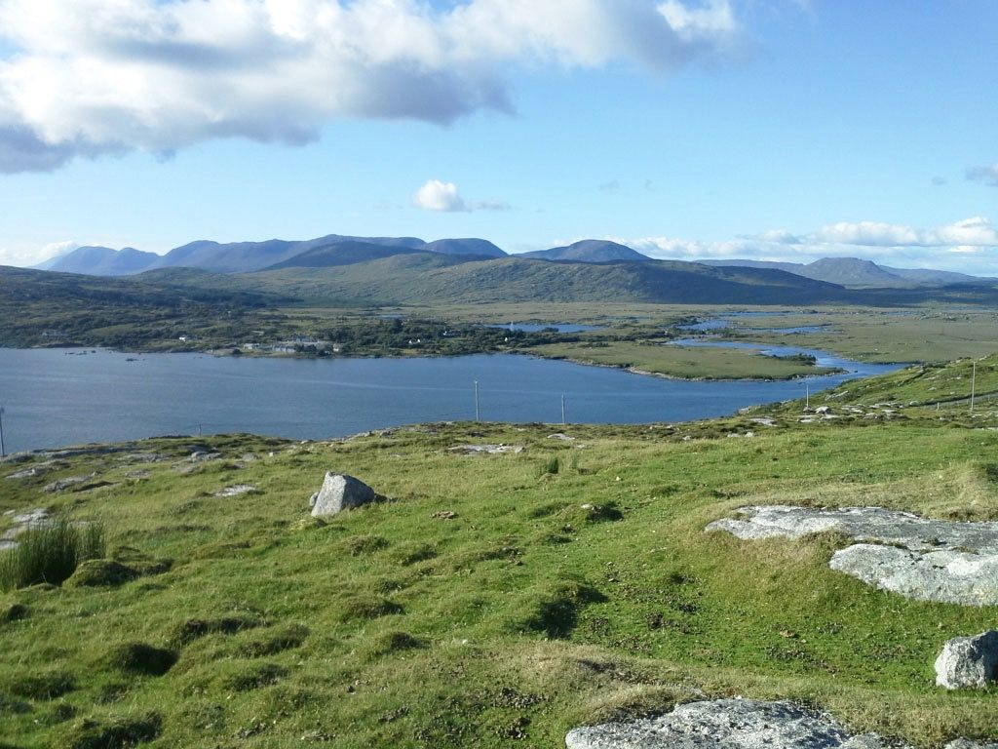
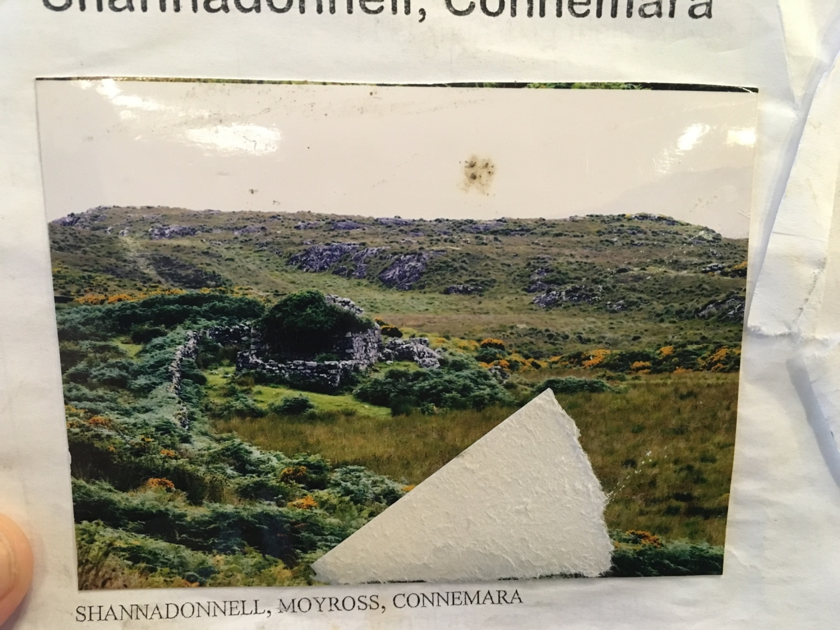

Slide 4

















Slide 5

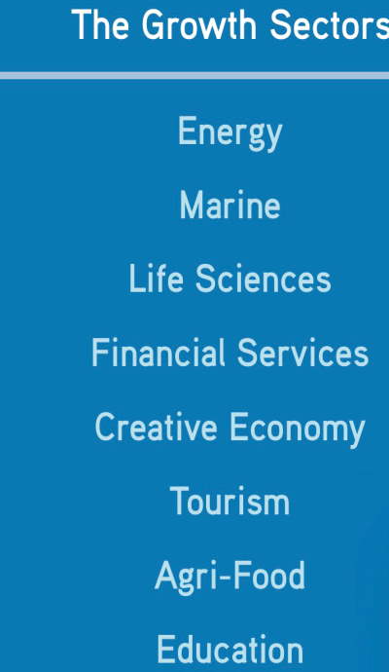










Slide 6


Slide 7






















Notes:
Tel Aviv list – engineering talent; active mentoring; technical infrastructure; start up culture; policy; government programmes
Tel aviv has 19 start ups per square km; ours are just more dispersed

Slide 8



Slide 9
























ATLANTIC
ECONOMIC
CORRIDOR
HEALTHCARE
FINANCIAL
SERVICES
NORTH WEST PARTNERSHIP
FIBRE OPTIC CABLE
SLIGO TO
ENNISKILLEN
CATCHMENT
ENGINEERING
MONAGHAN
EAST COAST
CONNECTION
AGRI-TECH
AGRI-TECH
KNOCK
EQUITY
GROUP
LIFE SCIENCES
Agri-technology
MARINE ECONOMY
ENGINEERING
UPPER ERNE
ECONOMY
PROJECT
AGRI-TECH
LIFE SCIENCES
BIO-PHARMA
ROSCOMMON
TO ATHLONE
CATCHMENT
SHANNON
CATCHMENT
TECHNOLOGY
AEROSPACE
Notes:
So when you look at the level of activity; our ambition is to assist in its convergence and connection

Slide 10

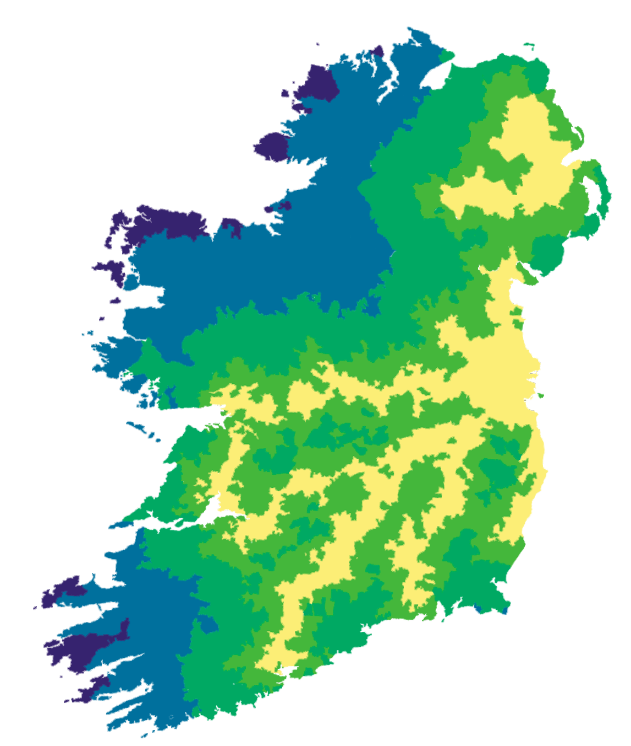



MOTORWAY NETWORK
> 120 mins
> 120 mins
60-120 mins
60-120 mins
> 120 mins

Slide 11
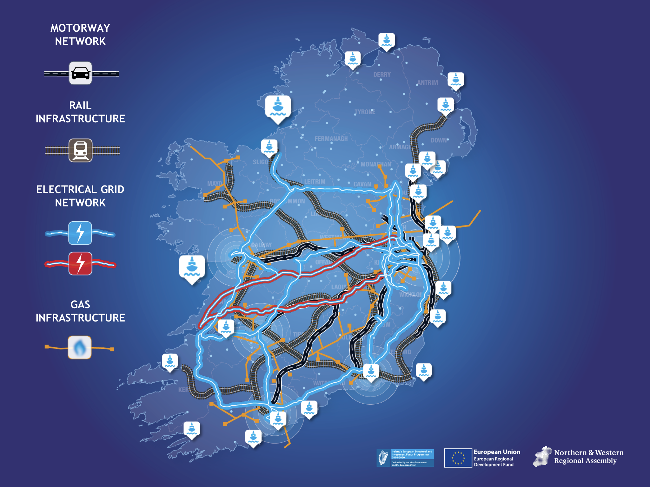

Slide 12
History of Regional Development
Romantic entanglement between the ‘Transformative’ and the the Transactional
Short History
1. Buchanan
2. NSS
3. NDP
4. NPF***any minute
Long History:
- LG Act 1963
- Urban Renewal ‘83 (tax incentive)
- Regional Authorities ‘94
- Sustainable Development - National Plan '97 –
Rural Renewal ‘98 – Upper Shannon
Euro Spatial Development Perspective
NDP 1999
Planning & Development Act 2002
Decentralisation ☹ 2003
RPGs 2004
NDP 07-13
LG Reform Act 2014 / Assemblies Order

Slide 13
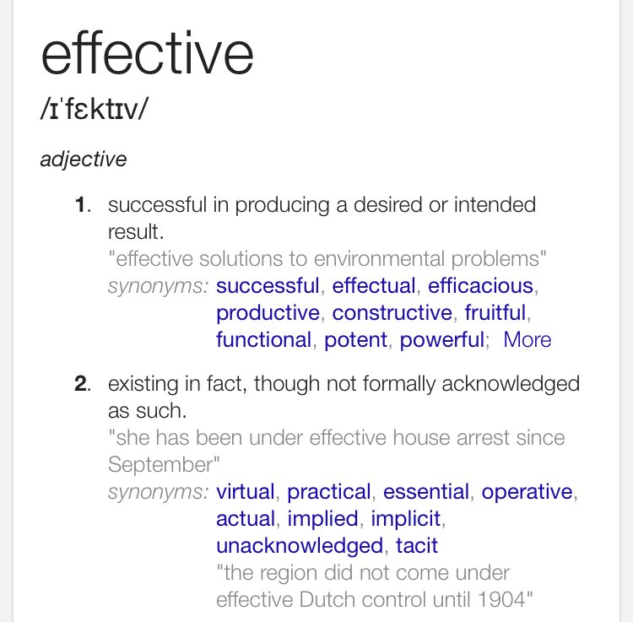
Effective Regional Development

Slide 14








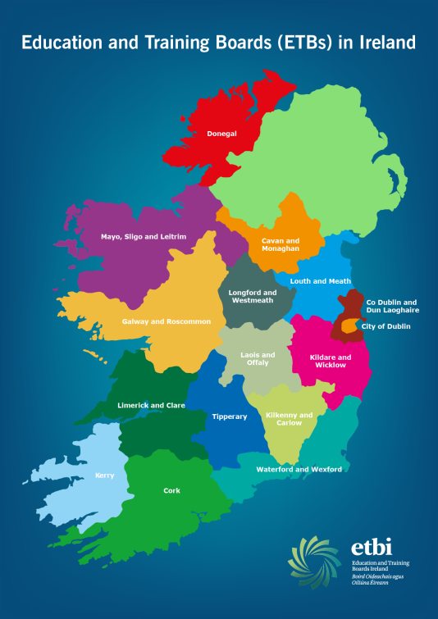

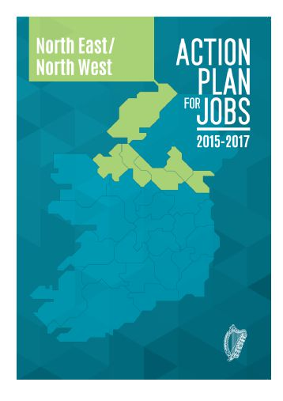
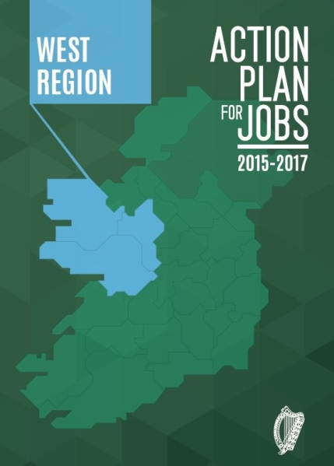



Slide 15
Effective Regional Development

Slide 16
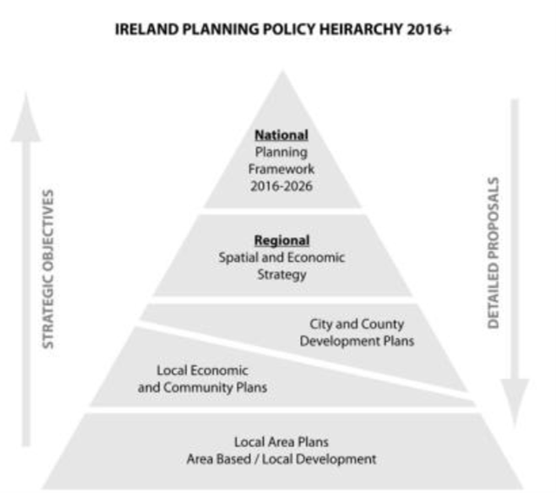
CAPITAL INVESTMENT

Slide 17
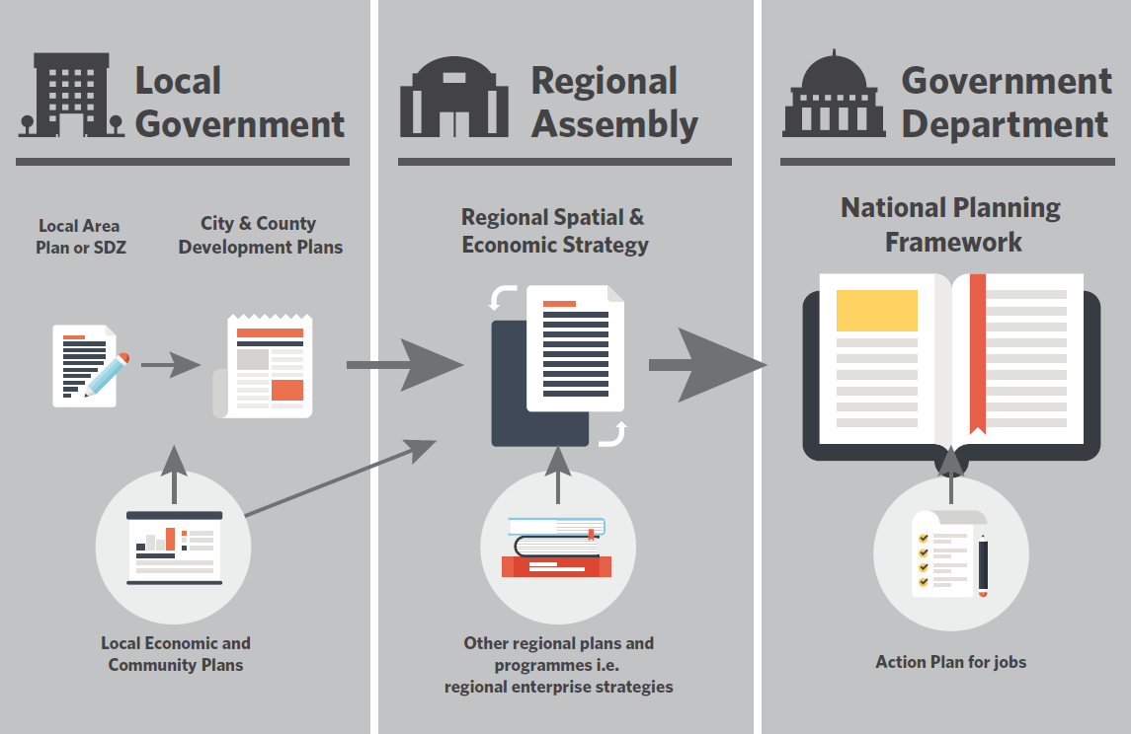

Slide 18
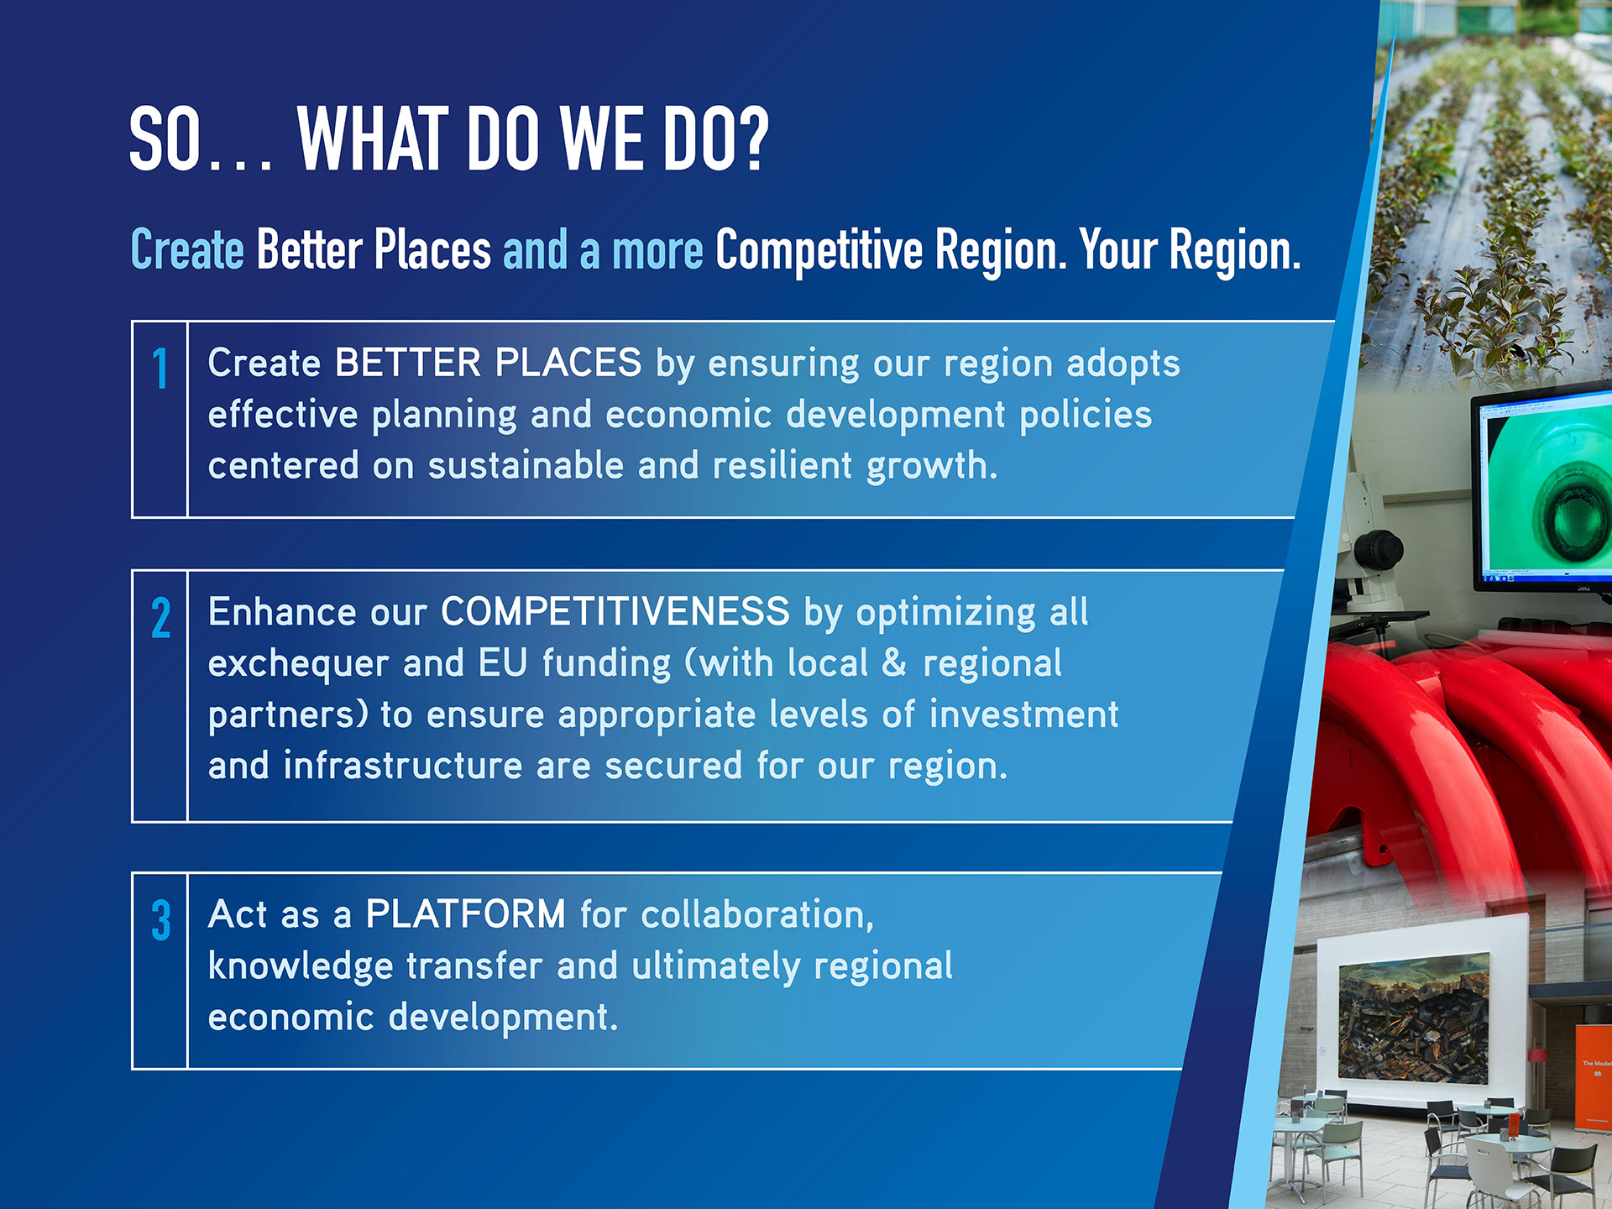

Slide 19
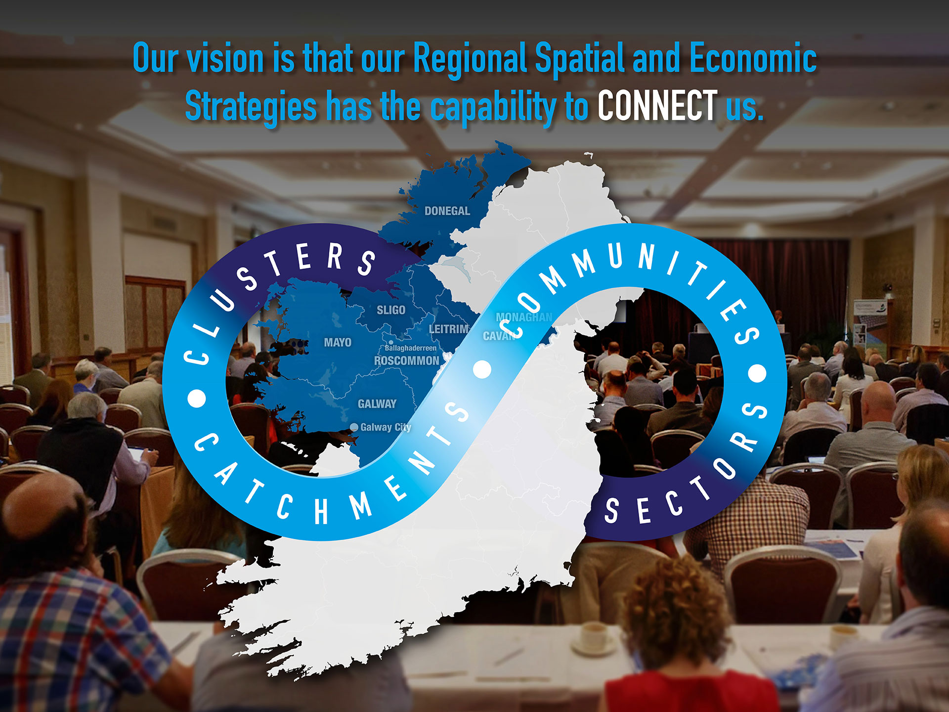

Slide 20
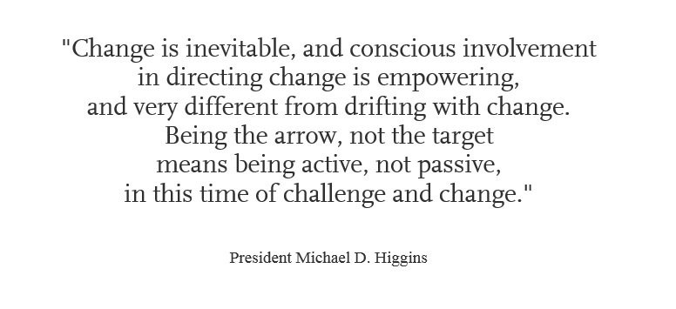
Thank you
Observation!!!!!!! If time allows

