Slide 1
Gina McIntyre, CEO
Special EU Programmes Body
European Alliance Group Seminar
11th February 2019

Slide 2
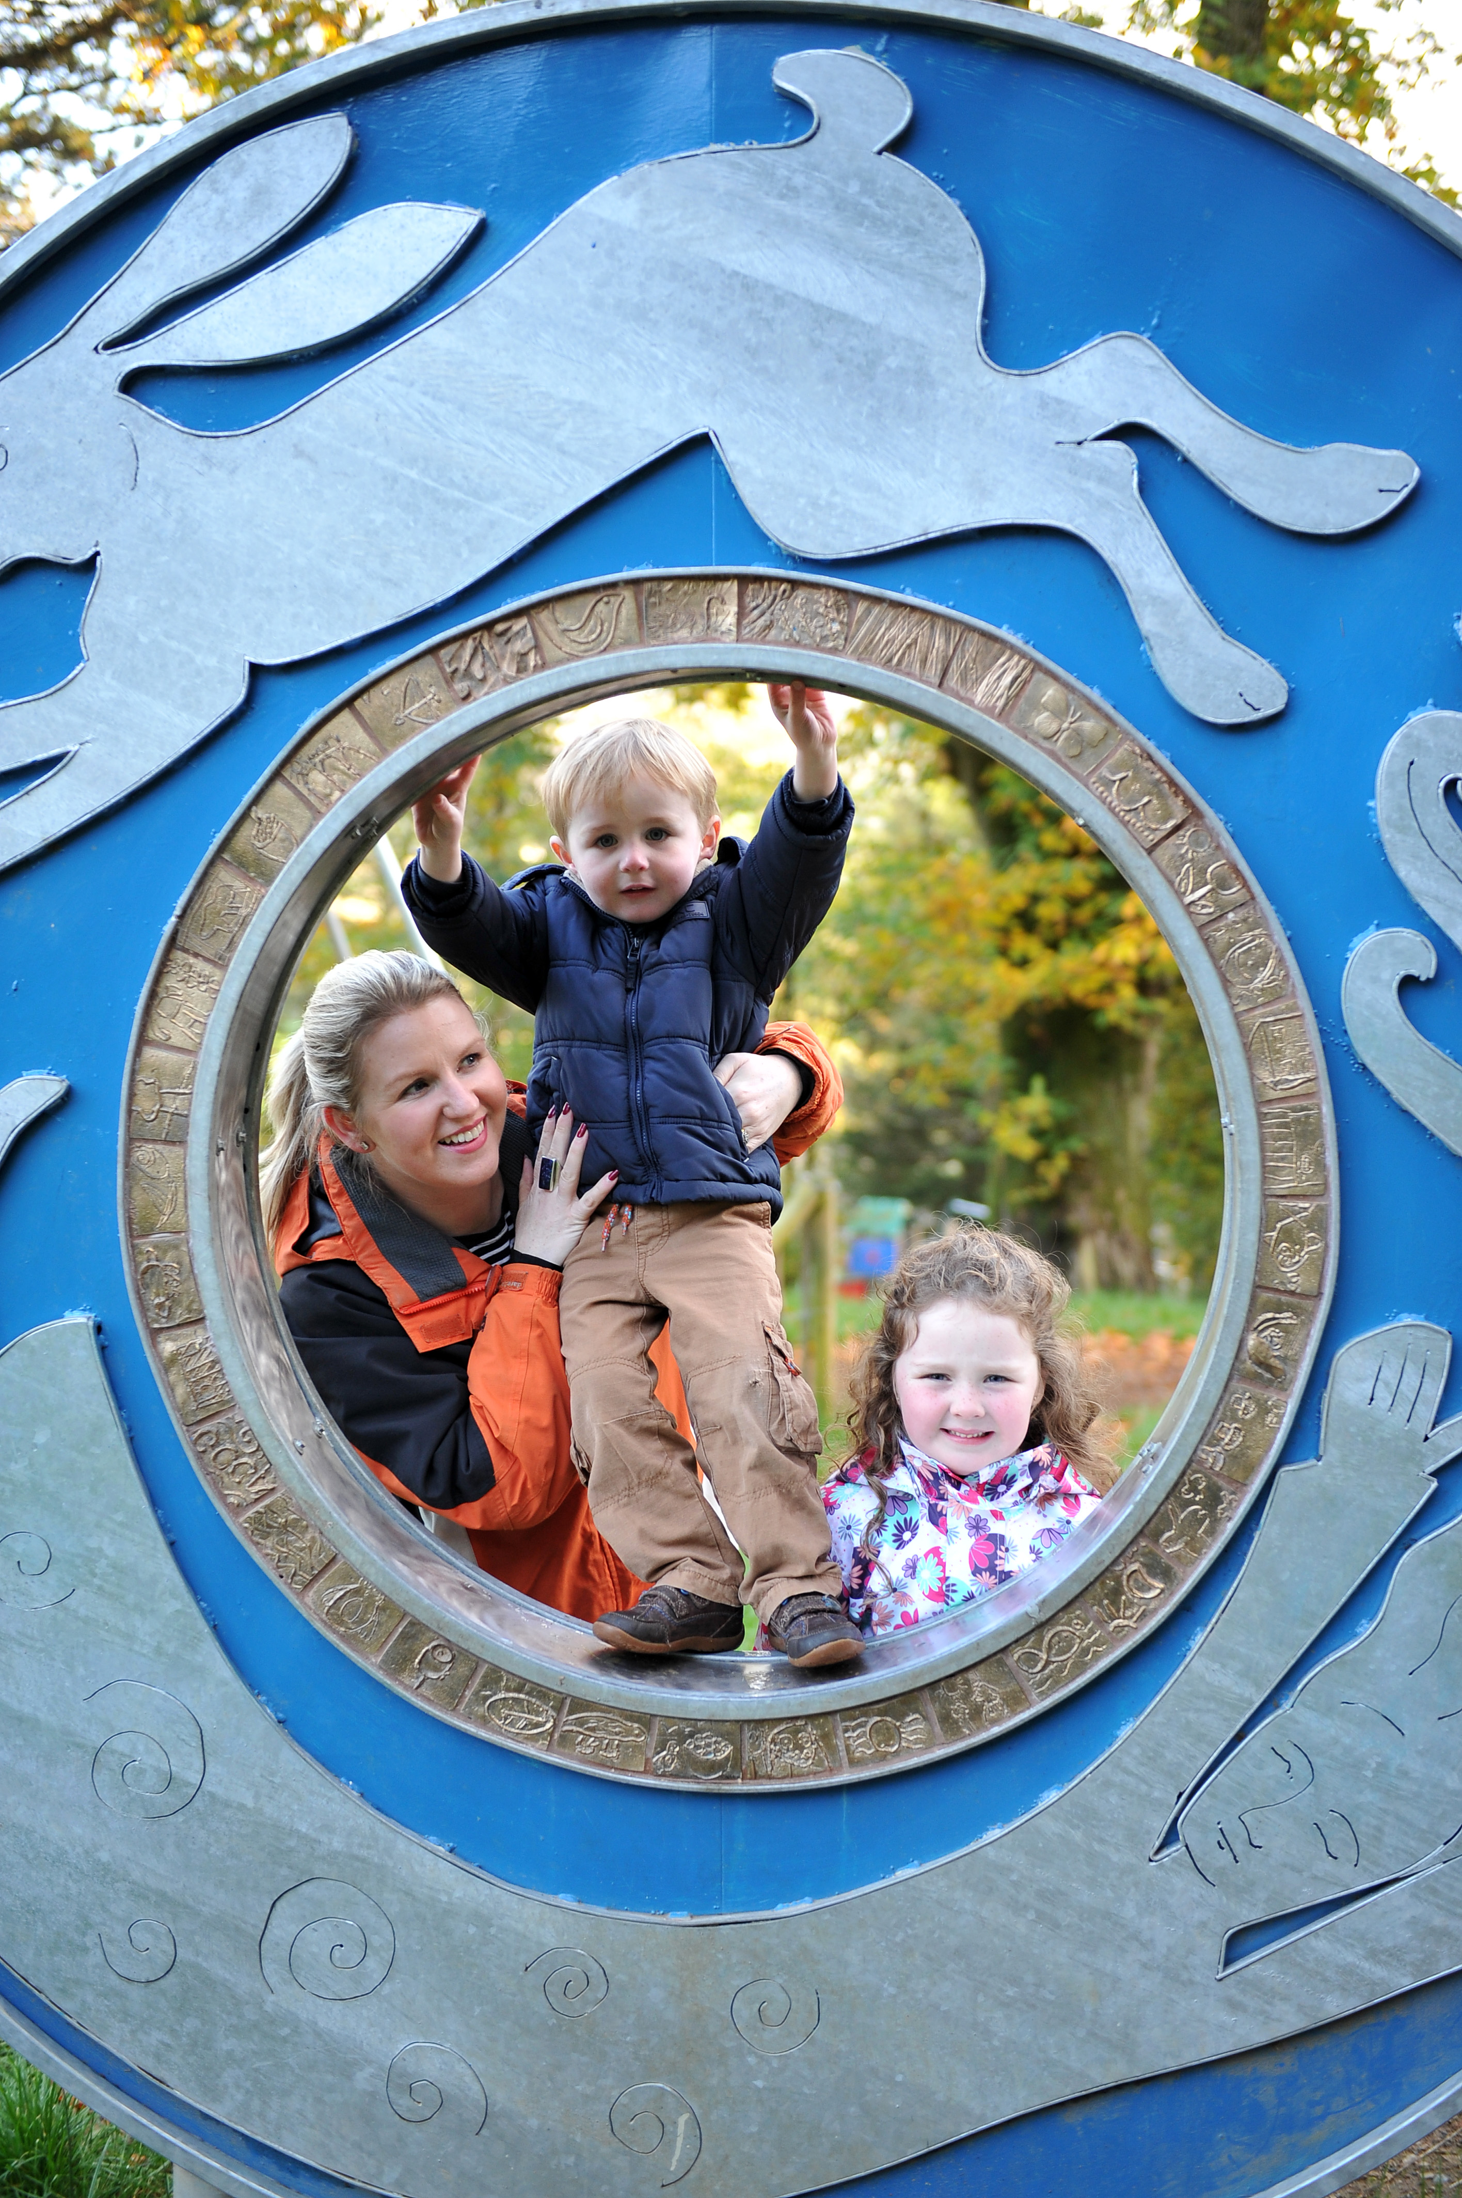
What is the role of the SEUPB?
Manage cross-border EU Structural Fund programmes in Northern Ireland, the Border Region of Ireland, and parts of Western Scotland, specifically:
  The European Union’s Programme for Peace and Reconciliation (PEACE); and
  The European Union’s cross border Programme for Territorial Cooperation (INTERREG A).
In addition, the SEUPB facilitates project participation in the INTERREG VB Transnational, as well as INTERREG VC Interregional Programmes.

Slide 3

PEACE Programme Overview
PEACE Programme - EU’s positive response to the Northern Ireland peace process. Unique programme across all member states:
PEACE I (1995) – Addressed the immediate legacy of the conflict.
PEACE II (2000) – Reinforced progress through economic development and cross border co-operation.
PEACE III (2007) – Reinforcing progress by promoting reconciliation.
PEACE IV (2014) – Renewed focus on children and young people.
AMPLIFY: Children & Young people development project funded under the PEACE IV Programme.

Slide 4
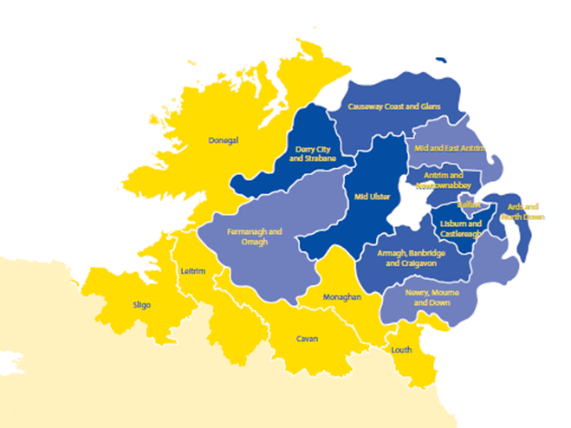
PEACE Programme Overview
PEACE I – IV (1995-2020) total investment of €2.26 billion.
Supported hundreds of thousands of projects to promote peace and stability within the region.
PEACE III examples:
  6,999 receive trauma counselling,
  189,007 attended anti-sectarian/racism events,
  25,429 attended conflict resolution training.
PEACE: Cross border Programme for Border Region of Ireland and Northern Ireland.

Slide 5

History of the INTERREG Programmes
European Territorial Cooperation, better known as INTERREG, aims to promote greater territorial cohesion.
INTERREG VA is one of 60 such programmes across all 28 Member States.
Created to support cross border cooperation:
  INTERREG IA (1990-1993)
  INTERREG IIA (1994-1999)
  INTERREG IIIA (2000-2006)
  INTERREG IVA (2007-2013)
  INTERREG VA (2014-2020)

Slide 6
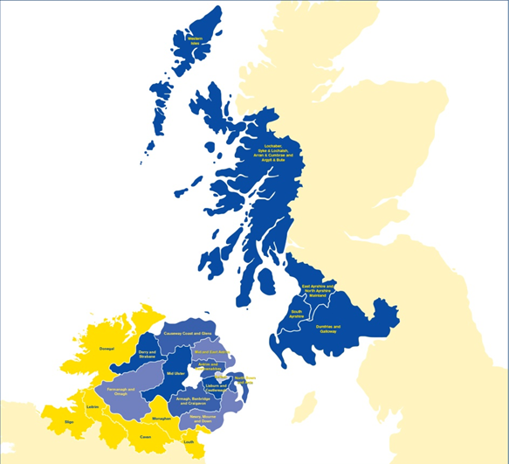
INTERREG Programme Benefits
INTERREG IA – VA (1991-2020) total investment of €1.1bn.
Western Scotland included since 2007. Innovative aspect and additional important institutions.
Supported tens of thousands of projects to build a sustainable and prosperous cross-border region.
INTERREG IVA examples:
3,552 businesses supported,
954 new jobs created,
121,741 beneficiaries in health, rural development, enterprise and tourism.
INTERREG: Cross border Programme for Northern Ireland, Border Region of Ireland and Western Scotland.

Slide 7
Challenges to this cross border region
Similar to many regions across Europe: Socio economic differences, physical obstacles in terrain, institutional obstacles (legal and administrative including labour mobility), cultural obstacles (trust, culture and language).
Neither cheap manufacturing costs nor extravagantly innovative or productive.
Economically fragile region (pre - Brexit).
Population / demographics.

Slide 8
Challenges to this cross border region
Labour markets: stagnant employment creation.
Long-term unemployment: loss of jobs and limited potential.
Education levels are lower: Border regions under preforming in relation to national economy GDP per head.
Depressed connectivity.
Transport infrastructure – question over how much this will improve rural issues.

Slide 9

Cross border Impact of PEACE & INTERREG
Since 2007 SEUPB has managed funding to projects of cross border benefit in a wide-range of sectors:
  Enterprise & Tourism
  Health & Social Care
  Public Sector Collaboration
  Rural Development
  Energy & Environment
  Roads & Transport
  Telecommunications

Slide 10
Impact of EU Programmes on cross border development
Significant levels of financial support provided to 17 local authorities across NI and Border Counties of Ireland for targeted localised community development projects.
Up-scaling and regional approach to cross border work.
Cross border working has been prioritized as a result.
EU funding viewed as ‘neutral’.
Funding rounds provide longevity for projects.
“Opened-up mind borders”.

Slide 11
Impact of EU Programmes on cross border development
SEUPB has a long history of providing opportunities for cross border participation and dialogue through PEACE & INTERREG Programmes.
Improved cross border public sector collaboration.
Developed cross border reconciliation and understanding.
Promoted joint approaches to social education, training and human resource development.
Built a network of relationships (both cross-community & cross border).
Transparent decision making.

Slide 12
Impact of EU Funding Programmes
Everyone works together for the benefit of all in the region, which has led to greater dividends.
Benefits include building better relationships in areas such as:
  Research,
  Environmental protection,
  Education,
  Health & social care,
  Youth and culture.
Innovative solutions: common problems and solutions – joint ownership for mutual benefit.

Slide 13
PEACE and INTERREG delivering on cohesion policy
Principles of Integrated territorial investment - place sensitive due to prevailing circumstances.
Partnership approach brought actors at all levels across border together and developed new relationships and governance structures.
Regional authorities centrally involved and including reps from business community, government, political reps, agencies – bottom up decisions.

Slide 14
PEACE and INTERREG delivering on cohesion policy
Programme content by consultation - focus on needs and also strengths of the region with ability to grow.
Link between social inclusion and public service provision, and also a factor for economic prosperity of a region.

Slide 15

Impact of PEACE Programmes on cross border development
Contained a number of specific support objectives for cross border development in rural areas, including:
  Basic Services for the Rural Economy Population.
  Skilling and Building The Social Economy Measure.
  Renovation and Development Of Villages and Protection and Conservation Of The Rural Heritage.
  Improving Our Rural Communities.

Slide 16
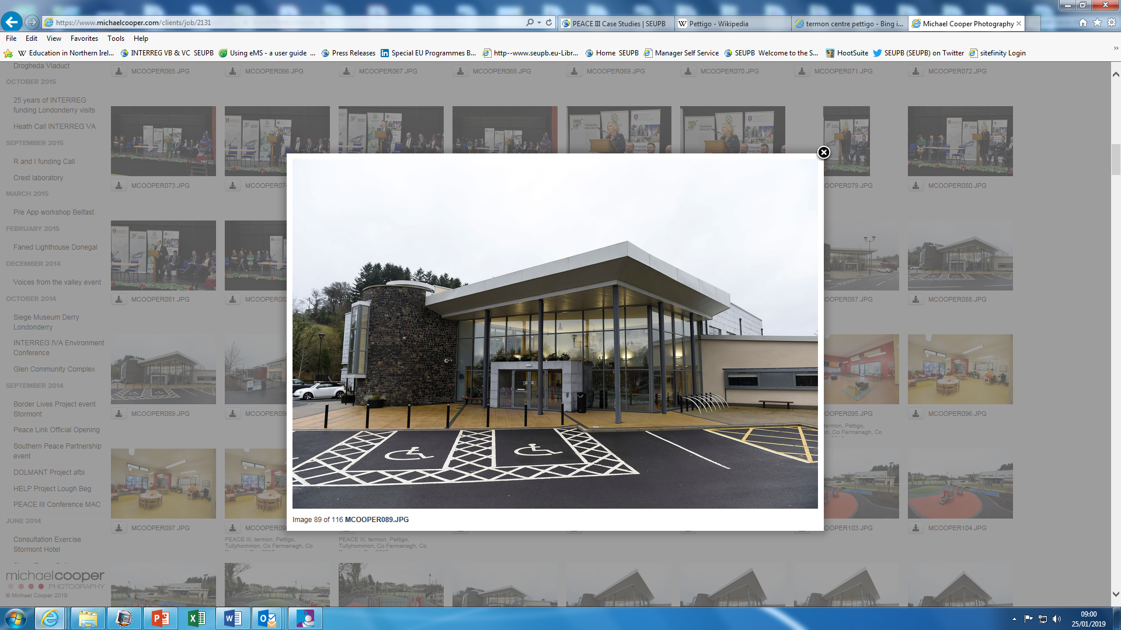
Impact of PEACE Programme on cross border development
‘Shared space’ objective used to help renew towns and villages and support social cohesion.
Termon project: €8m PEACE III regeneration project in the villages of Pettigo (Donegal) and Tullyhommon (Fermanagh). Area suffered serious under-investment as a result of the conflict/troubles.
Project involved the:
  Construction of a new Riverside walkway uniting both villages.
  Refurbishment of the Methodist Hall in Tullyhommon.
  Building of a 22,000 sq ft. community space and a new playgroup building.
Termon centre which acts as a focus for cross border and cross-community development.

Slide 17


Impact of PEACE Programme on cross border development
PEACE IV €1.2m funded ‘Regional Level’ project to tackle rural segregation and sectarianism within non-formal education settings.
It will help both parents and young people to challenge attitudes and perceptions.
The project will:
  Operate in 80 rural settings (pre-school, day care & after schools) across NI and the border counties of Ireland.
  Target 2,000 children aged 3 to 12 years on a cross-community basis.
  Will also engage 800 parents in a programme of awareness and good relations.
Project uses puppets and structured learning classes to teach young people about different religions and cultures.

Slide 18

Impact of INTERREG Programme on cross border development
Contained a number of specific cross border support objectives, including:
  Integrated Local Development Strategies (Total Allocation €69.01m ).
  Priority offered assistance to SMEs and other enterprises (particularly those in rural and isolated areas peripheral to their national economies) to exploit new market and educational linkages through ICT.
  Priority created sustainable cross border rural economy development opportunities and added value to existing agri-based and natural resource based enterprises.

Slide 19
Impact of INTERREG Programme on cross border development
‘Rural Development Initiative’ (Value: 13.5m) a number of specific support objectives:
  This support was used to impact on the problems of peripherality for rural communities, particularly in border areas on a cross border basis.
  It provided support for projects that provided basic services for the rural economy and population; encouraged tourist and craft activities; renovated & developed villages; as well as provided protection for conservation of the rural heritage.

Slide 20
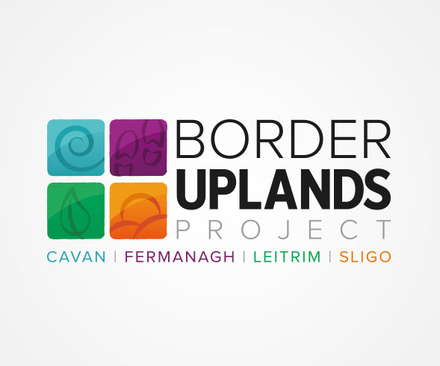
Impact of INTERREG funding on cross border development
INTERREG IVA Programme had a strong focus on cross border Tourism and Rural Development.
Border Uplands Project: €3m INTERREG IVA cross border development project designed to provide sustainable tourism in remote rural cross border locations, (which would otherwise not attract significant visitor numbers).
Project involved the:
  Creation of outdoor access, recreational and amenity infrastructure in Fermanagh, Cavan, Leitrim and Sligo.
  Upgraded and enhanced aspects of the Marble Arch Caves Global Geopark.
  Coordinated the development and refurbishment of strategic walking routes, trails and other countryside recreational opportunities.

Slide 21
Impact of INTERREG funding on cross border development
Harnessing Natural Resources Project: €3m cross border development project designed to stimulate rural regeneration within the central border area.
It delivered 26 different projects based in Cavan, Fermanagh and Leitrim, across six central themes.
The project aimed to:
  harness the nature based tourism potential of the region;
  increase visitor numbers;
  create jobs;
  ensure a long-term strategic approach to all investment;
  encourage cross-border tourism; and
  work with local communities to support sustainable development.

Slide 22

Impact of INTERREG funding on cross border development
Social Farming Across Borders Project: Practice of offering family farms as a form of social service. ‘Rural Development’ initiative.
The service provides disadvantaged groups of people the opportunity for inclusion.
It is proven to increase their self-esteem and improve their health and well-being.
The project:
  Implemented 20 farm-based pilot projects in rural areas on a cross border basis.
  Established a network of farmers and health/social care personnel.
  Raised awareness of the benefits of social farming.

Slide 23
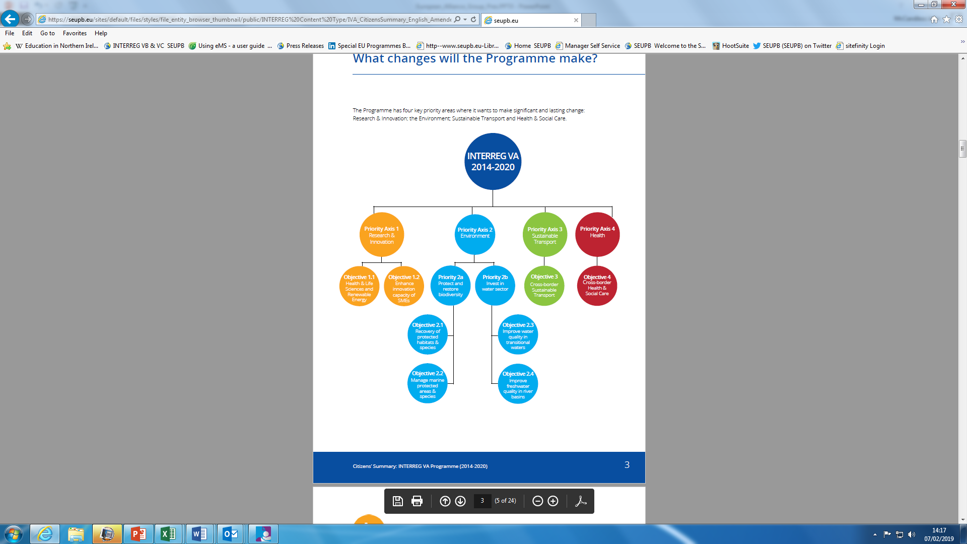
INTERREG Programme

Slide 24
Impact of INTERREG funding on cross border development
Research & Innovation: Over 1,408 SME’s receiving support on a cross-border basis.
Research & Innovation: Over 469 enterprises receiving one-to-one innovation advice.
Environment: 4,500 hectares of habitats restored to better conservation status.
Environment: Over 10,000 people benefiting from improved wastewater treatment.
Health & Social Care: Increased number of ‘episodes of care’ for over 57,000 people on a cross border basis.
Sustainable Transport: Creation of over 80km of new cross border greenways.
Sustainable Transport: Creation of one cross border, multi-modal transport hub.

Slide 25
Benefits of EU funding and working cross border
Up-scaling and regional approach to cross-border work, mainstreamed, it just makes sense to help each other.
Programmes became a valuable part of the regional policy approach and funding gets spent
Built capacity and trust, culture of cooperation for the benefit of all in the region with greater dividends.
Benefits include building better relationships in areas such as research, security, environmental issues, education and culture.
Delivery of essential services in a more cost effective manner i.e. critical mass.
SMEs work together not compete against each other.

Slide 26
Benefits of EU funding and working cross border
The programmes provide for integrated development between neighbouring MSs in the border region - practical cooperation required e.g. environment.
Unlock competitiveness potential for industrial and cultural activities and growth related to human and social capital Needs new investment to achieve potential
Solutions to social economic or environmental issues in sectors such as education tourism job opportunities, mobility, medical services, cultural and heritage.
Focus on cooperation /shared ownership - centres of innovation for example universities, and allow for exchange of knowledge and access to experts.
Local level knows what they need/ a bottom up approach engaging with all levels up to government- building capacity. Place based sensitivity- ownership.

Slide 27
EU Programmes developed cross border relations
Knowledge economy – free movement, student academics, researchers, artists, recognised qualifications.
Research between Universities/Institutions will affect quality of education.
Border Institutions will be hit worst.
NI/Ireland worked so well together they could access grants in each jurisdiction.

Slide 28
Future Programmes and cross border development
Future PEACE Plus Programme – Commitments provided by EU, Irish and UK Governments.
Combination of peace and reconciliation, economic and social priorities.
Vehicle to maintain cross border cooperation and to develop and sustain rural communities.

Slide 29
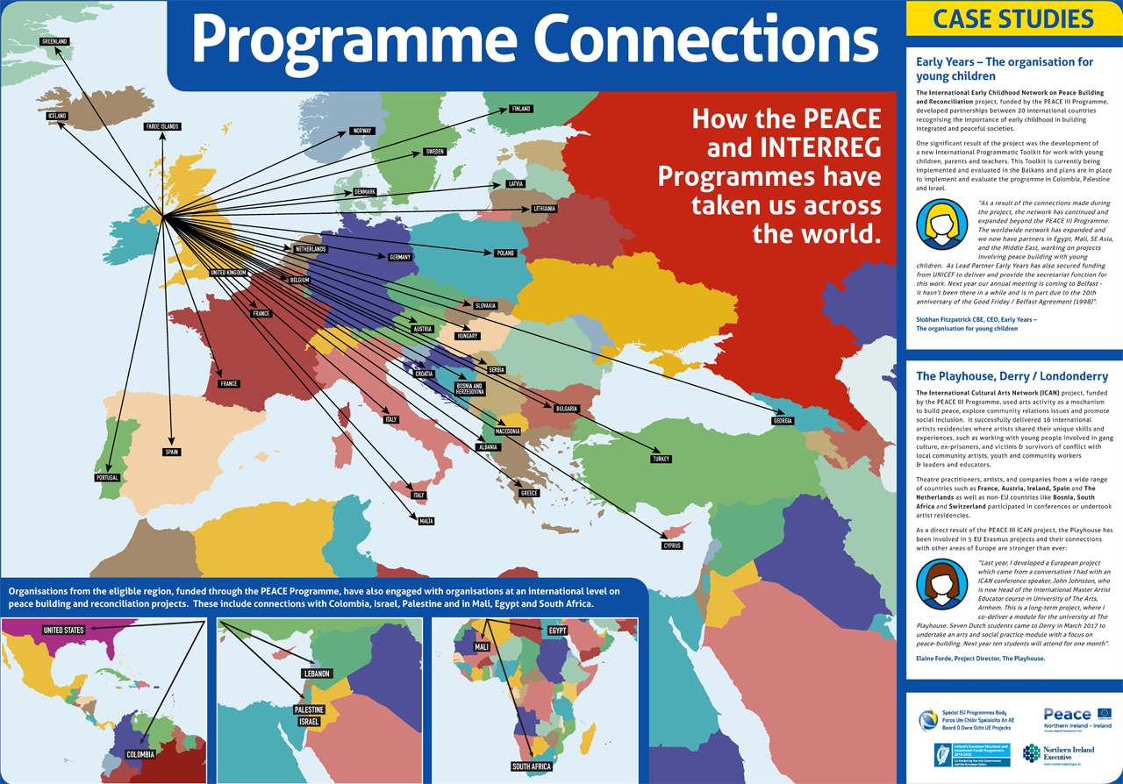
Flight map

Slide 30




Thank you

