Slide 1
Promoting Cultural & Linguistic Heritage of Europe
June 4, 2018
Rodolphe de Looz-Corswarem
Executive President of the European Historic Houses Association

Slide 2
Who we are & what we do ?
2. Promoting the European Year of Cultural Heritage
3. Activities during the European Year of Cultural Heritage
4. Expected political outcomes of the European Year of Cultural Heritage

Slide 3
Who we are & what we do ?

Slide 4
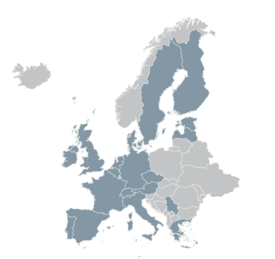
The European Historic Houses Association
Voice of 50.000 privately-owned historic houses and gardens across Europe since 1985
22 national associations
2 observer countries

Slide 5
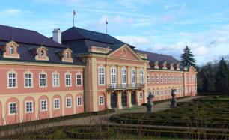
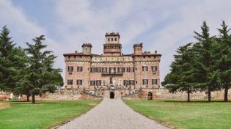
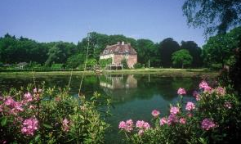
Our objectives
Promote European cooperation to secure conservation and preservation of historic houses and gardens
Provide a platform of exchange of information and support for National Associations
Demonstrating that private cultural heritage counts for Europe
Notes:
Our raison d’être is defending private historic houses and their owners.
Preventing them from disappearing
- 1000 castles in France are for sale and do not find an owner

Slide 6
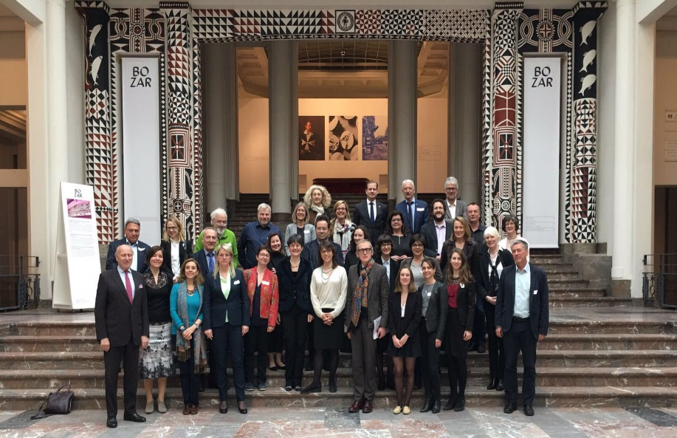
The European Heritage Alliance – Alliance 3.3
Informal platform of
48 European and international
networks active in cultural
heritage
Coordinated by Europa Nostra
The name refers to article 3.3 of the Lisbon Treaty:
“The Union (…) shall respect its rich cultural and linguistic diversity, and shall ensure that Europe's cultural heritage is safeguarded and enhanced.”
Notes:
Alliance created in 2011 under the impulse of EHHA and Europa Nostra – 6 organization
Today: almost 50

Slide 7





























Slide 8
The European Heritage Alliance – Alliance 3.3
Joint lobbying actions
EYCH and funding
Project and report ‘Cultural Heritage Counts for Europe’
Regular meetings
Include exchange of views with representatives from the European Commission (DG EAC) and key stakeholders
Contribution to EYCH 2018
Events & initiatives organised by Alliance members
Notes:
We worked together to promote the idea of the European Year of Cultural Heritage
Collaborated on the report Cultural Heritage Counts for Europe published in 2015
We hold meetings at least twice a year to discuss our activities / policy
All Associations contribute to the 2018 EYCH

Slide 9
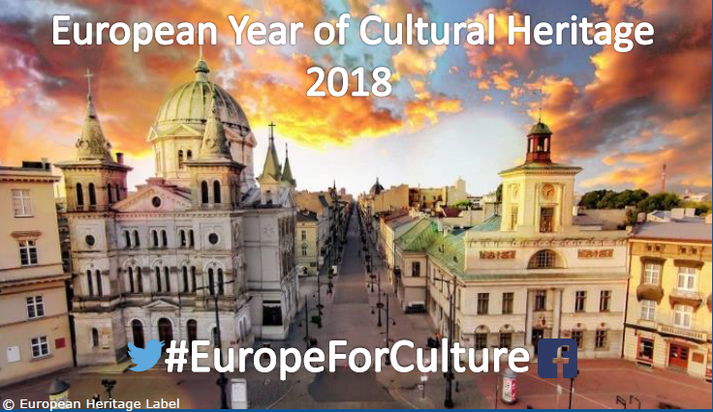
2. Promoting the European Year of Cultural Heritage

Slide 10
Proposal by the European Commission for EYCH 18
13 Sept
Juncker supports EYCH 18
Cultural heritage in the European Agenda for Culture
Impulse from EU Cult. Min & European Parliament
25 March Rome Declaration
2007
2014
2015
2016
2017
2018
Towards an integrated approach to cultural heritage for Europe
Cultural Heritage Counts for Europe report
April
Approval EYCH 18 by European Parliament
11 May
Final approval EYCH 18
7-8 Dec
Launch event in Milan @ European Culture Forum
Notes:
Long campaign to promote 2018 EYCH started in 2014
Cooperation between the civil society and the institutions
Launched in Milan in December
Thank you to the institutions

Slide 11
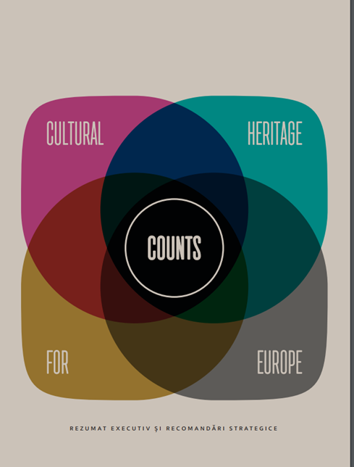
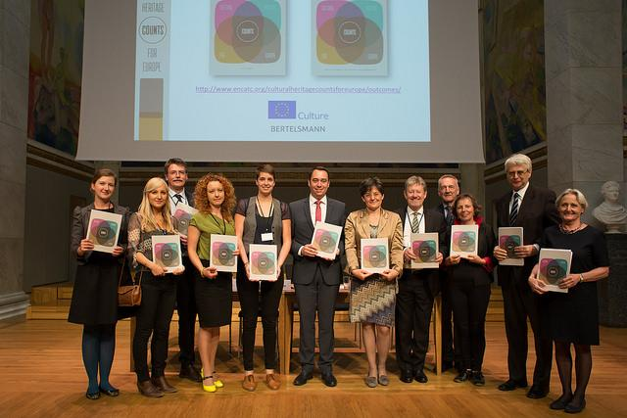
The report “Cultural Heritage Counts for Europe”
On 300+ pages, it demonstrates the multiple benefits of heritage for Europe’s economy, society, culture and the environment,
Policy recommendations on how to tap into the full potential of cultural heritage for Europe
Notes:
Great contribution of the report: impact assessment of how much cultural heritage contributes to Europe: economically, socially, and for the environment

Slide 12


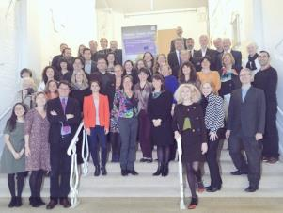
Key stakeholders for the European Commission
18 members of the European Heritage Alliance are part of the European Commission stakeholders group to
European Alliance 3.3
Stakeholders group European Commission
Notes:
We also contribute to the Year by being involved in the stakeholders committee supporting the European Commission with the implementation of the Year
Cooperation with the national coordinators of the Year

Slide 13
3. Activities during the European Year of Cultural Heritage
Notes:
Now that the institutions have given us the chance to highlight our contribution, we have to seize the chance and act!

Slide 14
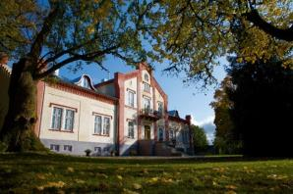
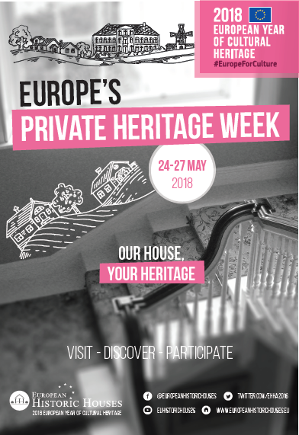
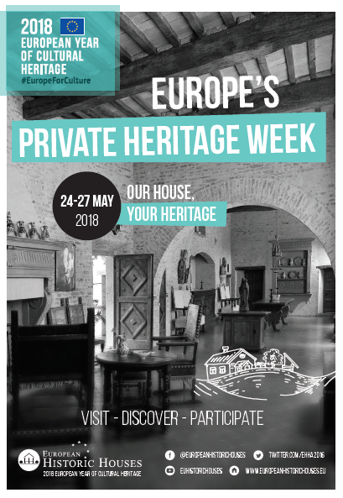
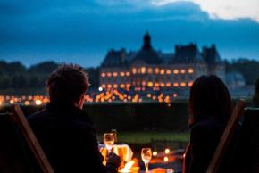
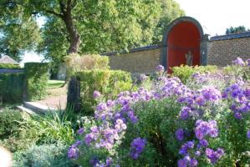
European Historic Houses Association
European Private Heritage Week (24-27 May)
International photographic competition
Notes:
EHHA two major activities for the Year:
Private Heritage Week (24-27 May)
648 houses open in 18 European countries. A great success!
Aim: showcase the contribution of private heritage houses to Europe.
International photographic competition
Launched on May 24 – running until July
Award ceremony in November in Brussels
Aim: Showcase the beauty and diversity of historic houses in Europe

Slide 15



One of the highlights of the
European Year of Cultural Heritage 2018
© Michael Bader
Notes:
Highlight of the year for civil society: European Cultural Heritage Forum in Berlin (18-24 June) with high-level summit on June 22

Slide 16
4. Expected political outcomes of the European Year of Cultural Heritage

Slide 17
Political Momentum during the EYCH 2018
Social Summit Gothenburg 17 November (28 MS Heads of State)
President Tusk organized a Working Lunch ‘Education & Culture’
Prompted by E.Macron Pnyx speech (7.09.17)
Commission sent some recommendations
  2 Years: Capitalize on the 2018 European Year of Cultural Heritage
  2025: Establish a long term EU Action for Cultural Heritage
Davos Forum : declaration of Ministers on the Build Environment

Slide 18
Expected political outcomes of the EYCH 2018
Alliance Manifesto presented in Berlin
Objectives of the European Historic Houses Association
Recognize the contribution of private owners of historic houses to EU economic, social and cultural developments
Improve the legal and regulatory frameworks
Encourage participatory governance with landowners
Promote new and innovative funding models & management systems
Notes:
We want to achieve true political outcomes during the EYCH, which will continue beyond 2018

Slide 19
Look beyond the EYCH 2018
Proposed new Agenda For Culture (22 May)
Improve support of the cultural and creative sectors
Propose an Action Plan for Cultural Heritage
Broaden the current structured dialogue with civil society
Council conclusions on the need to bring cultural heritage to the fore across policies in the EU (22 May)
Introduce a more explicit focus on cultural heritage in the MFF
Improve participatory governance
Broaden dialogue with civil society

Slide 20

We need you!
Notes:
We should work all together during this Year to make it a true success!

Slide 21
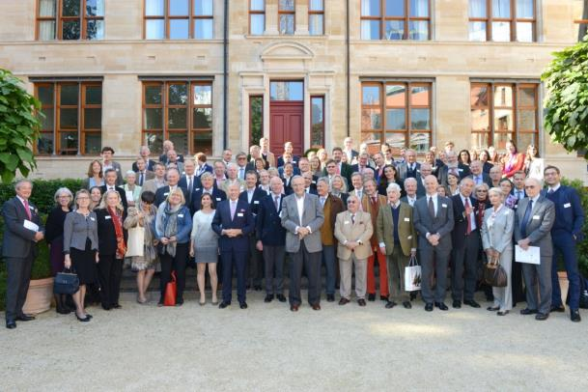


Thank you for your attention !
European Historic Houses Association
@EHHA2016

