Slide 1
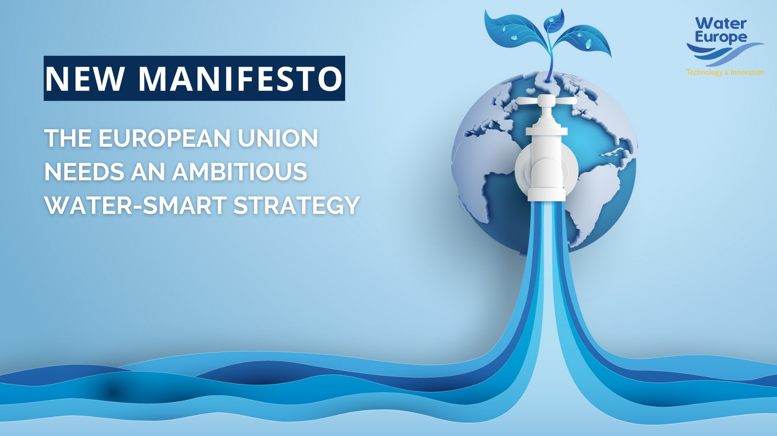
Notes:
WE is a purpose-driven multistakeholder association representating the full water value-chain/ecosystemwith the ultimate ambition to achieve a Water-Smart Society.
In order to do so:
- we need to Collaborate,
- we need to Innovate, and
- we need to Advocate!

Slide 2
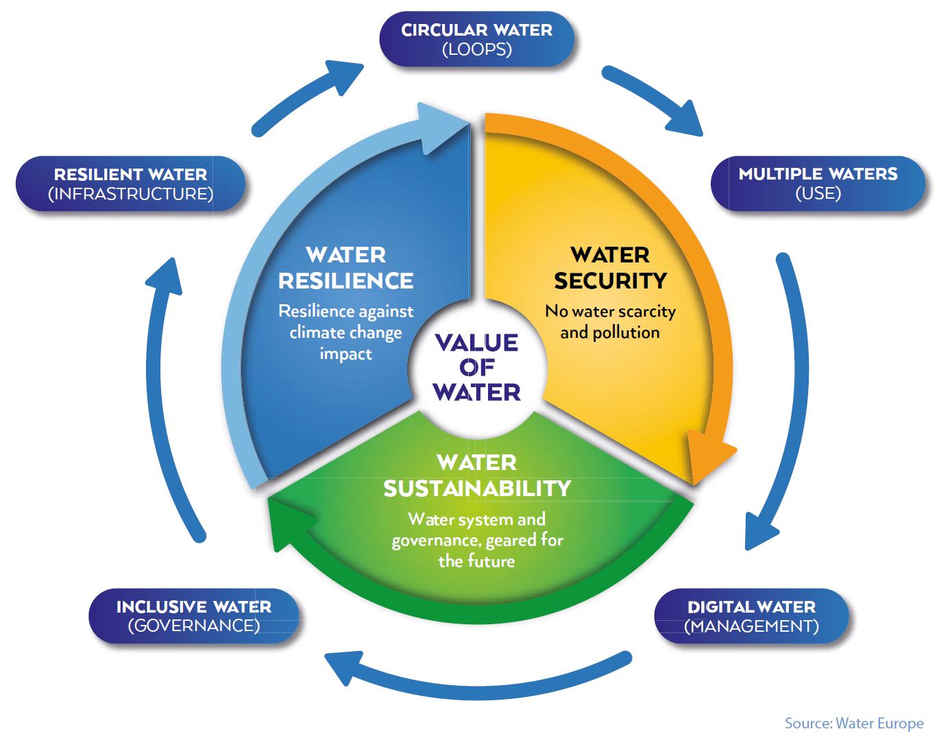
Water-Smart Society
Water-Smart Society:
A society in which the value of water is recognised and realised to ensure water security, sustainability, and resilience.
all available water sources are managed so that water scarcity and pollution are avoided.
water and resource loops are largely closed to foster a circular economy and optimal resource efficiency.
the water system is resilient against the impact of climate and demographic change.
all relevant stakeholders are engaged in guaranteeing sustainable water governance.
Notes:
2

Slide 3
Europe needs a Water-Smart Strategy
Water scarcity affected 29% of the EU territory during at least one season on 2019, states the European Environment Agency (EEA).
EU policymakers must master the cross-sectoral water risks and challenges, including their full economic impacts.
Water must become a top priority for the European Union.
The nomination of an EU Vice-President in charge of the whole water dimension is required.
A Water-Smart Strategy is a competitive asset for our European autonomy alongside the energy and critical raw materials strategies.
Ensuring water security, resilience and sustainability will require leveraging financial tools, beyond the EU innovation policy.
Notes:
Water Europe issued its Manifesto for the EU 2024 elections, calling on European institutions and policymakers to adopt an ambitious and holistic European Water-Smart Strategy with a strategic political accountability within the Commission.
The EU institutions, political groups, and policy makers are already preparing their programme for the EU elections 2024. The national political parties and the national governments have a key role to play in this process. Therefore, it is time to make them aware about the importance to build a Water-Smart Society in Europe and raise awareness about water challenges and opportunities for our societies, economy, and environment.
We therefore invite you to share the WE Manifesto with influential actors in your country including your government and political parties and any relevant actors that can contribute to this objective.
Water Europe manifesto has also been published on the homepage and the Energy & Environment hub and in the Opinion section of EURACTIV.com

Slide 4
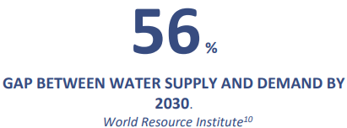
Water-Smart Strategy Calling upon policymakers
While the EU has provided dedicated funds to key strategic sectors, one of our main resources has remained largely overlooked: WATER
€43 billion is invested in the European Chips Act, while an integrated circuit on a 30cm wafer requires 8,300 litres of water.
€235 billion is dedicated to digital under the EU Budget 2021- 2027, while a 1 MW data centre uses 5 million litres of water each year.
€130 billions of EU investments are directly associated with hydrogen projects, while 9kg of demineralized water is consumed for every kg of hydrogen produced.
Notes:
Do you think that semiconductors, batteries, and hydrogen productions or other critical supply chains are secured? The World Resource Institute predicts a 56% gap between water supply and demand by 2030. European competitiveness is threatened by the lack of water-smart management of the resource while invest in promising sectors. Europe shall accelerate water efficiency, reuse and exploit the full value in water. Water matters.
We call on policymakers to adopt an ambitious and holistic European Water-Smart Strategy with a strategic political accountability within the Commission for its the next term 2024-2029.

Slide 5







Thank You
watereurope@watereurope.eu
www.watereurope.eu
H2OEU
Water Europe

