Slide 1
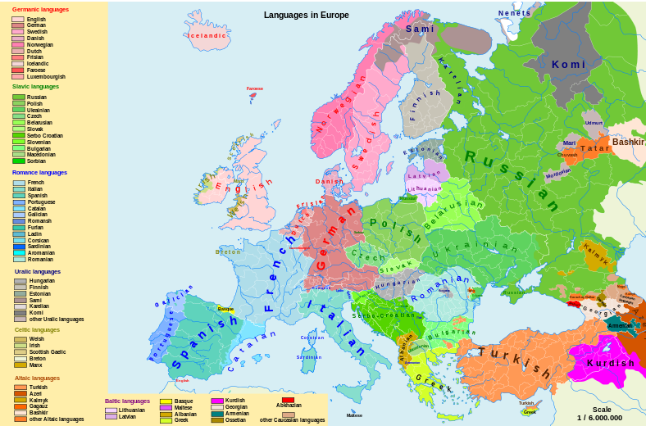
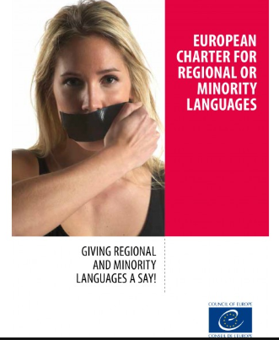
In the EU, 40 to 50 million people speak one of its 60 regional and minority languages
http://www.europarl.europa.eu/thinktank/fr/document.html?reference=EPRS_BRI%282016%29589794

Slide 2
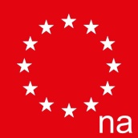
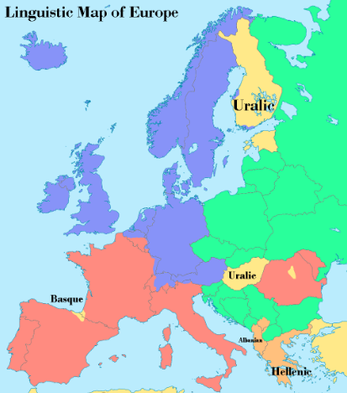
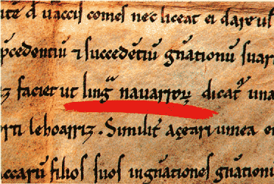
Basque language
The Basque language is the ultimate linguistic mystery. It is spoken natively by some of the Basque people who live in Spain and France, but it is completely unrelated to any Romance language (which French and Spanish are) or indeed any other language in the world.
The Navarrese king Sancho VI, called 'The Wise', referred to the Basque language as 'Lingua Navarrorum' (the language of the Navarreses) in one of his manuscripts of 1167.

Slide 3
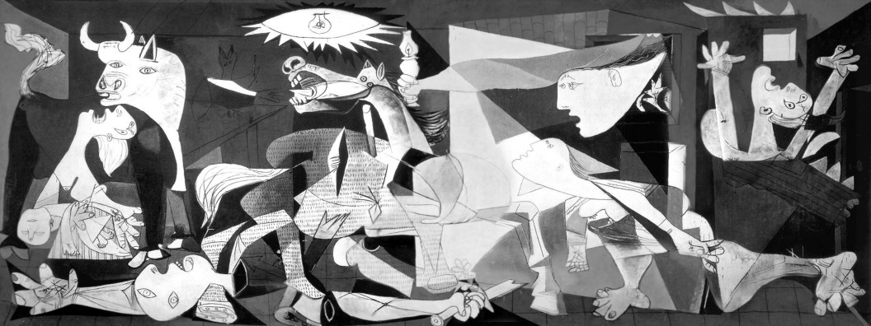
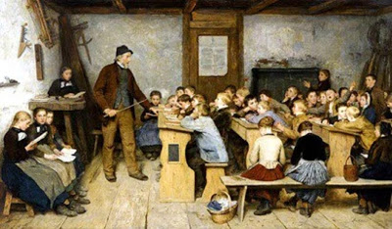
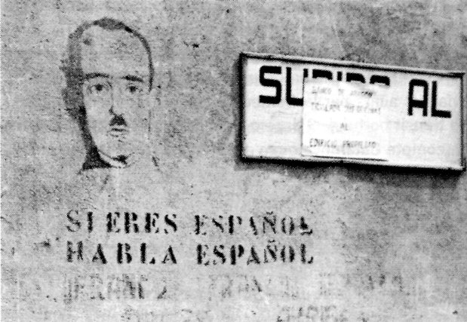
XIX – XX Centuries
Linguistic genocide

Slide 4
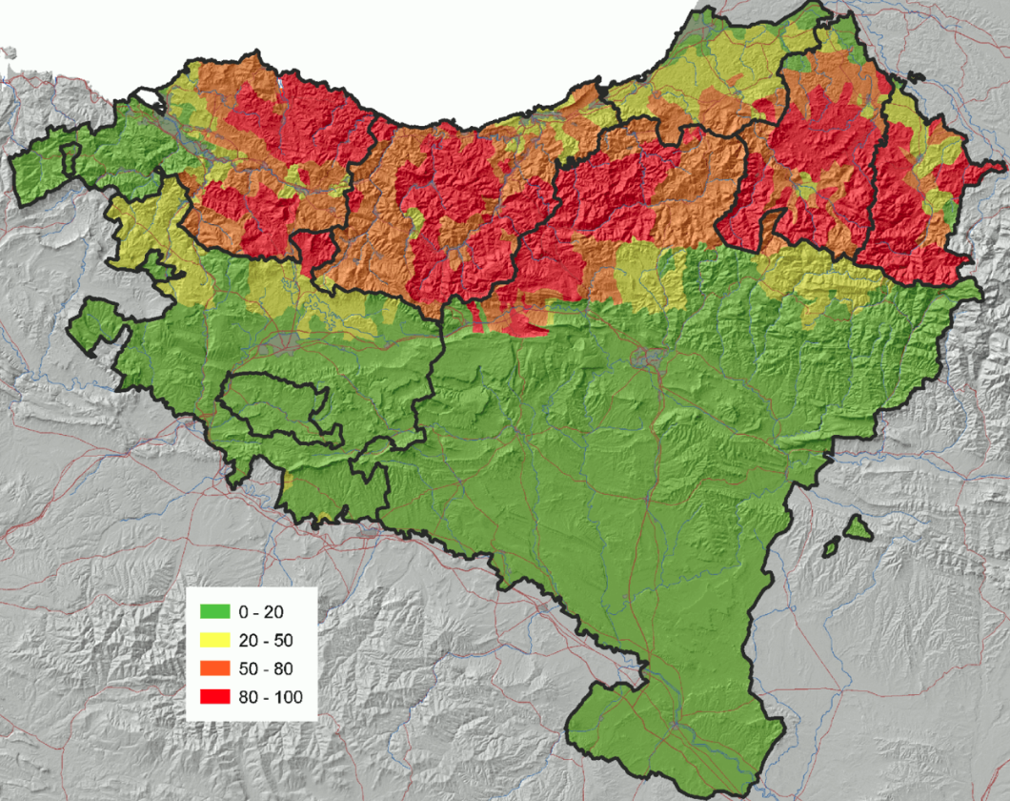
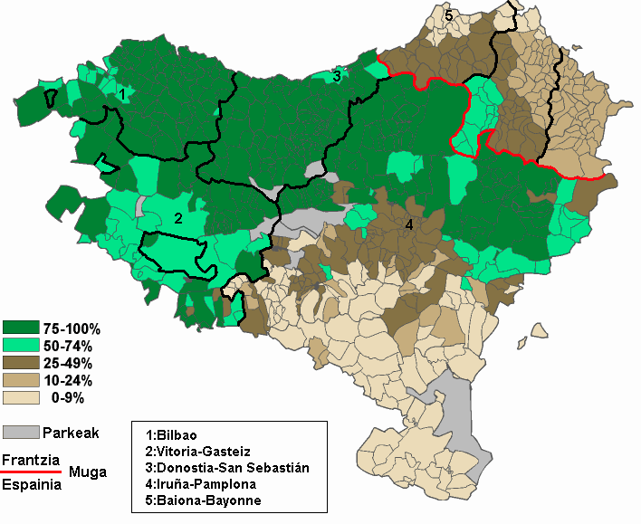
Basque language
XXI Century
Recovery
Percentage of Basque speaking people
Percentage of students registered in Basque language schools

Slide 5
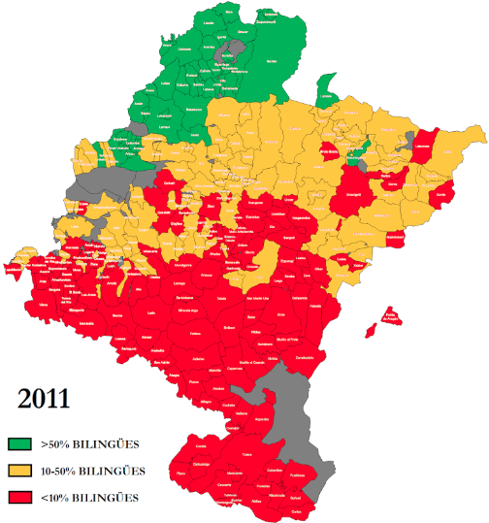
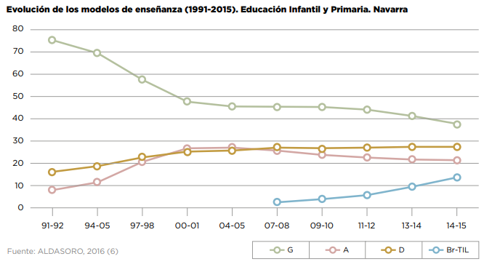
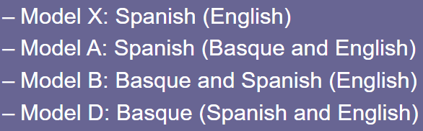
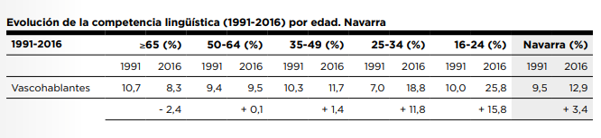
Basque language in Navarra

Slide 6
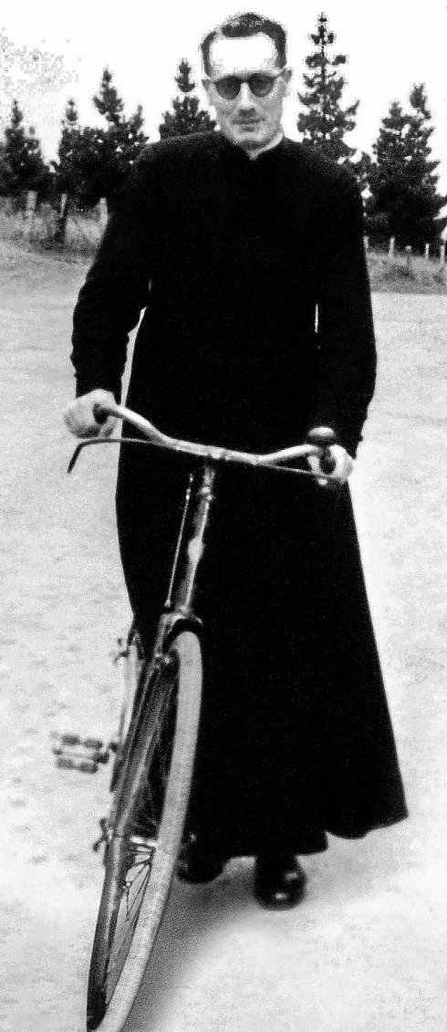
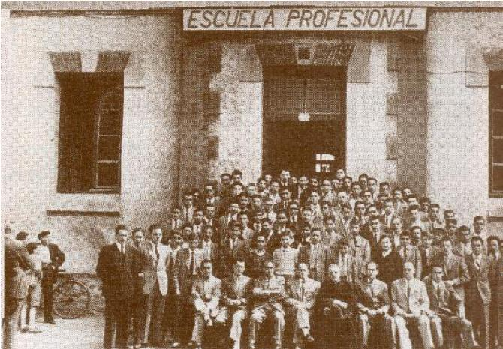
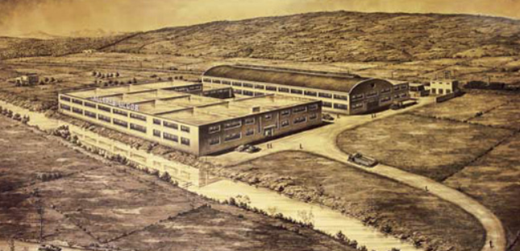
Basque cooperativism
1943
1956

Slide 7
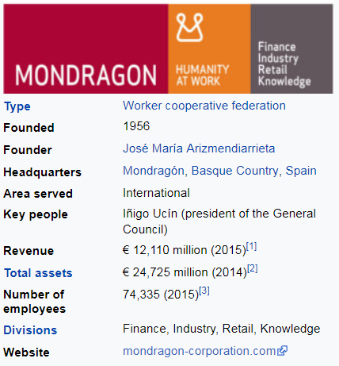
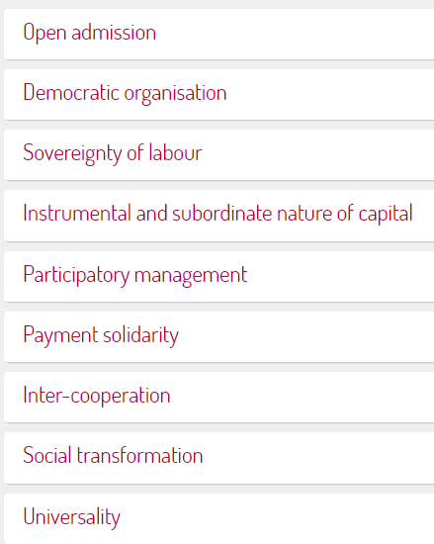
Basque cooperativism
2017

Slide 8

Basque cooperativism to foster the language
Cooperativism key tool to develop industry, basque language, culture and education
108 schools
54.000 students

Slide 9
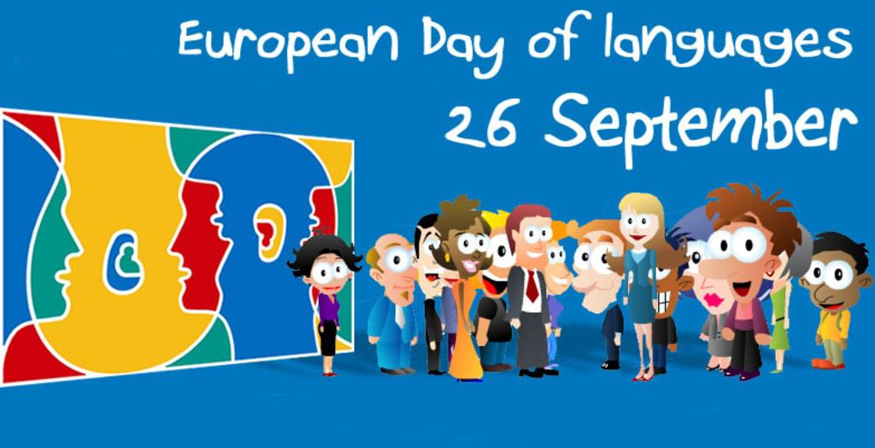
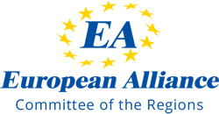

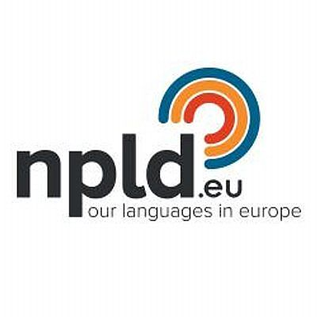
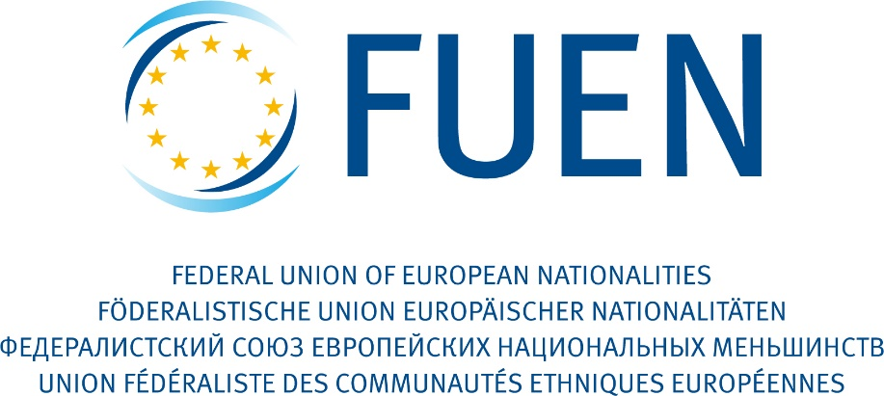
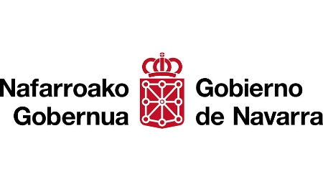

Slide 10
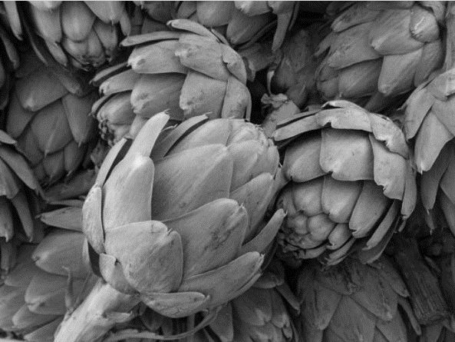
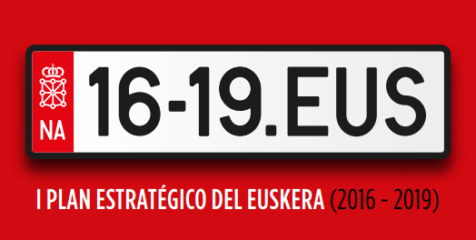
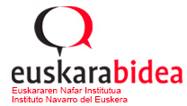
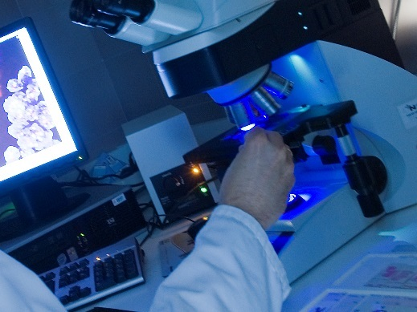
Eskerrik asko !!
Thanks a lot !!
Mr. Mikel Irujo
Delegate Government of Navarra in Brussels

