Slide 1
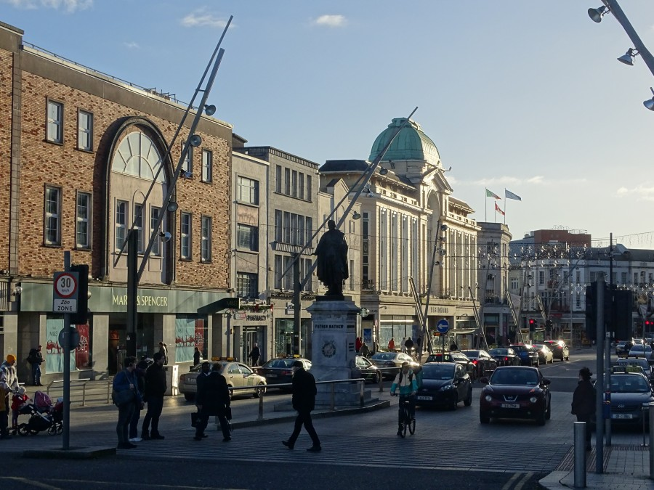

Dr Kieran McCarthy, Member of COR & Cork City Council
Promoting Culture and Heritage: Views from the COR & LRA’s

Slide 2
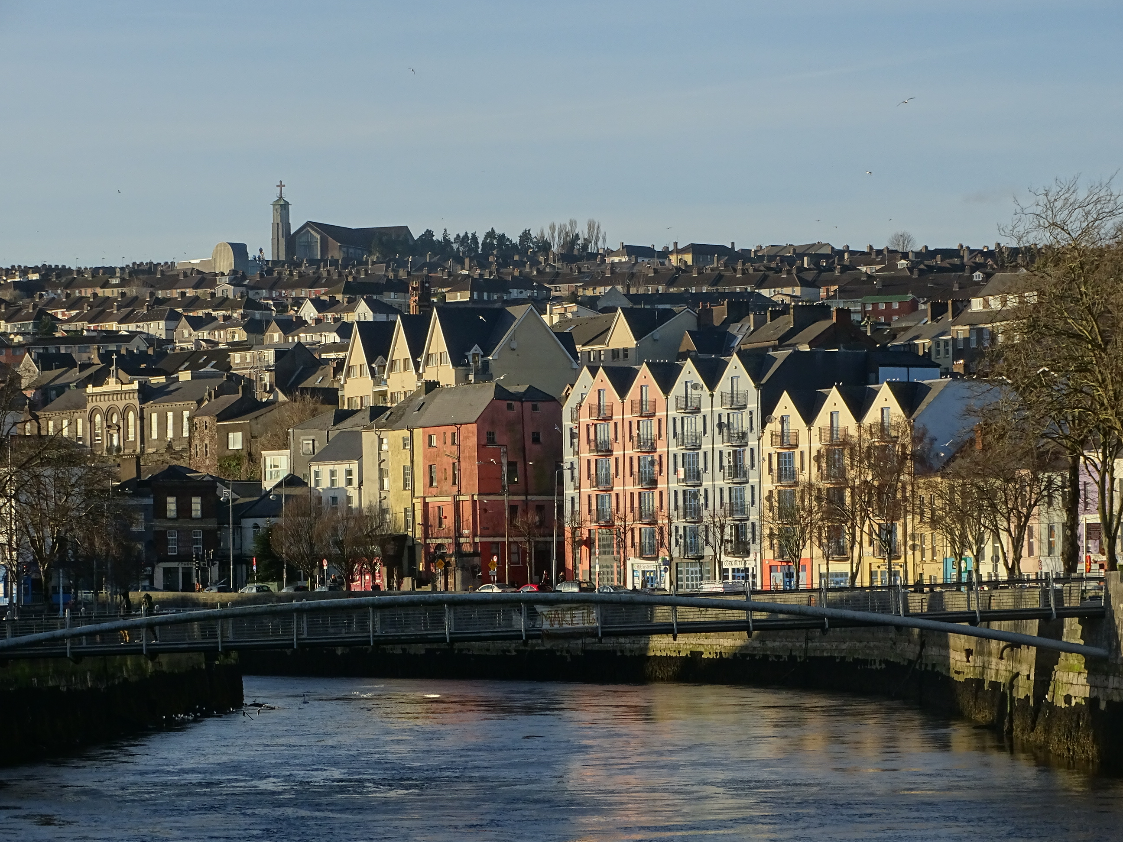
Introduction
The many layered chessboard of cultural heritage
Understanding the role of LRA’s and communities in heritage management
The National Cultural effect on LRA work in Cultural Heritage
The COR view on cross wiring with other topics

Slide 3
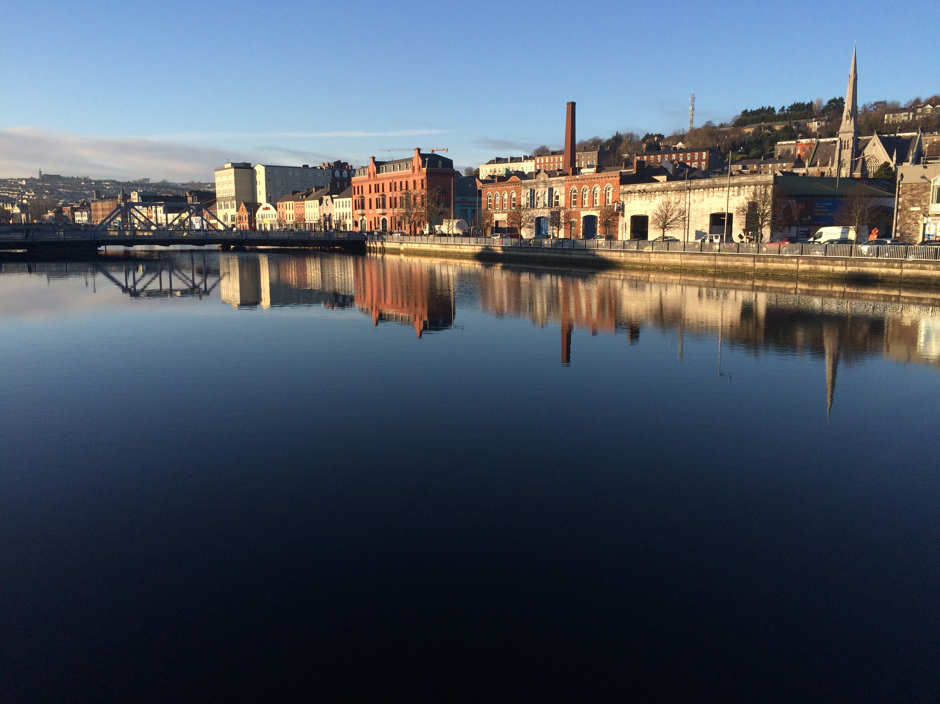
LRA’s as governors of cultural heritage
Oversee the urban and social fabric of towns and cities, 2,000 years old in Europe
Layered and organic growth for many of them
Many old crossroads of trade
Citadels of Empire construction
Charter driven – Mayors and officialdom
Evolving civic functions, embedded in ancient town infrastructure
Civic heritage ingrained for centuries in these settlement’s DNA

Slide 4
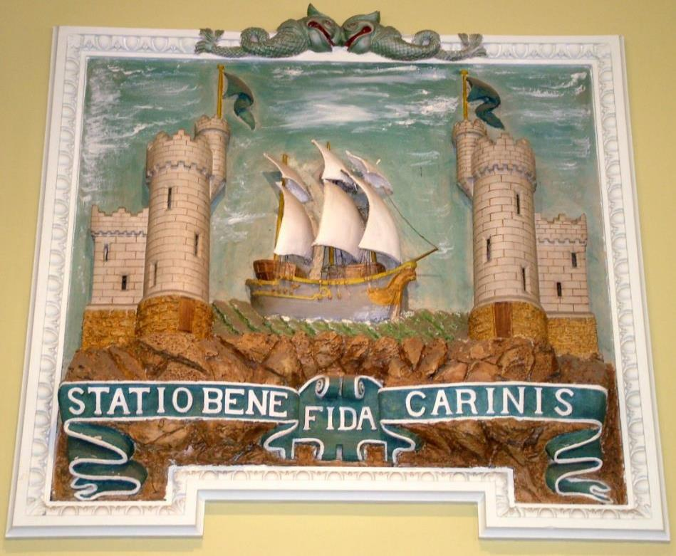
LRA’s as Repository of Public Memory
Vast repositories of symbolism, iconography and ideology
Validation of public memory, which is highly nuanced
Identity formation and place making fuelled by public memory
Civic memory can help remembering process and forgetting process
Most potent in placenames, street names, civic plaques and monuments
The new branding tool – place matters
Arts and heritage plans in settlement development plans
Festival creation
Works closely in cultural management also led by communities

Slide 5
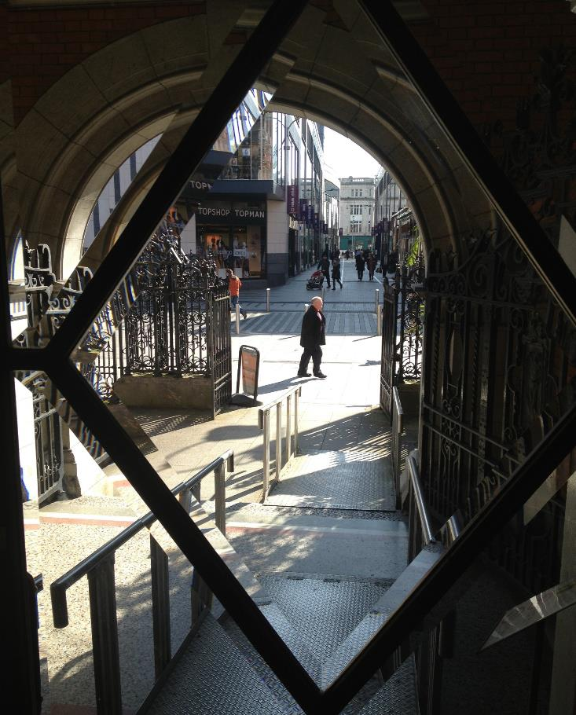
Cultural management also led by communities
Role of local historians
Distinct rise & dissemination of local history studies
Rise of community artists interested in place-making
Rise of family histories
Kitchen table heritage construction
Rise of personal digital archives online – in particular facebook

Slide 6
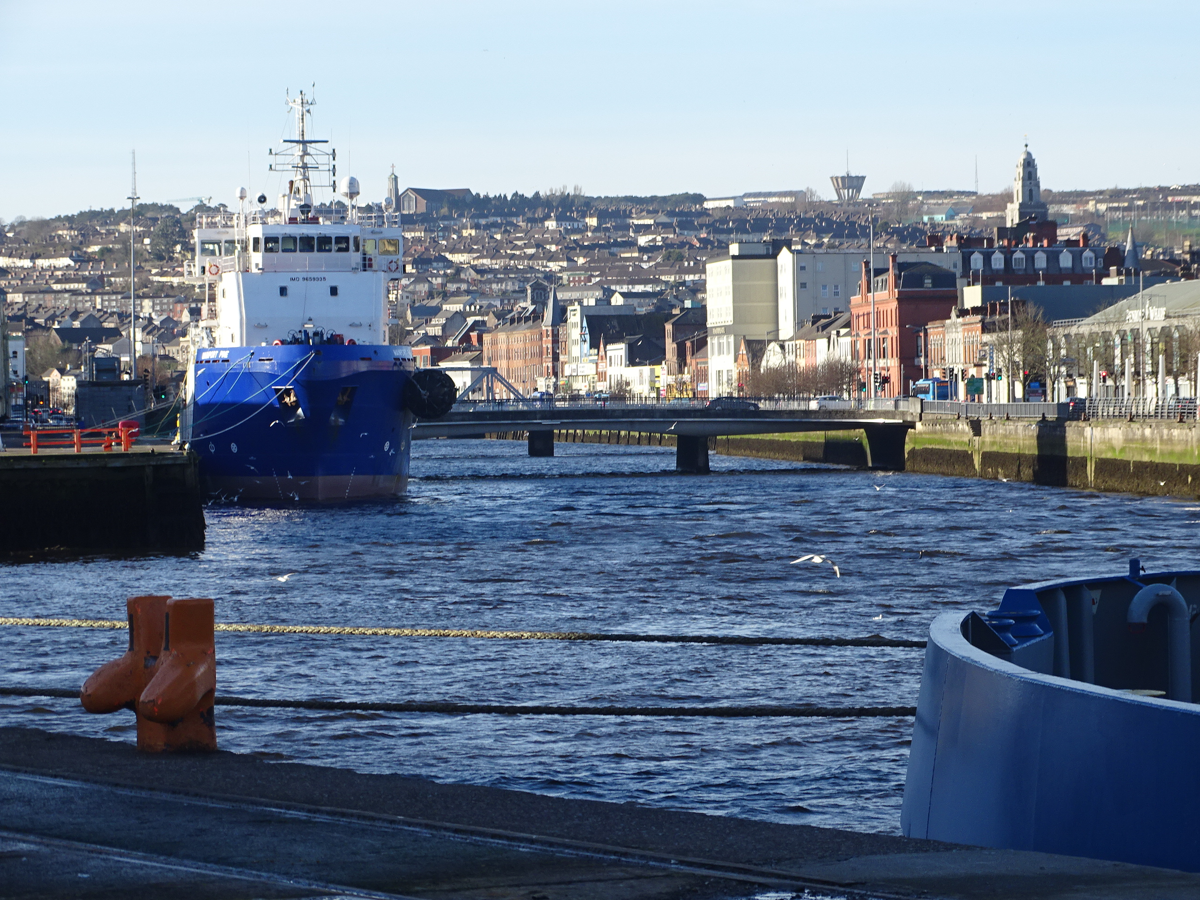
National Heritage buffering the local
Stronger power in shaping local heritage
Inspires, constructs, invents, disrupts, destroys, distils, re-invents, re-makes heritage
Larger tensions and contestations involved with imposed heritage
Not as organic as the locale
More intrusive and problematic
Individual voice lost in
Strong elements of narrative
Larger grasp on collection memory construction

Slide 7
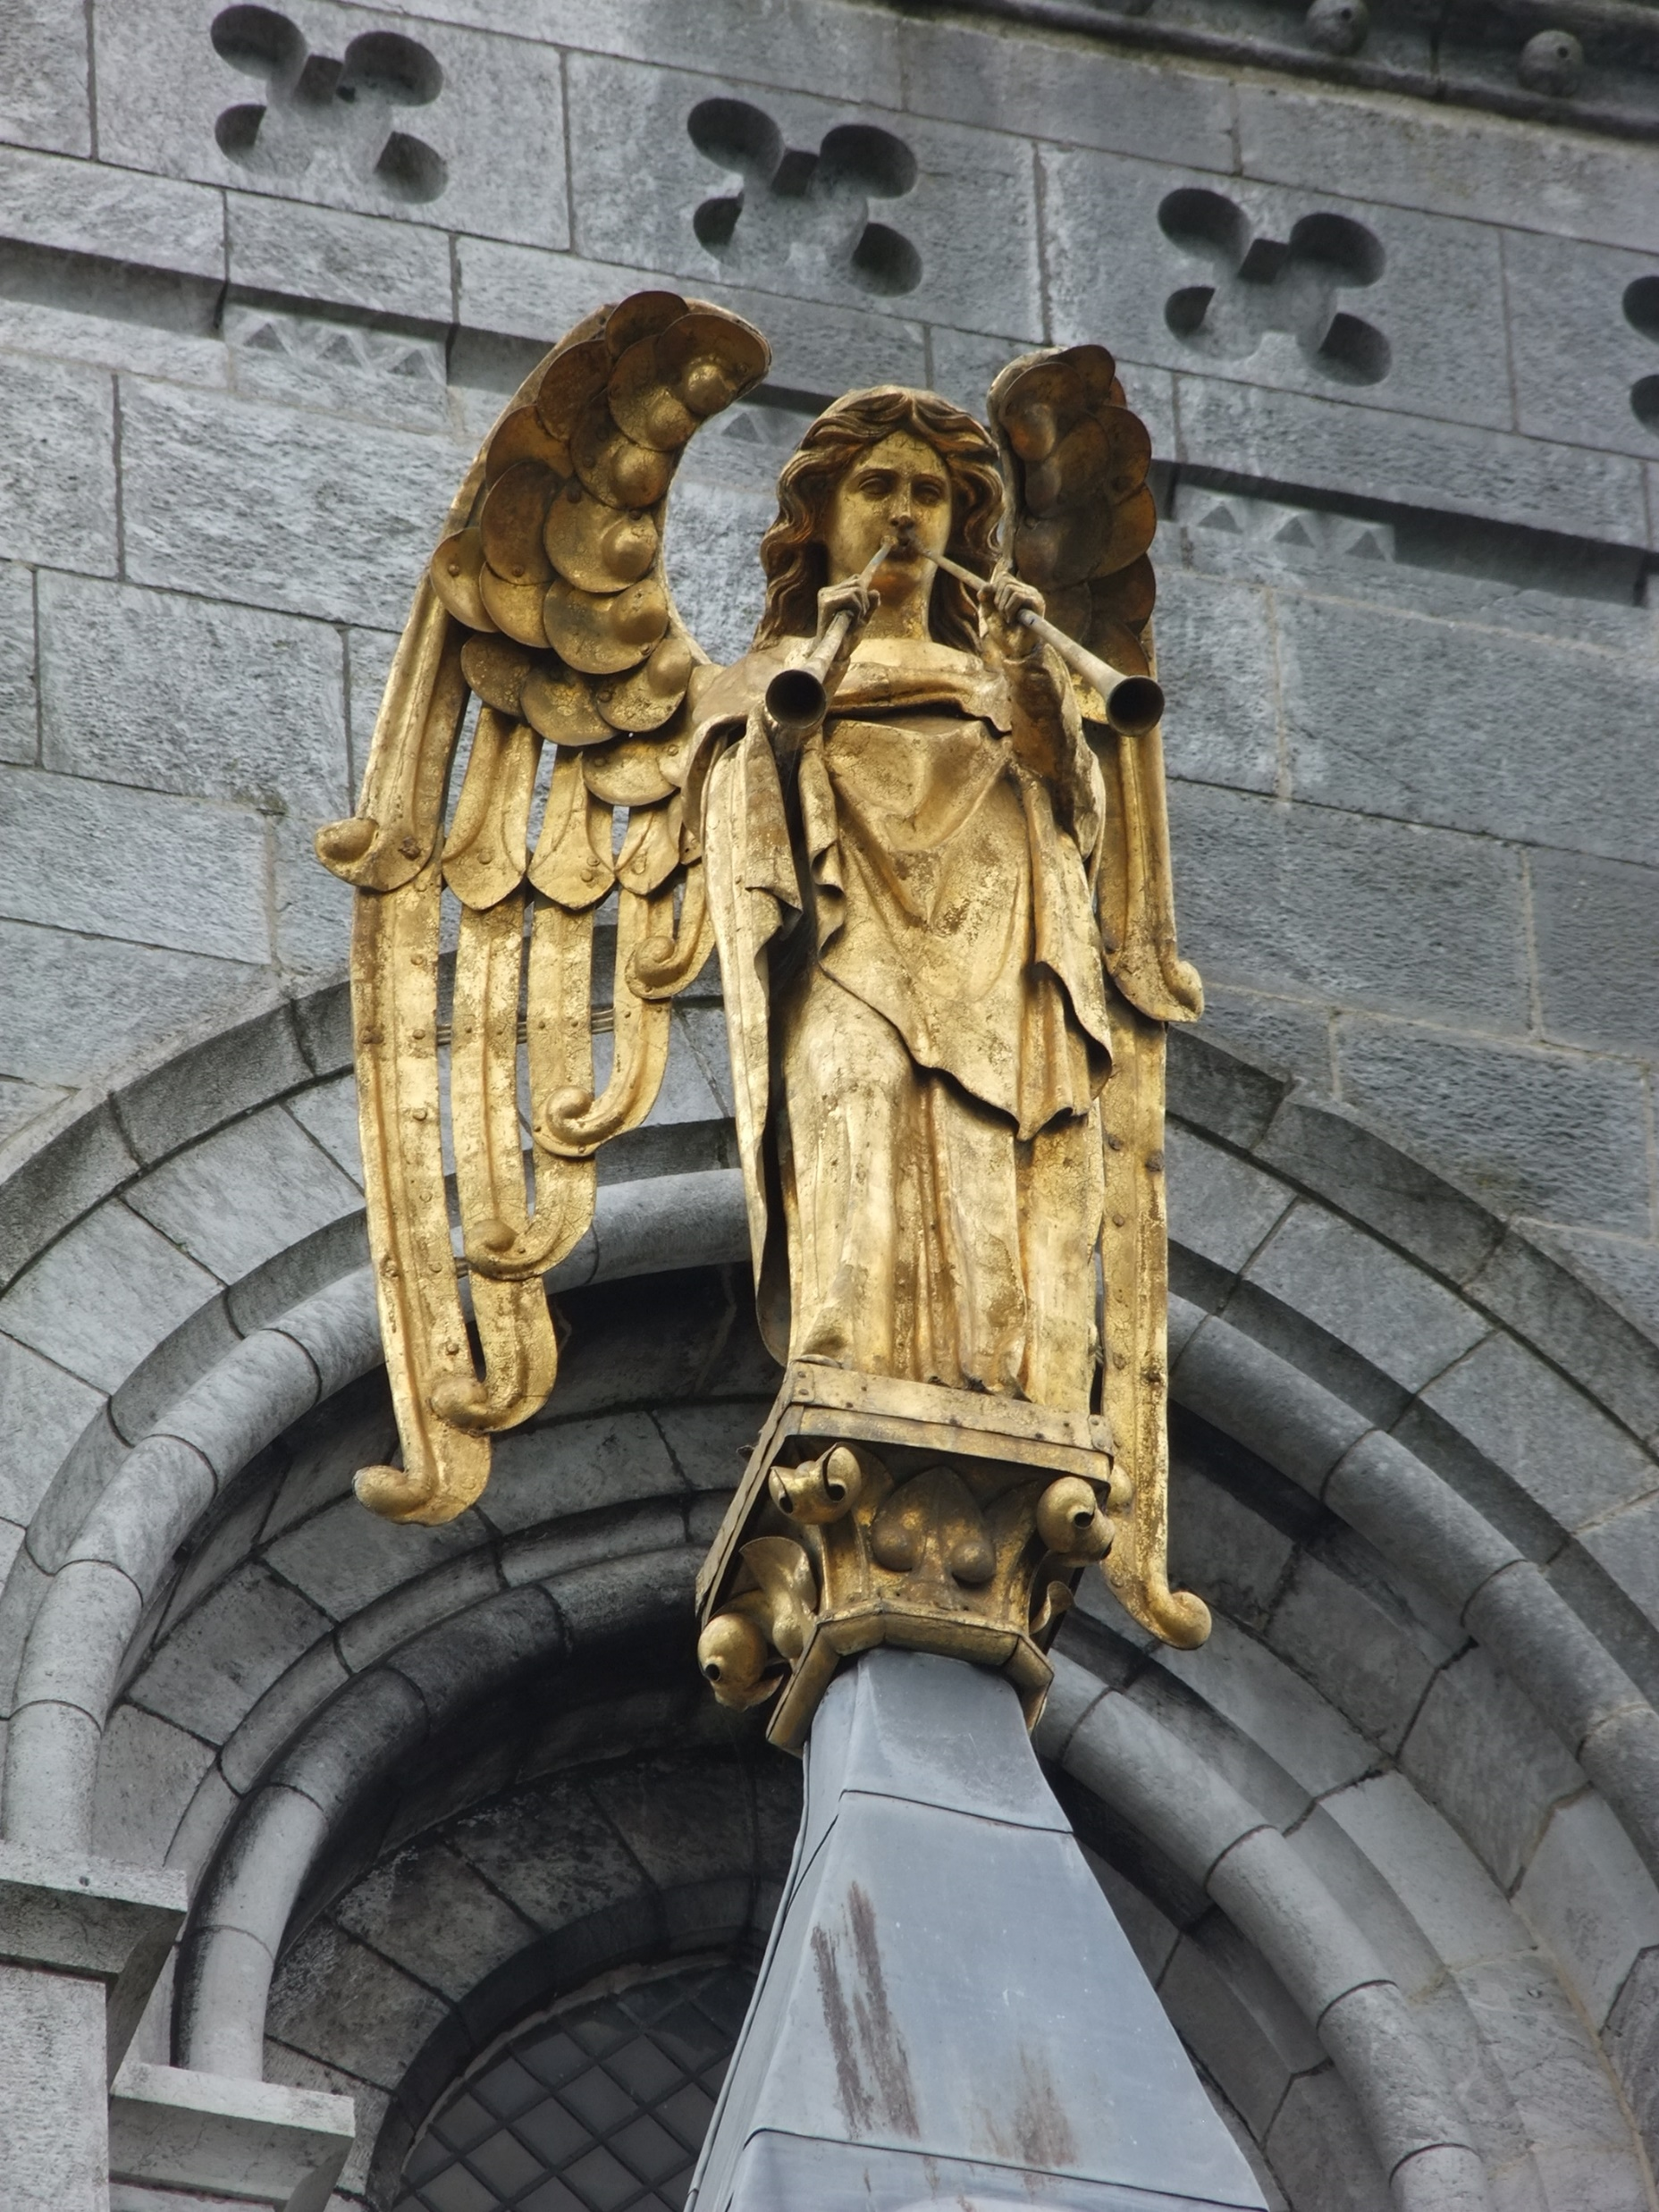
Nation State Memory Construction
Varied cultural frames of conditioning
Political parties
The control of history, whose history is it?
Infrastructure of nation state
Myth-making – foundational myths, statues, museums, school curricula
Monuments, spectacle and landscape
Performance – parades and pageantry

Slide 8
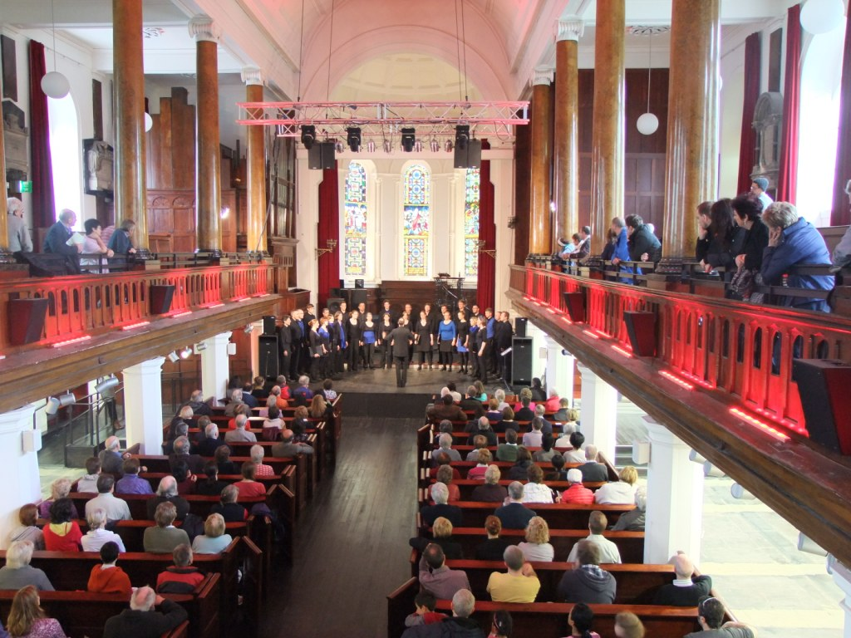
Key Point
Vast amount of debates on culture, sometime culture can appear v siloed, indeed there is a huge need to cross fertilise knowledge on the ground with European models on cultural heritage management. Both must inform each other.

Slide 9
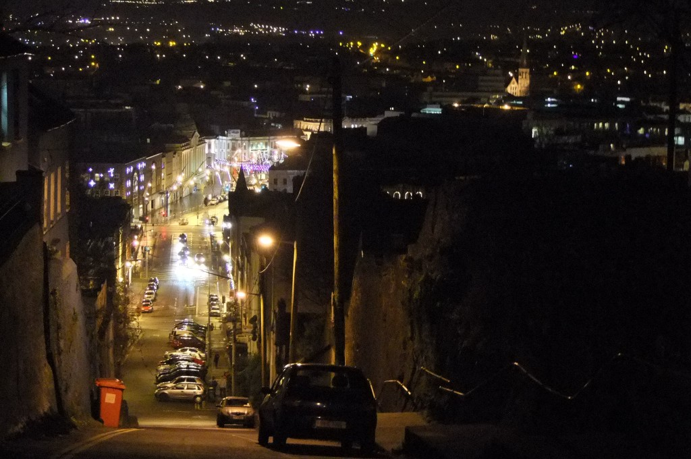
COR Context
An opinion body for the regions
Citizen led vision
Added value

Slide 10
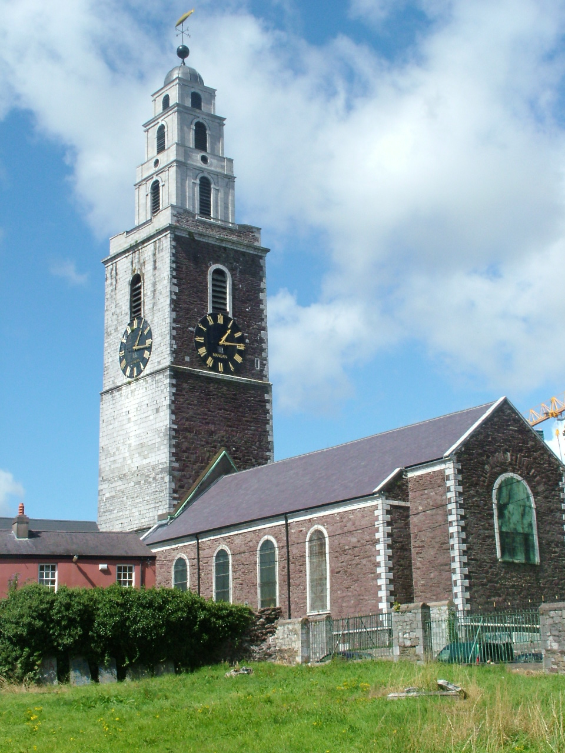
The Added Value Paradigm
Sharing of best practice
Frontiers of ideas
Inclusiveness & connections
Partnership & opportunity
Dialogue & synergy driven
Diversity and unity
Cross-border and Interoperability

Slide 11
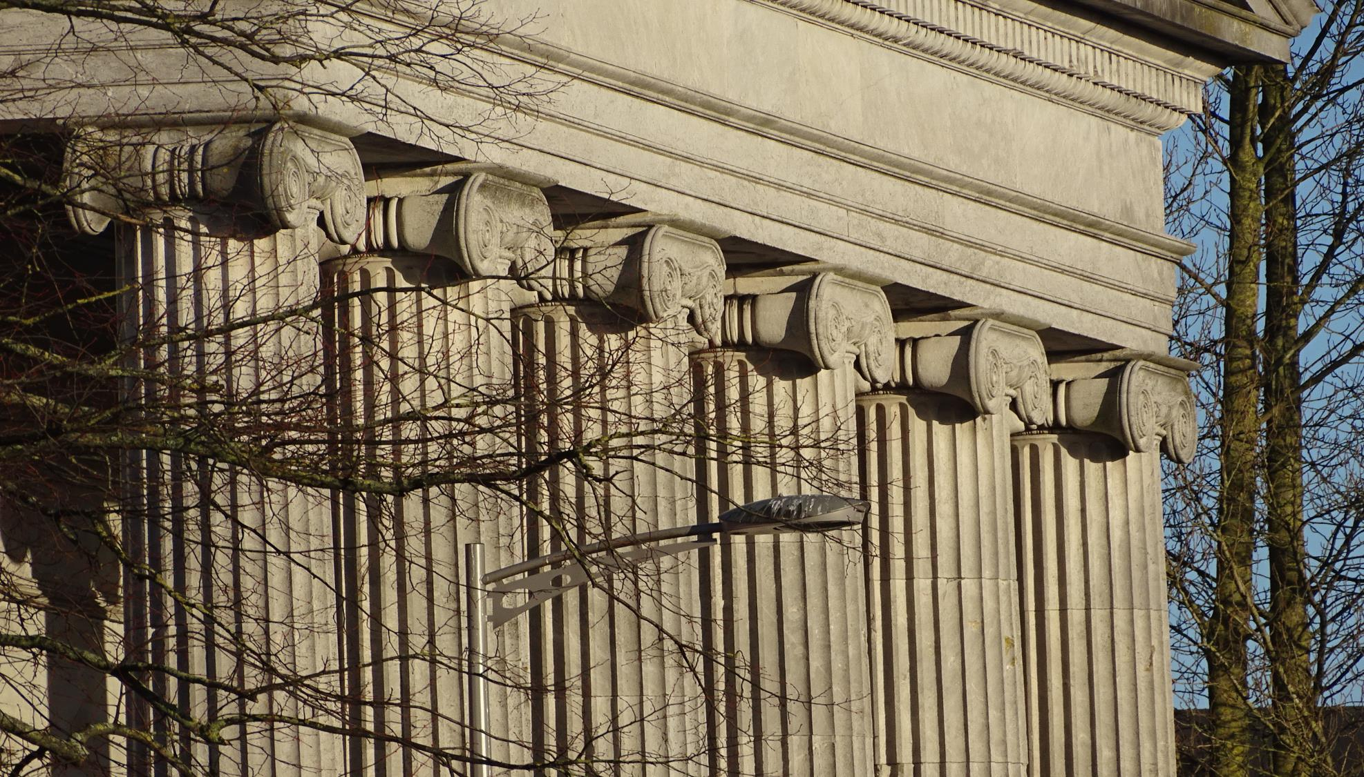
The acupuncture treatment….Re-Imagining Cities and Regions as…
C & R as the Future of Europe
C & R as flexible networks of growth
C & R as nodes of place-based thinking
C & R as laboratories
C & R as learning platforms
C & R as test beds
C & R as resilient spaces
C & R as champions of beyond GDP indicators & thinking

Slide 12
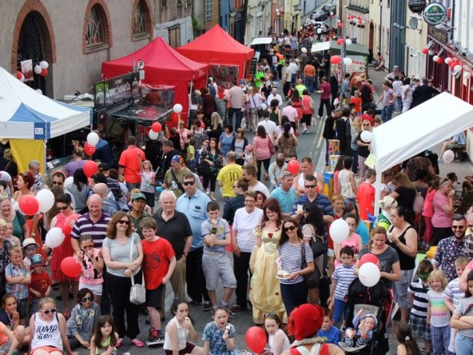
COR campaigns of recent interest
Defending Cohesion Policy
Narrowing regional disparities
Leading the Future of Work
Discussing new technologies
Incubating and processing
Unveiling Innovation 5.0
– data, AI, Computing
Creating Smart Cities & Regions
Breaking silos
Constructing Q Helixes + 1

Slide 13
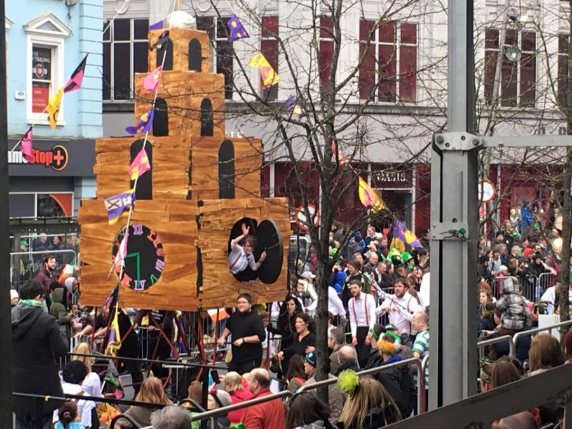
Recent seminar and Opinion work in SEDEC commission
Cultural Heritage,
Opportunities envisaged:
Unites in diversity, bridge builder
Showcasing of best practice
Future of Europe
Boosts social activity
Boosts creative industries
Boosts GDP
Boosts tourism and jobs
Boosts SME development and entrepreneurship
Stakeholders and multi-level governance
Embeds in development plans

Slide 14
Further acknowledgement by formal Europe needed
Treaties
Europe 2030
Creative Europe
Europeana
European Heritage Labels
UNESCO management
Creative Europe
Digitalisation and access
Interreg
Leader
Cohesion Policy
ERDF
Smart Specialisation
LEVERAGE

Slide 15
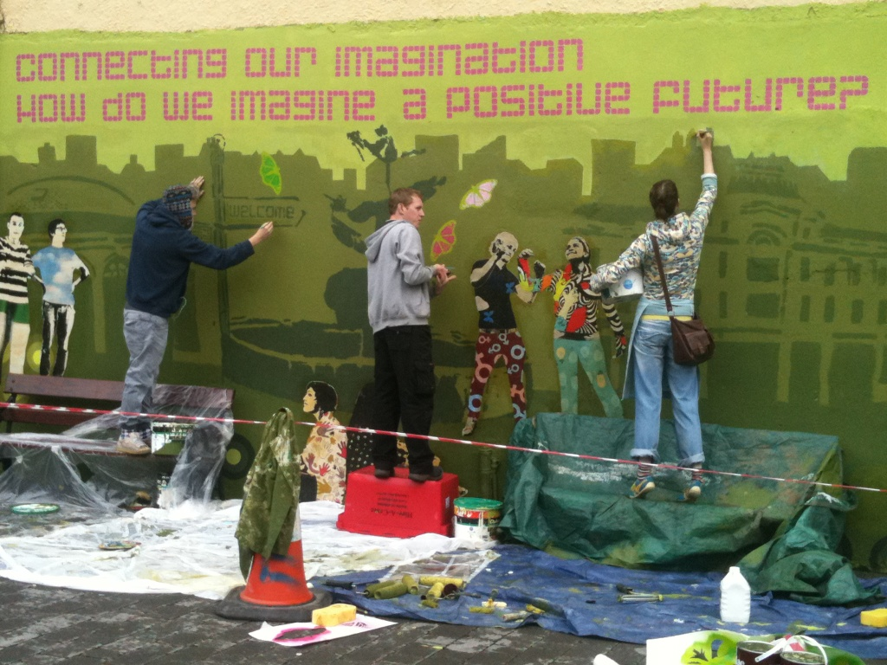
Working Models

Slide 16
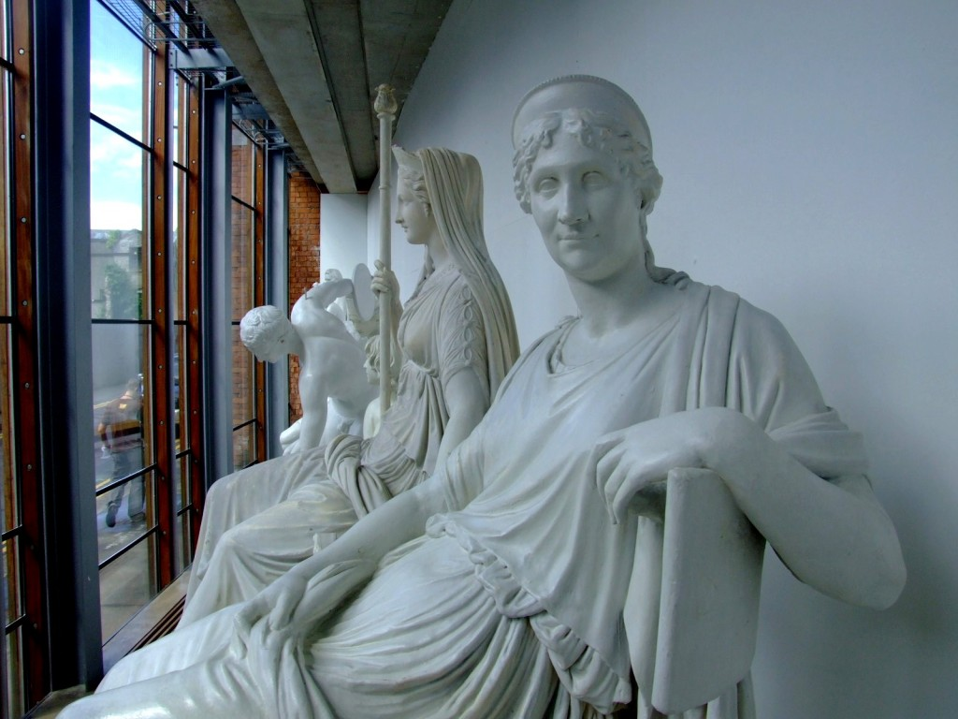
Thanks!

