Slide 1
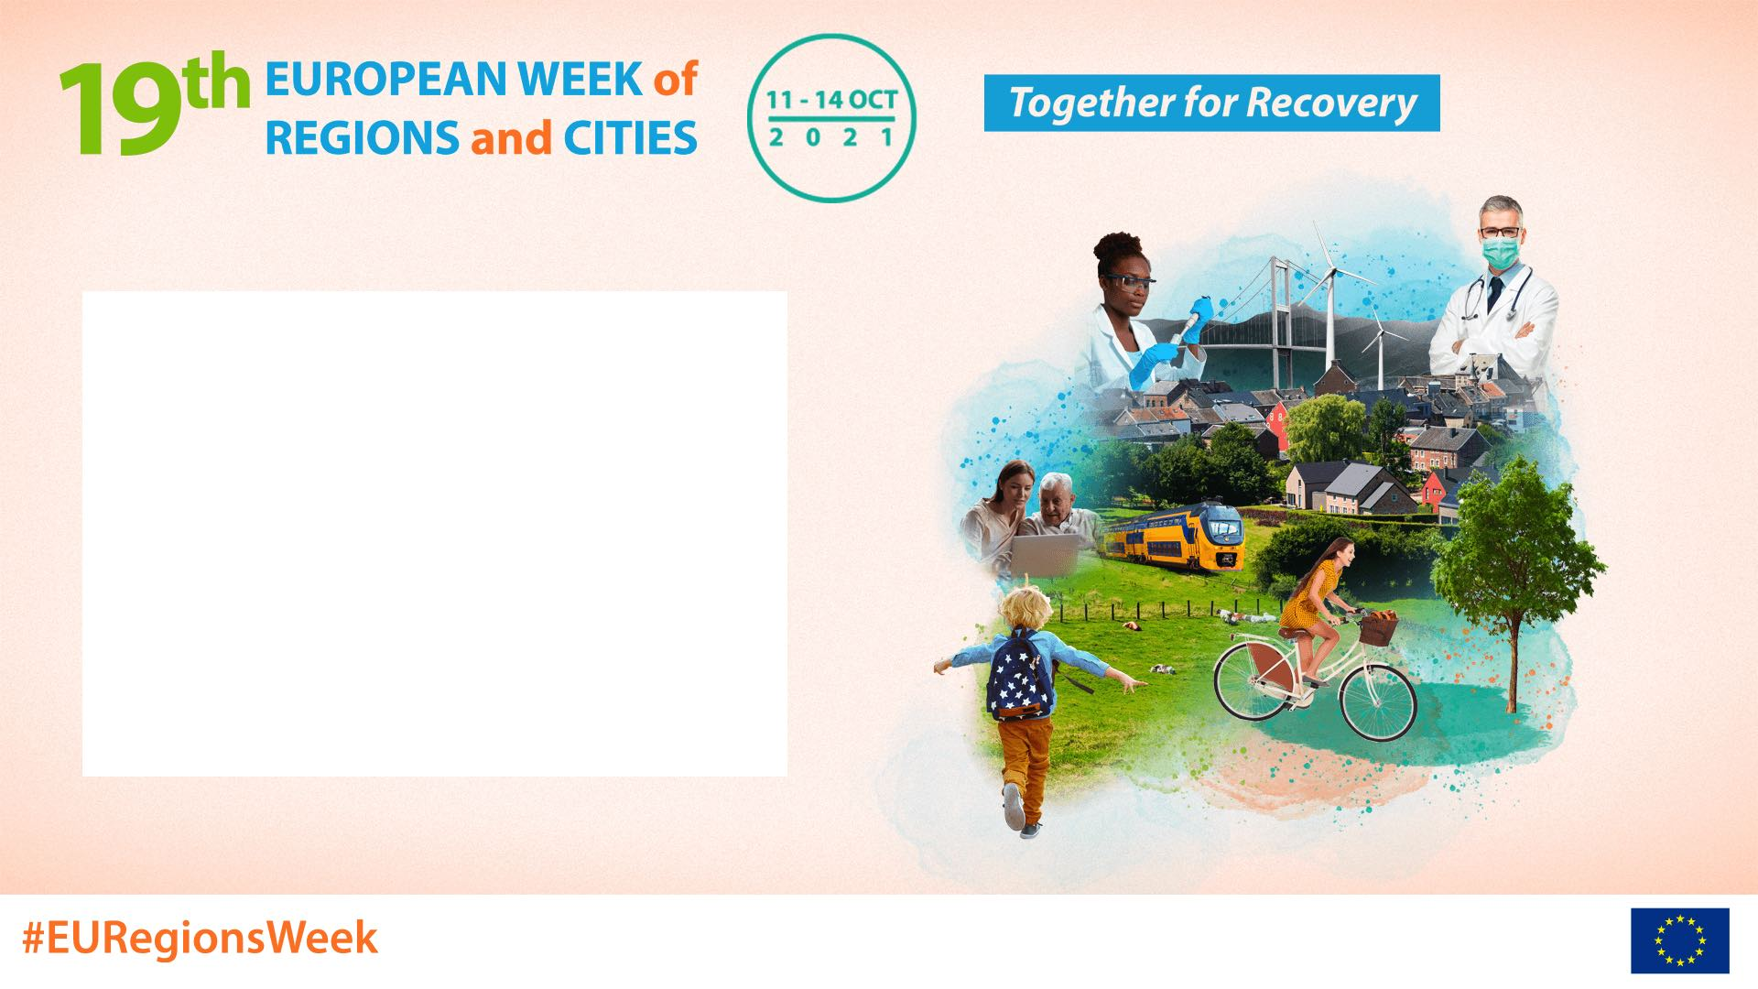
The Regeneration of Towns and Cities in Ireland:
The Cork Example
Adrienne Rodgers
Director of Services,
Community, Culture & Placemaking,
Cork City Council

Slide 2
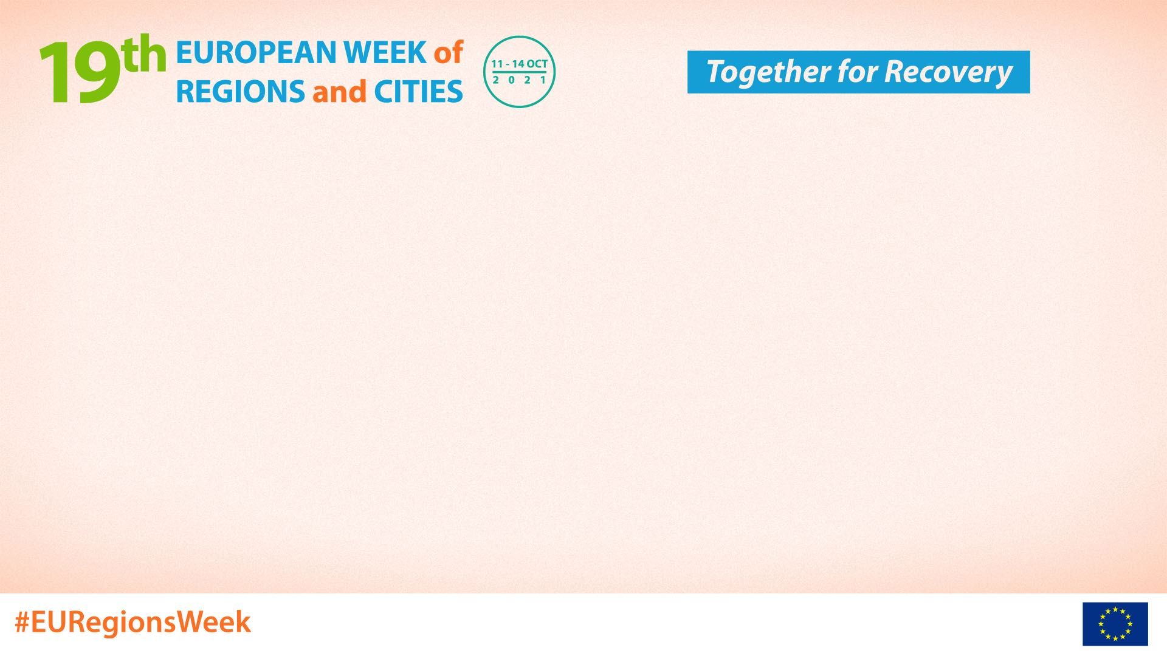
Cork City – Strategic Vision
With a population of over 210,000 and ambitious growth targets over the next 20 years, Cork City is an emerging international centre of scale and a national driver of economic and population growth while also acting as a counter balance to Dublin.
Notes:
Strategic Vision
embracing diversity and inclusiveness and growing as a resilient, healthy, age-friendly and sustainable compact city with placemaking, communities and
quality of life at its heart.
This strategic vision is based on the following key strategic principles:
Compact growth
Integrate land-use and transport planning to achieve a compact city with 50% of all new homes delivered within the existing built-up footprint of the City on regenerated brownfield, infill and greenfield sites identified in the Core Strategy, and to achieve higher population densities aligned with strategic infrastructure delivery.
A city of neighbourhoods and communities
Develop a sustainable, liveable city of neighbourhoods and communities based on the 15-minute city concept, ensuring that placemaking is at the heart of all development.
Sustainable and active travel
To implement the Cork Metropolitan Area Transport Study (CMATS) and develop a transformed sustainable transport system with a significant shift toward walking, cycling and public transport and to enshrine this principle in all developments across the City.
Enhanced built and natural heritage
Protect, enhance, support and develop our built and natural heritage, our open spaces and parks, and our green and blue infrastructure, and expand our built heritage with new buildings, townscapes and public spaces achieved through the highest standards of architecture and urban design.
A strong and diverse economy
Support Cork City’s role as the economic driver for the region and the creation of a strong, resilient, diverse and innovative economy.
A resilient City
Contribute to a framework for the transition to a low-carbon and climate-resilient City, resilient to extreme weather events, pandemics, economic cycles and other potential shocks.
A healthy, inclusive and diverse city
Build on Cork City’s status as a World Health Organisation designated Healthy City, offering an inclusive and vibrant environment for all whilst promoting healthy living and wellbeing.
A connected City
Cork City will continue to be a highly connected city providing local, regional, national and international connectivity.
A city of learning and culture
To build on Cork’s designation as a UNESCO Learning City and the city’s rich cultural heritage and to foster learning, culture, heritage and the arts throughout the City.

Slide 3
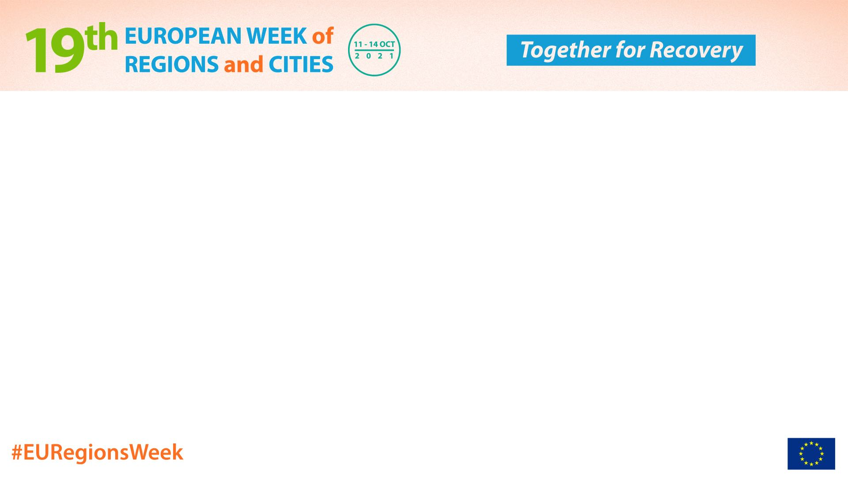
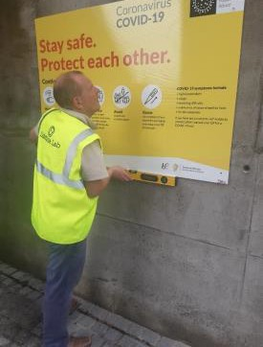
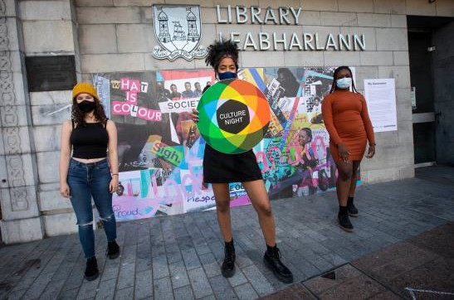
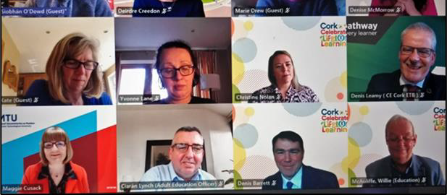
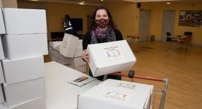
WE MADE IT WORK!
Notes:
Not unlike everyone else Cork City had to react with agility to combat the effects of Covid 19. Inclusion for all was our core message and we established a community response forum which allowed for solutions to be crafted from the ground up. This Forum will continue on beyond Covid and is currently focused on recovery solutions with local communities across the city.
When someone asks me what is Cork like. One of the first things that comes to my mind is “connectivity”. Cork is and always has been very connected. The scale of the city allows for real engagement across all communities, local government, businesses large and small, Educational sector and Tourism.
I believe it was this bedrock of connectivity – those foundations which were a huge help for dealing with the pandemic.

Slide 4
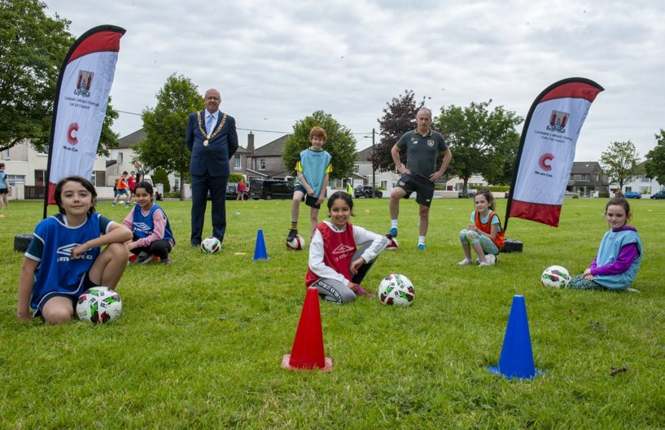
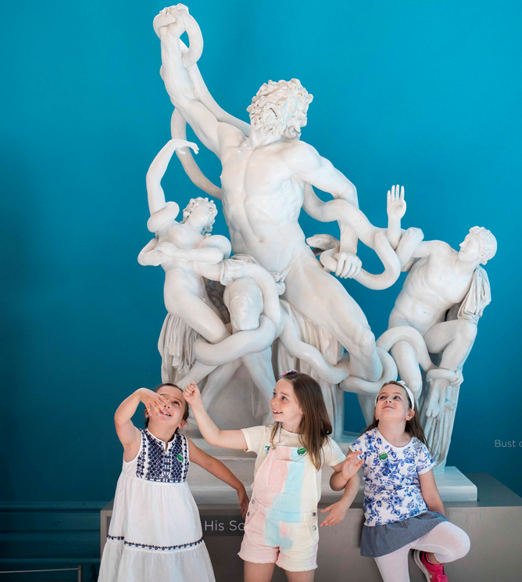
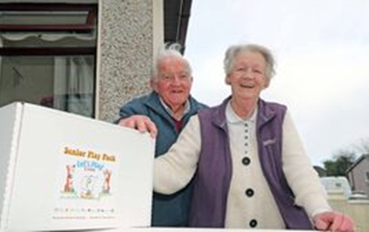
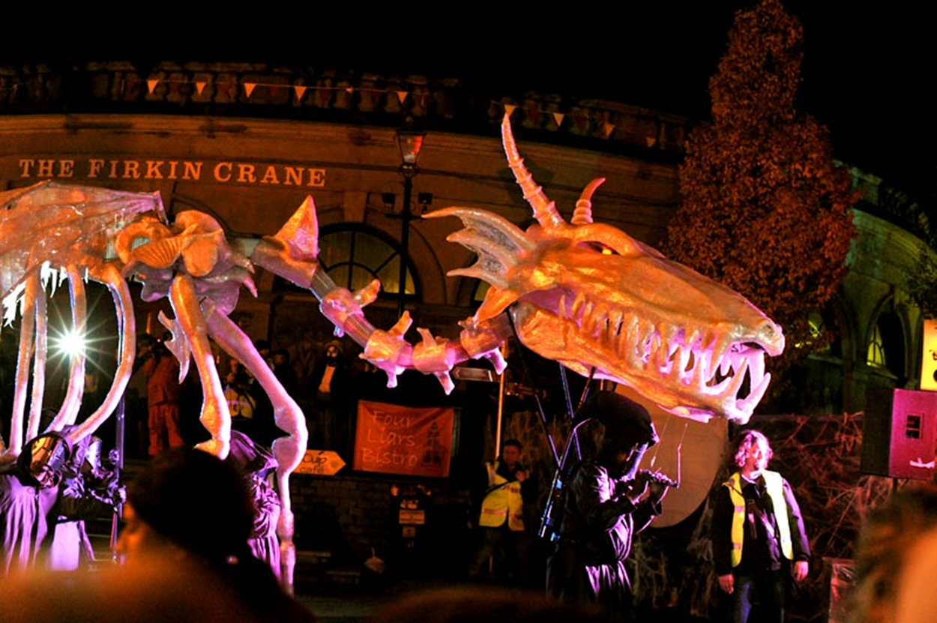
New Ways of Working
Play Packs for young and old based on URBACT Playful Paradigm Project
Animation of Streets for people to view from their own homes
Sports on the Green
Notes:
As the whole City became a “Virtual” hub Cork City had to find new ways of engaging with communities.
Building on the URBACT Playful Paradigm Project introduced to the city in 2017, Play packs for both the young and old were delivered across the city to allow us maintain engagement with vulnerable groups but also to make sure young students and their parents were provided with home school supports.
We took sports and outdoor activities to housing estates and this has been so successful that this initiative is now growing momentum beyond covid 19
While crowds could not gather we still found ways to bring animation to our streets with visual puppetry such as “The Dragon of Shandon” which people could watch from their homes.
And we ensured that arts and culture was kept alive most especially in our youth.

Slide 5
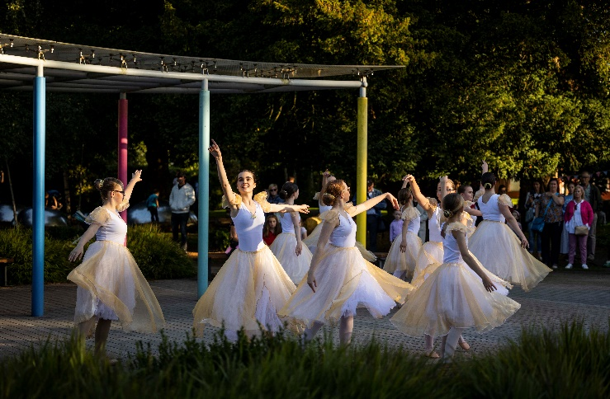
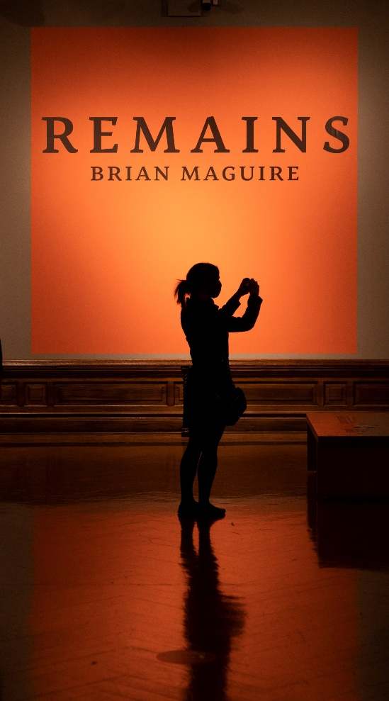
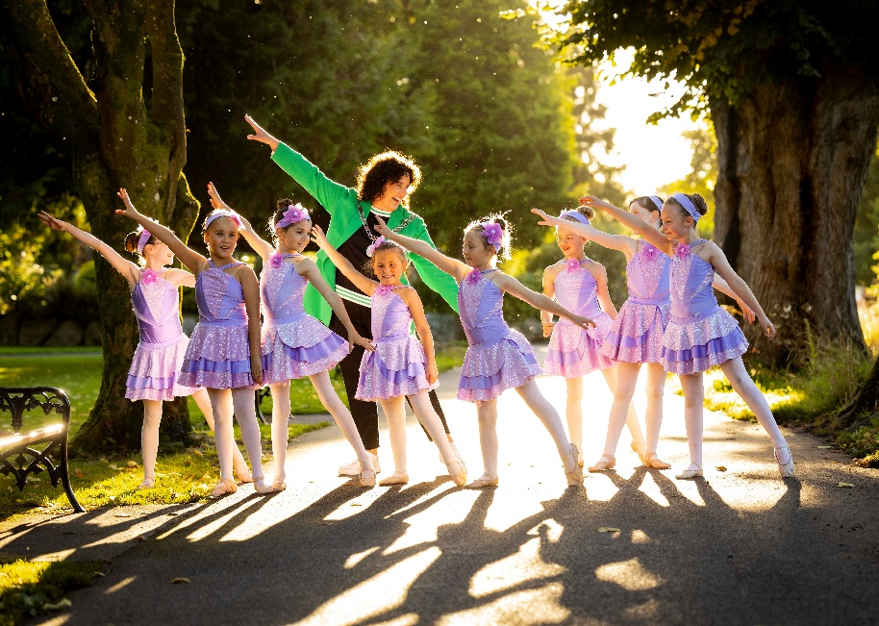
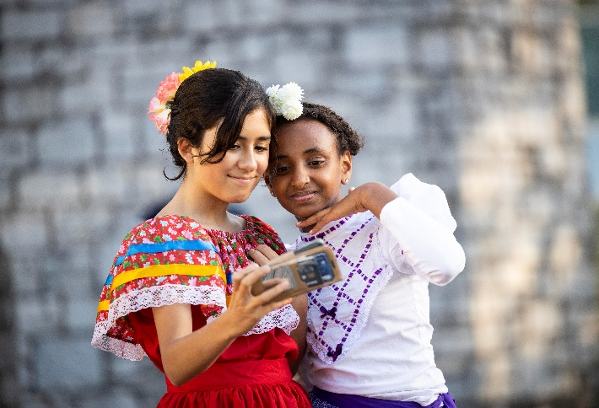
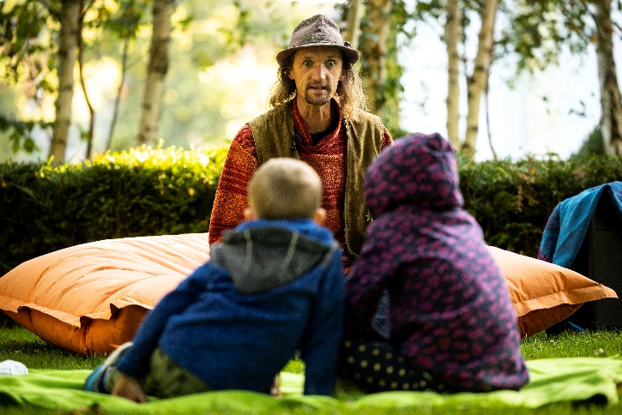
Culture Night
A City Of Festivals
Notes:
One of my own favourites nights in Cork City is “Culture Night”. This year while still applying covid safety guidelines the city came alive with Ballet, Fire Eating, Mexican Dancing, Storytelling and on this evening when all cultural venues are open free of charge, our parks and streets are animated with performers of all sort. Young and old take to the streets to enjoy all the city has to offer in a mardi gras fashion.
Cork Midsummer Festival
Glow Christmas
Lifelong Learning
Cork World Book Fest
Seafest Cork 2019
Cork International Choral Festival
Cork Folk Festival
Cork Film Festival
Cork Jazz Festival
St. Patricks Day Festival

Slide 6
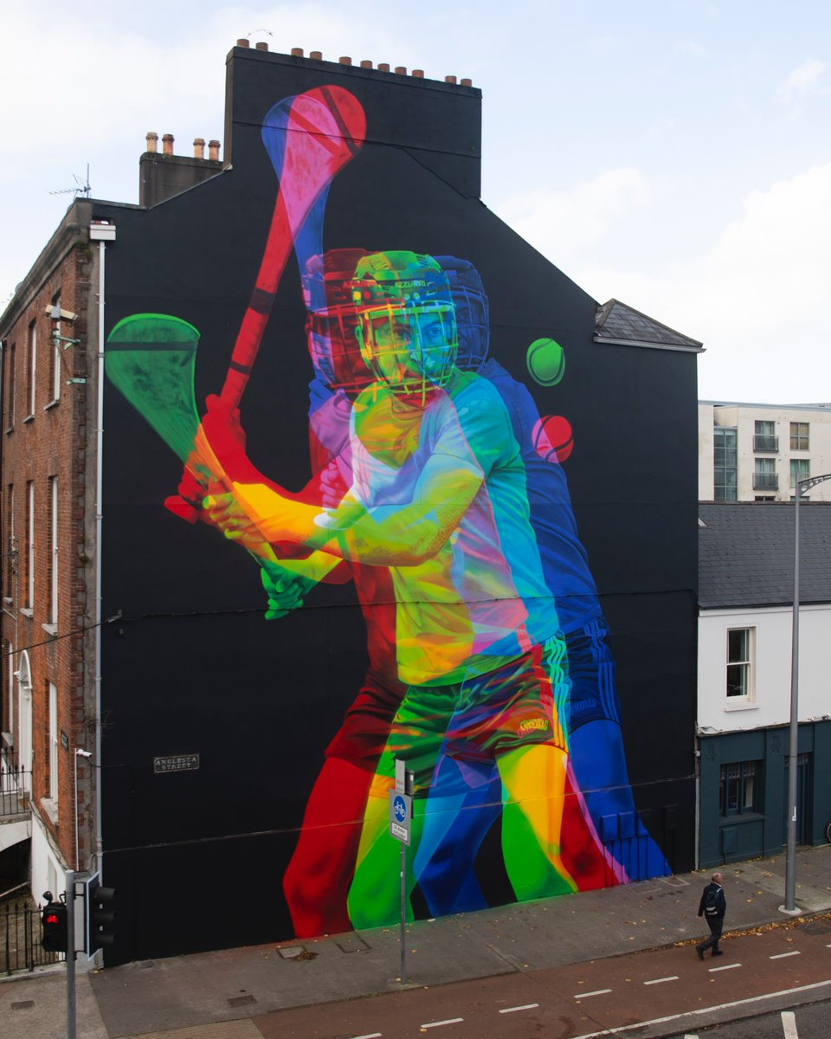
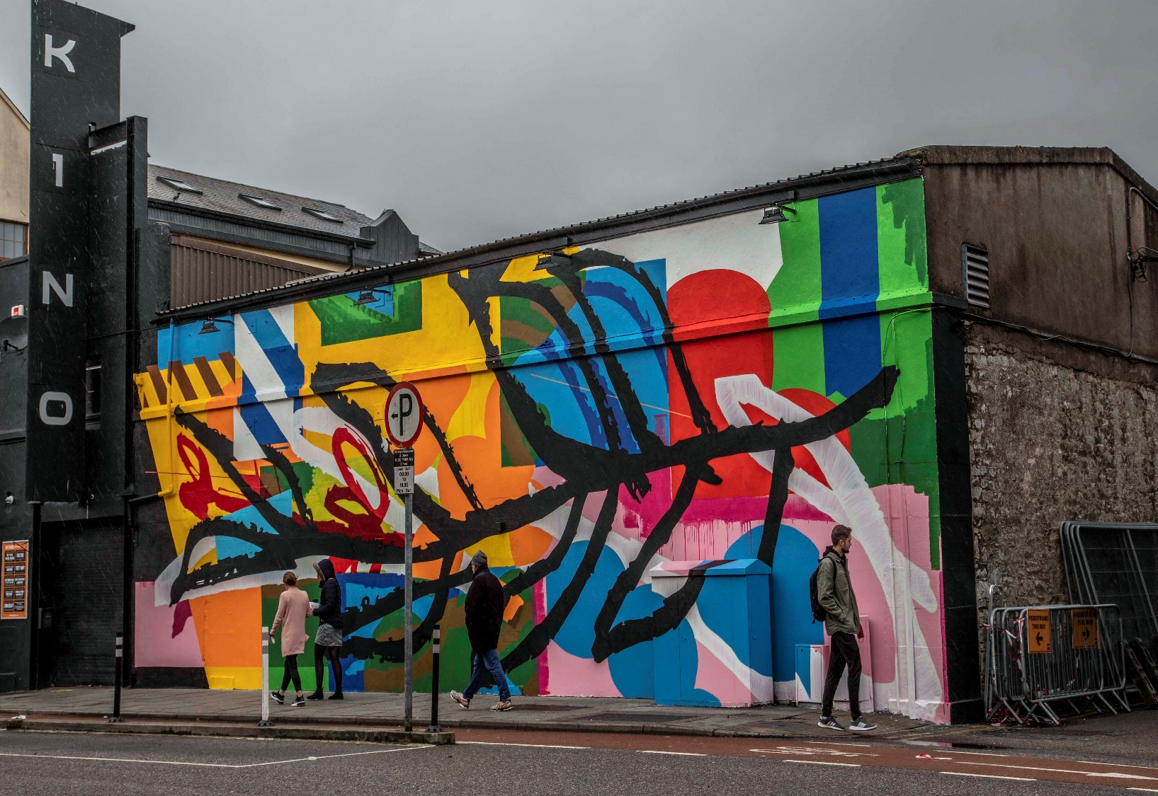
ARDÚ
An Puc by Aches. Photo by Claire Keogh, courtesy of Ardú
Notes:
ARDÚ – Rising was the theme in Autumn2020
7 large-scale Murals by renowned street artists. Led by local team of organisers supported by Arts Office and colleagues across various directorates.
“At a time when we face shared and personal challenges, each of our artist’s murals are a rallying cry to the city – a call to remember that we have been through terrible times before and we rose up. We can do it again.
High Impact media campaign across TV, radio, print and online media.
Legacy: Improved urban environment; trail map and audio tours available from ardu.ie; Ardú 2021 has now commenced and is another positive legacy from Covid 19
Funded by Creative Ireland; Cork City Council and Fáilte Ireland

Slide 7
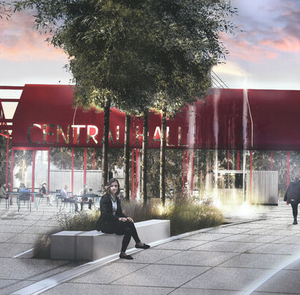
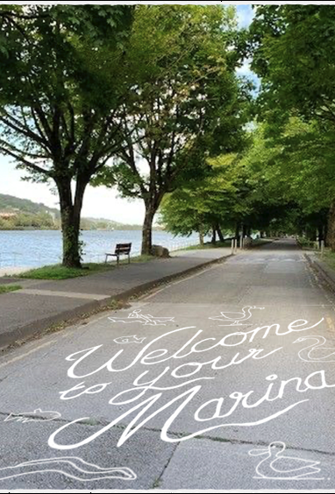
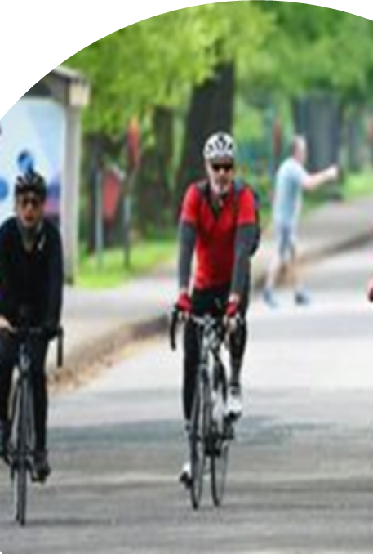
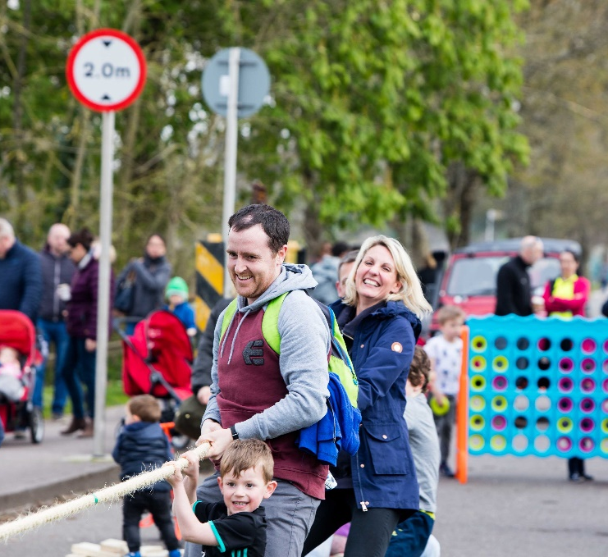
New Marina Park
Playing
Walking
Cycling
Notes:
Another wonderful addition to the range of initiatives across the city was the pedestrianisation of the Marina. A 2km stretch of roadway on the river that was given over to pedestrians and cyclists and this has proved to be a huge success.
This stretch will be the first project to assist with animating our river frontage to encourage activity and promote our blue infrastructure which it would be fair to say Cork has not capitalised on to date due to the fact that the river was mostly viewed as a commercial asset. However the relocation of commercial shipping closer to our harbour has now allowed us to take advantage of this wonderful amenity.
The marina demonstrates best practice in playmaking and placemaking.

Slide 8
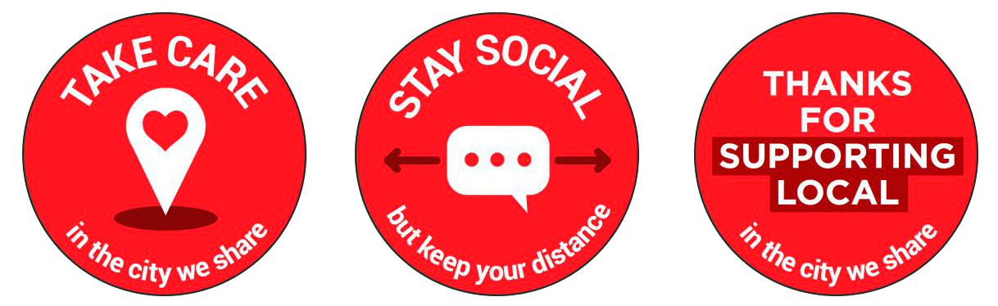

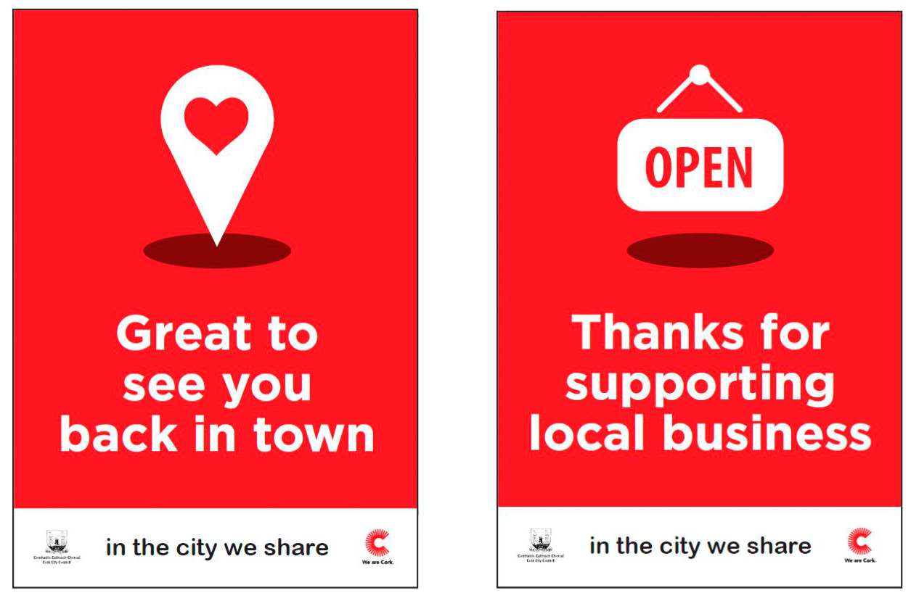
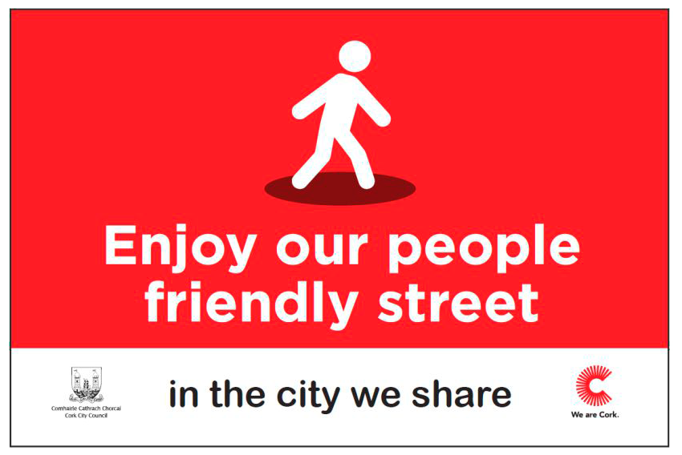
Collaborating
and
Communicating
the
Objectives
Notes:
As with all cities the environment is complex in order to serve the needs of all so before we commenced the new infrastructural works across the city centre itself we worked to engage with all stakeholders. We took time and resources to build a strong stakeholder architecture eg. CORE (Chamber, CBA, Gardai, Ind Traders, Bus Eireann, Irish Rail, hospitality) , City Centre Forum, PPN, etc . We worked with each street individually and consulted with those working, living and visiting the street.
In addition we created multi skilled teams internally in Cork City Council to support initiatives such as outdoor dining, winter proofing, parklets etc. While each of these teams had a particular focus they were all combined under the one City Centre Strategy Group.
We tailored our message to ensure clarify of purpose
Getting buy in from city traders – street by street. I cant state how important this engagement piece was in helping the city as a whole to deliver the changes that were implemented

Slide 9
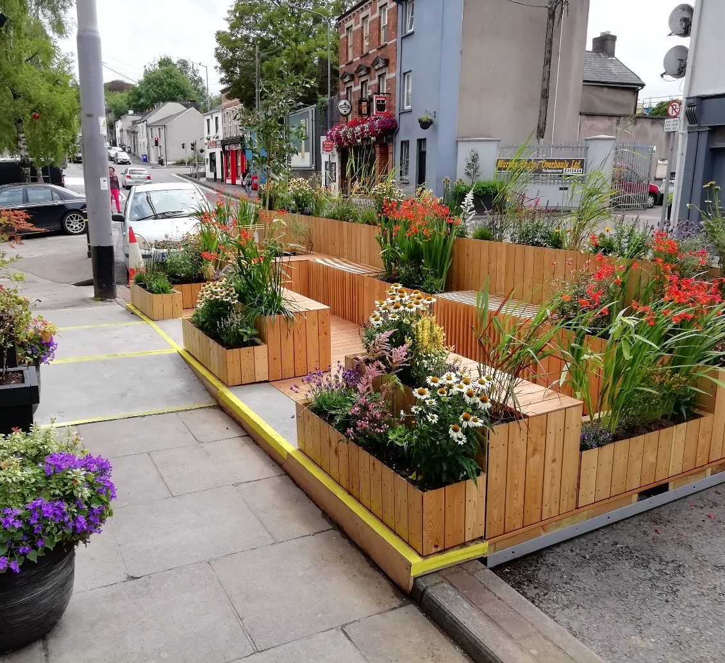
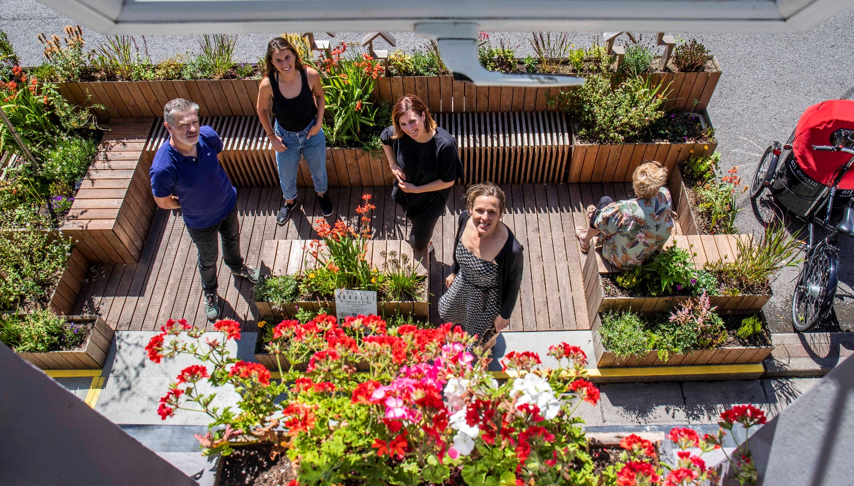
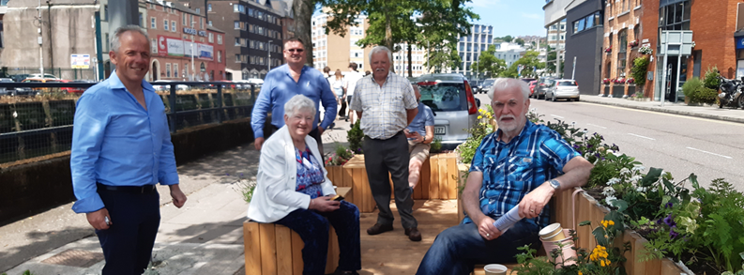
Urban Parklets
Notes:
The roll out of 10 parklets across the city not just to provide more outdoor seating but also as an Age Friendly solution for our senior citizens.
These parklets are sponsored by Cork City Council and a local Craft and Design Hub called Benchspace who do the build out and they are only placed where a co located business or organisation can manage and maintain with city council support.
As you can see the parklets are attractive, serve a double purpose and have been very well received by everyone.

Slide 10
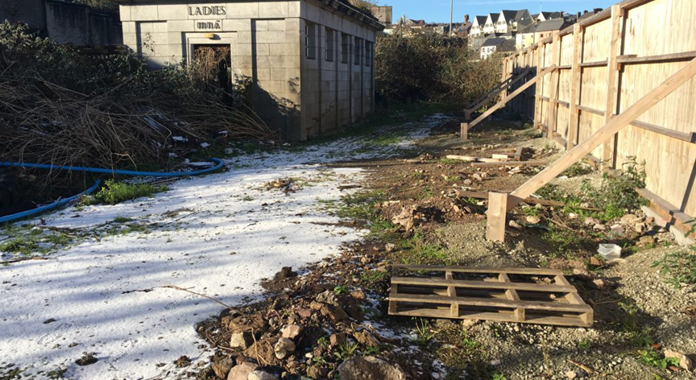
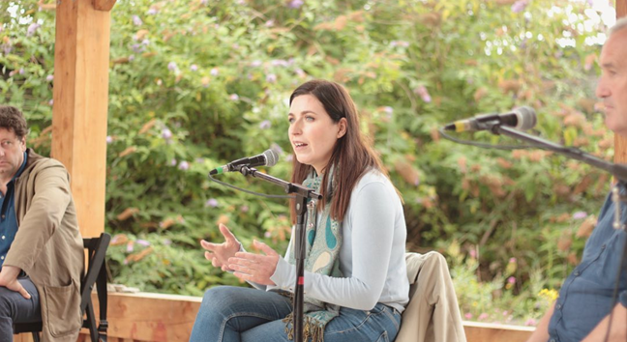
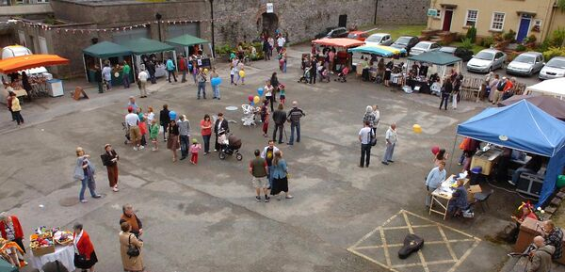
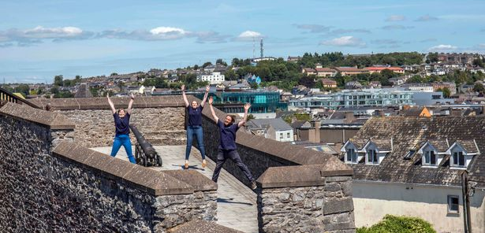
Revitalising Derelict and Heritage Sites
Notes:
The top 2 images here show a derelict site in our city centre and with the imagination of two architects and support from the Arts Council this site was transformed into a space for lectures, theatre, greening and music. And the images underneath are those of Elizabeth Fort, an ancient fort right in the hear of the city.
These initiatives:
Support the Recovery of the Creative / Cultural / Entertainment & Events
Have added Benefits for Tourism / Hospitality
Provide Staging / Seating / Outdoor Projectors / Weatherpoofed
Funding Source: Dept of Tourism, Culture, Arts, Gaeltacht, Sport & Media

Slide 11
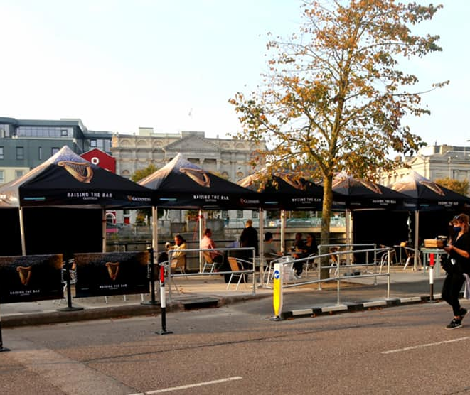
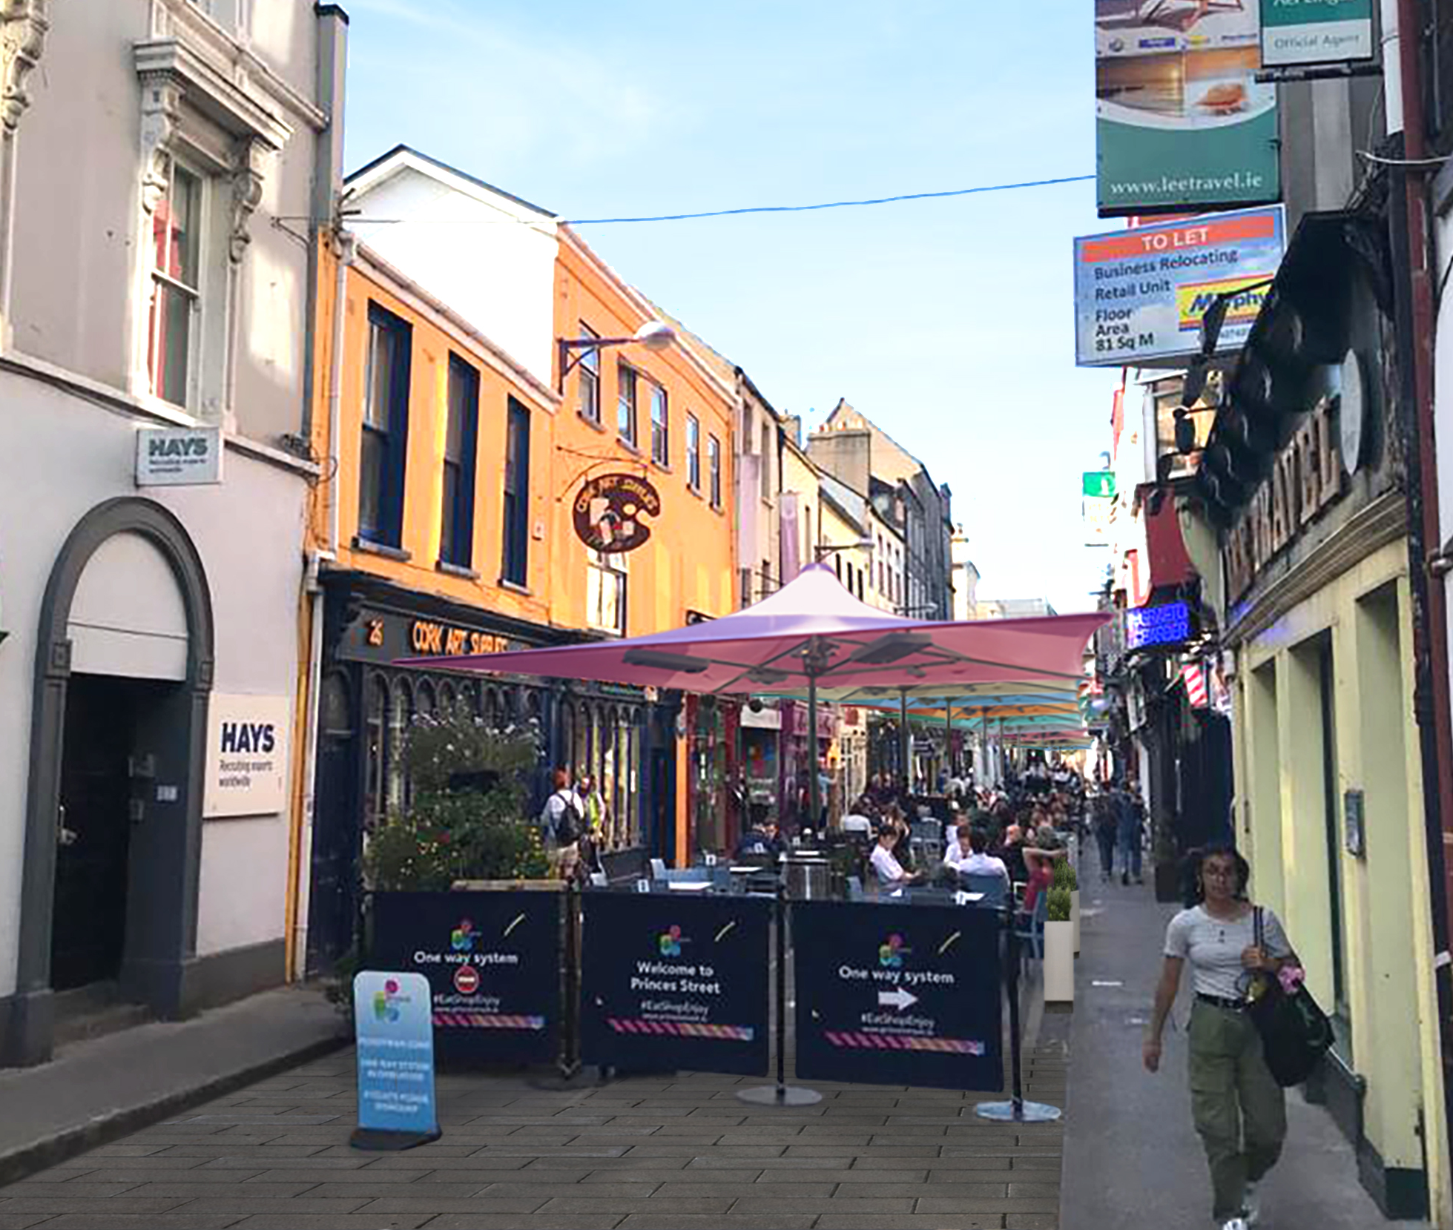
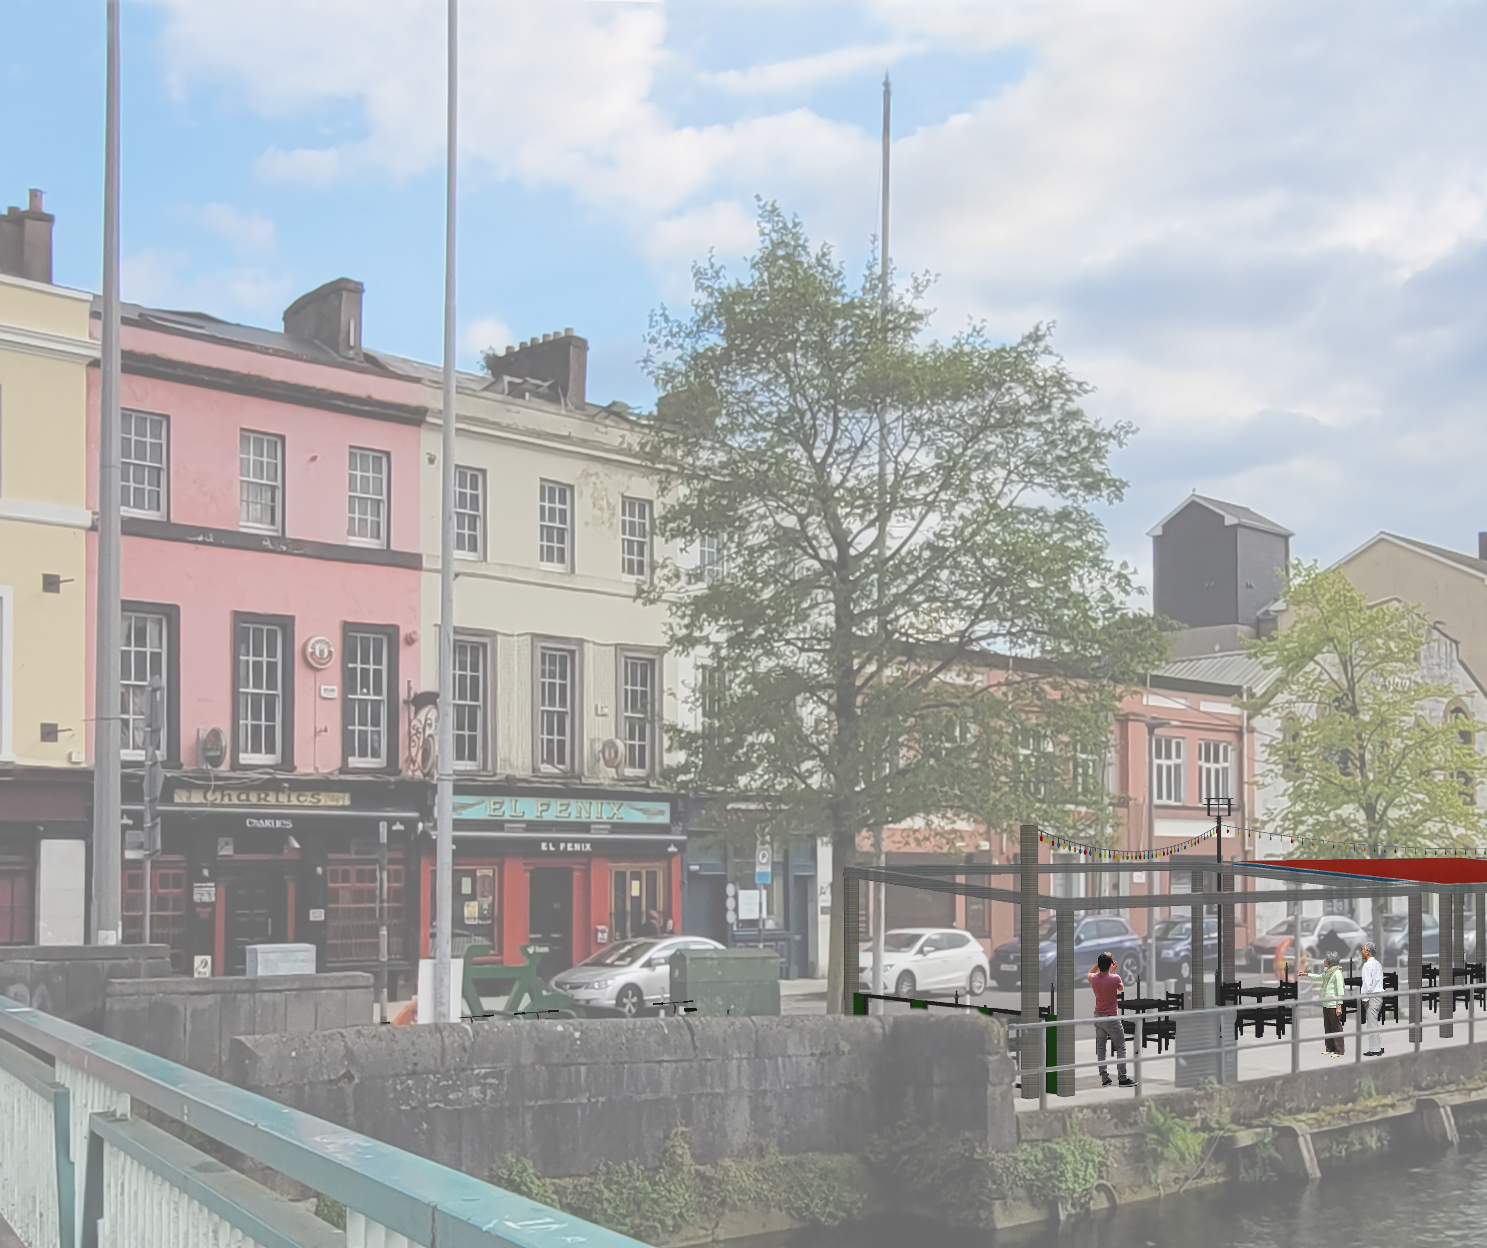
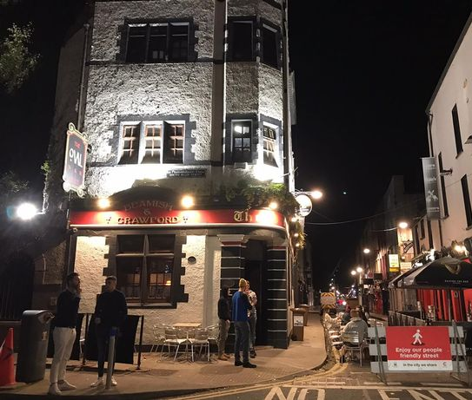
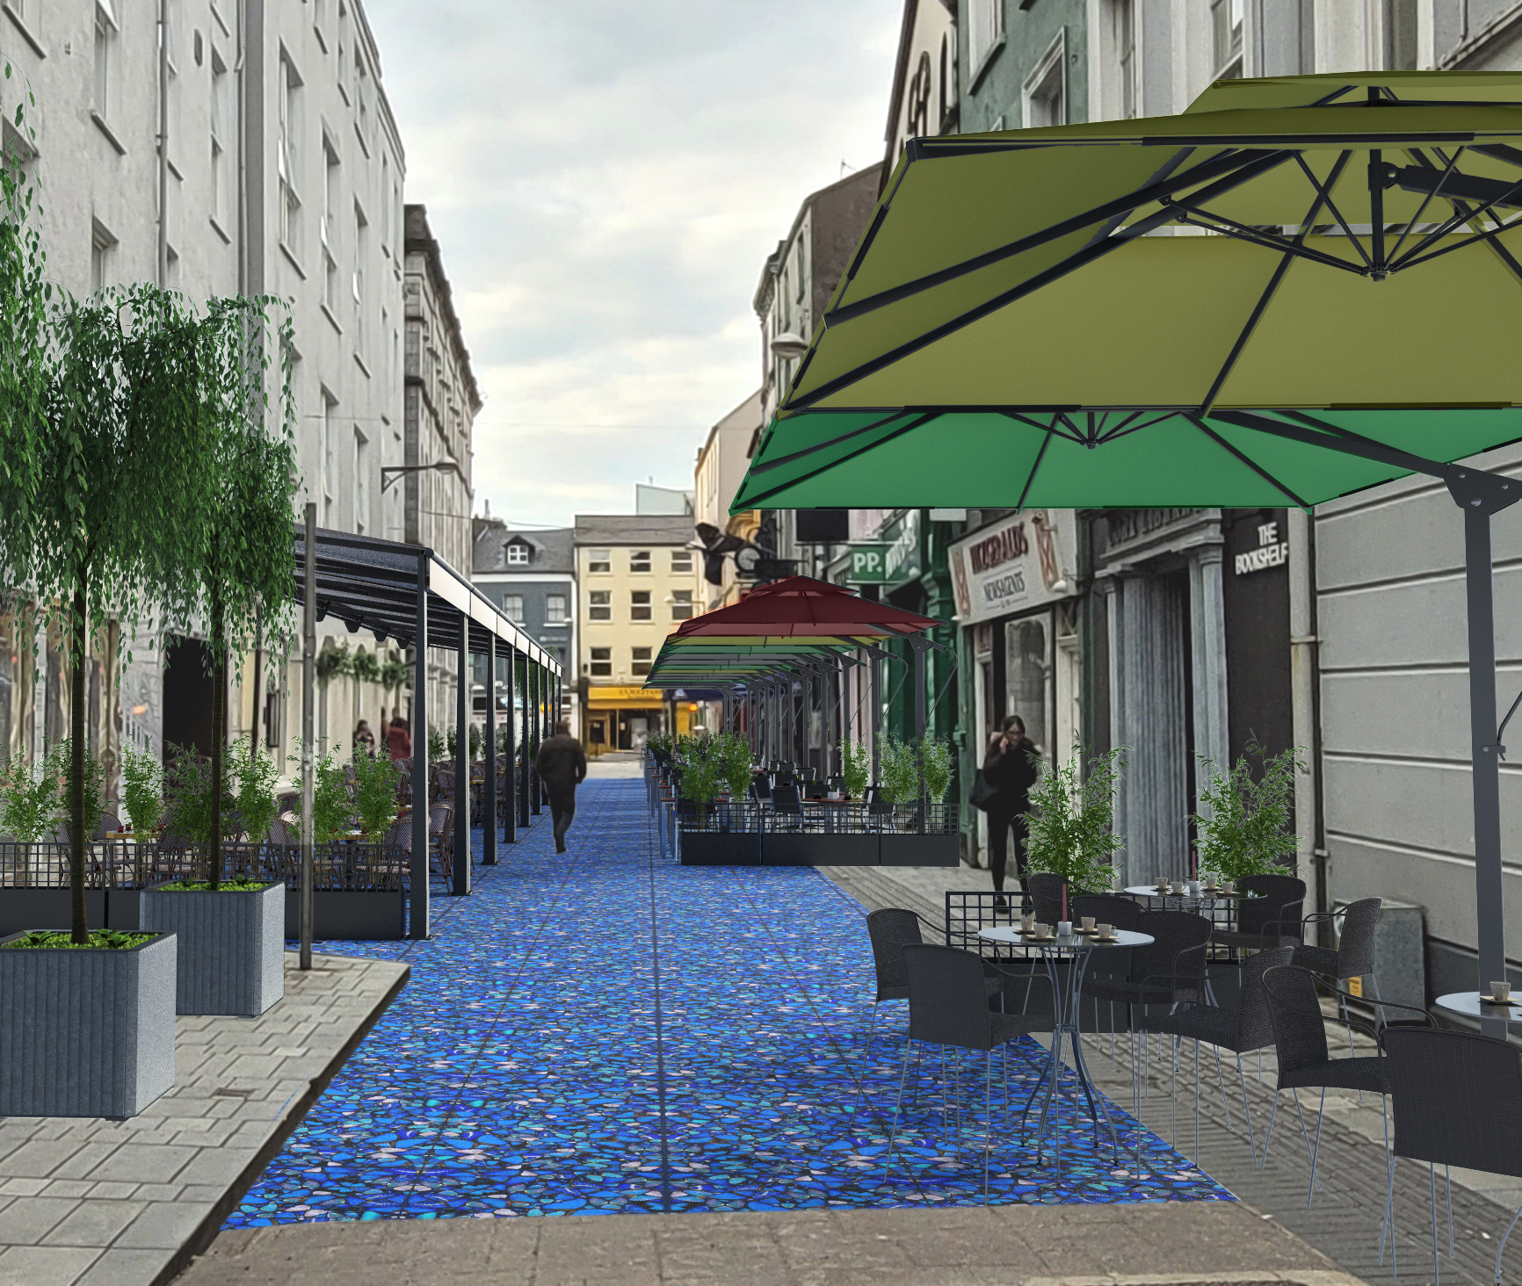
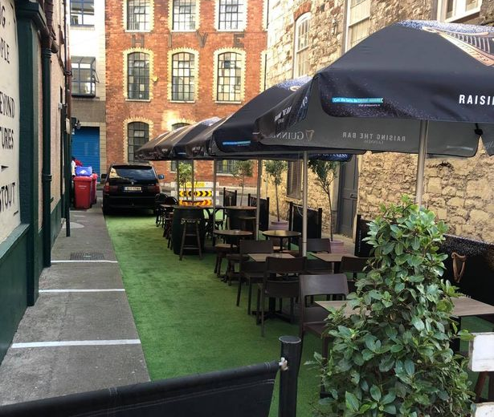
Outdoor Dining & Business Supports
National Funding of €4,000 per Business
Furniture & Accessories – Footpaths and Courtyards
Further funding from Failte Ireland to support tourism
LEO’s provided mentoring, TOV’s, Rebooting Business Training (CTRL-ALT-DELETE)
Cork City Council provided waiver on rates and re-start grants
1000 Spaces
1.3km
Pedestrianised
17 streets
Planting
Greening of the City Grants
4.1km cycle lanes
50 bike racks
Notes:
Obviously none of this could be done without funding and nationally and locally we built funding supports that supported the delivery of all of this to ensure added value in everything we developed.

Slide 12
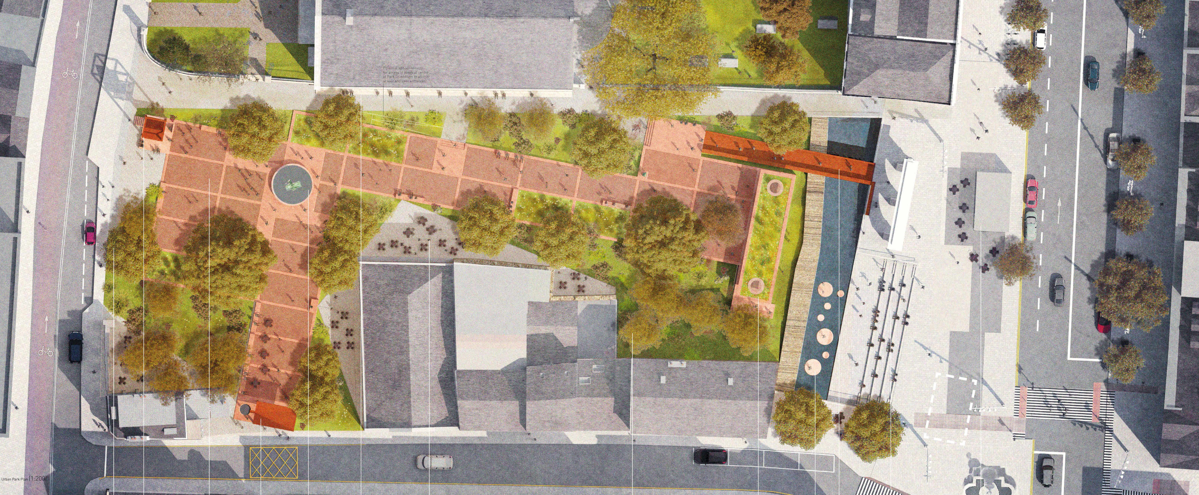
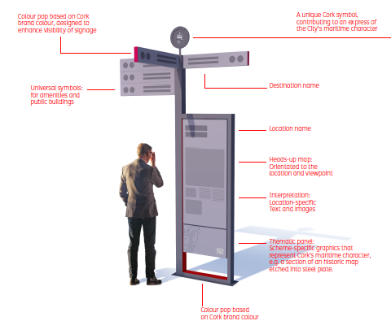
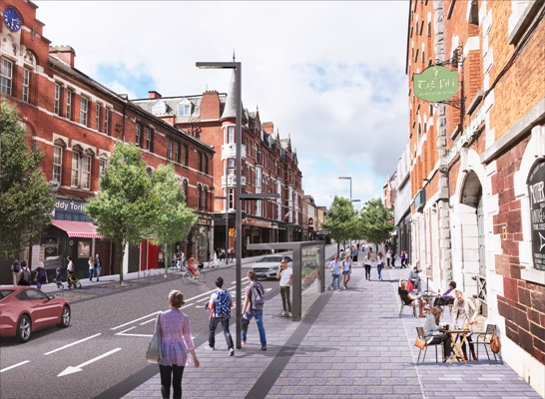
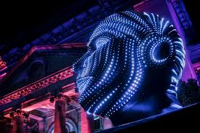
URDF – Grand Parade Quarter €46m
Wayfinding
City Centre Strategy
City Development Plan 2022 - 2028
Notes:
The Future - Pipeline Projects
Outdoor Public Spaces Scheme 2021 – Capital investment in public space for arts and cultural use
Goal: Creative / Innovative &Sustainable Projects -
Invigorate Public Spaces
Light / Water / Sculpture - Linked to Place
Potential to Attract Visitors
National funding for our Grand Parade Quarter of €46m which will incorporate a new city library, Revitalisaion of Bishop Lucey Park and the viking quarter.
Implementation of a new way finding strategy
City Development Plan 2022 - 2028

Slide 13
Never waste a good crisis!
Relationships built during the pandemic will be maintained and developed
Internal cross directorate working groups
Community Response Forum Network
Playmaking and Placemaking fundamental in our approach to development
Digital Transformation & Blended approach
Sports on the Green
Street Art Toolkit
Greenways and Pedestrianisation
Outdoor Dining
Agility
Notes:
Strategic Vision
embracing diversity and inclusiveness and growing as a resilient, healthy, age-friendly and sustainable compact city with placemaking, communities and
quality of life at its heart.
This strategic vision is based on the following key strategic principles:
Compact growth
Integrate land-use and transport planning to achieve a compact city with 50% of all new homes delivered within the existing built-up footprint of the City on regenerated brownfield, infill and greenfield sites identified in the Core Strategy, and to achieve higher population densities aligned with strategic infrastructure delivery.
A city of neighbourhoods and communities
Develop a sustainable, liveable city of neighbourhoods and communities based on the 15-minute city concept, ensuring that placemaking is at the heart of all development.
Sustainable and active travel
To implement the Cork Metropolitan Area Transport Study (CMATS) and develop a transformed sustainable transport system with a significant shift toward walking, cycling and public transport and to enshrine this principle in all developments across the City.
Enhanced built and natural heritage
Protect, enhance, support and develop our built and natural heritage, our open spaces and parks, and our green and blue infrastructure, and expand our built heritage with new buildings, townscapes and public spaces achieved through the highest standards of architecture and urban design.
A strong and diverse economy
Support Cork City’s role as the economic driver for the region and the creation of a strong, resilient, diverse and innovative economy.
A resilient City
Contribute to a framework for the transition to a low-carbon and climate-resilient City, resilient to extreme weather events, pandemics, economic cycles and other potential shocks.
A healthy, inclusive and diverse city
Build on Cork City’s status as a World Health Organisation designated Healthy City, offering an inclusive and vibrant environment for all whilst promoting healthy living and wellbeing.
A connected City
Cork City will continue to be a highly connected city providing local, regional, national and international connectivity.
A city of learning and culture
To build on Cork’s designation as a UNESCO Learning City and the city’s rich cultural heritage and to foster learning, culture, heritage and the arts throughout the City.

Slide 14
Thank You

