Slide 1


Rural revival – territorial perspectives
Richard Tuffs
Helping towns and villages drive rural revival in the European Union

Slide 2
Background
European Regions for Research and Innovation Network
ERRIN network www.errin.eu
130 members> regions – Scotland, Northern Ireland, Flanders, Cork…
ESPON Transnational Outreach Events www.espon.eu
  Dublin May 2018
  Soria, Spain May 2018
  Vaxjo, Sweden September 2018

Slide 3
Outline
Shrinking rural regions ESPON Policy Brief
Inner peripheries
Rural reacting to mega trends
Rural case studies
  Castilla la Mancha – Integrated Territorial Investment
  Andalucia – general support to services
  Fundão – using agri-food as basis of tourism activities
  Castilla y Leon – supporting social enterprise
Reflections

Slide 4
ESPON Policy Brief
https://www.espon.eu/rural-shrinking

Slide 5
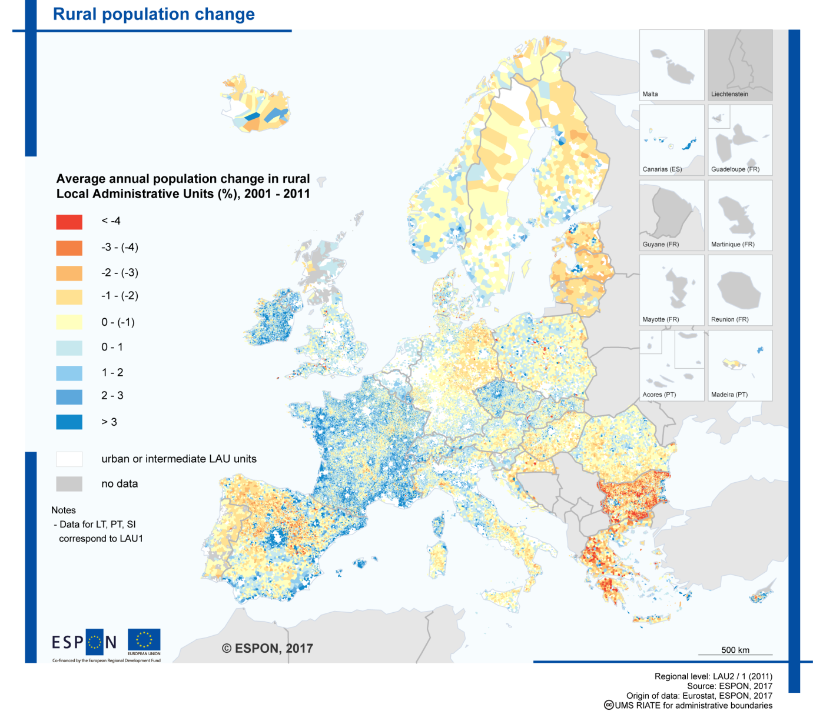
Rural population change 2001-2011
Shrinking rural regions
ESPON Policy Brief
https://www.espon.eu/rural-shrinking

Slide 6
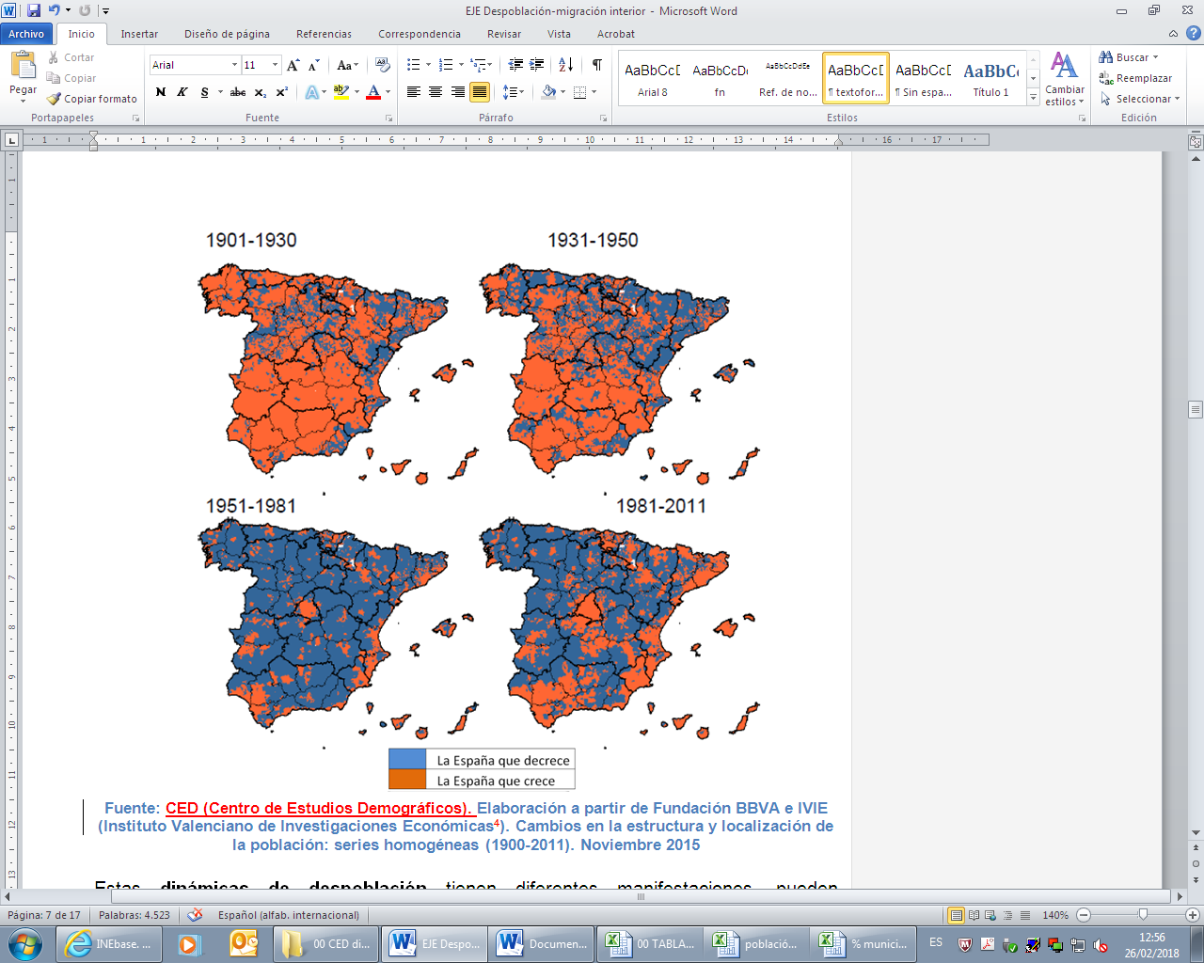
Spain: Population trends (1901-2011)
1901-1930.
Strong urbanisation in the whole country
1931-1950. Settled population and strong natural growth
1951-1981. High intensity migratory rural - city flows and emigration abroad
1981-2011. Demographic decline in smaller municipalities that contribute to depopulation
Source:
Edelmira Barreira Diz,
Commissioner for the Demograpic Challenge, Spain
Notes:
El asentamiento de la población no ha sido un proceso homogéneo en el espacio y en el tiempo. Se ha producido una ocupación diferenciada, caracterizada por la existencia de polos de atracción de población, en las ciudades grandes e intermedias, desde una perspectiva histórica conviene señalar diferentes etapas, que marcarán estos movimientos, la evolución y, en gran parte, la distribución actual de la población en nuestro país.
1º Etapa: A comienzos del siglo XX, se inicia un fuerte crecimiento de la urbanización en el conjunto del país
2º Etapa; entre 1931 y 1950, la población se asienta en el territorio y se registra un marcado crecimiento vegetativo en las áreas rurales.
3º etapa; a partir de 1950 y hasta finales de los setenta, se da la mayor intensidad de flujos migratorios del campo a la ciudad, así como una notable emigración al extranjero, con importantes contingentes de población atraídos por las oportunidades urbanas, motivando un gran éxodo rural.
En ese período, un 81% de los municipios perdió población; un 45% de la población en 1951 se vio involucrada en esas pérdidas en una superficie de casi el 80% del territorio español, aunque esas cifras se sitúan o superan el 90% de municipios afectados en regiones como Aragón, Castilla-La Mancha, Castilla y León, Extremadura o La Rioja.
Por el contrario, el intenso proceso de urbanización en las regiones metropolitanas de Madrid y Barcelona, una franja estrecha del litoral mediterráneo, áreas insulares y espacios dispersos del valle del Guadalquivir, el País Vasco y el Valle del Ebro, así como diferentes capitales de provincia del interior, constituyen el reverso de esa despoblación.
4ºetapa. Así, en los últimos años se han producido cambios sustantivos en las causas demográficas implicadas en los procesos de despoblación rural. Antes de la década de los noventa del siglo XX el mecanismo determinante de la despoblación era la emigración a las grandes ciudades y capitales de provincia, en la actualidad a este componente se suman las pérdidas demográficas derivadas de la dinámica del crecimiento natural: una natalidad muy baja y una mayor mortalidad, ambas asociadas a unas estructuras demográficas muy envejecidas, especialmente entre los municipios más pequeños.
Por otra parte, mientras las ciudades se han beneficiado profusamente del aporte inmigratorio exterior reciente, esta inmigración del exterior ha pasado de puntillas por la mayoría de las áreas rurales españolas. La llegada de inmigración tuvo efectos heterogéneos en estas zonas, en demasiados casos no destacados y, en muchas ocasiones, no duraderos. Por poner un ejemplo, el conjunto de municipios de 1.000 y menos habitantes solo ha captado el 1,85 por ciento de la inmigración exterior, un valor incluso menor del que representa su población en el conjunto de España, 3,1 por ciento.
6

Slide 7
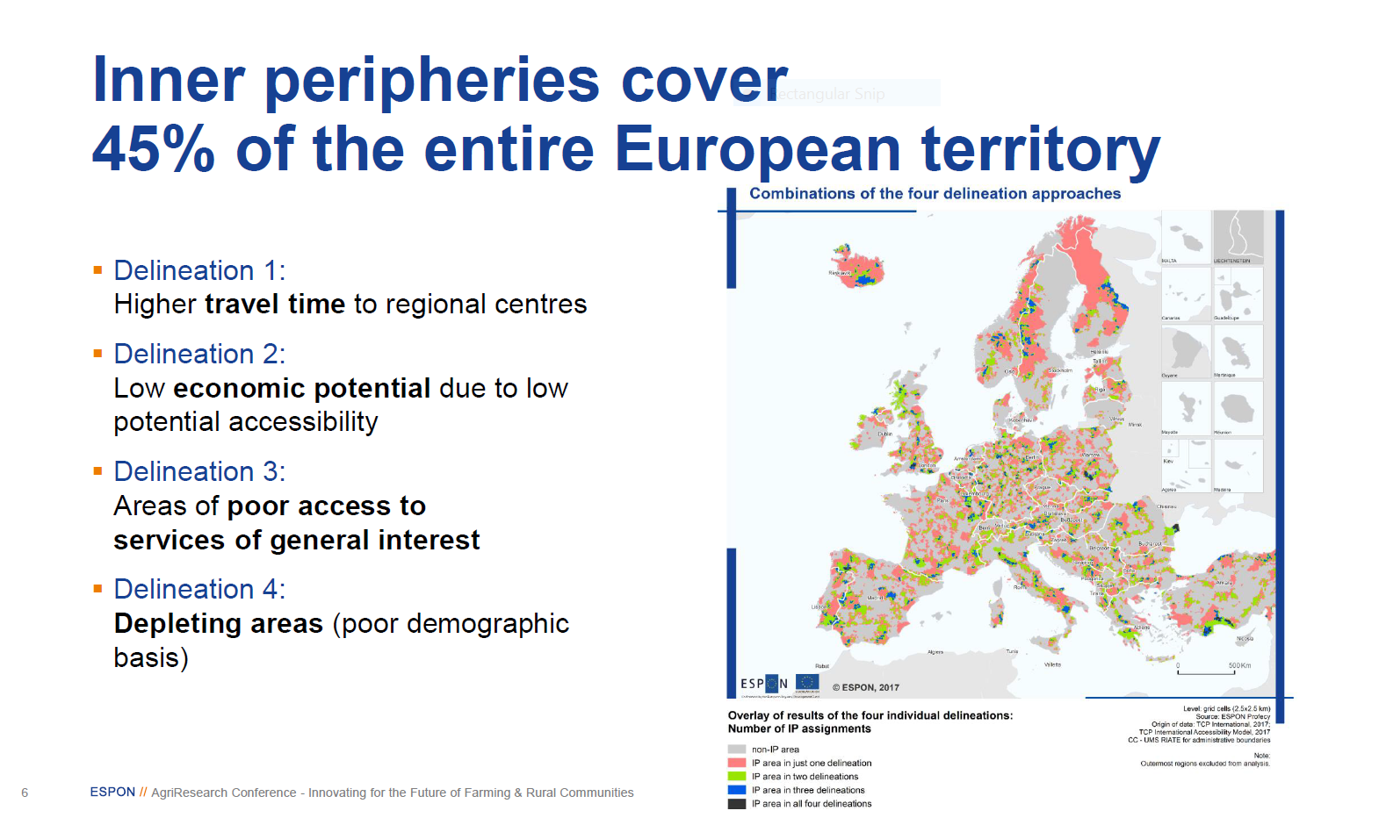
Inner peripheries

Slide 8
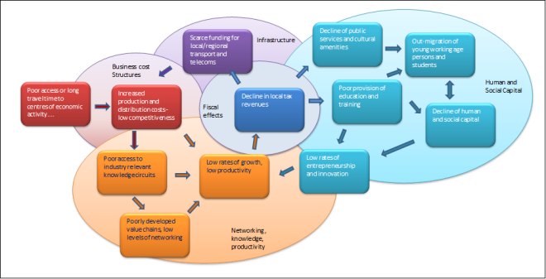
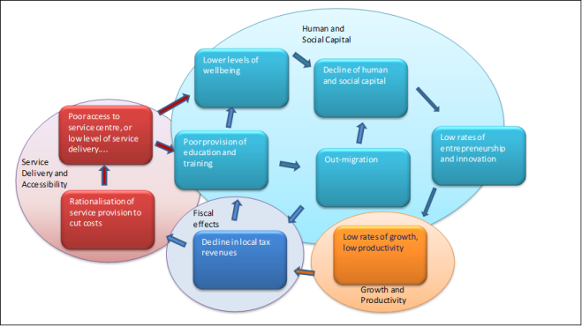
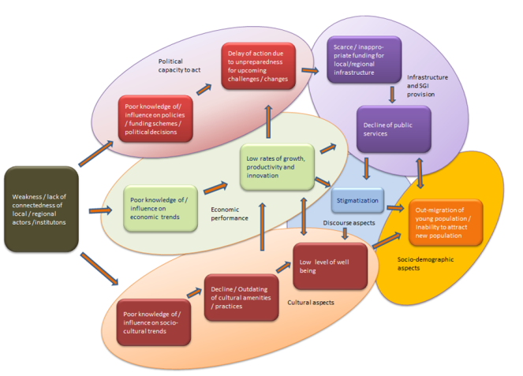
Descriptive models of periperalization processes
Process models…
Concepts…
Enclaves of low economic potential (islands of conventional peripherality caused by poor transport infrastructure)
Areas with poor provision of, or access to, SGI (Services of General Interest)
Areas with poor relational proximity (non-geographical peripherality – caused by lack of interaction/poor relationships)

Slide 9
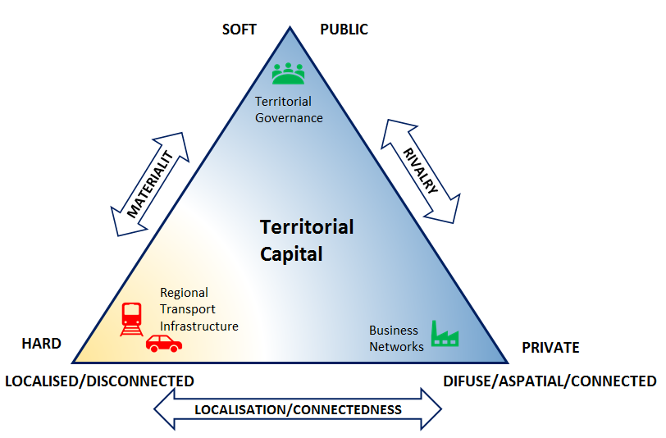
What Processes Cause Them?
Inner peripheries are usually complex hybrids of the three primary processes, embedded in a range of secondary marginalisation effects.
The key defining characteristic of an Inner Periphery is that its territorial capital suffers a deficit of connectedness (which can be manifest in many different forms)…
Source:
Andrew Copus, NordRegio
https://www.espon.eu/inner-peripheries

Slide 10
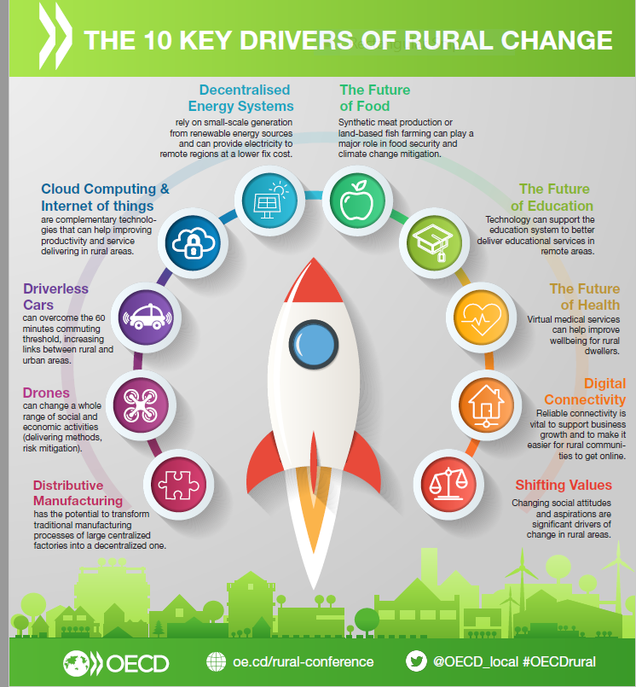
OECD RURAL 3.0 Megatrends
Population ageing and migration.
Urbanisation.
Global shifts in production.
Rise of emerging economies.
Climate change and environmental pressures.
Technological breakthroughs

Slide 11
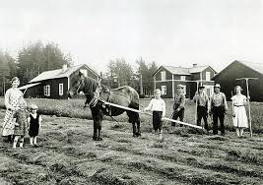
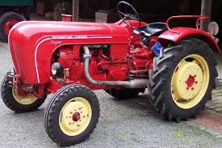
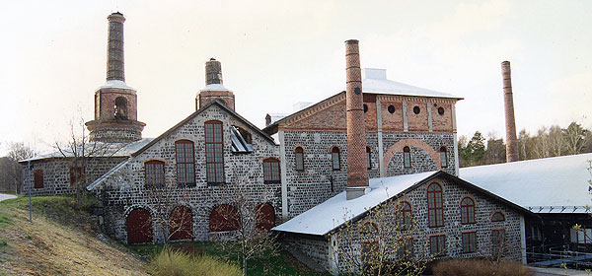
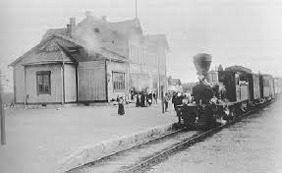
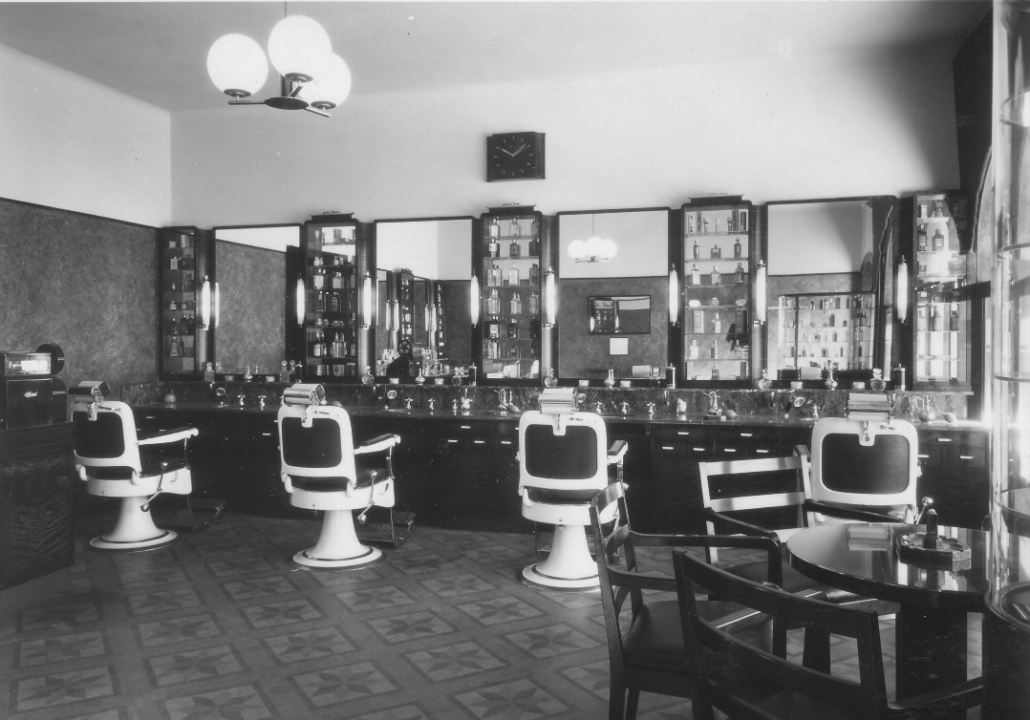
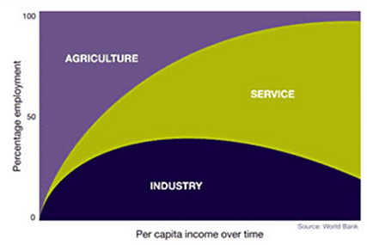
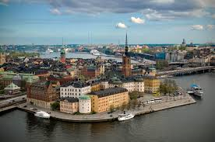

Structural change……..
1818
1858
1918
1948
1958
1968
2018

Slide 12
Policy agendas
EU Shrink Smart* indicates there are three potential policy responses:
  “Do nothing”
  “Reverse the trend and stimulate growth”
  “Accept and adapt to decline”
Planning for shrinkage:
Shrinkage as an opportunity
Effective government-led policy interventions
Place-based approaches
* http://shrinksmart.eu/
12

Slide 13
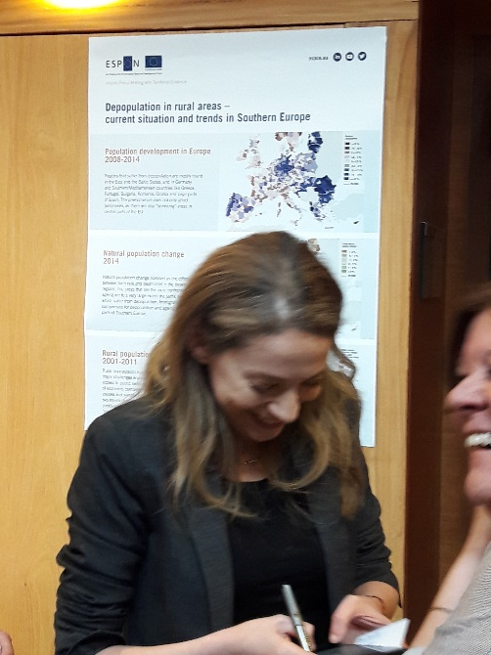
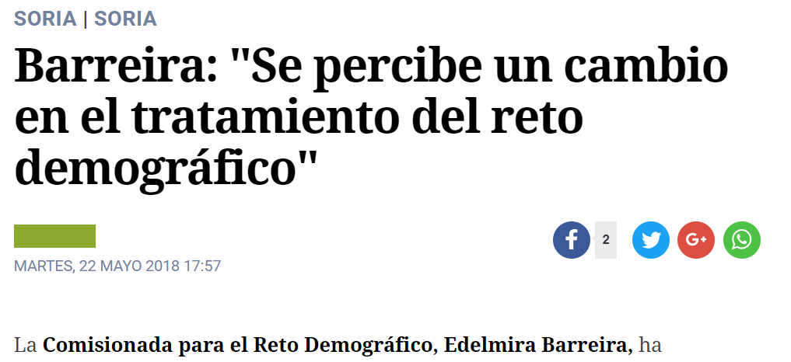
Do nothing and reverse the trend
“The reality of depopulation is often presented as a taboo which does not fit with one-size-fits-all normative policy goals and political perspectives, resulting in an overriding policy imperative to reverse depopulation and return to growth, and not very often leading to success.
The very idea of adaptation planning for shrinkage has not been widely accepted to date as it is generally considered counterintuitive and defeatist amongst politicians and civil society at large.
This makes it difficult to find workable solutions which require creative new ways of thinking and context specific solutions.
Edelmira Barreira Diz, Commissioner for the Demograpic Challenge, Spain

Slide 14
Mobilising endogenous resources
From an economic sustainable point of view, it’s important to
Diversify the local economy by using comparative territorial advantages
Landscape - tourism
Increase resilience and adaptive capacity by downsizing infrastructure and rightsizing the local economy
Improve environmental sustainability
Ensure access to basic services and infrastructure
1/26/2019
Fighting depopulation in rural areas – ESPON workshop in Soria - Spain on 22-23 May 2018
14

Slide 15
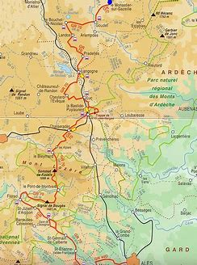
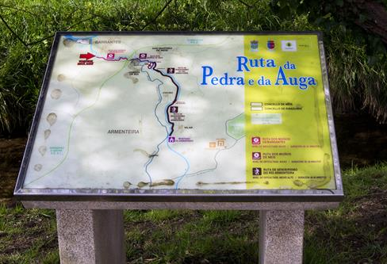
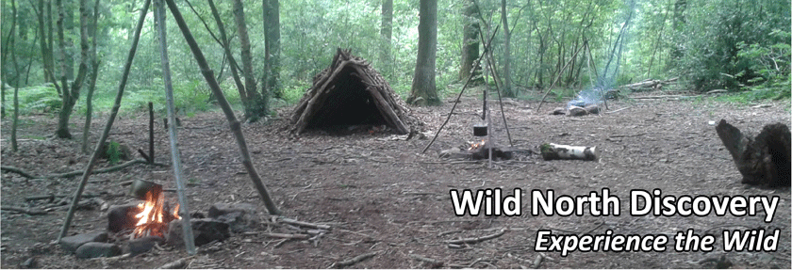
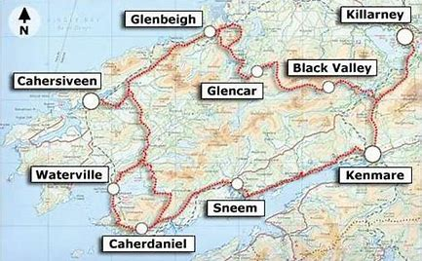
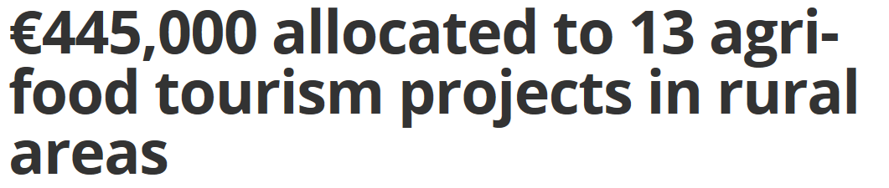
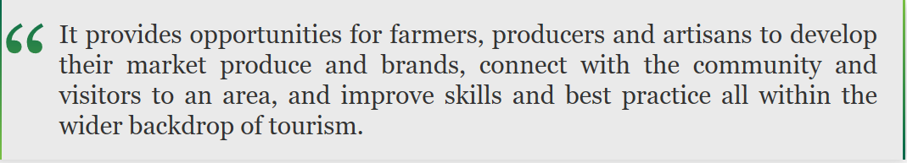
Walking trails
Walking routes (1 week?)
Stevenson Trail
Kerry Way

Slide 16
Social innovation and ICT
ICT for public services and new employment opportunities.
Social innovation to develop a new intergenerational pact
Examples:
“Silver economy”
“White economy” (healthcare and medical services)

Slide 17
Fostering ecosystem services and the green economy
Using the “natural green advantage”
Promote low-carbon economy
  Circular economy
  Promoting local produce supported by technology and ICT
  Smart diversification in agri-food, energy, biomass, tourism and cultural activities
1/26/2019
Fighting depopulation in rural areas – ESPON workshop in Soria - Spain on 22-23 May 2018
17

Slide 18
Spanish Strategic objectives against depopulation
Encourage balanced development to promote the equality of all citizens in care and access to services.
Encourage equal opportunities regardless of the place of residence.
Enhancing /strengthening resources against depopulation.
Special attention to key groups in areas with low population and rural areas: young people and women
Awareness and commitment to a balanced and sustainable development

Slide 19
Integrated territorial investment
Joining up policies and seeking synergies in funding
ITI is a tool to implement territorial strategies in an integrated way. It is not an operation, nor a sub- priority of an Operational Programme. Instead, ITI allows Member States to implement Operational Programmes in a cross-cutting way and to draw on funding from several priority axes of one or more Operational Programmes to ensure the implementation of an integrated strategy for a specific territory.
As such, the existence of ITI will both provide flexibility for Member States regarding the design of Operational Programmes, and enable the efficient implementation of integrated actions through simplified financing.
It is important to underline that ITIs can only be effectively used if the specific geographical area concerned has an integrated, cross-sectoral territorial strategy.
The key elements of an ITI are:
  • a designated territory and an integrated territorial development strategy;
  • a package of actions to be implemented; and
  • governance arrangements to manage the ITI.
https://ec.europa.eu/regional_policy/sources/docgener/informat/2014/iti_en.pdf

Slide 20


The SWOT diagnosis and matrix are based on Castilla-La Mancha’s Thematic Objectives (TO’s) *:
Promoting research, technological development and INNOVATION.
Investing in EDUCATION, capacity building and lifelong learning through educational development and training infrastructures.
1
10
2
Improving the use and quality of and access to ICT’s.
Promoting SOCIAL inclusion and fighting poverty and any form of discrimination.
9
THEMATIC OBJECTIVES
3
Improving COMPETITIVENESS of small and medium enterprises within the farming sector.
8
4
Encouraging the transition to a LOW CARBON economy in all sectors.
Supporting sustainability and quality of JOBS while boosting labour mobility.
6
Preserving and protecting the ENVIRONMENT while promoting resource efficiency.
The diagnosis of the entire ITI regional area is supplemented with ITI subarea diagnoses identifying territorial peculiarities.
* TO’s 5 and 7 are not included in Castilla-La Mancha’s OP.

Slide 21
➔ The Strategy’s main goal is the sociodemographic recovery of ITI areas by means of three development vectors: digitizing the territory, boosting economic activity and supporting a sustainable use of available resources.
Main objective
Attracting population.
Action vectors
Digital
Job opportunities
Making the most of our resources
Promoting telecommunication infrastructure in order to improve digitization of the ITI area.
Encouraging productive investments compatible with the territory’s sustainability in the following sectors: agri-food, tourism, green economy & social economy.
Developing environmental infrastructure enabling the preservation and value of territorial resources: water, biomass, renewable energies and heritage.
4 thematic axes
INNOVATION
ECONOMIC FABRIC
ENVIRONMENTAL RESOURCES
HUMAN ENVIRONMENT.

Slide 22
Retaining and improving services

Slide 23

GENERAL STRATEGY
For re-population and retention of the rural population:
Improvement in the provision of basic services to the population.
Provision of essential services for the implementation of economic activities.
Training aimed at young people and women from rural areas and emigrant population.
Special treatment of priority rural areas: on tax incentives for companies and entrepreneurs, special budgets for small municipalities, etc
Put in value the services and infrastructures of the municipalities that facilitate the location of new economic activities and the settlement of population.
Design of a common strategy to fight against depopulation.
  Consejeria de Agricultura, Pesca y Desarrollo Rural

Slide 24
KEYS OF RURAL DEVELOPMENT IN ANDALUSÍA LEADER 2014 - 2020
  Consejeria de Agricultura, Pesca y Desarrollo Rural

Slide 25
Agrifood opportunities

Slide 26
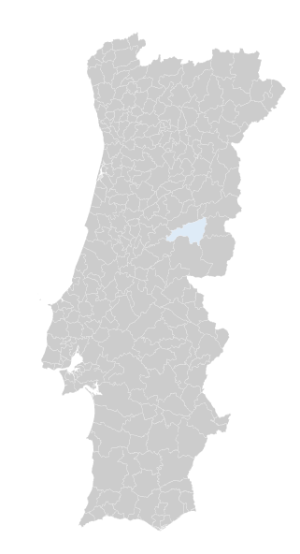

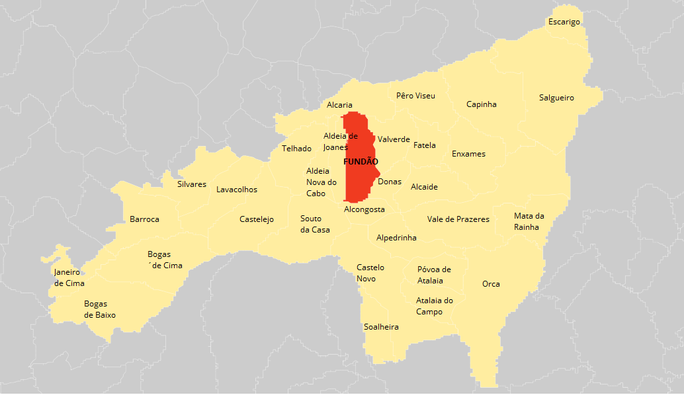
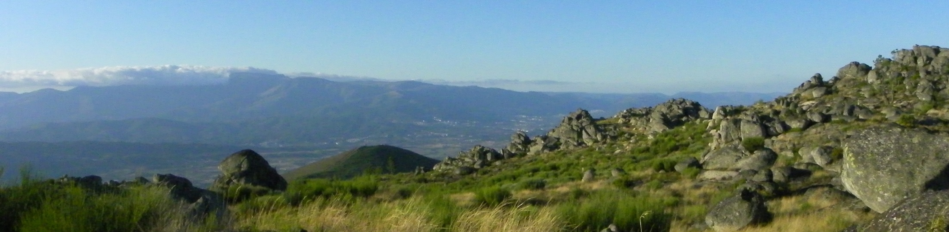
Overview
Fundão is located in the Centro region of Portugal (Cova da Beira).
In terms of their identity genesis, the Fundão county is characterized by geographical dispersion in which contrast markedly urban areas, such as the city of Fundão.
Principal activity sectors: trade and services, herding and forestry, and agriculture ( fruit, olive oil and wine production). In terms of industry, we emphasize the food and agriculture one.
Area: 700,20 km2
Population: 29 000 inhabitants
Density: 42 inhabitants per km2
26
Notes:
26

Slide 27
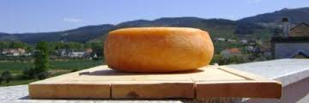
Agro-food Products
ANNUAL PRODUCTION:
Wine: 4.000.000 l
Olive Oil: 1.400.000 l
Cheese: 4.000 ton / 3.500 per day
Smoked sausages: 3.000 ton
Fruit concentrated: 4.100 ton
Fruit jelly: 200.000 units
26/01/2019
Adicione um rodapé
27

Slide 28

Cherries from Fundão
the original ones
63% of national production
7.000 ton / year
1500 jobs
500 direct
1000 seasonal
2004 – selling price: 1,4 € / Kg
2015 – 3€ / Kg
Economic value
20 M €

Slide 29

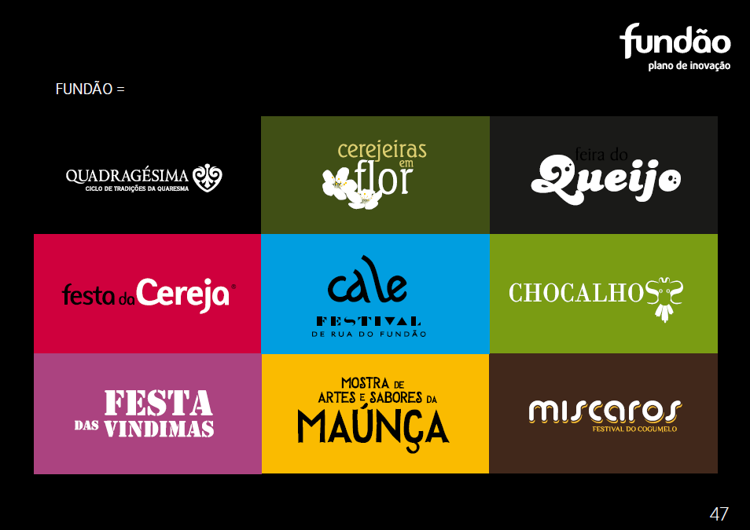

In June, every year
26/01/2019
Adicione um rodapé
29

Slide 30
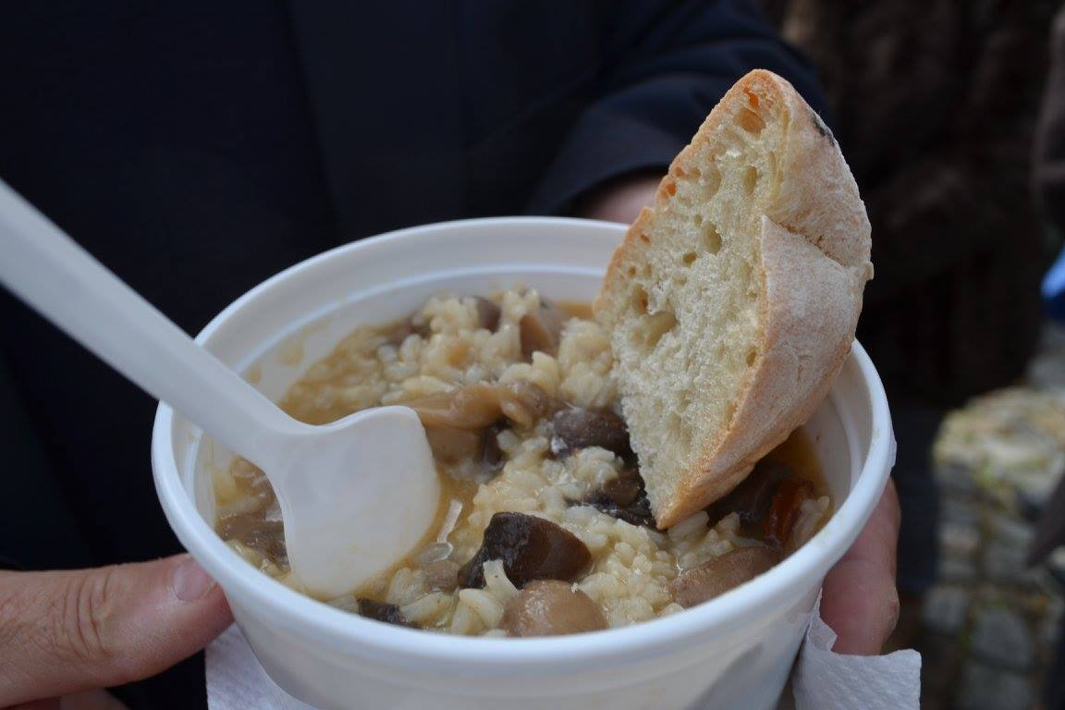
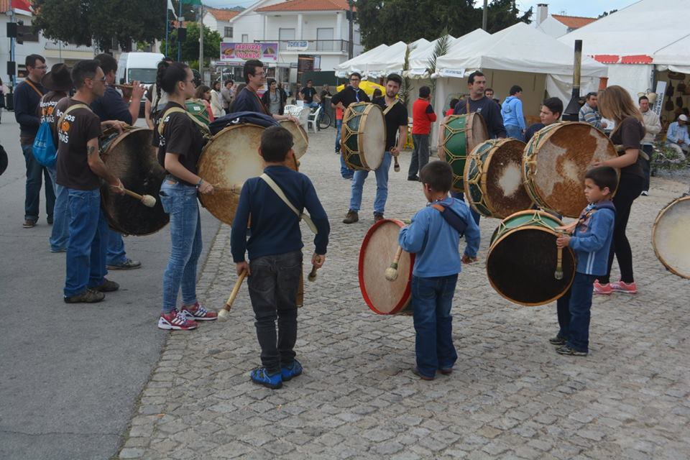
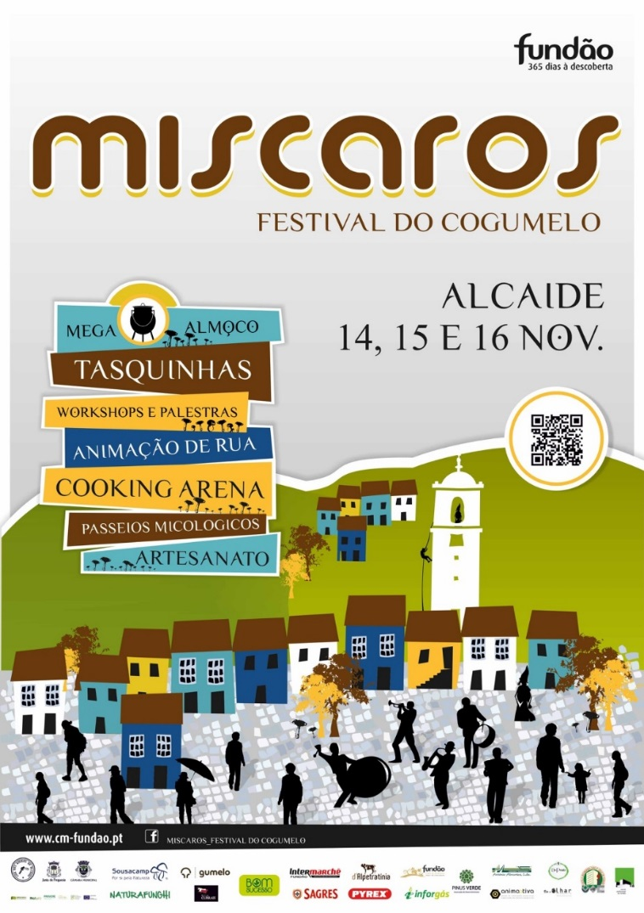

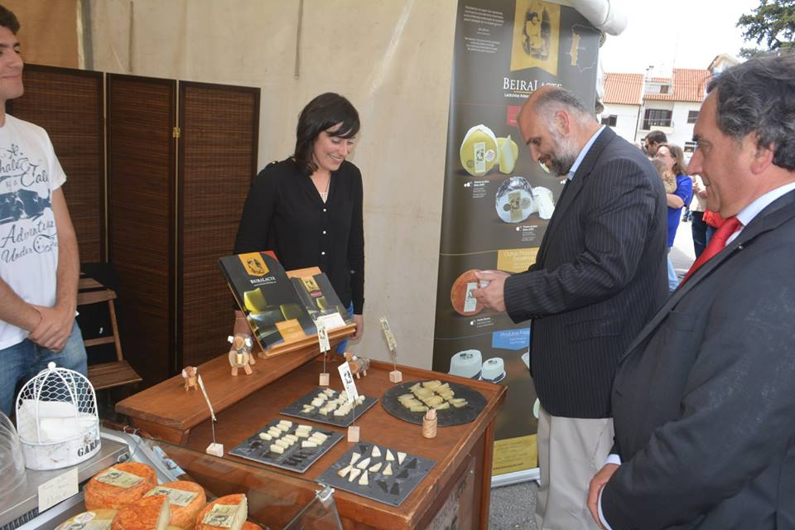
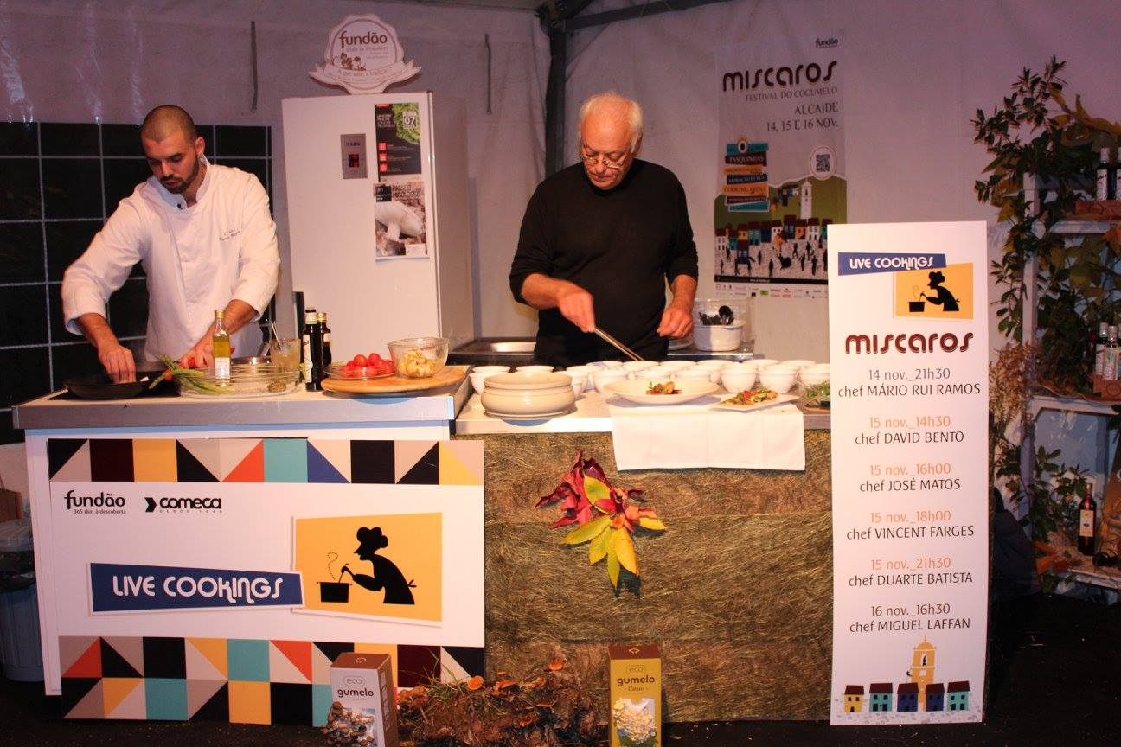

Festivals
November -mushrooms
May - cheese

Slide 31
Social enterprise
El Hueco https://www.elhueco.org/
An ecosystem for the promotion of entrepreneurship, the start-up and the development of business initiatives.
‘In El Hueco we want them to be more than words, to become reality. That's why our goal is to create the optimal conditions to encourage you to enter the difficult, but exciting world of those who have an idea and struggle to get it going’.
El Hueco currently has extensive facilities in Soria whose purpose is to welcome entrepreneurs and encourage entrepreneurship. They are divided into several areas: coworking space, incubation space (social entrepreneurship, eco-entrepreneurship, startups ...), multipurpose rooms and space for companies.

Slide 32
LINES OF THE ACTION PLAN OF CASTILLA Y LEÓN
Build an adequate legal framework that typifies social enterprises.
Improve access to capital generation of specific fiscal and financial incentives to develop enterprises and social enterprises in sparsely populated areas
Promote the spirit of social entrepreneurship in the Educational System and in public employment devices.
Promote social innovation and knowledge.
Promote markets for social enterprises through alliances with the public sector and other actors (companies, consumers, etc.).
Improve support infrastructures (physical and internet) in sparsely populated areas, favoring their connectivity.

Slide 33
Some reflections
Need integrated, holistic place-based approach
  Tax breaks
  Service provision
Strategic spatial planning
  Functional areas
  Connectivity
Long-term perspective
  Clear and agreed visions - cross-party agreement to avoid shifting policies
Strengthen institutional capacity
  Thomas Norrby ‘we need knowledgeable and entrepreneurial bureaucrats’
Support entrepreneurship
  Targeted financial instruments

Slide 34
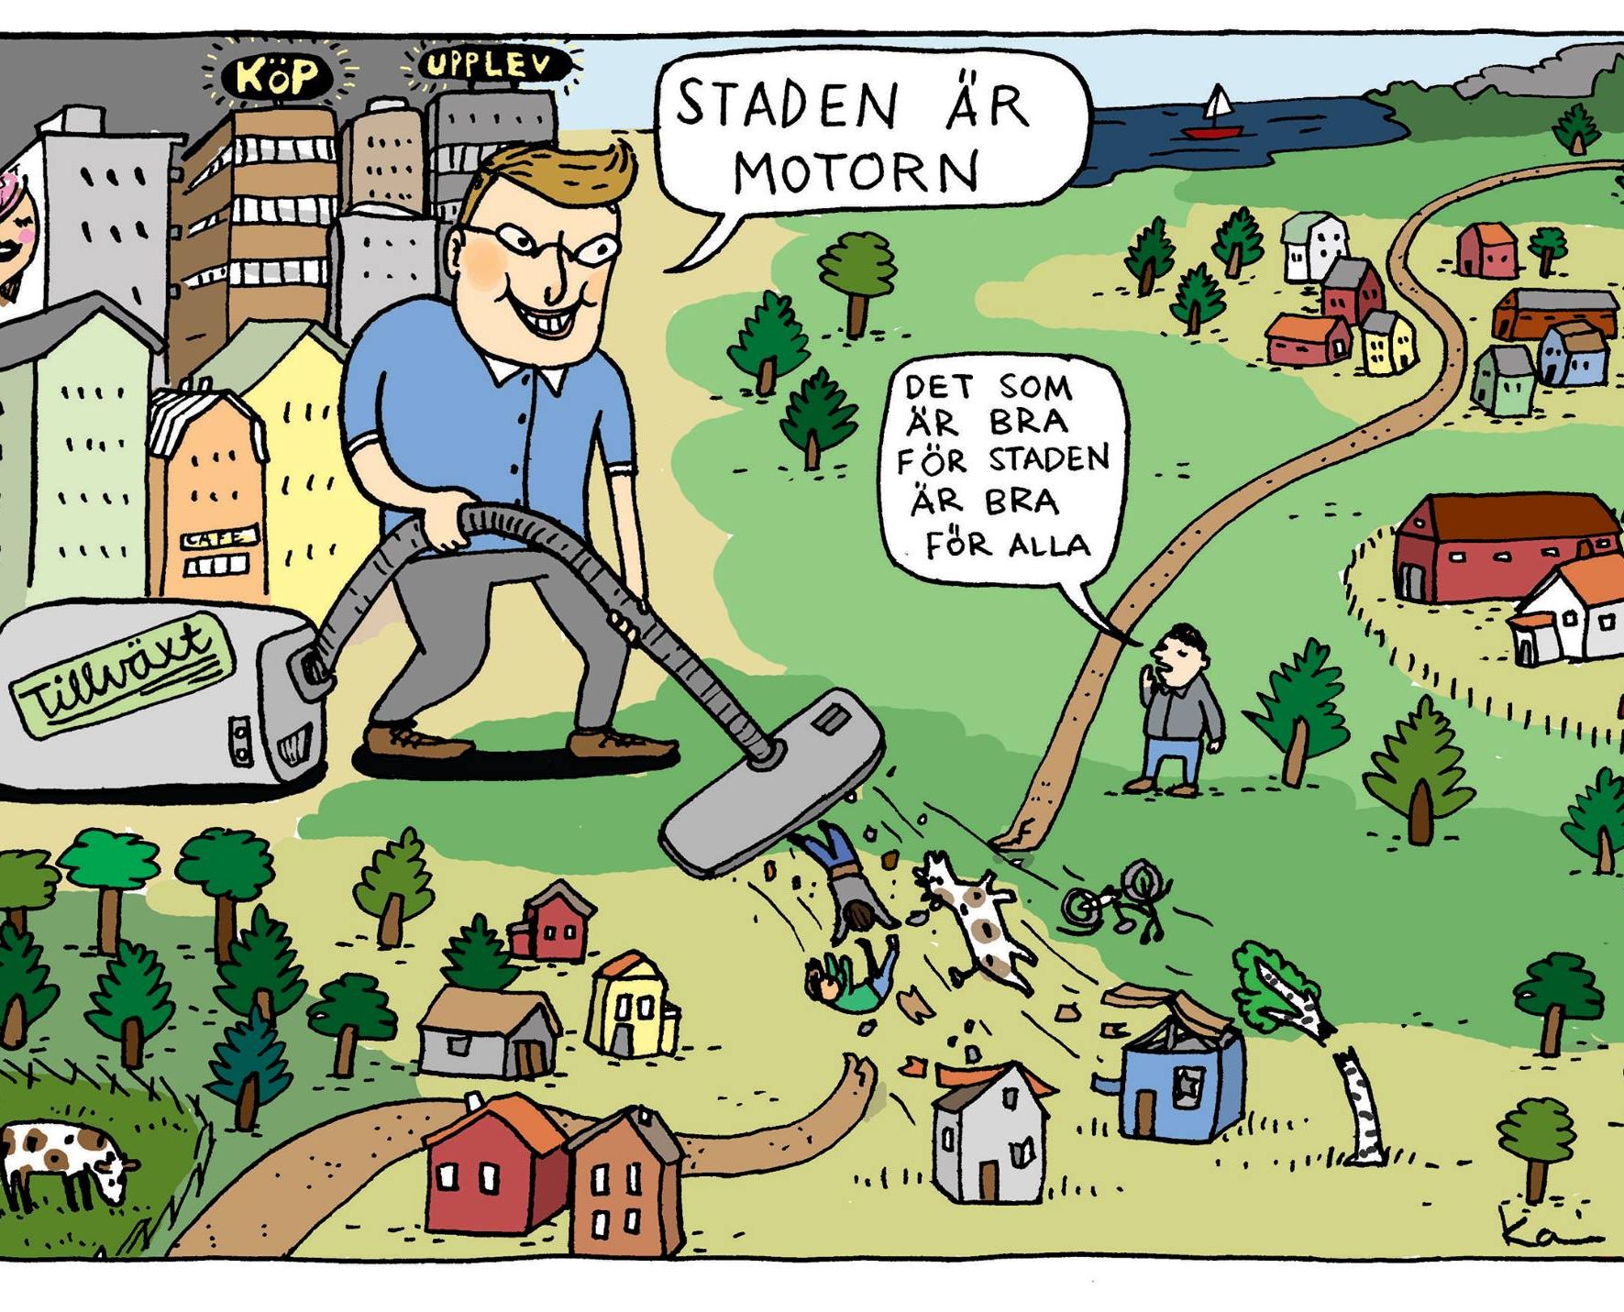
Reflections 2
Rural areas are not expected to live, just to deliver…
Professor Lina Bjerk
Jönköping International Business School
More targeted researchas are npected
‘We lack knowledge of ‘Target areas, Target groups and Tools…’ Professor Lina Bjerk
Encourage rural migrants to return ‘home’
  Target groups and conditions
The City is the Engine
Source: Thomas Norrby

Slide 35
Thanks for listening
Richard Tuffs
richardtuffs@ymail.com

