Slide 1
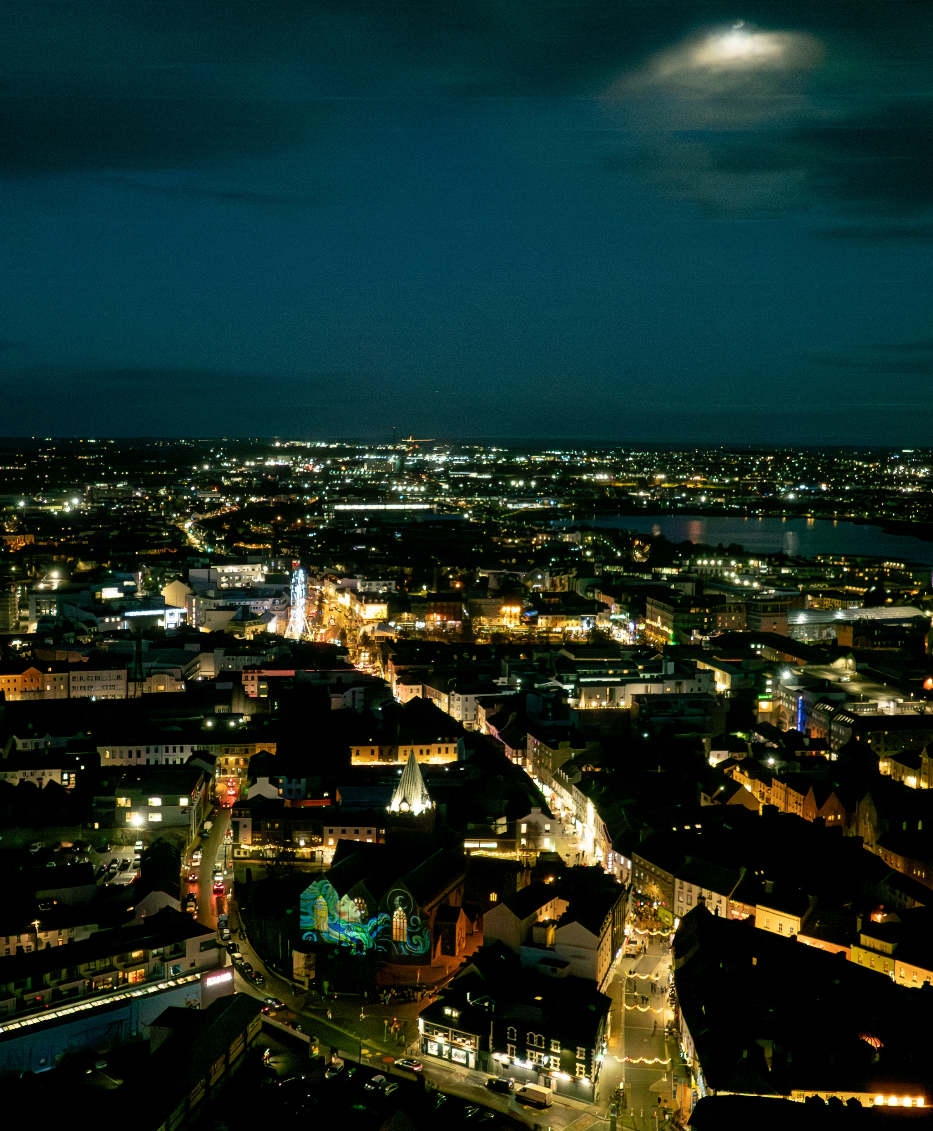

Session 2
Leonard Cleary
Chief Executive, Galway City Council

Slide 2
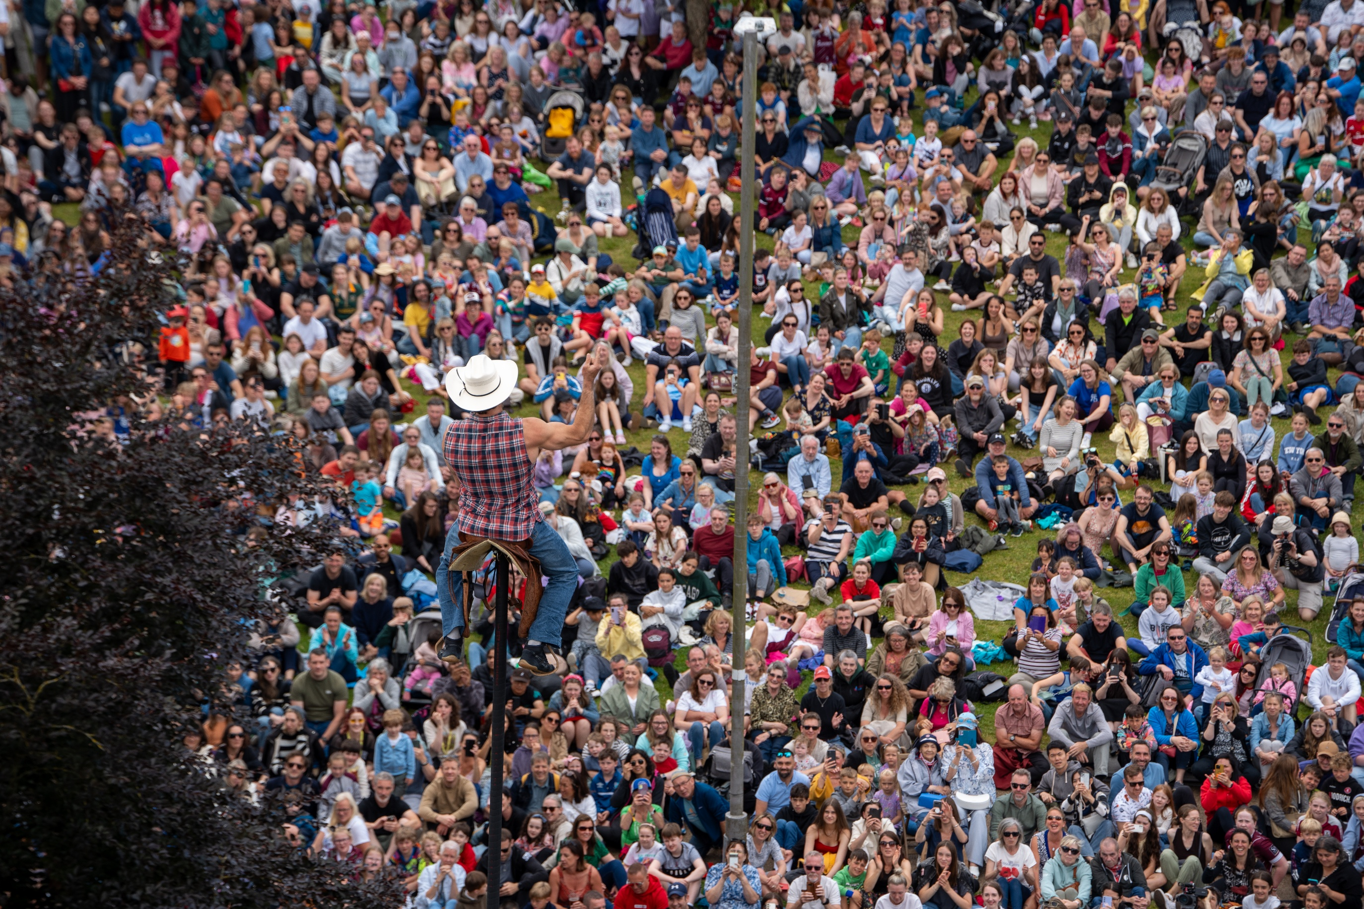
Fáilte
Welcome to Galway City
Les P’Tit Bras’ Galway International Arts Festival.

Slide 3
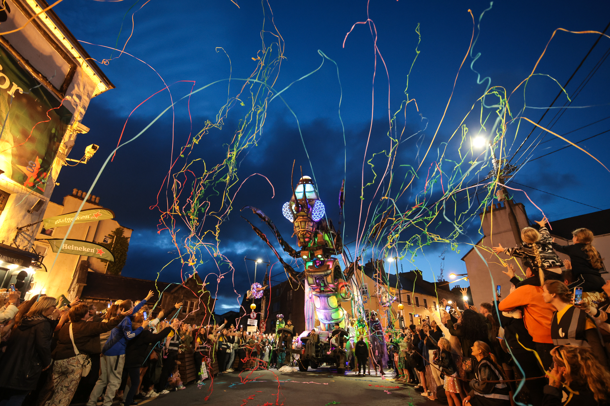
Culture as an Economic Asset
For decades, culture has been central to Galway City's development story
Helped position Galway as one of Ireland's most vibrant and creative urban centres.
Microcosmos, Galway International Arts Festival. Photo: Emilija Jefremova

Slide 4
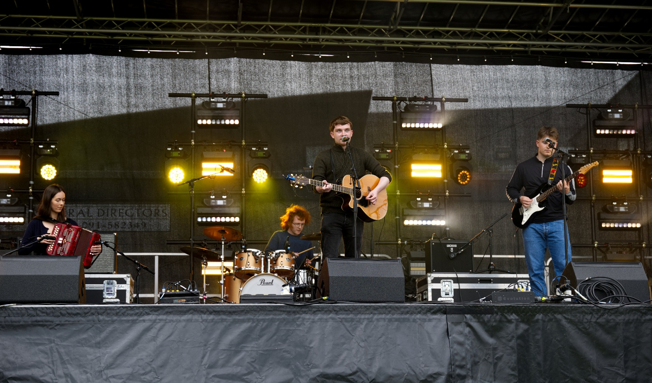
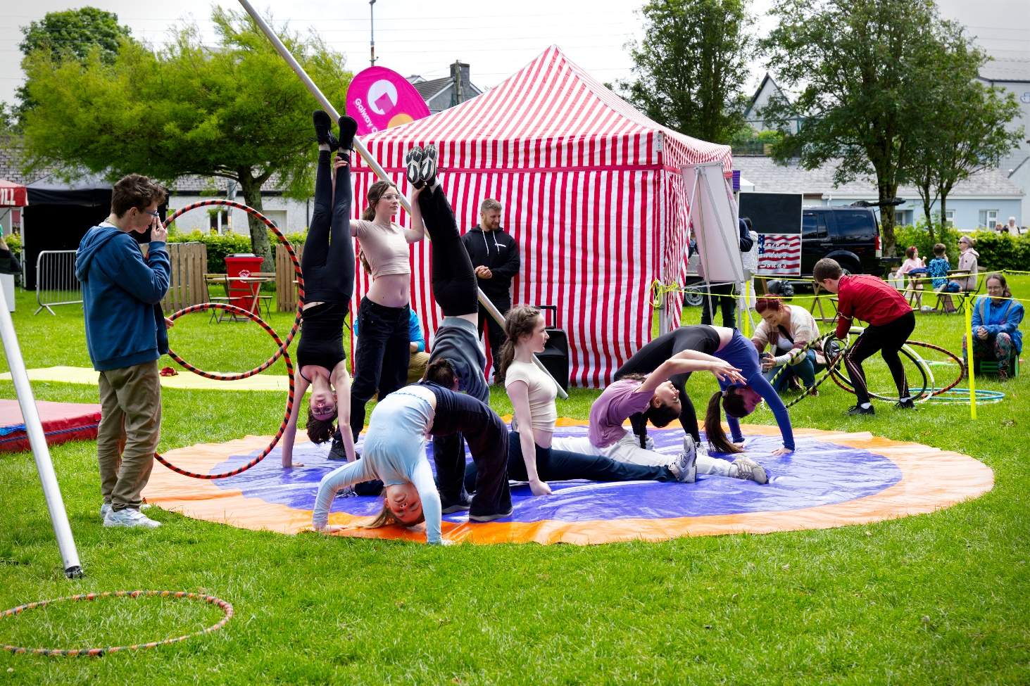
Galway City Council's Commitment to Culture
Through our Arts Office, annual festivals and events programme, Creative Ireland initiatives, heritage projects, cultural infrastructure, and support for community-led cultural activities:
we continue to invest in Galway's cultural ecosystem.
Crinniú na nÓg 2026

Slide 5
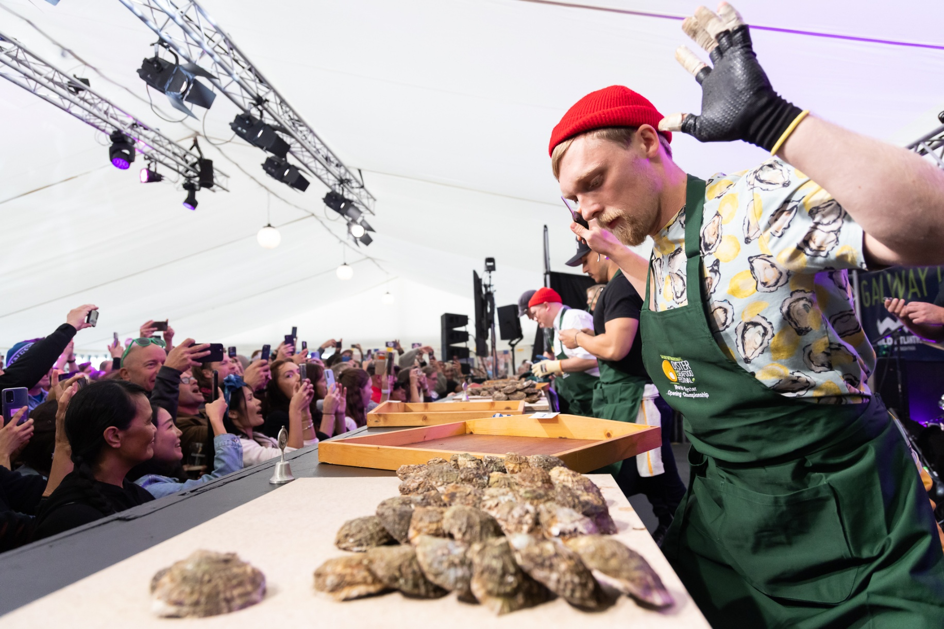
Culture, Traditions and Language as Drivers of Entrepreneurial Development
For coastal cities and regions in particular, culture and heritage help create businesses that cannot simply be replicated elsewhere.
They provide entrepreneurs with something increasingly valuable: a unique identity rooted in place.
Galway International Oyster and Seafood Festival 2024

Slide 6
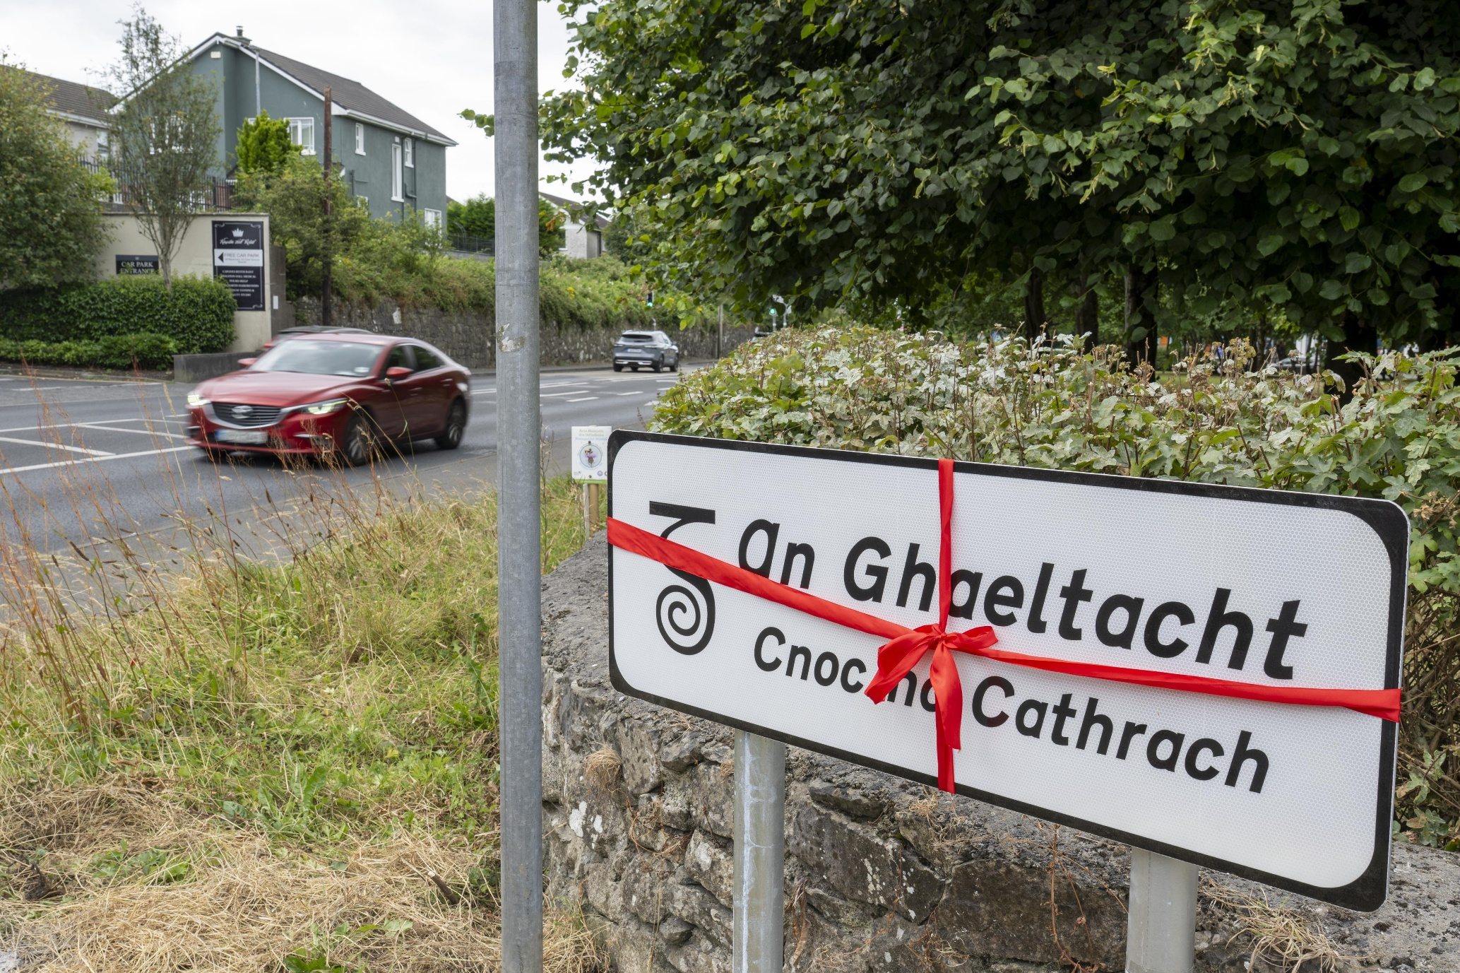
The Irish Language as a Driver of Enterprise
The Irish language is a defining element of our regional identity,
But it is also a contributor to economic activity and enterprise development.
Launch of new An Ghaeltacht signage, July 2026

Slide 7
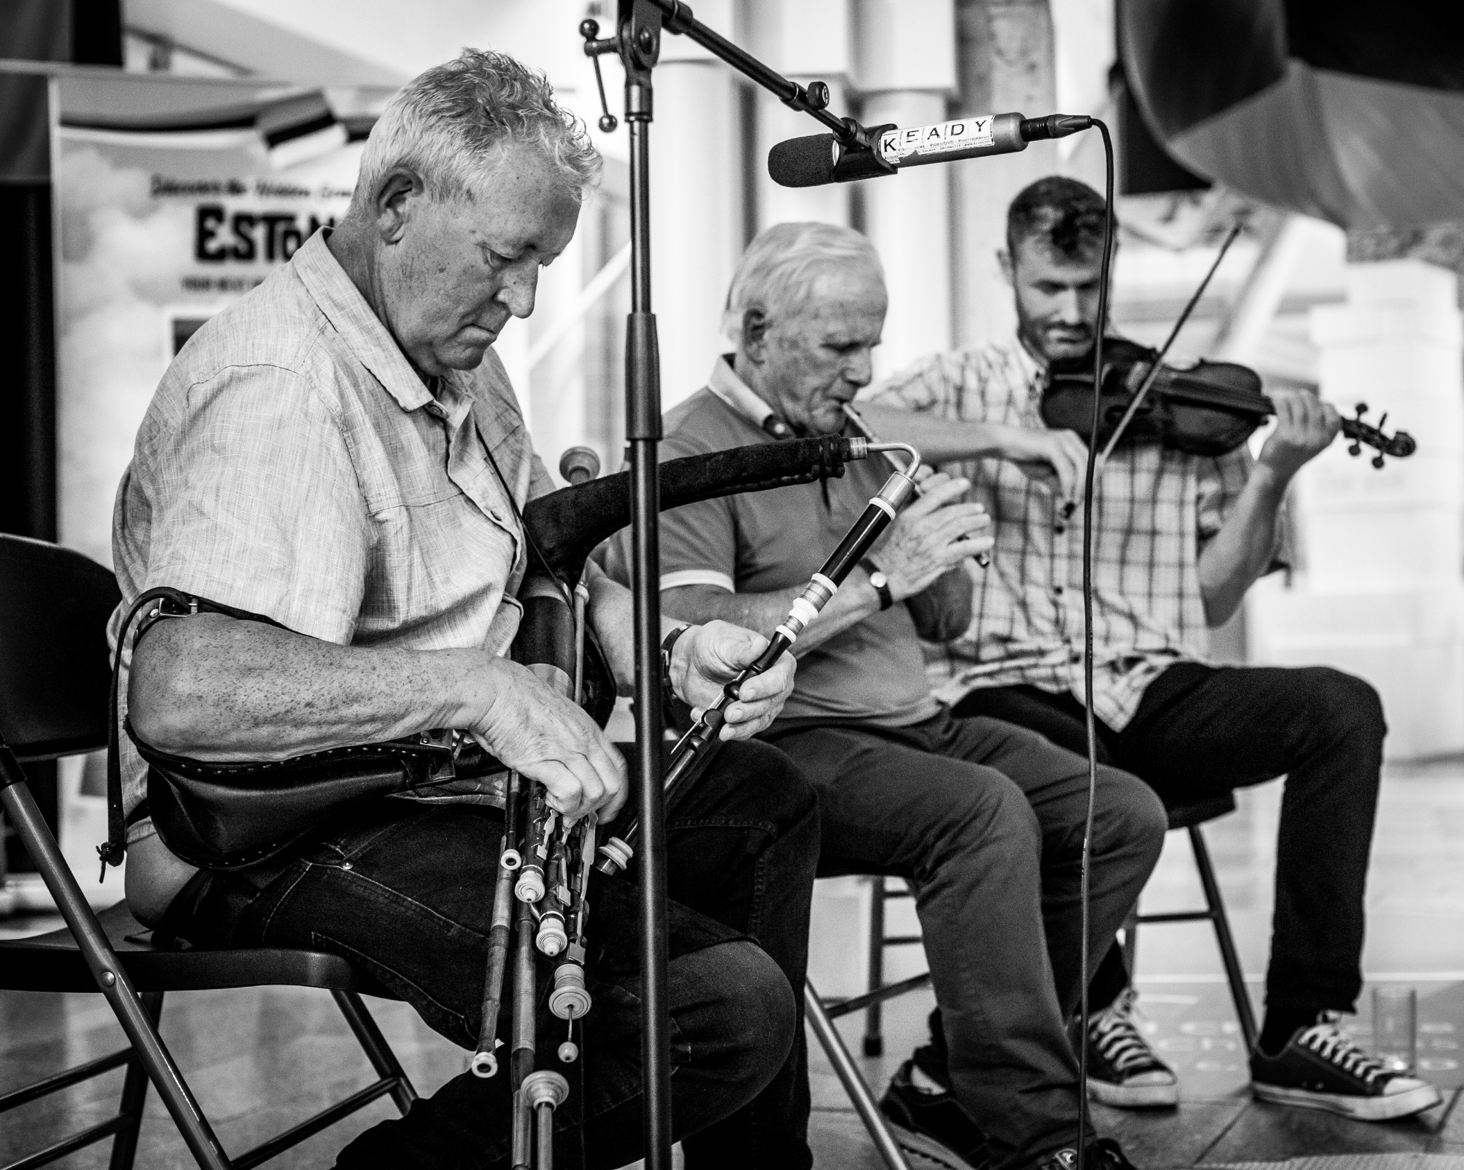
Authenticity, Heritage and Tourism
Traditional music, storytelling, maritime heritage, gastronomy, festivals and living cultural traditions - experiences that are unique and memorable.
Authenticity cannot be manufactured.
It is built over generations through culture, heritage and community.
EU County Pairing Event with Estonia, Galway City Museum

Slide 8
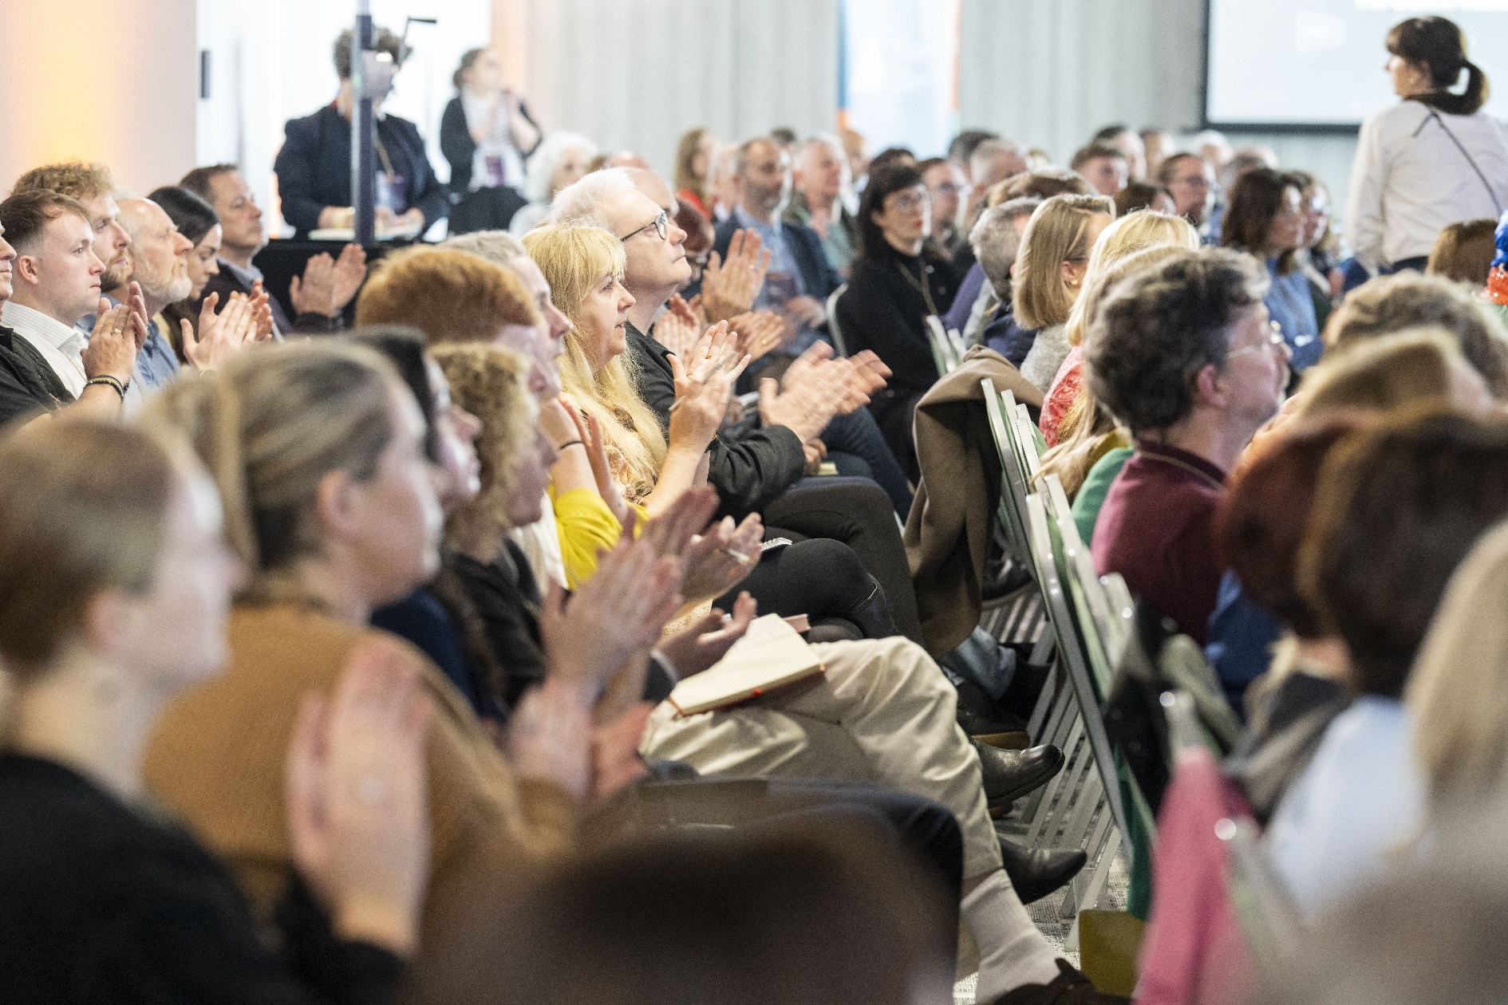
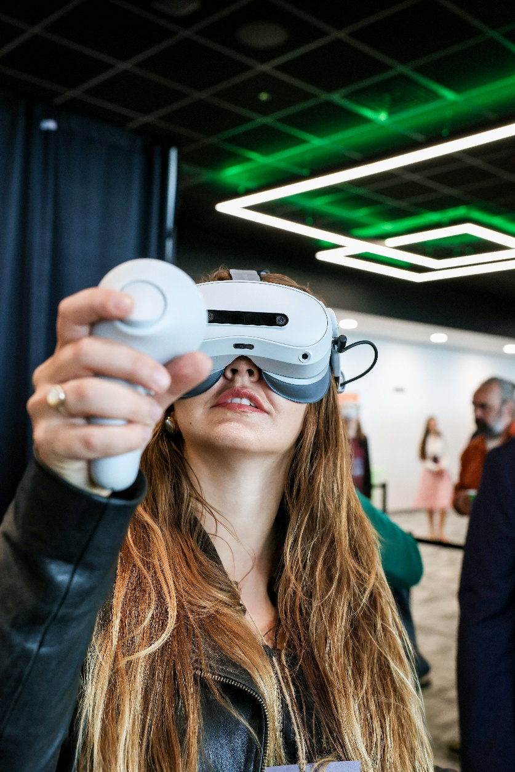
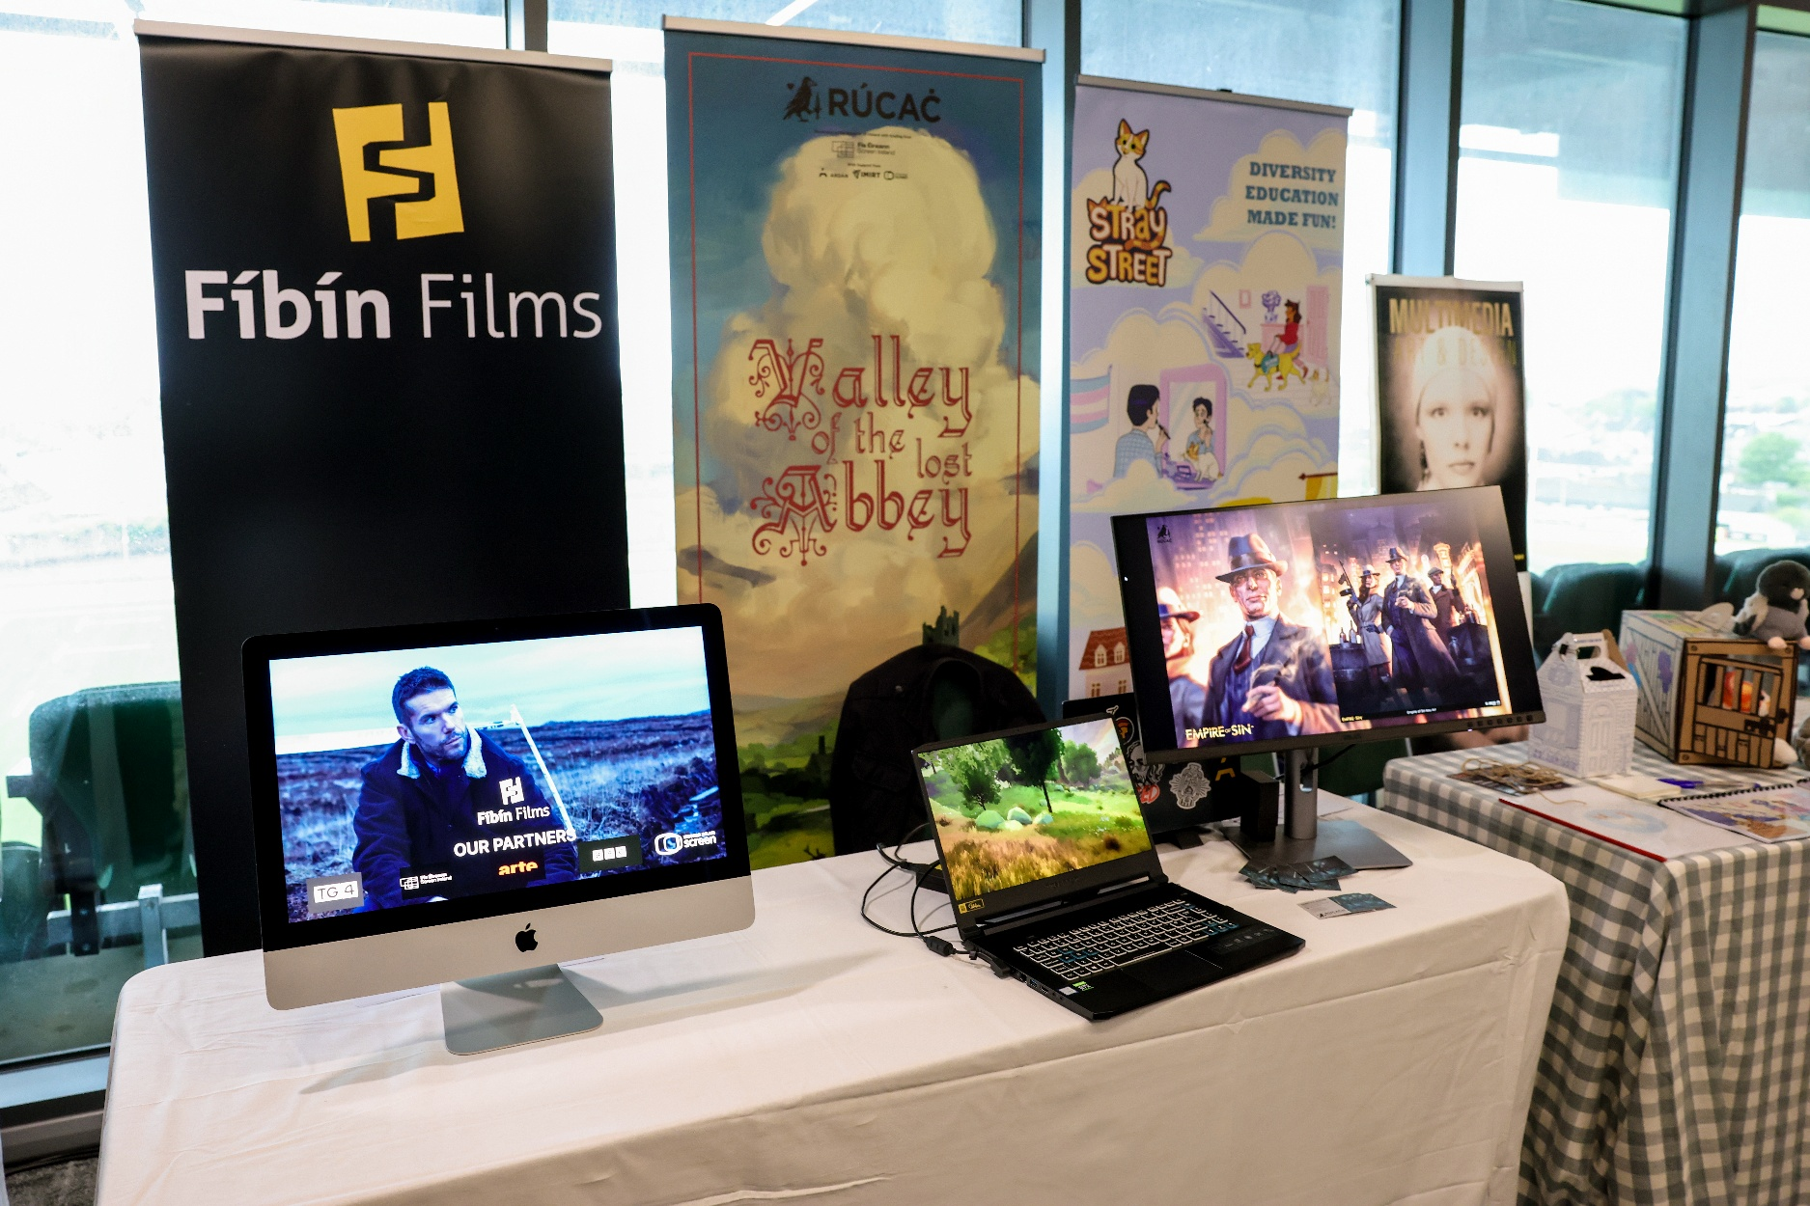
Entrepreneurship Thrives in Creative Communities
The creative economy and the innovation economy are becoming ever more interconnected.
EDGE 2026 Conference by Crew

Slide 9
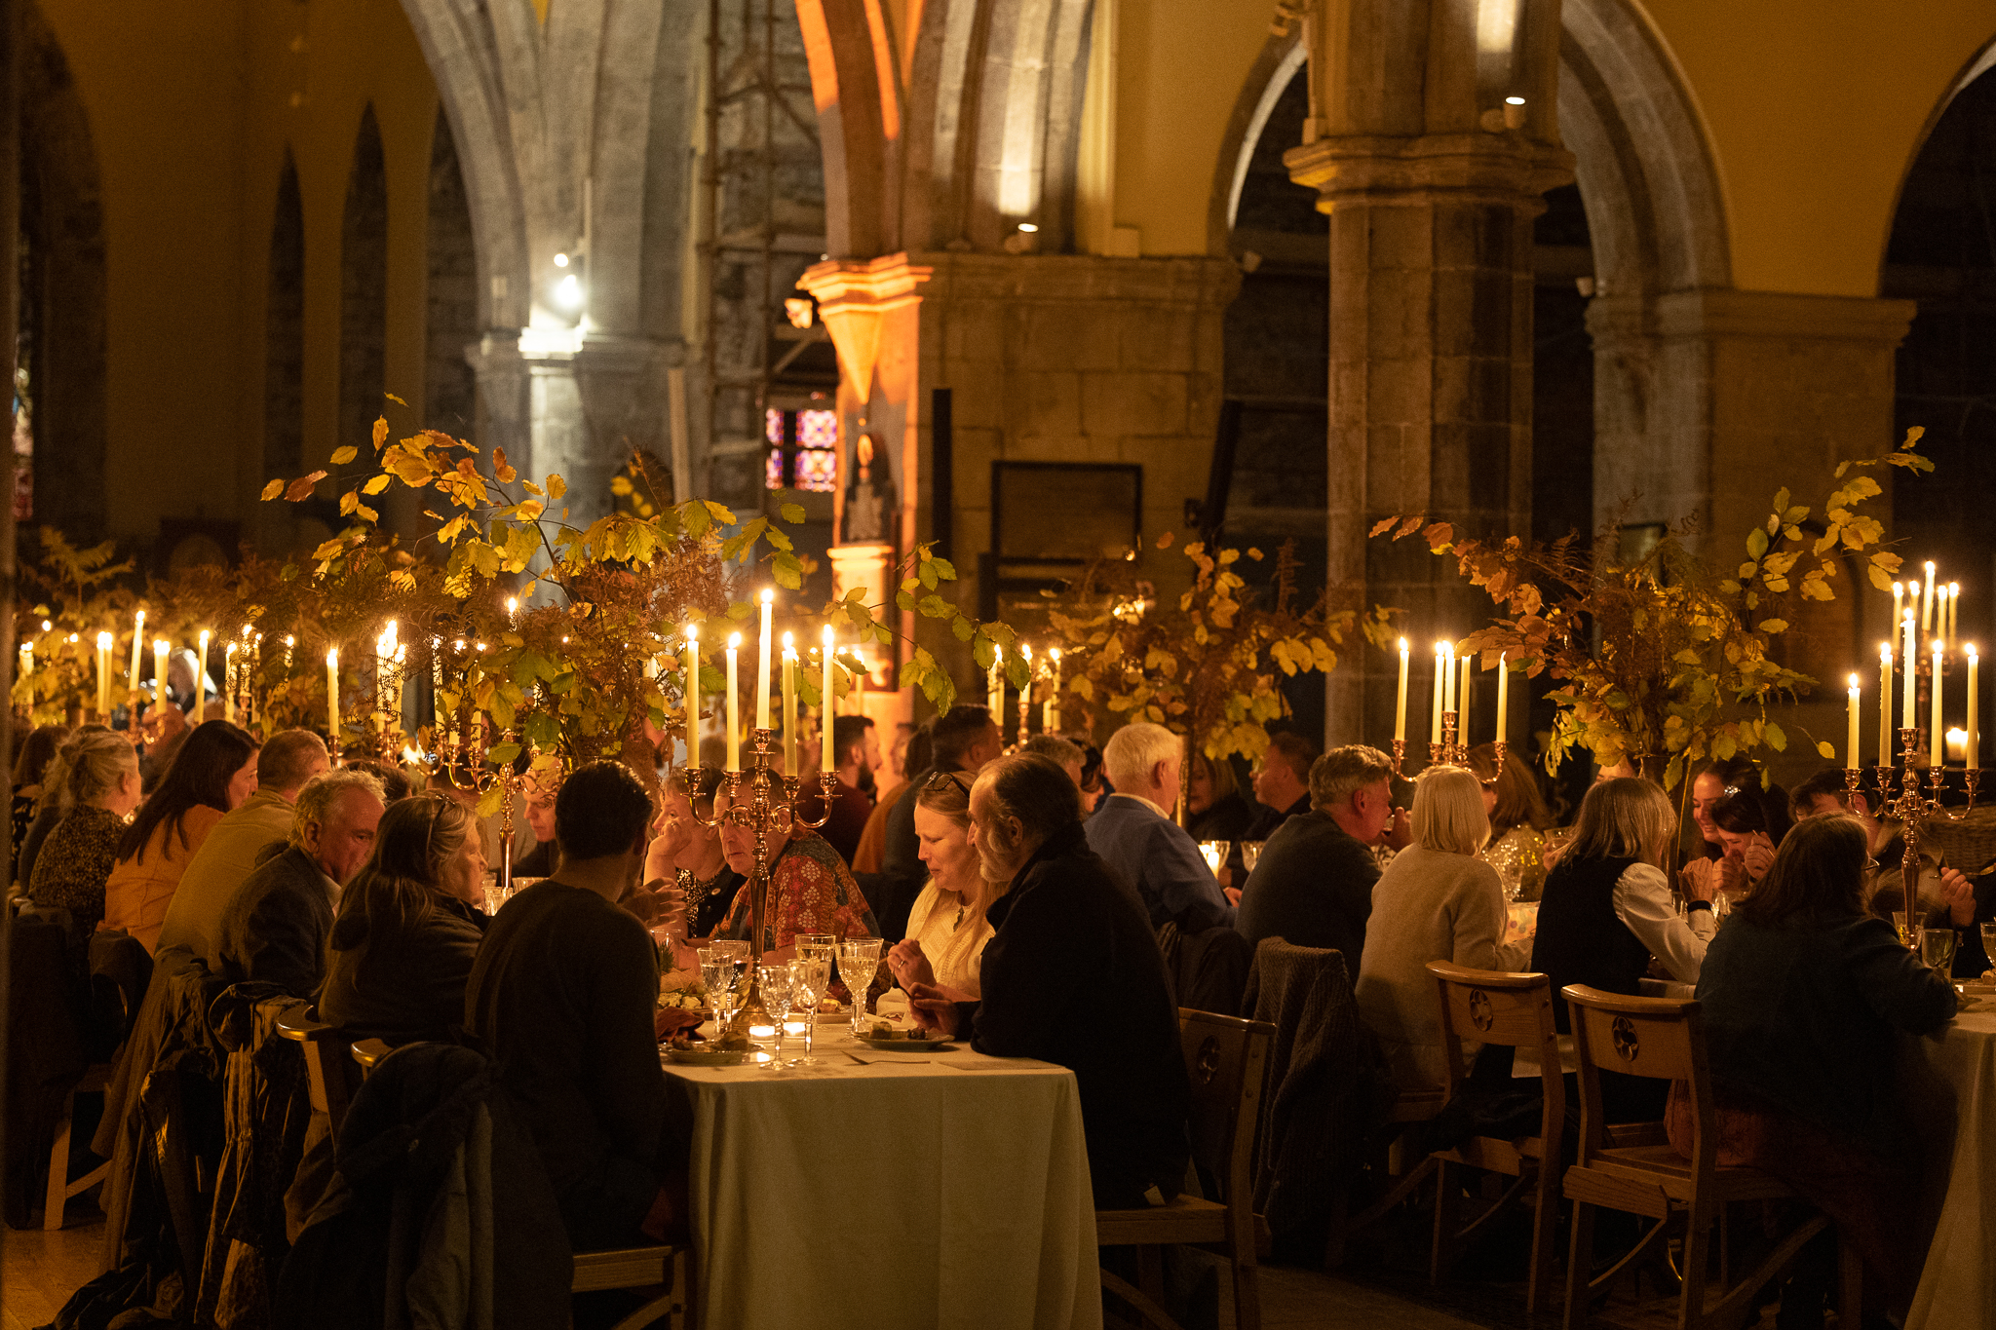
The Role of Local Government
Supporting culture is not simply a cultural objective.
It is an economic objective, a tourism objective, a place-making objective and an entrepreneurship objective.
By investing in culture, we are investing in the conditions that help businesses start, grow and innovate
Feasta 2025, St Nicholas Cathedral

Slide 10
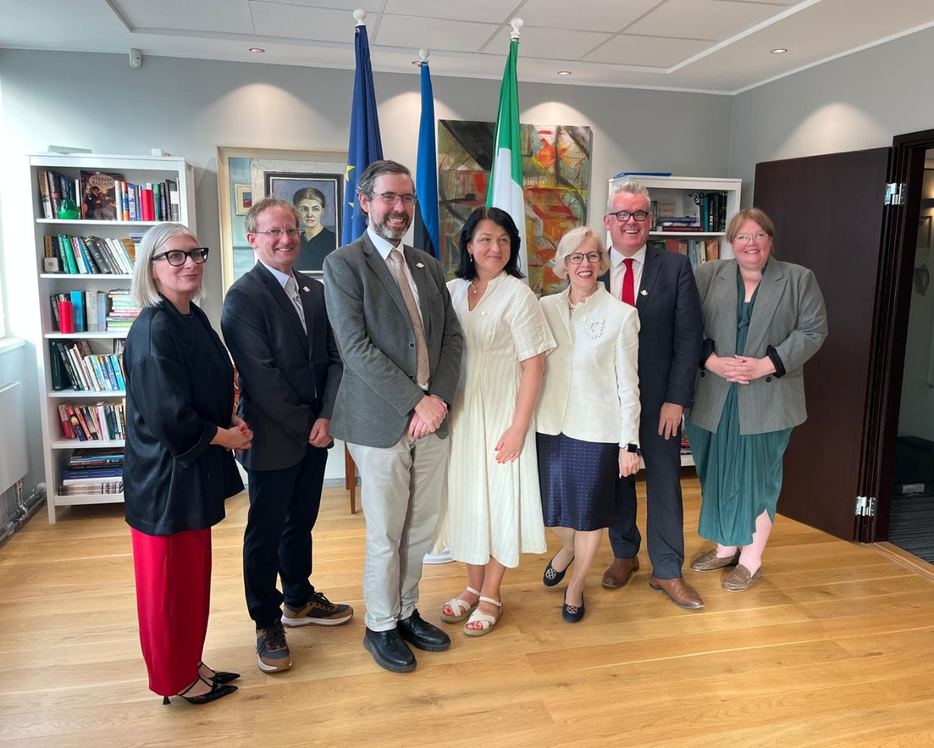
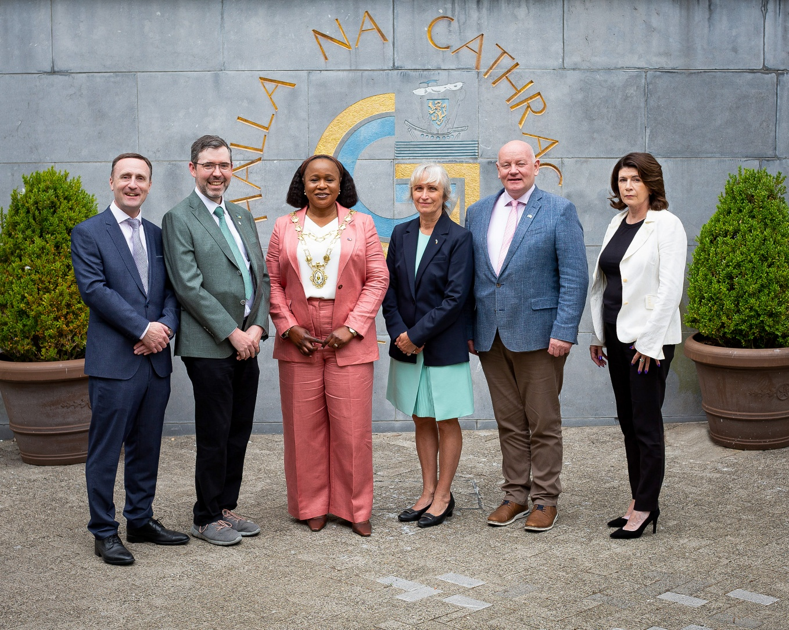
A European Perspective
The challenges facing coastal regions across Europe are often remarkably similar.
Culture, tradition and language offer a powerful response to these challenges because they are rooted in place.
Unlike many economic assets, they cannot be outsourced or relocated.
EU County Pairing Event with Estonia – Tallinn and Galway

Slide 11
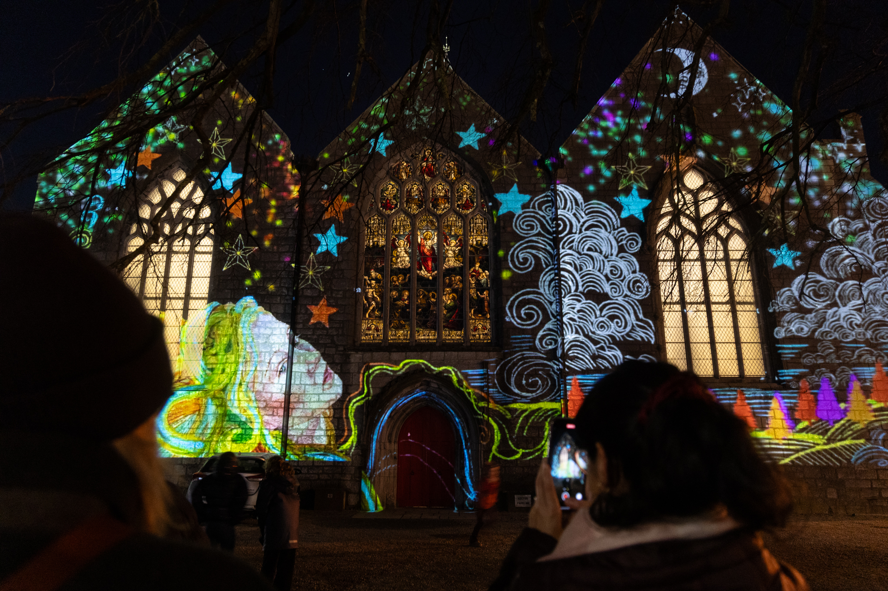
Closing Remarks
Trick of the Light – created by local Galway artists, Jennifer Cunningham and Jane Cassidy, in conjunction with Galway Training Centre, Merlin Park. Part of New Year’s Eve celebrations 2025, #GalwayByNight

