Slide 1
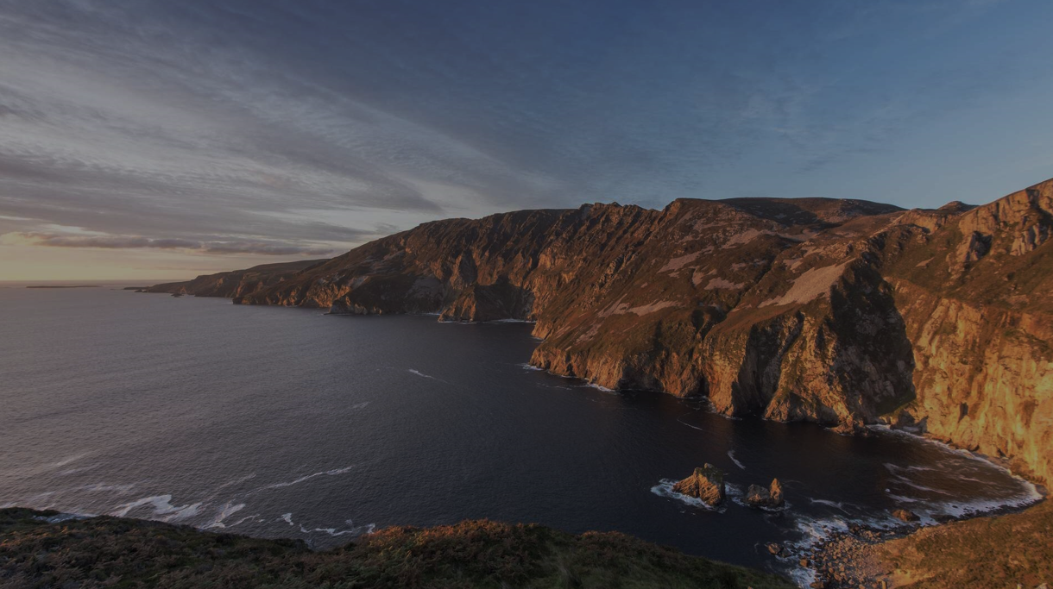

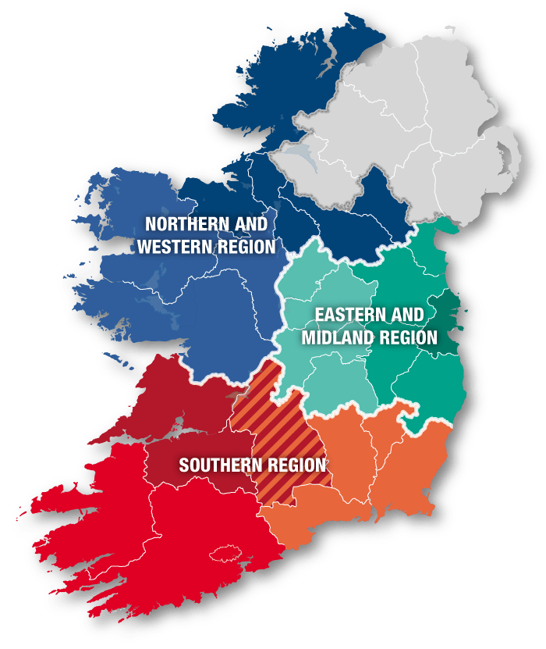

Coastal Regional Economies:
The Northern and Western Region
John Daly, Economist of the Northern and Western Regional Assembly (NWRA)
Date: 14th of September 2026

Slide 2
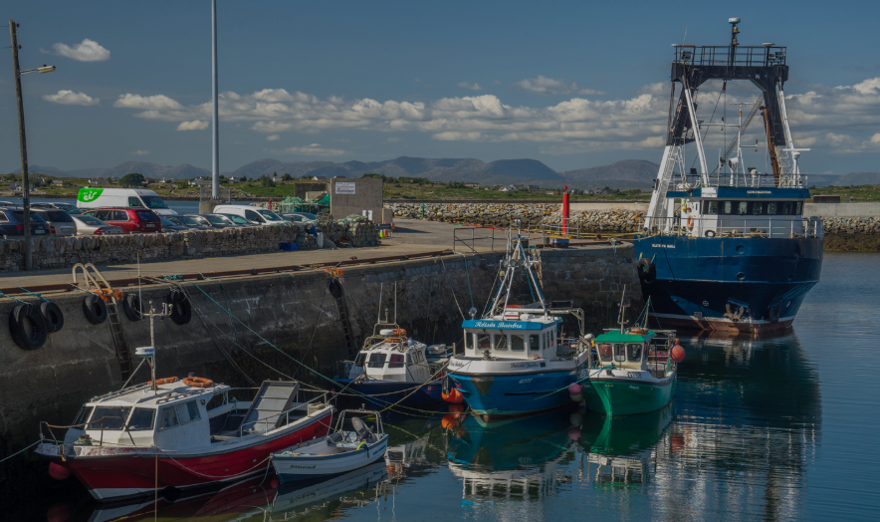
1: Economic Overview
Photo credit: Michael Harpur

Slide 3
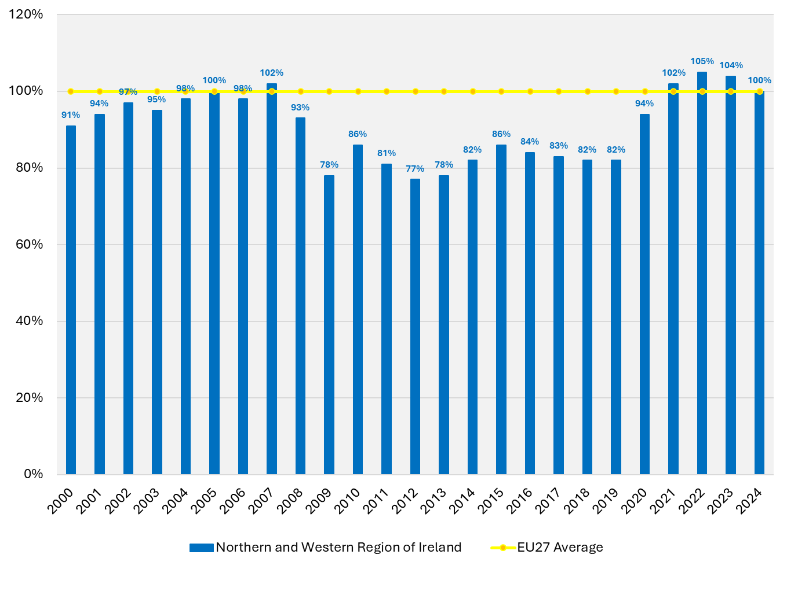
Figure 1: GDP per capita for the Northern and Western Region of Ireland, as a percentage of the EU27 average, 2000-2024 (PPS*)
More Developed Region:
A NUTS 2 Region with a GDP per capita more than 100% of the EU27 average*
Transition Region:
A NUTS 2 Region with a GDP per capita between 75% and 100% of the EU27 average*
Less Developed Region:
A NUTS 2 Region with a GDP per capita less than 75% of the EU27 average*
Source: Eurostat. *PPS = “Purchasing Power Standard”. * During evaluation period of 2021-2023

Slide 4
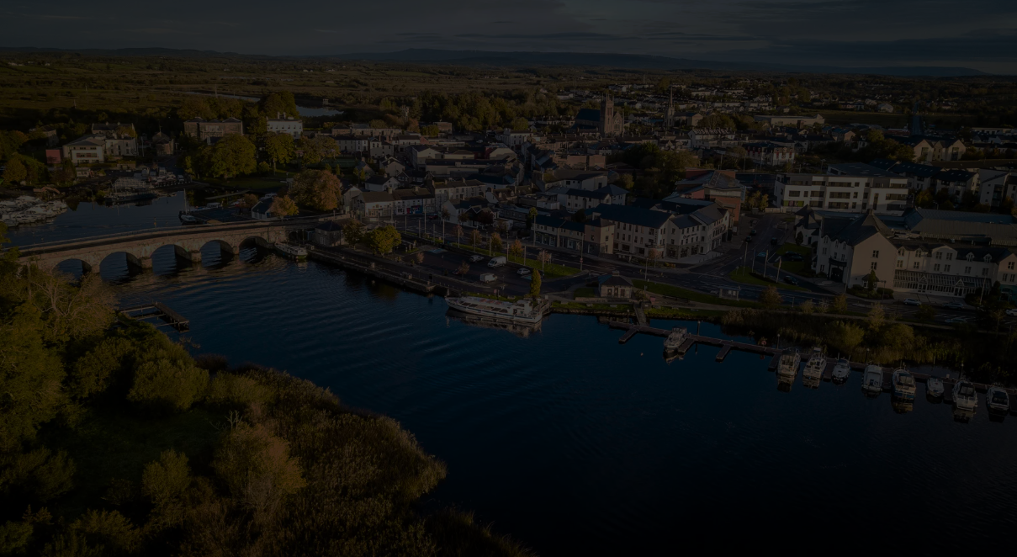
2: Driving Factors
Photo credit: visitcarrickonshannon.ie

Slide 5


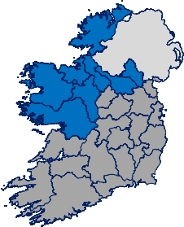
Human Capital: Northern and Western Region
53.2%
17th
61.2%
Higher Education Attainment Rate*
(25-64 years old) (2025)
Higher education ranking* out of the
243 NUTS 2 Regions of the EU27 (2025)
Higher Education Attainment Rate (25-34 years old) (2025)
-0.8pp
5 places
+1.1pp
Change relative to the previous year
Change relative to the previous year
Change relative to the previous year
Data: CSO, Eurostat. *residents aged 25-64. Data only available for 243 NUTS 2 Regions, with 1 NUTS 2 Region – namely the French Region titled “Mayotte” – unavailable in the Eurostat dataset
Notes:
X

Slide 6
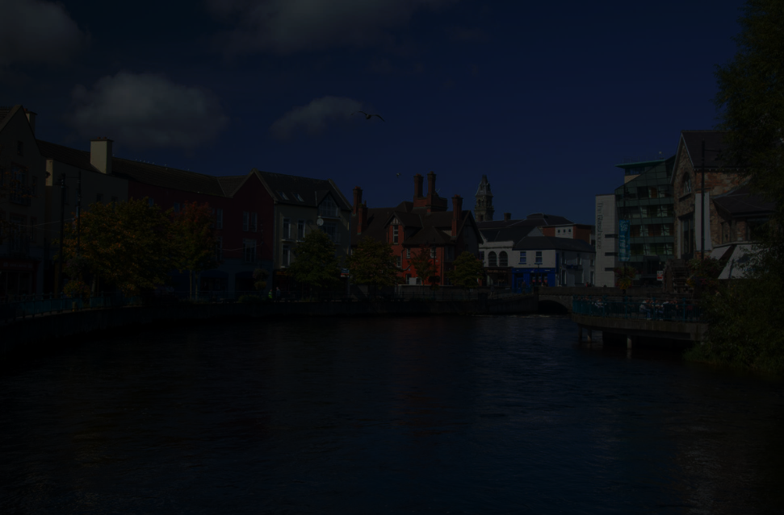
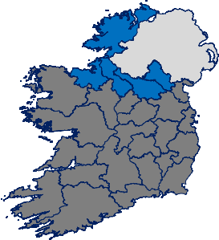
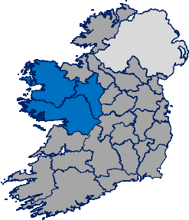
Export Markets: Northern and Western Region
€24.4 billion
€8.3 billion
€16.1 billion
Value of exports from client companies supported by enterprise agencies* in the Northern and Western Region
(2024)
Value of exports from client companies supported by enterprise agencies* in the Border (2024)
Value of exports from client companies supported by enterprise agencies* in the West (2024)
+3.4%
+10.3%
+0.1%
Change relative to the previous year
Change relative to the previous year
Change relative to the previous year
Data: Department of Enterprise, Tourism and Employment (Annual Employment Survey).* Client companies supported by the IDA, Enterprise Ireland and Údarás na Gaeltachta. Photo credit: Gareth McCormack
Notes:
X

Slide 7
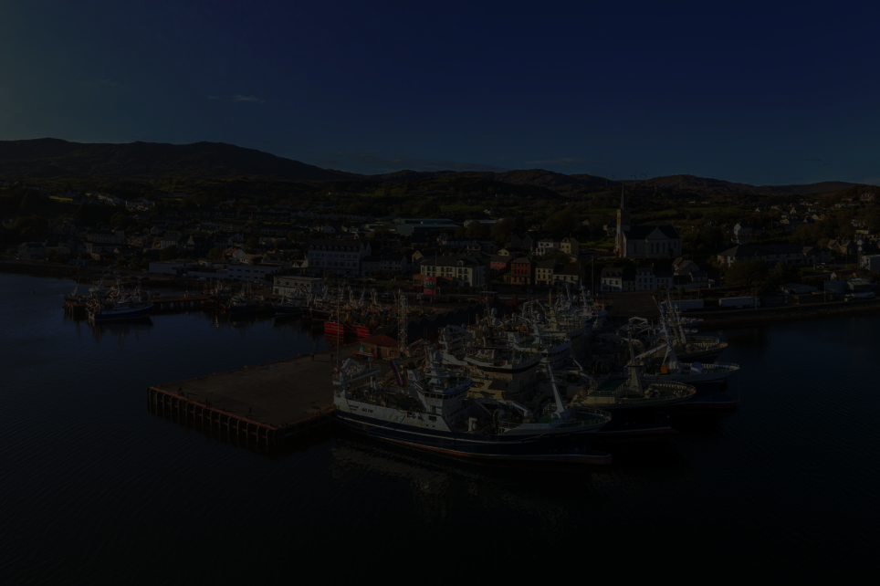
R&D Spending: Northern and Western Region
€1.0 billion
€153 million
€855 million
Value of “In-House R&D Spending” from client companies supported by enterprise agencies* in the Northern and Western Region (2024)
Value of “In-House R&D Spending” from client companies supported by enterprise agencies* in the Border
(2024)
Value of “In-House R&D Spending” from client companies supported by enterprise agencies* in the West (2024)
+13.0%
+7.1%
+14.1%
Change relative to the previous year
Change relative to the previous year
Change relative to the previous year
Data: Department of Enterprise, Tourism and Employment (Annual Employment Survey).* Client companies supported by the IDA, Enterprise Ireland and Údarás na Gaeltachta. Gareth Wray Photography
Notes:
X

Slide 8
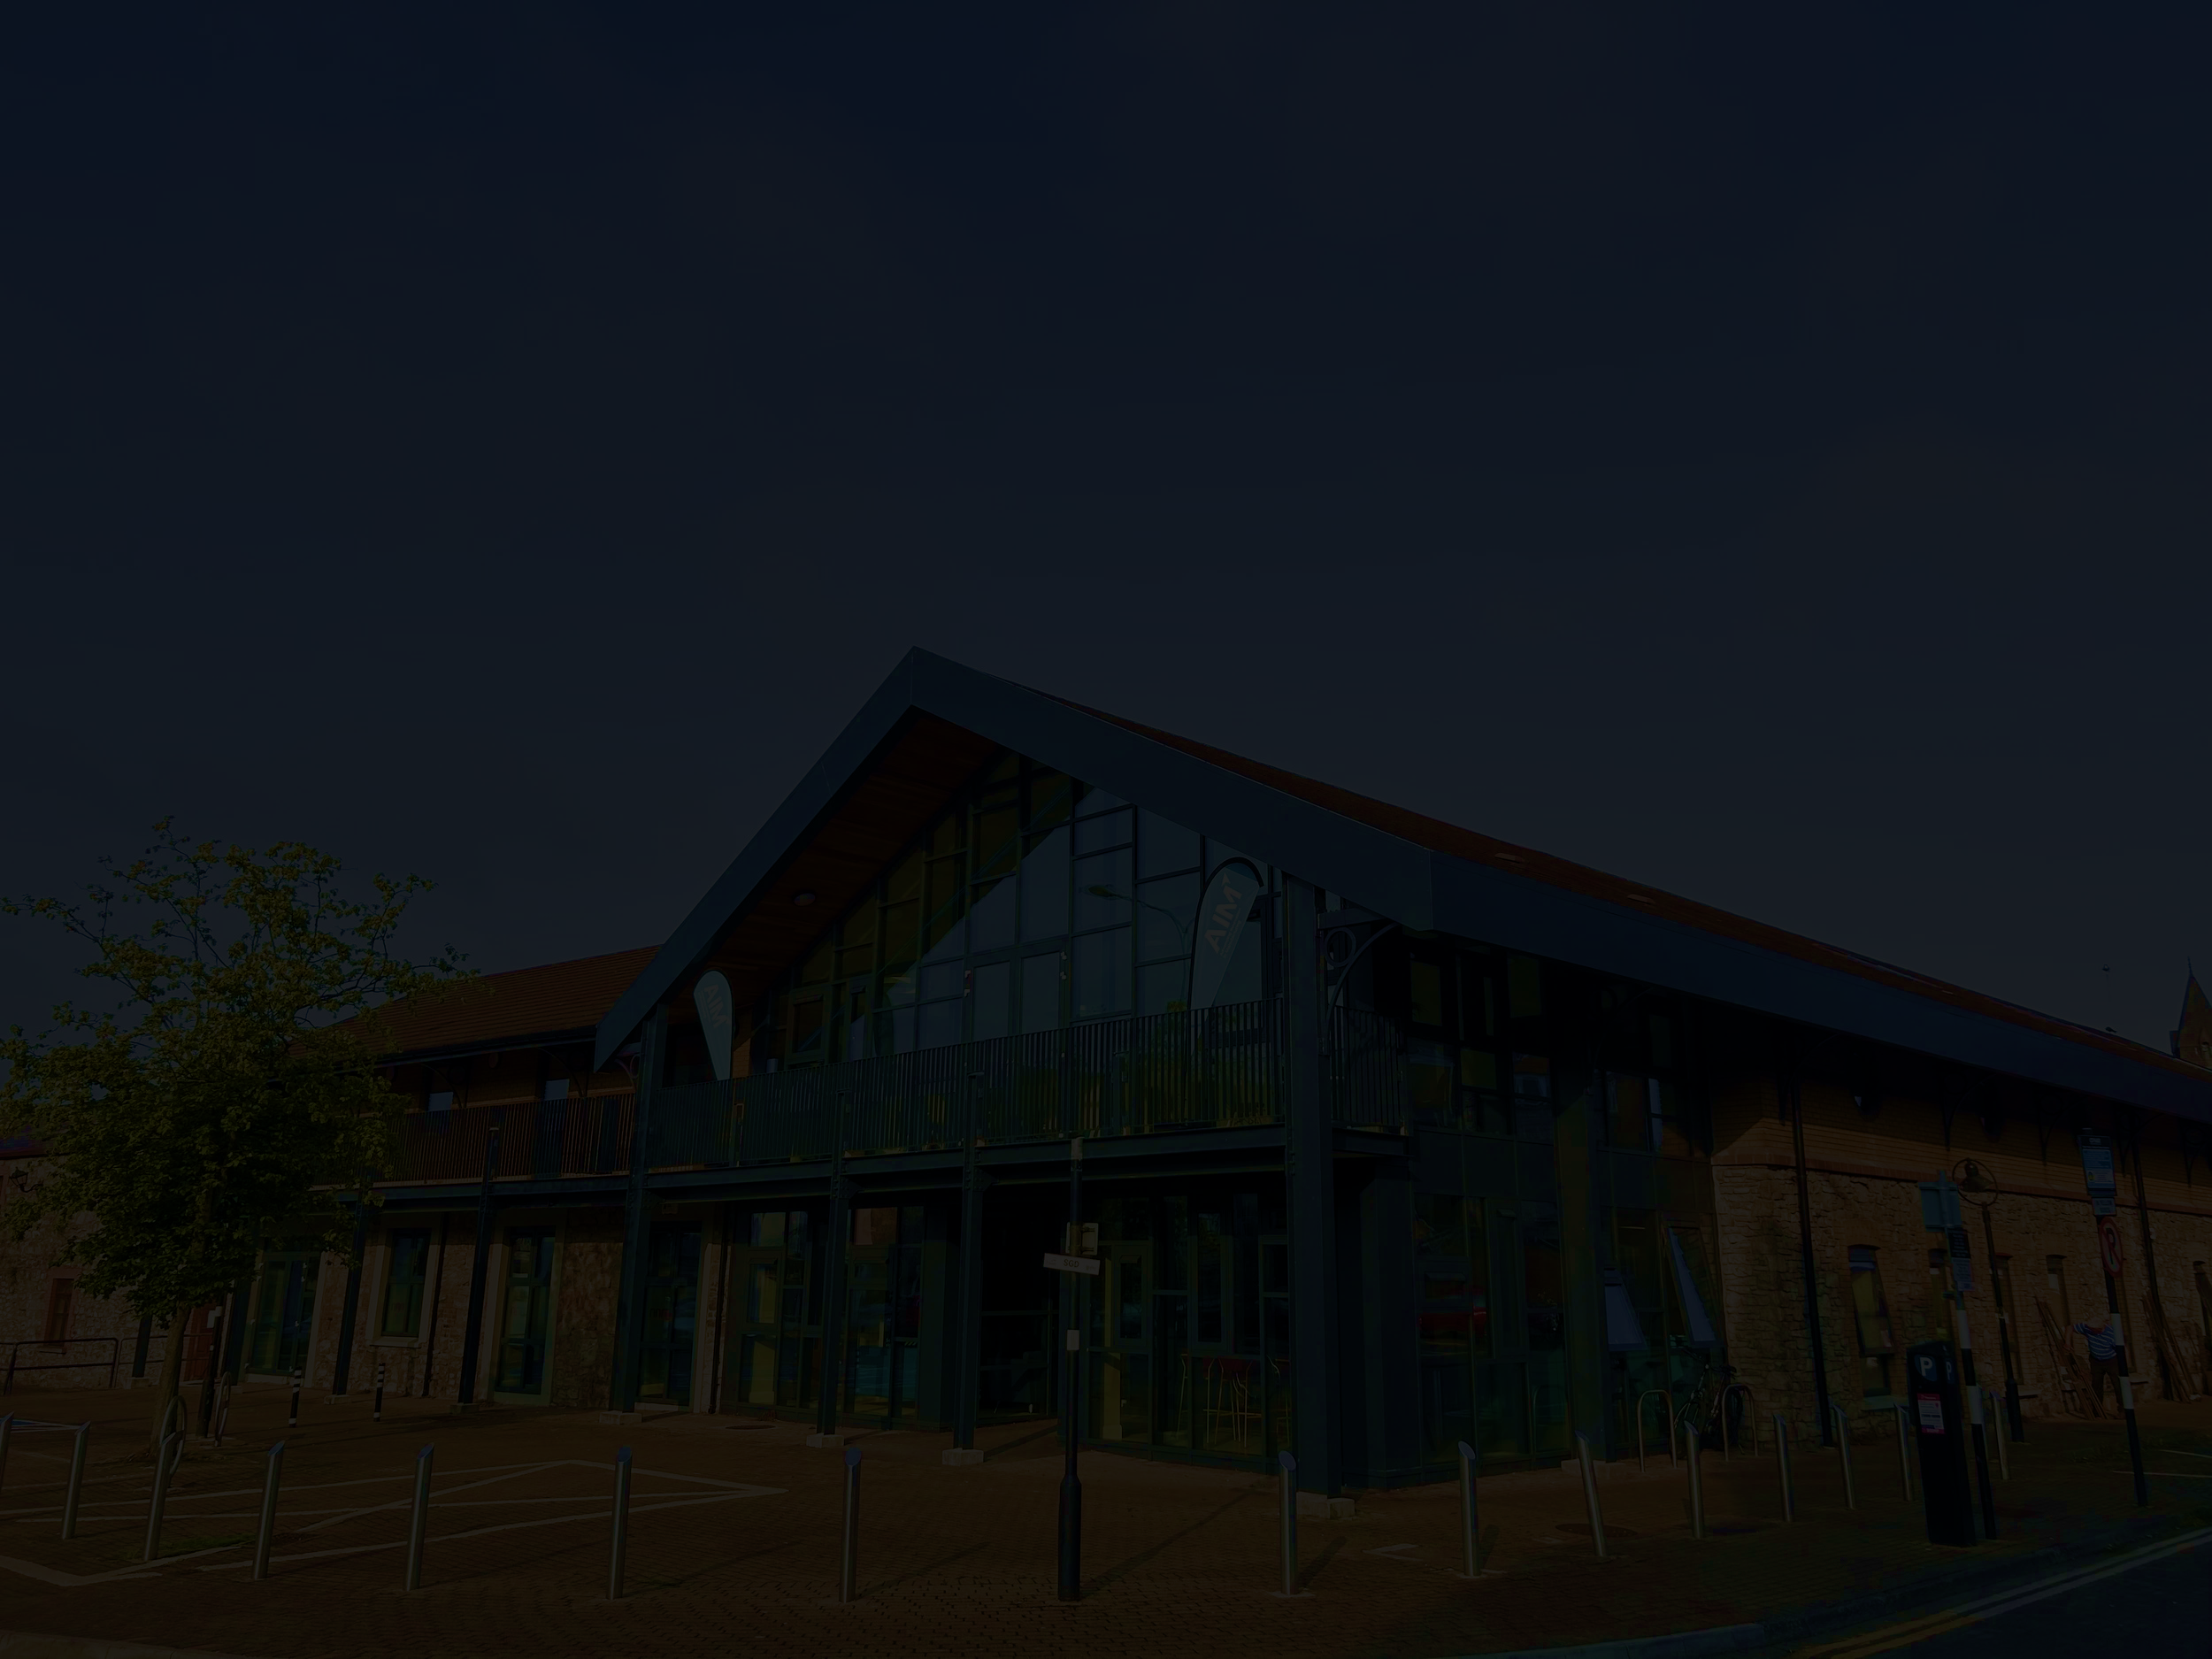
In the European Commission’s “Regional Innovation Scoreboard”, the Northern and Western Region is ranked …
41st
1st
27th
Overall Innovation Ranking
(Strong Innovator +)*
Sales of new-to-market + new-to-firm innovations
Innovative SMEs collaborating with others
65th
76th
79th
Exports of medium / high technology products
Broadband penetration
Labour Productivity
Data: European Commission’s “Regional Innovation Scoreboard”. *Strong Innovators (+)” are regions between 116.7% and 125% of EU average in terms of an overall innovation index score. Photo credit: AIM Centre

Slide 9













Key Economic Assets

Slide 10
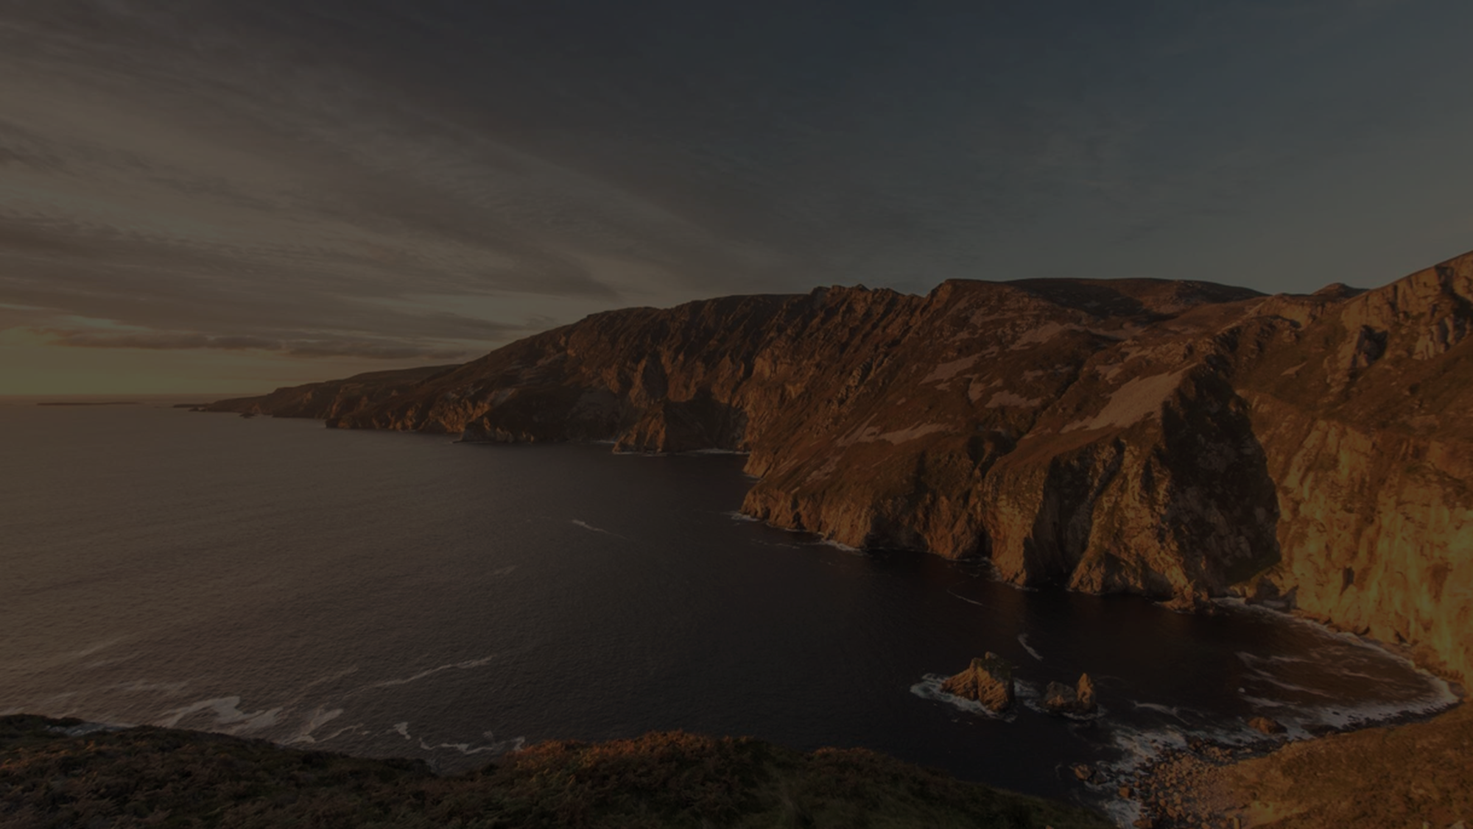
Of the 234 NUTS 2 Regions, the Northern and Western Region is ranked …
High-level indexes
Sub-indexes
114th
46th
52nd
73rd
Overall Competitiveness
Households with
broadband access
People involved
in Science and Technology
Total Patent
Applications
218th
215th
200th
135th
Infrastructure (transport)
Rail Infrastructure
Road Infrastructure
Airport Infrastructure
Data: European Commission’s “Regional Competitiveness Index”.

Slide 11
3: Conclusion

Slide 12
Conclusion
1) Specialisation
2) Research and Innovation
3) Human Capital Profile
4) Export Markets
5) Infrastructure Provision

