Slide 1
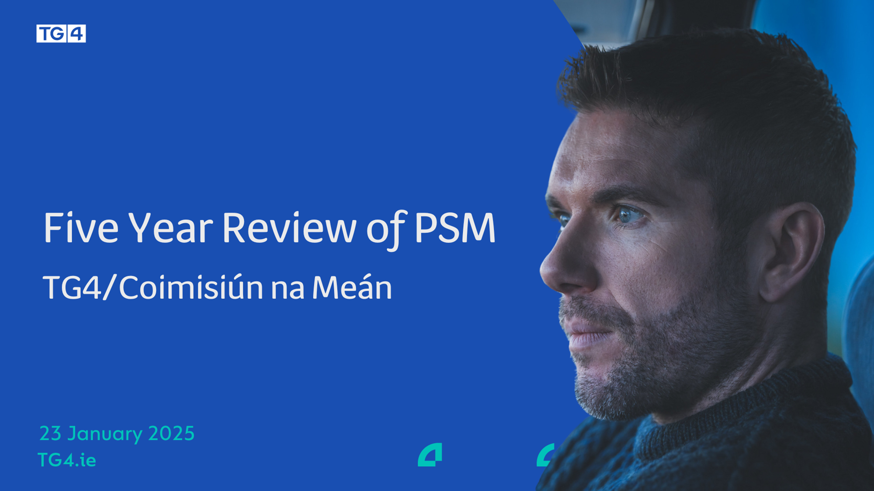
Developing entrepreneurship in
coastal cities and regions
TG4
14 Meán Fómhair 2026

Slide 2

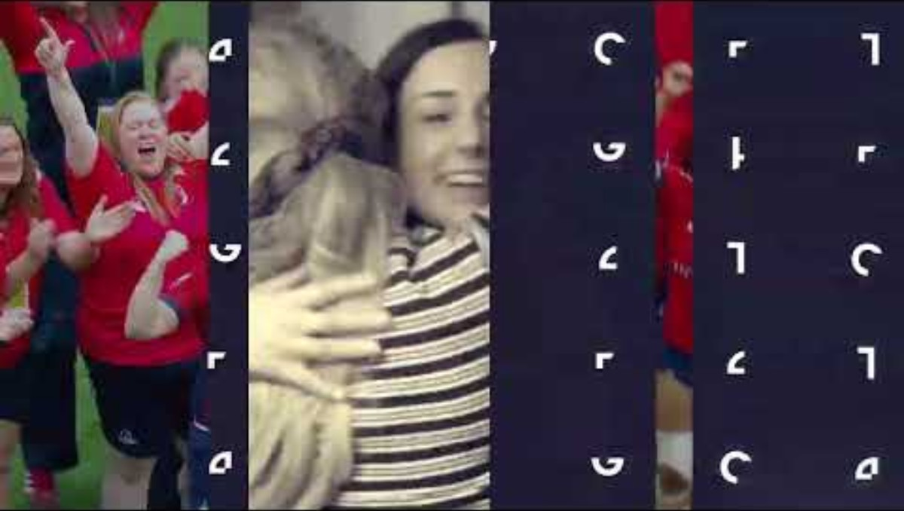

Slide 3
§
TG4 is at the heart of Ireland’s creative sector and supports the creative economy
TG4 was established in 1996.
30 years on air in October
TG4 is a Publisher / Broadcaster - we commission programmes and content from the independent production sector, similar to Channel 4 and S4C
Direct funding of €65.4m per annum
TG4 is an independent entity since 2007
1 hour of programming a day from RTÉ

Slide 4
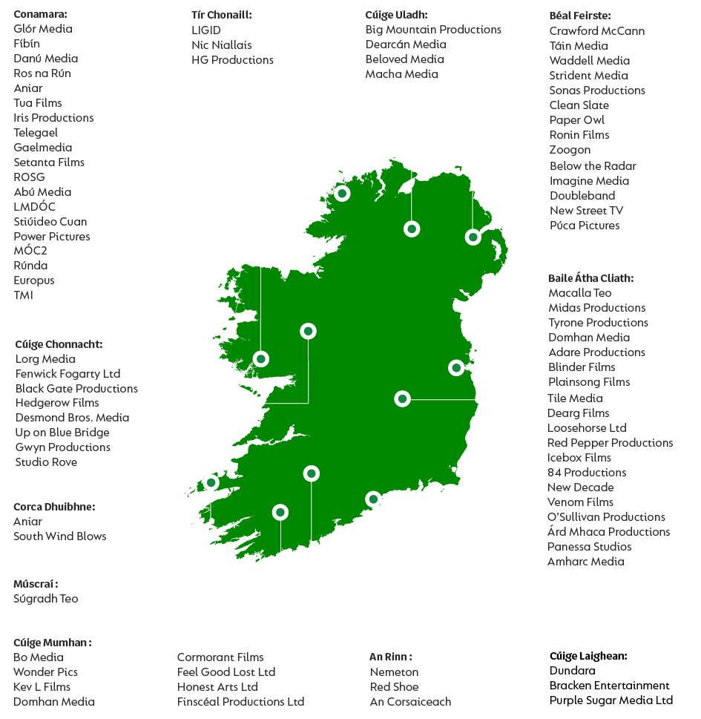
TG4 & The Independent Production Sector
TG4 is the largest investor in independent production in the regions.
We source content primarily from Irish language production companies, most of which are based in the regions and the Gaeltacht.
We work with approximately 60 independent production companies annually, a mixture of multiannual output contracts, coproductions and individual programme contracts.

Slide 5



Cultural Partnerships and Platform for Culture and Language
Sport and Ladies Football
Gradam Ceoil TG4
Oireachtas na Gaeilge

Slide 6

Drama
CRÁ - ‘Gaeltacht Noir’
Crime Drama series Co-commissioned by TG4, BBC NI
Funded support from Fís Éireann, ILBF
Very successful on TG4 Player and iplayer
Broadcast on BBC Network
Sold to 70 countries worldwide
Series 2 coming this autumn

Slide 7


TG4 at the Oscars
Cine4 is a partnership scheme between TG4, Fís Éireann, and Coimisiún na Meán, to develop feature length original Irish-language films.
An Cailín Ciúin was nominated for Best International Feature Film in 2023.
9 films have been produced from the scheme to date.

Slide 8


Cine4 and TG4 at the Oscars

Slide 9
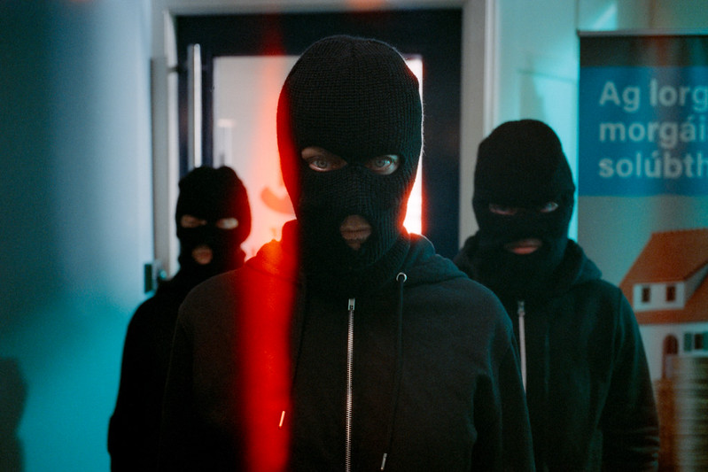
Aontas

Slide 10









Changes to Content Distribution and Television Technology
95% will watch television on a smart television by 2035
Growth of audiences watching television via apps rather than linear television
Television technology moving to IP based systems rather than DTT, satellite and cable.
‘Prominence’ – Visibility of PSM on Apps and platforms needs to be ensured in legislation and implemented

Slide 11
Need for Prominence of Public Service Media Content
Global tech platforms control content discovery (e.g. connected TVs, online platforms, in-car systems, AI assistants).
Commercial interests drive visibility, prioritising paid content and platform-owned services over public service media.
Algorithms favour engagement, not trusted, public-value journalism.
AI and search engines often summarise content without directing users to or crediting the original source.
Public Service Media is harder to find in the digital landscape.
Consequences: Access to PSM and minority language public service content increasingly will depend on private global companies rather than serving the public interest.

Slide 12
AgoraEU
European Commission recommended Three strands
Creative Europe
Media+
Democracy, Citizens, Equality, Rights and Values CERV+
European Parliament recommended Seven Strands instead of Three
Creative Europe Strand
Music
Media (Audiovisual Sector – (Possible audiovisual budget of €2.17bn)
Journalism and Information (Democratic News Ecosystem)
CERV+ (Rights, equality, civil society, Rule of Law and Democracy, Inclusive Democratic Participation)
Daphne Strand (zero-tolerance of gender based violence)
Union Values (Civic space resilience)

Slide 13

Go raibh míle maith agaibh

